Slide 1
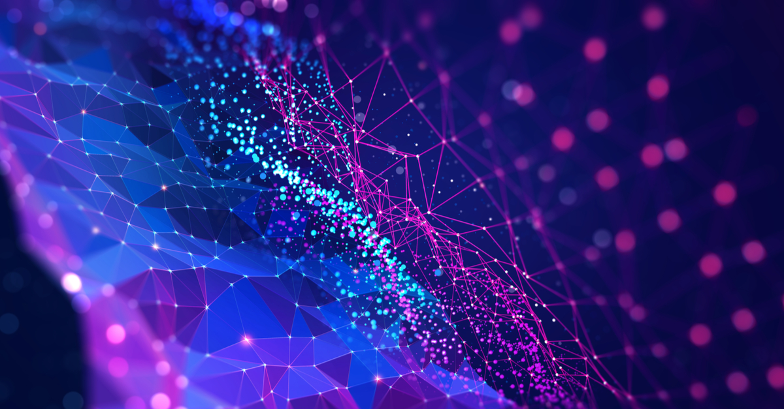

Slide 2
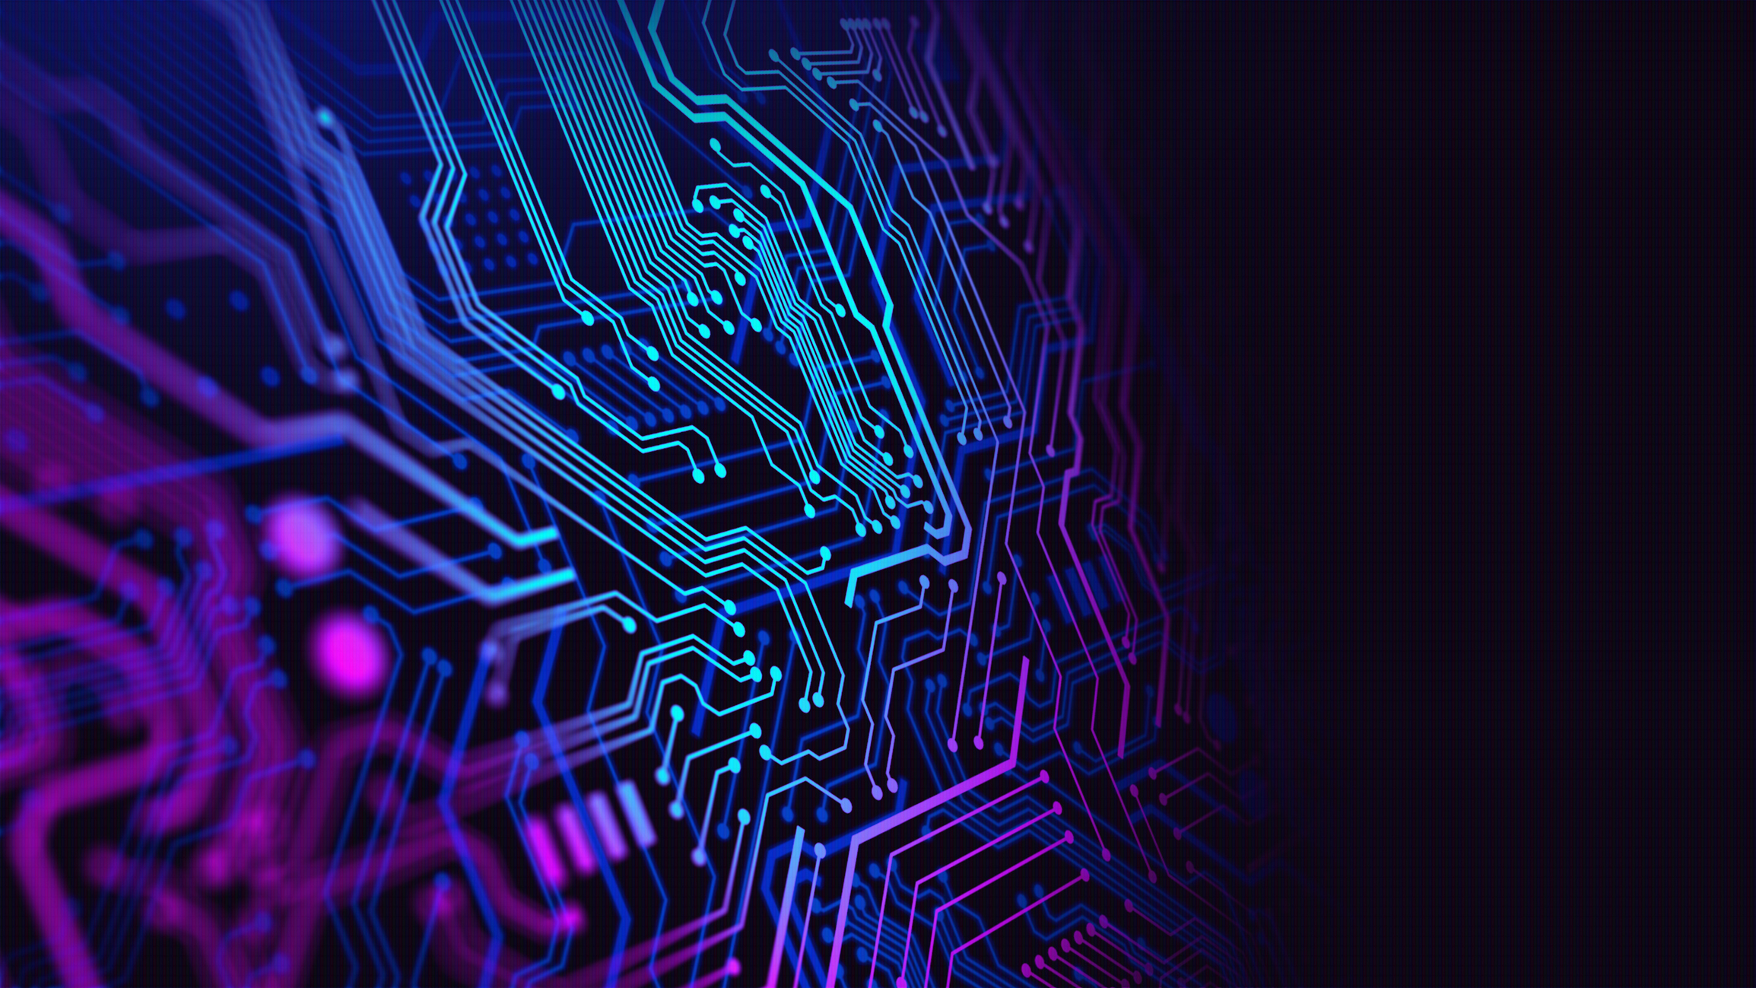
The First Cyber Attack?
Have you ever thought about what could be considered the first cyberattack in the world?

Slide 3
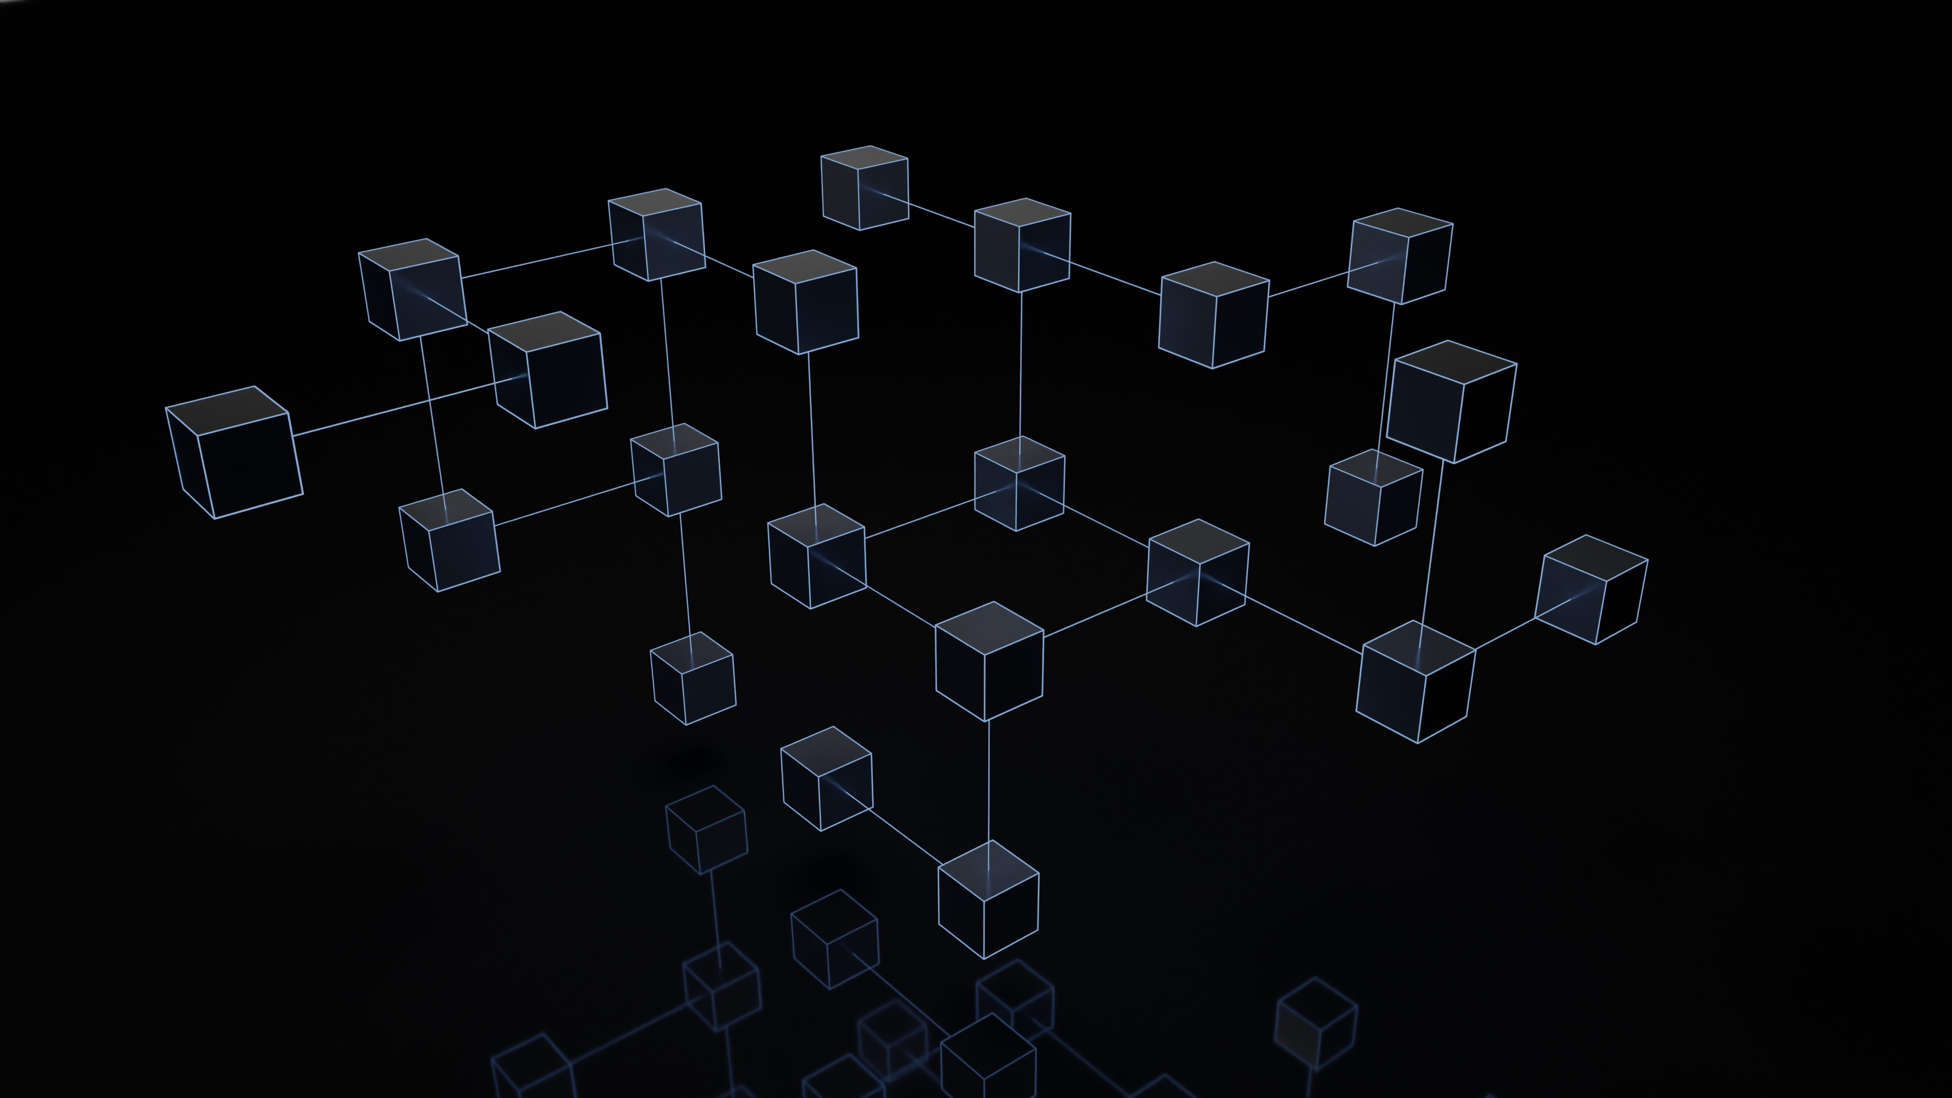
But First… Definite “Cyberattack”
First, we need to decide what is the definition of a “cyberattack”?
Discuss as a class, or in small groups for a few minutes working to produce a short definition.

Slide 4
Cyberattack Defined:
According to the National Institute of Standards and Technology a cyberattack is defined as:
"Any kind of malicious activity that attempts to collect, disrupt, deny, degrade, or destroy information system resources or the information itself.”
https://csrc.nist.gov/glossary/term/Cyber_Attack

Slide 5
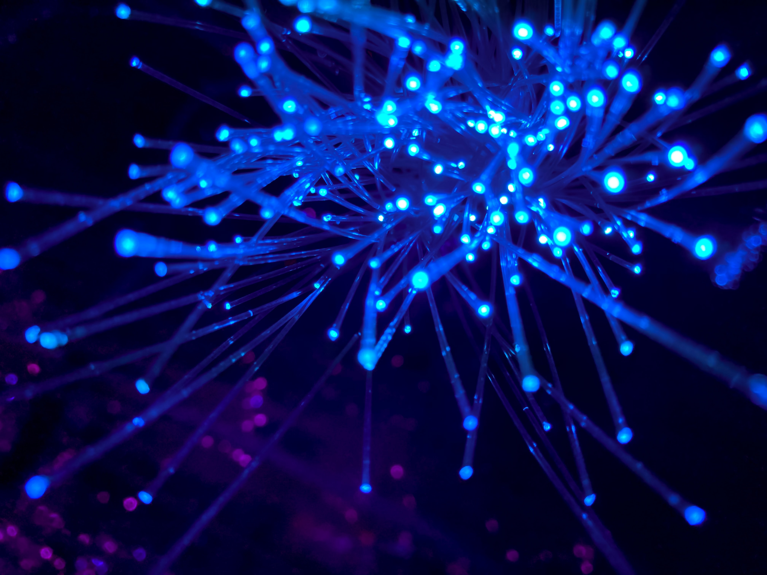
What Do You Think?
With a broader definition of cyberattack, discuss as a class or in small groups: Can you think of any other event in the past that could be considered a “cyberattack”?

Slide 6
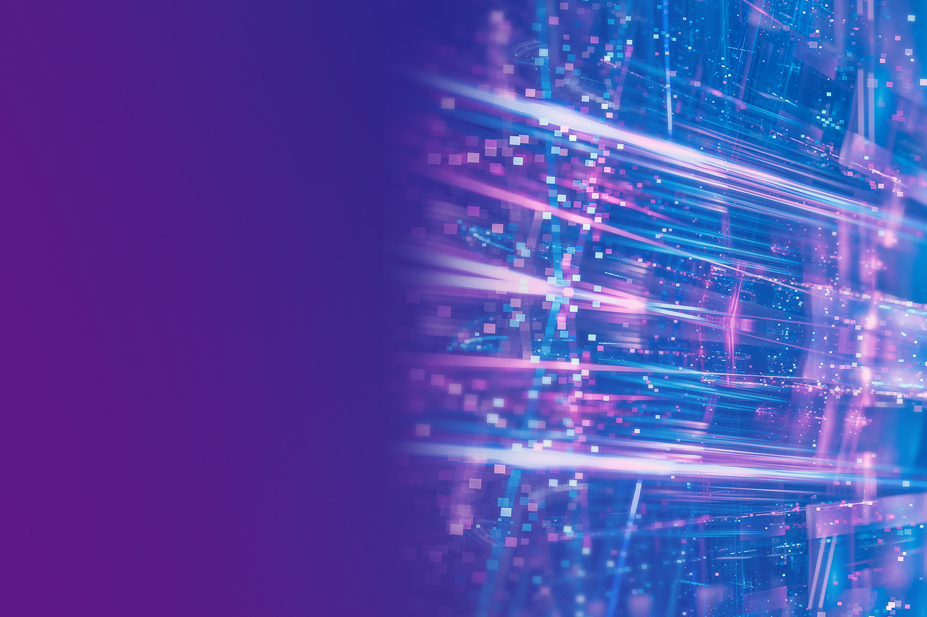
Targets of Cyberattacks
We can classify several groups who are likely targets of cyberattacks:
Governments (Federal, Provincial, Municipal)
Government Departments (i.e.: EECD)
Military
Businesses
Utilities
Individuals

Slide 7
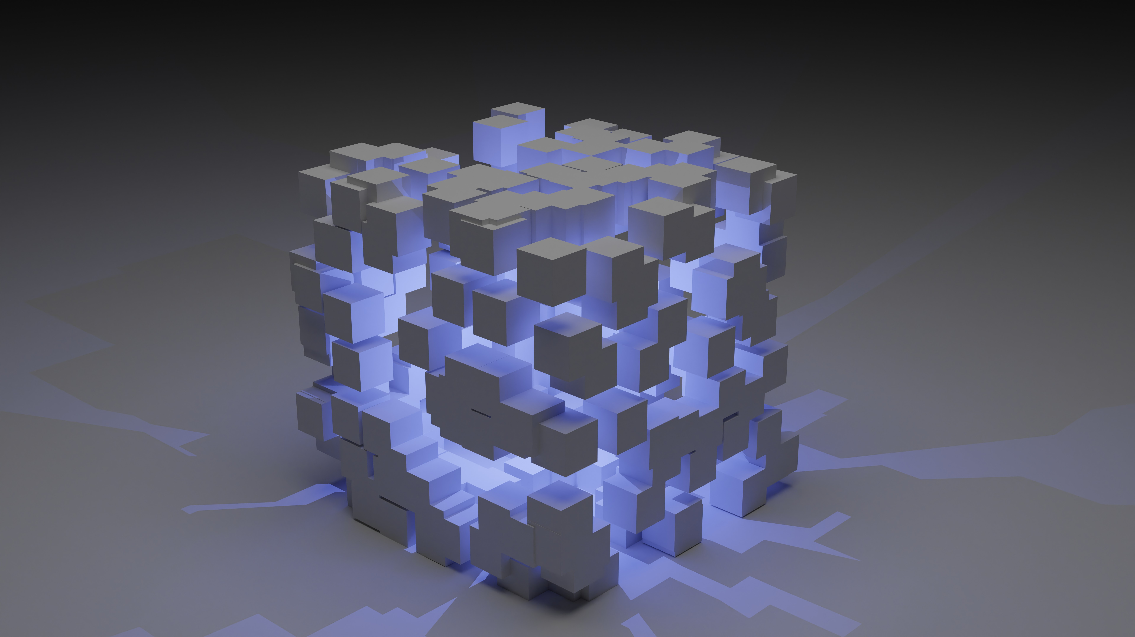
Cyberattack Motivations
Now that we have defined what a cyberattack is, and what some typical targets of these attack are…
Discuss as a class or small groups: Produce a few hypotheses of what are the reasons or motivations for cyberattacks?

Slide 8
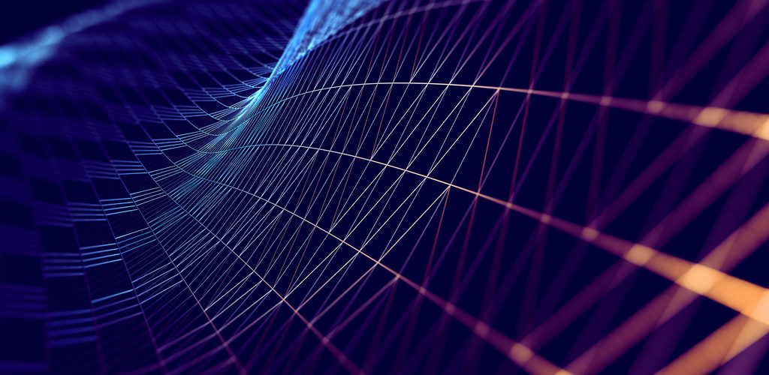
A Cyberattack Tale
Equipped with some knowledge about cyberattacks, their targets and motivations, you will listen (or read) about perhaps the worlds’ first Cyberattack.

Slide 9
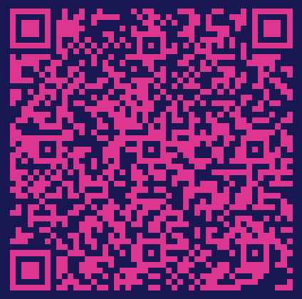
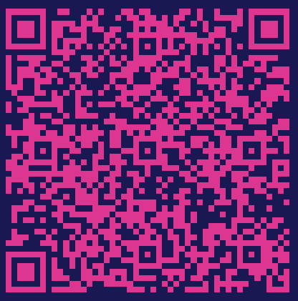
A Cyberattack Tale
Listen | Read
Click here to listen Or scan this QR code | Click here to read the transcript. Or scan this QR code

Slide 10
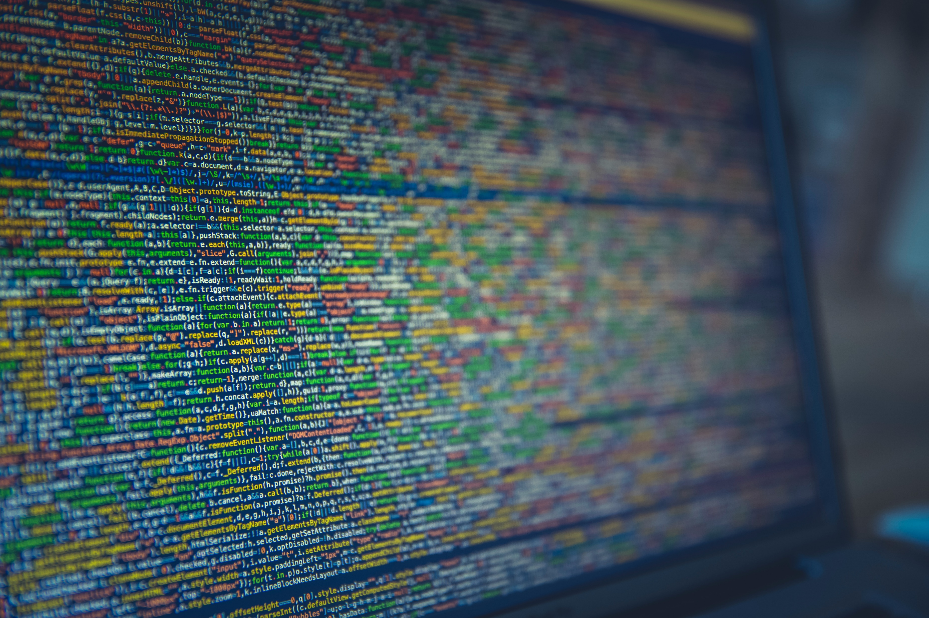
A Few Things to Explore…
After you’ve listened or read the podcast episode and have had some class discussions, some further investigation may be worthwhile to learn more.
Feel free to use whatever technology or medium you want to present your findings. Some ideas: A slidedeck, a short essay/report, a video, a poster/infographic, or even your own podcast episode.

Slide 11
Famous Cyberattacks
Research another major cyberattack that has happened (recently or in the past) and tell the story of what happened.

Slide 12
Future Attacks?
We live in exciting and rapidly changing times. Technology is constantly changing, and new inventions are occurring daily. Predict some potential future cyberattacks that we could see in our lifetime and how they could happen.

Slide 13
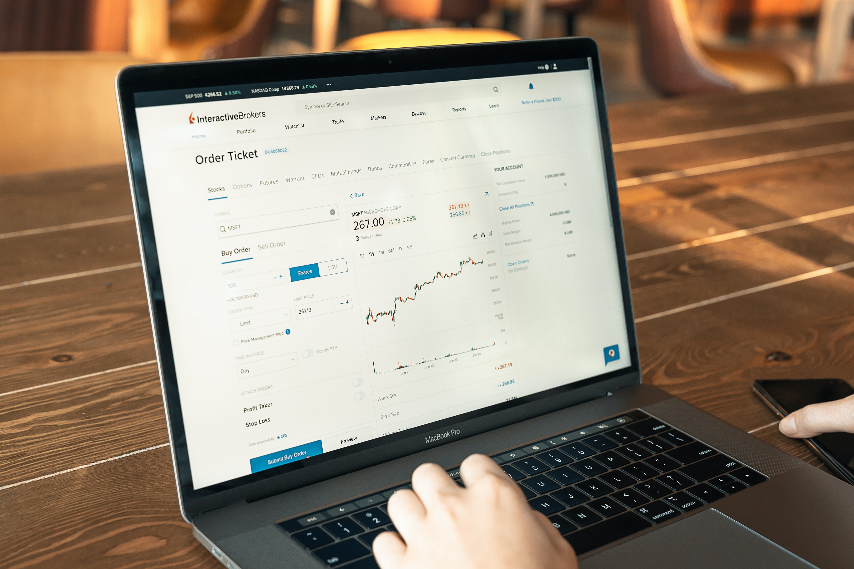
Further Exploration
If you enjoyed this activity, and want to know more, reach out!
The COE for Digital Innovation can help book guest speakers, arrange site visits and coordinate mentorship and co-op oppportuniuties too!
www.centreofexcellencenb.ca
E-Mail or Teams Message Adam.Binet@nbed.nb.ca

