Slide 1
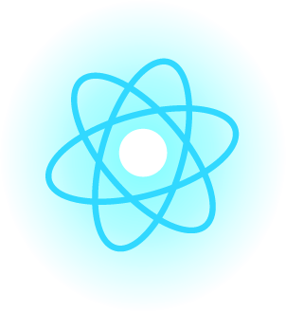
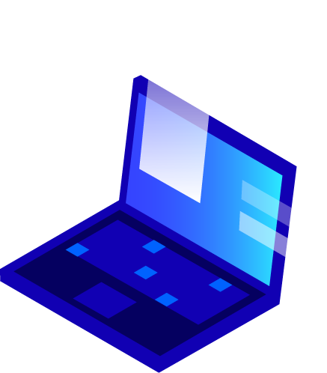
What’s Inside a Digital Device?

Slide 2
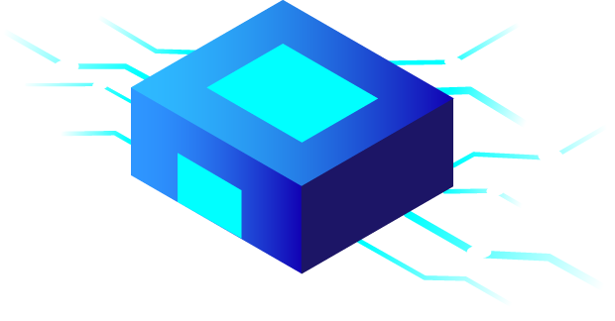
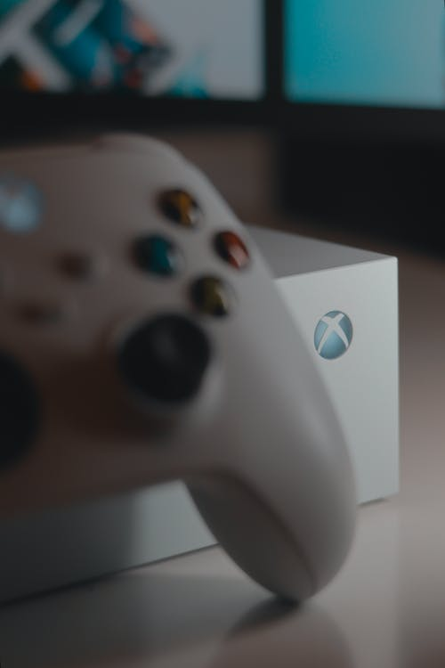
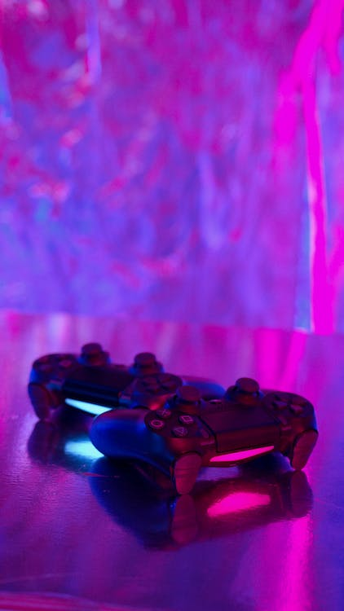
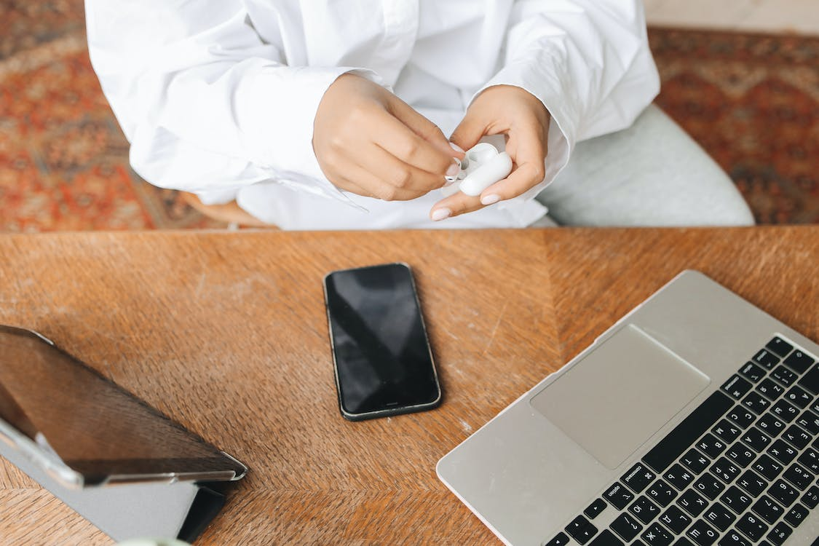
Have you ever wondered…
What’s inside a computer? A Playstation or X-Box? What about a tablet or smartphone?
Notes:
Photo by Imthiyaz Syed from Pexels: https://www.pexels.com/photo/close-up-shot-of-a-game-console-13678229/
Photo by Artem Podrez from Pexels: https://www.pexels.com/photo/game-controllers-on-the-table-7774029/

Slide 3
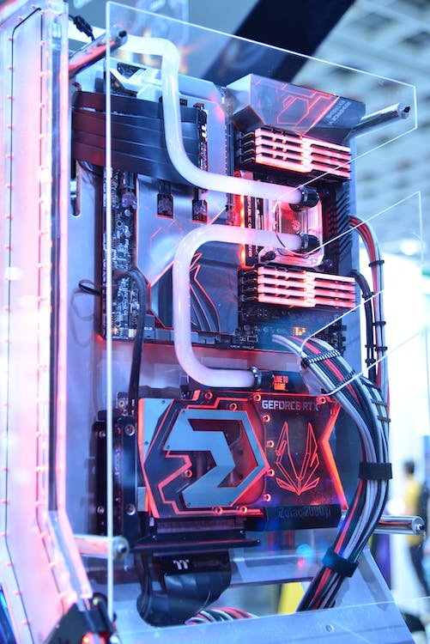
Did You Know
Every digital device that we interact with, most of the time, consists of the exact same components that make it work?
Notes:
Photo by 洋榤 郭 from Pexels: https://www.pexels.com/photo/black-and-red-computer-motherboard-2399840/

Slide 4
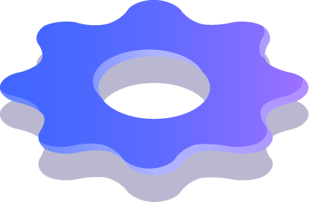
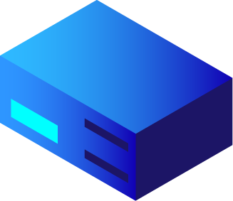
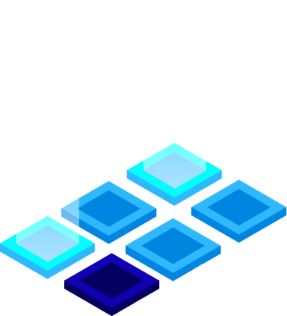
Take some guesses..
Can you name any of the components found in digital devices? Take a few minutes to discuss. If you can name them, can you also explain what they do?

Slide 5
These are the common components found in virtually all digitial devices:
A Central Processing Unit (CPU)
A Storage Device
Volatile Memory, AKA: Random Access Memory (RAM)
Input/Output (I/O) of some sort (display and ability to input with a keyboard, physical or virtual)
A Circuit Board (motherboard) that all the components plug into
A Graphic Processing Unit (GPU)

Slide 6
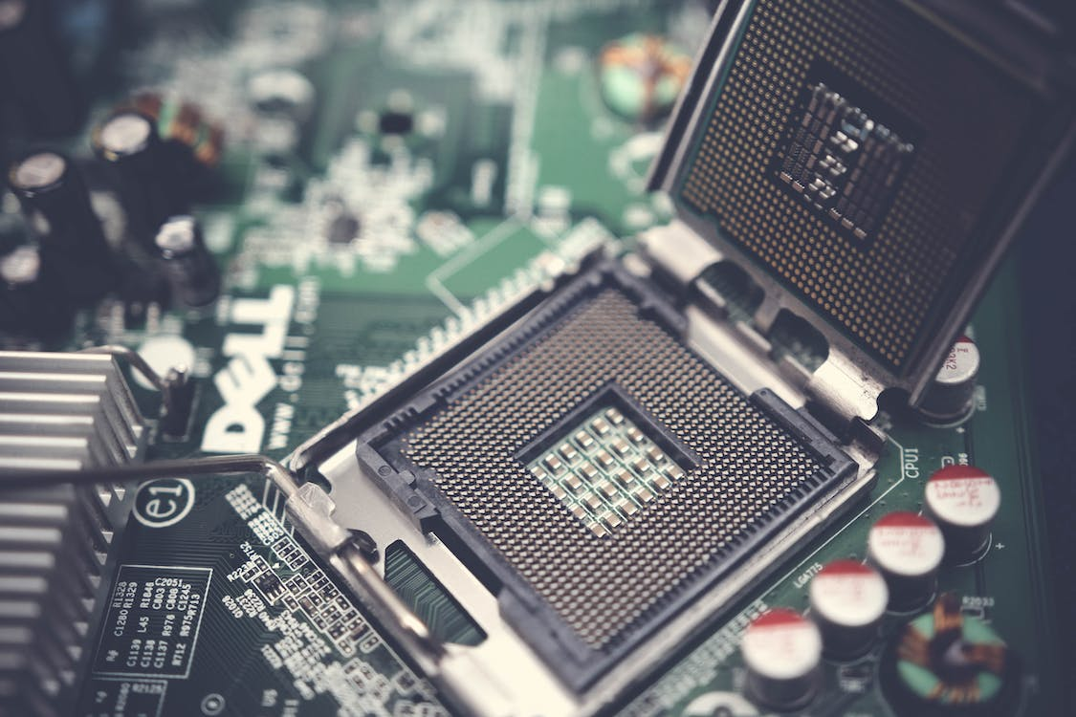
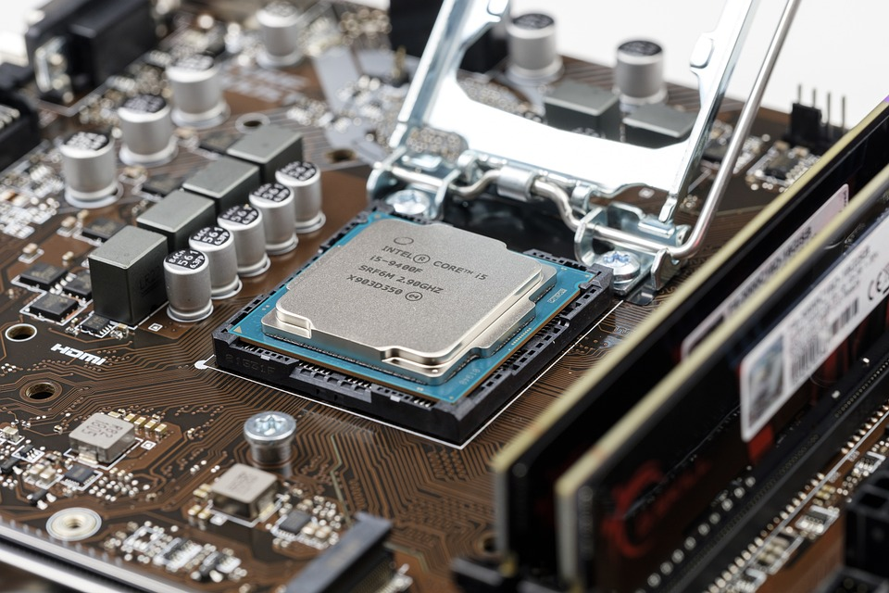
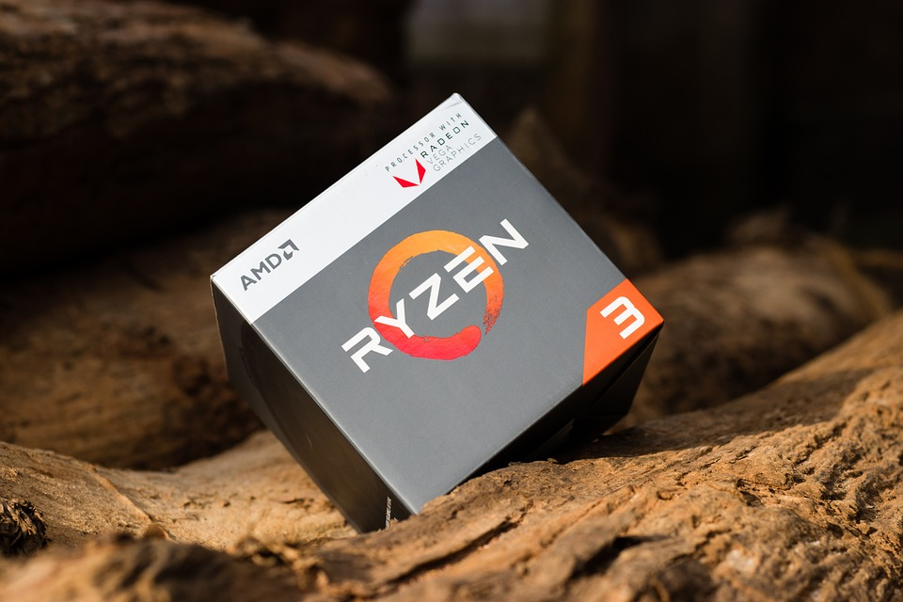
Central Processing Unit (CPU)
What it is: The CPU is often called the "brain" of a computer, thanks to its direct plug connection to the motherboard, and communication with all the computer’s other components.
What it does: Whenever you write a line of code (in Python, Java, C++, or any other programming language), it's broken down into assembly language—which is a language that the processor can understand. It fetches, decodes, and executes these instructions.
And that’s where the CPU comes in—all the processes a computer handles are taken care of by the CPU.
Notes:
https://www.pexels.com/photo/dell-motherboard-and-central-processing-unit-1432675/
https://pixabay.com/photos/cpu-processor-chip-motherboard-4393376/ https://pixabay.com/photos/ryzen-amd-processor-technology-3523675/

Slide 7
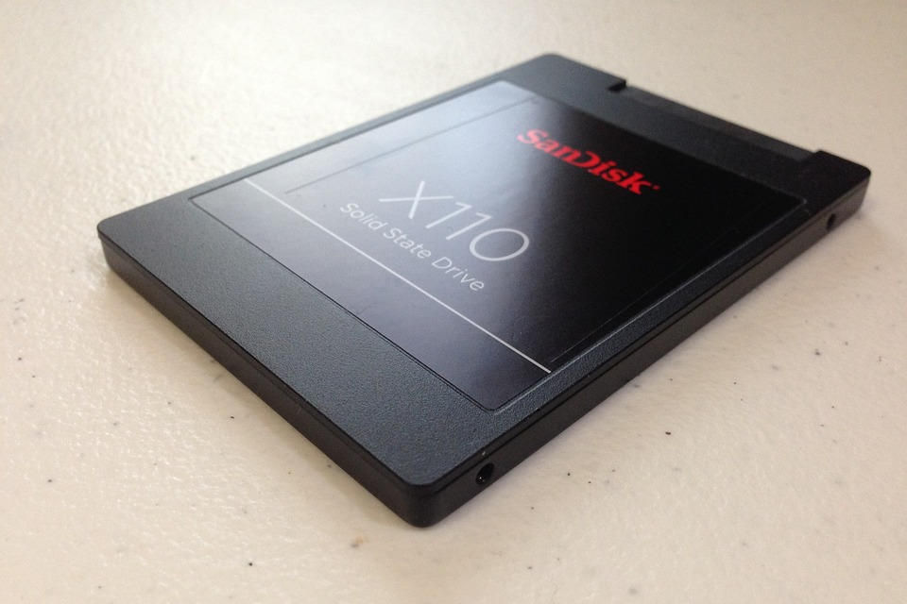
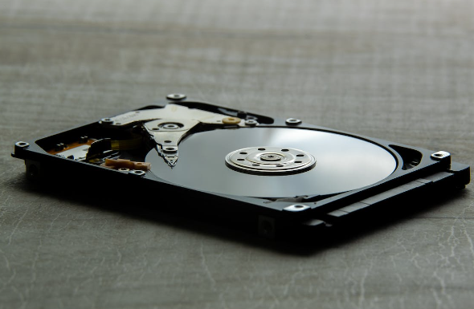
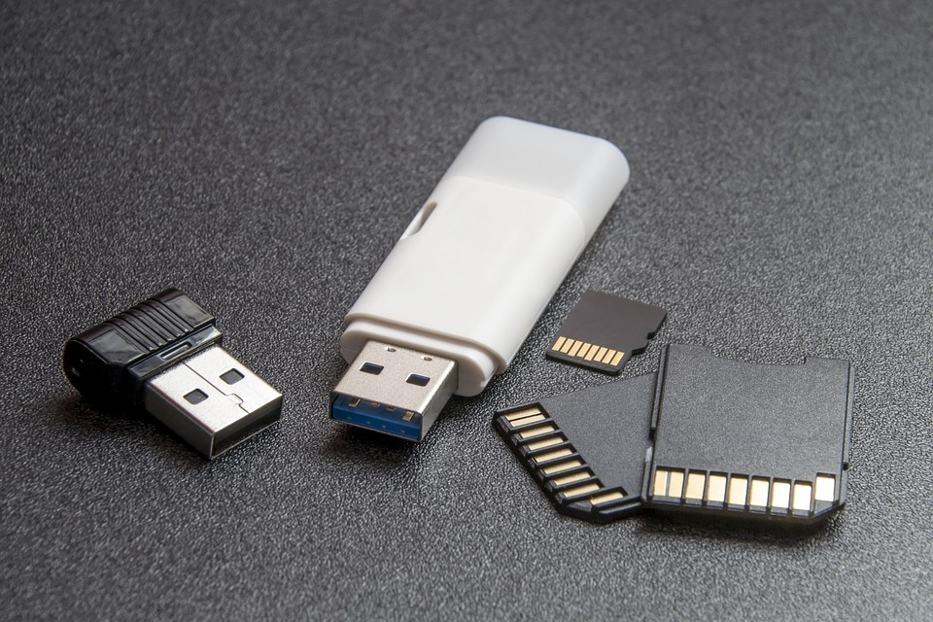
Storage Device (HDD, SSD, Flash)
What it is: All computers need somewhere to store their data. Modern computers either use a Hard Disk Drive (HDD) or Solid-State Drive (SSD).
What it does: HDDs are made of an actual disk onto which data is stored. The disk is read by a mechanical arm. (HDDs are cheaper than SSDs but are slowly becoming more and more obsolete.)
SSDs (think SD cards or USB flash drives) have no moving parts and are faster than a hard drive, because no time is spent waiting for a mechanical arm to find data on a physical location on the disk.
Notes:
https://pixabay.com/photos/data-storage-ssd-hard-drive-memory-319844/
https://www.pexels.com/photo/computer-hard-drive-laid-on-gray-surface-6429162/
https://pixabay.com/photos/computer-accessories-computers-1841254/

Slide 8
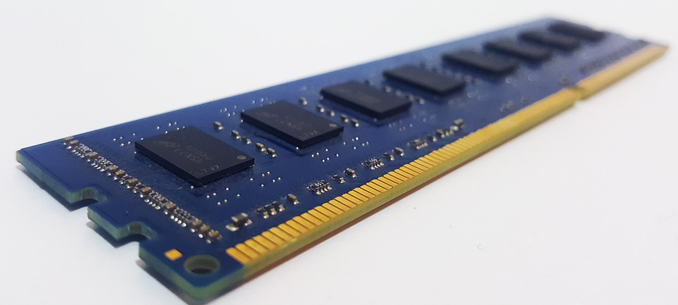
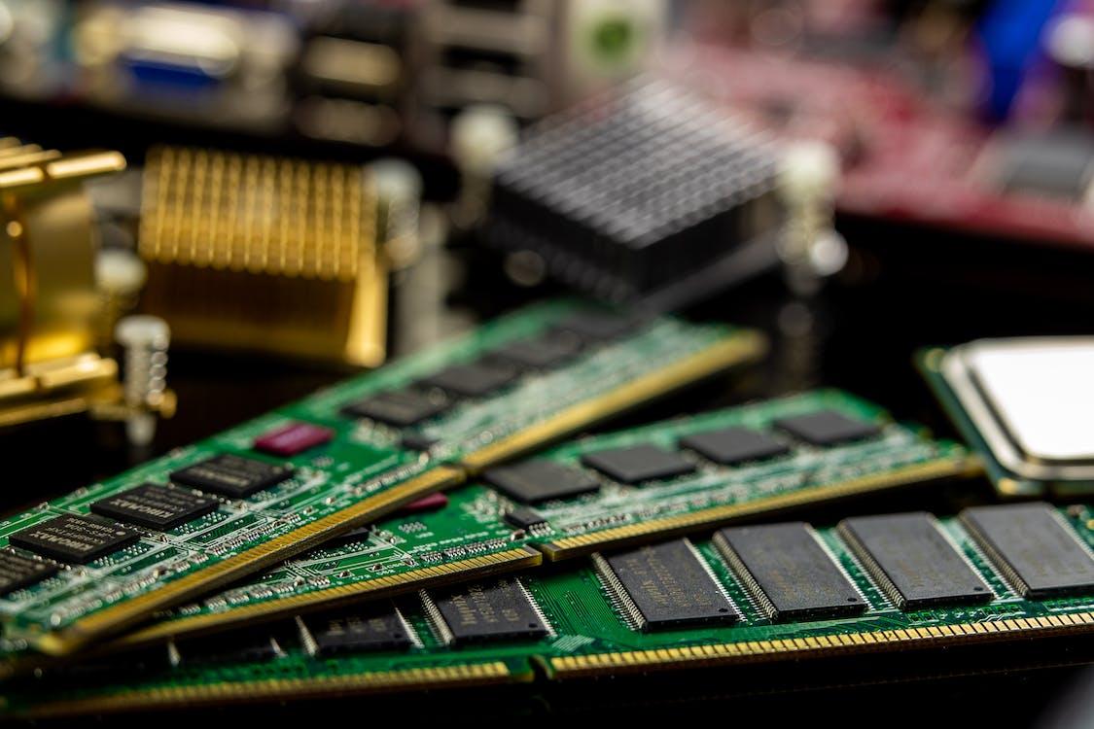
Random Access Memory (RAM)
What it is: RAM, also known as volatile memory, stores data regarding frequently accessed programs and processes. (It's called volatile memory because it gets erased every time the computer restarts.)
What it does: RAM helps programs and games start up and close quickly.
Notes:
https://pixabay.com/photos/memory-ram-random-access-memory-4704236/
https://www.pexels.com/photo/green-and-black-computer-ram-stick-6636474/

Slide 9
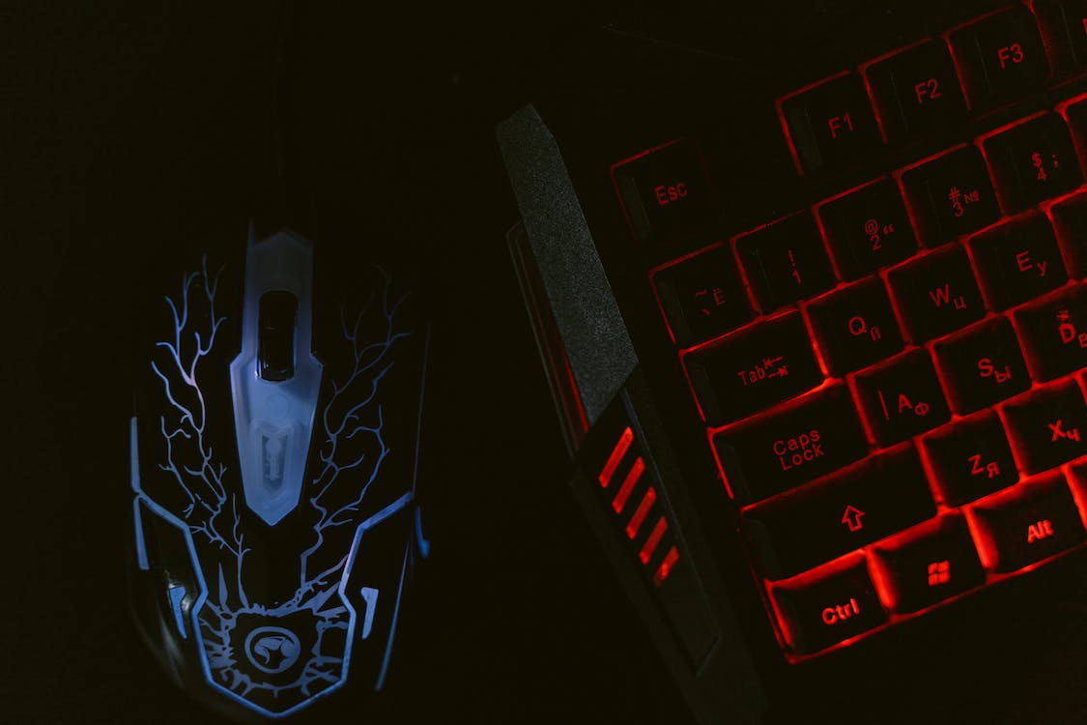
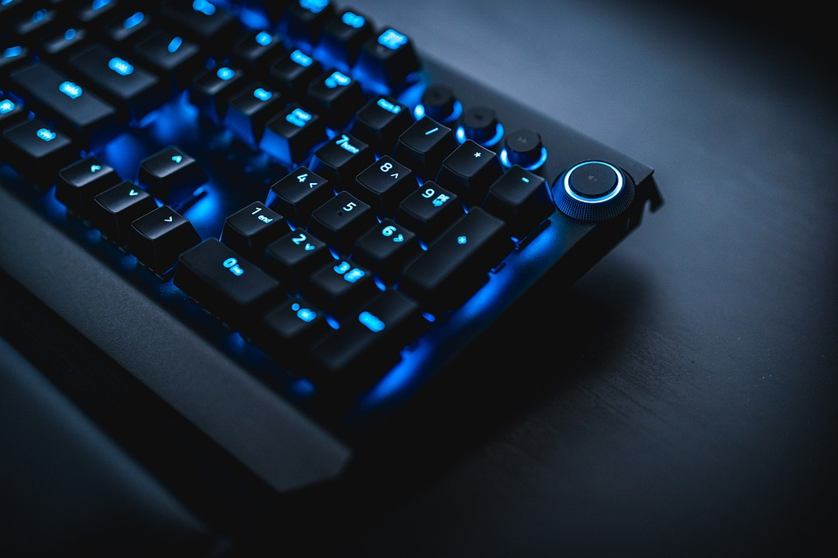
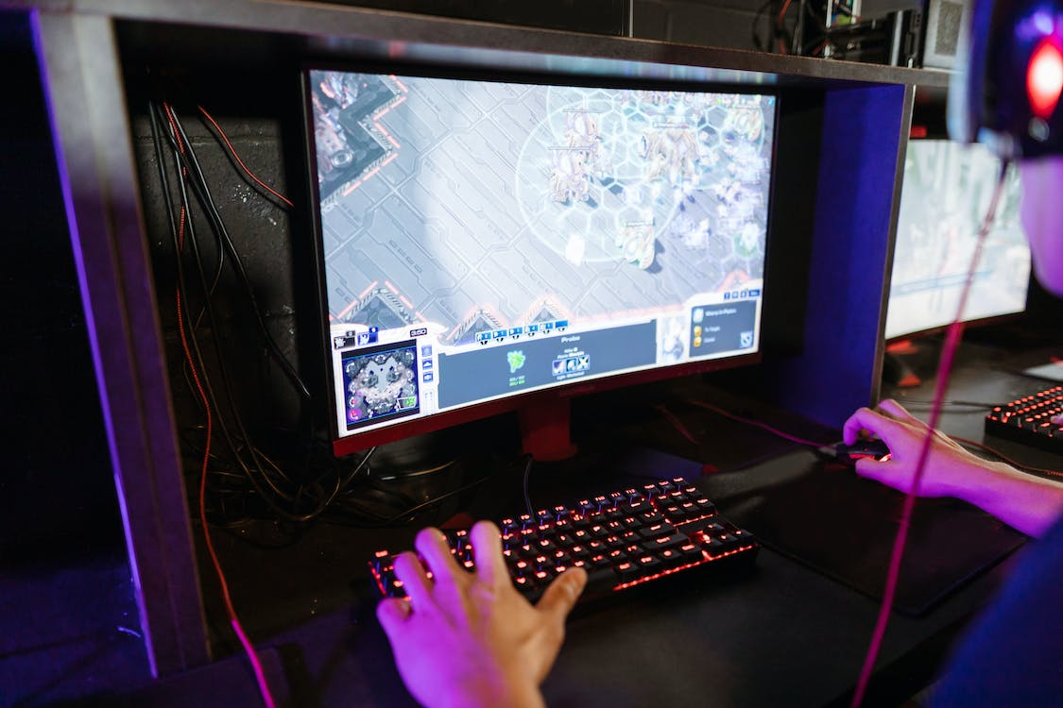
Input and Output Devices
What it is: Input and output devices are pieces of equipment (also known as peripherals) that allow a user to interact with a digital device. Examples of inputs would be things like a mouse, keyboard or touchscreen. An example of an output device would be a display (such as a LED/LCD display or monitor) or a printer.
What it does: Allowing for both input and output gives users the ability to control, configure and get information into and from digital devices.
Notes:
https://www.pexels.com/photo/close-up-shot-of-gaming-mouse-and-keyboard-7047612/ https://pixabay.com/photos/keyboard-technology-office-internet-4759502/
https://www.pexels.com/photo/person-playing-computer-game-7915225/

Slide 10
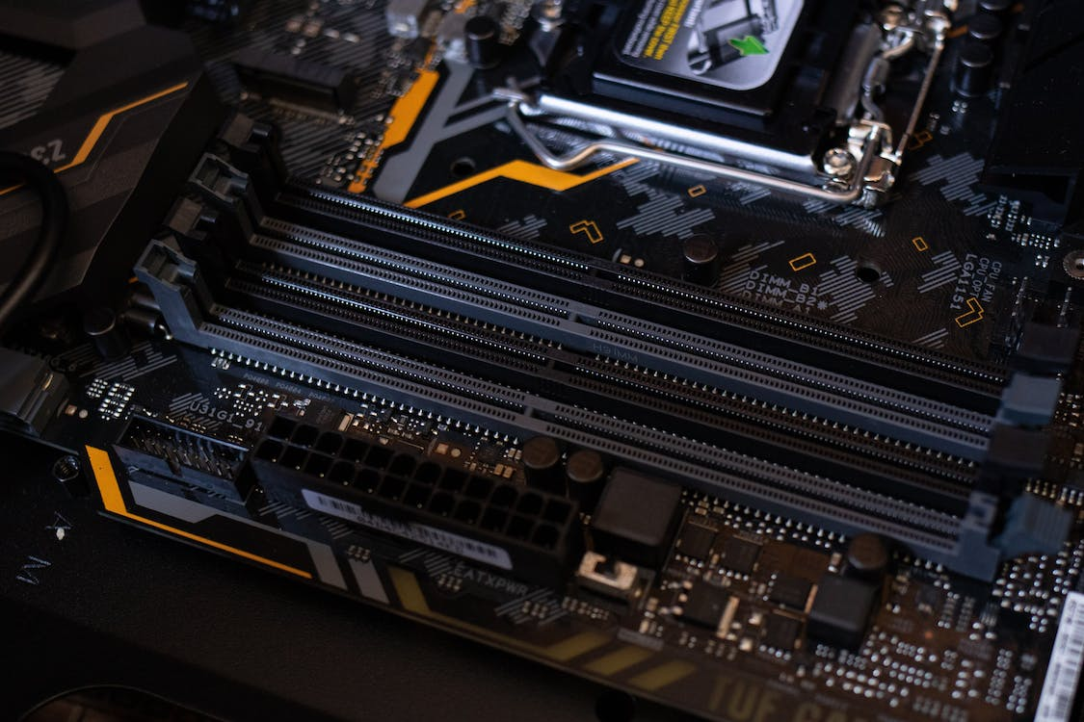
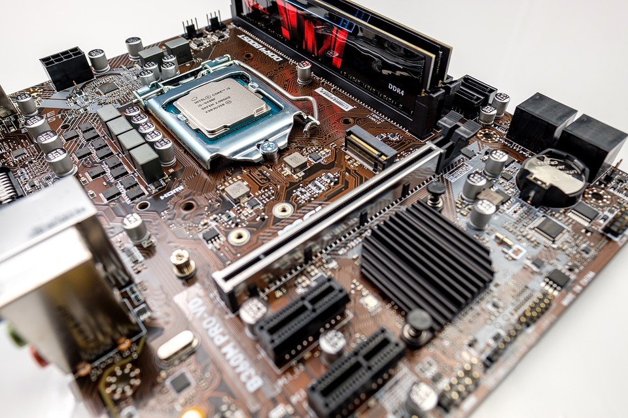
Central Circuitboard
What it is: All components of a computer communicate through a circuit board called the motherboard, as was mentioned above.
What it does: Think of the motherboard as the glue that holds everything else together.
Sometimes, the motherboard’s video card and Central Processing Unit are contained in an integrated (built-in) chipset.
Notes:
https://www.pexels.com/photo/black-and-gray-motherboard-2582932/
https://www.pexels.com/photo/man-person-people-woman-6755053/

Slide 11
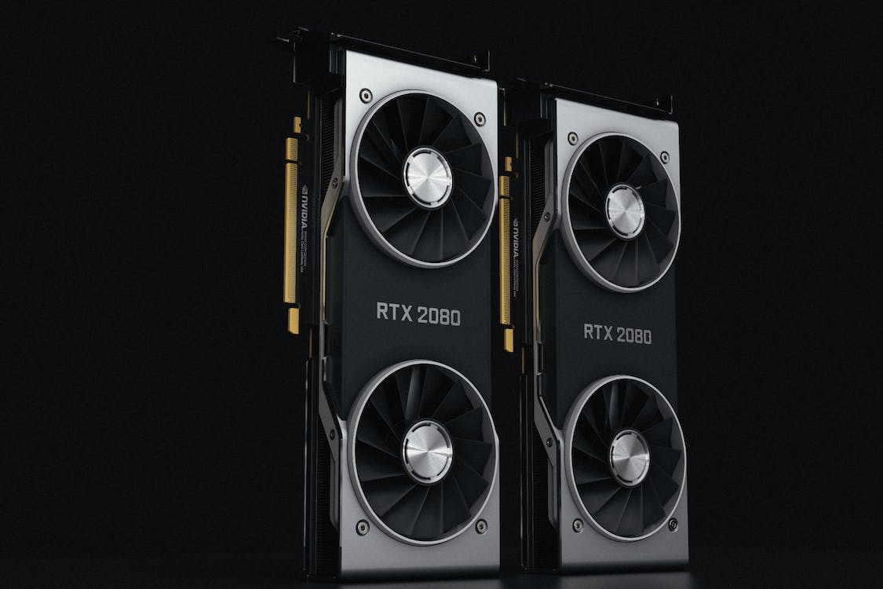
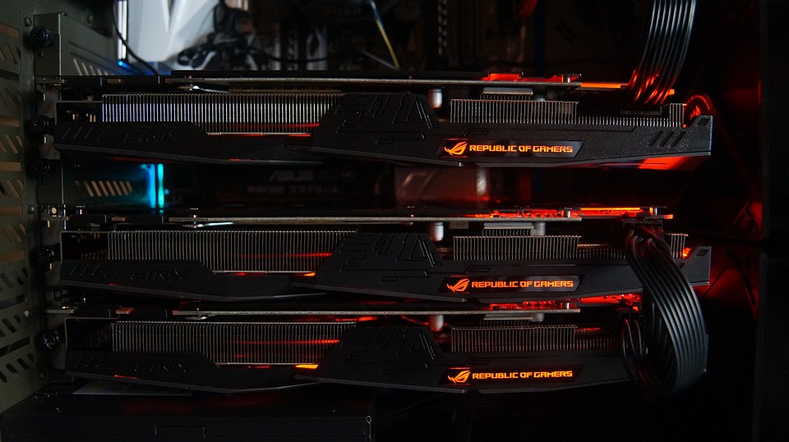
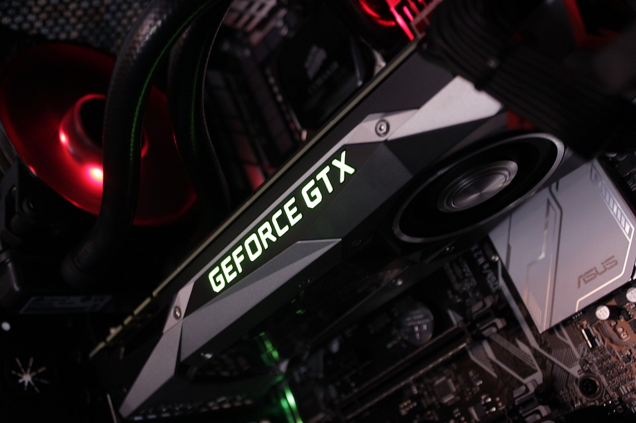
Graphics Processing Unit
What it is: It's not uncommon to hear gamers obsess over the next new graphics card, as these graphic cards make it possible for computers to generate high-end visuals like those found in the many different types of video games.
In addition to video games, though, good graphics cards also come in handy for those who rely on images in order to execute their craft, like 3D modelers using resource-intensive software.
What it does: Graphics cards often communicate directly with the display monitor, meaning a $1,000 graphics card won't be of much use if there isn't a high-end monitor connected to it.
Notes:
https://www.pexels.com/photo/close-up-of-two-rtx2080-graphics-cards-8622912/
https://pixabay.com/photos/pc-calculation-technology-mining-2810957/
https://pixabay.com/photos/pc-calculation-technology-mining-2810919/

Slide 12
Taking it Further…
Now that you have a general understanding of the types of components found in most digital devices here are a few activities you can try!
1. eWaste: A lot of devices have a lifespan of only a few years. Because of this, people are often buying the latest and greatest technology and left with a lot of electronic waste. Do a project looking at why this waste is so bad for the environment, how precious minerals and metals (which are non-renewable) also complicates the future of digital devices and how they are designed.
2. Create a timeline that features 5 to 10 different digital devices, their release dates, and why they were a big deal then (i.e.: the original Nintendo Entertainment System, or the Commodore 64 personal computer).

Slide 13
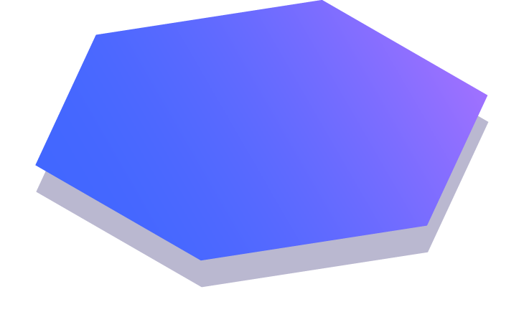
Thanks!
Any questions? E-mail: adam.binet@gnb.ca
Follow Centres of Excellence on Twitter @NBCOE

