Slide 1






LEARNING ACTIVITY FOR GRADES 3-5
PROVINCIAL
DIGITAL
PEN PALS

Slide 2

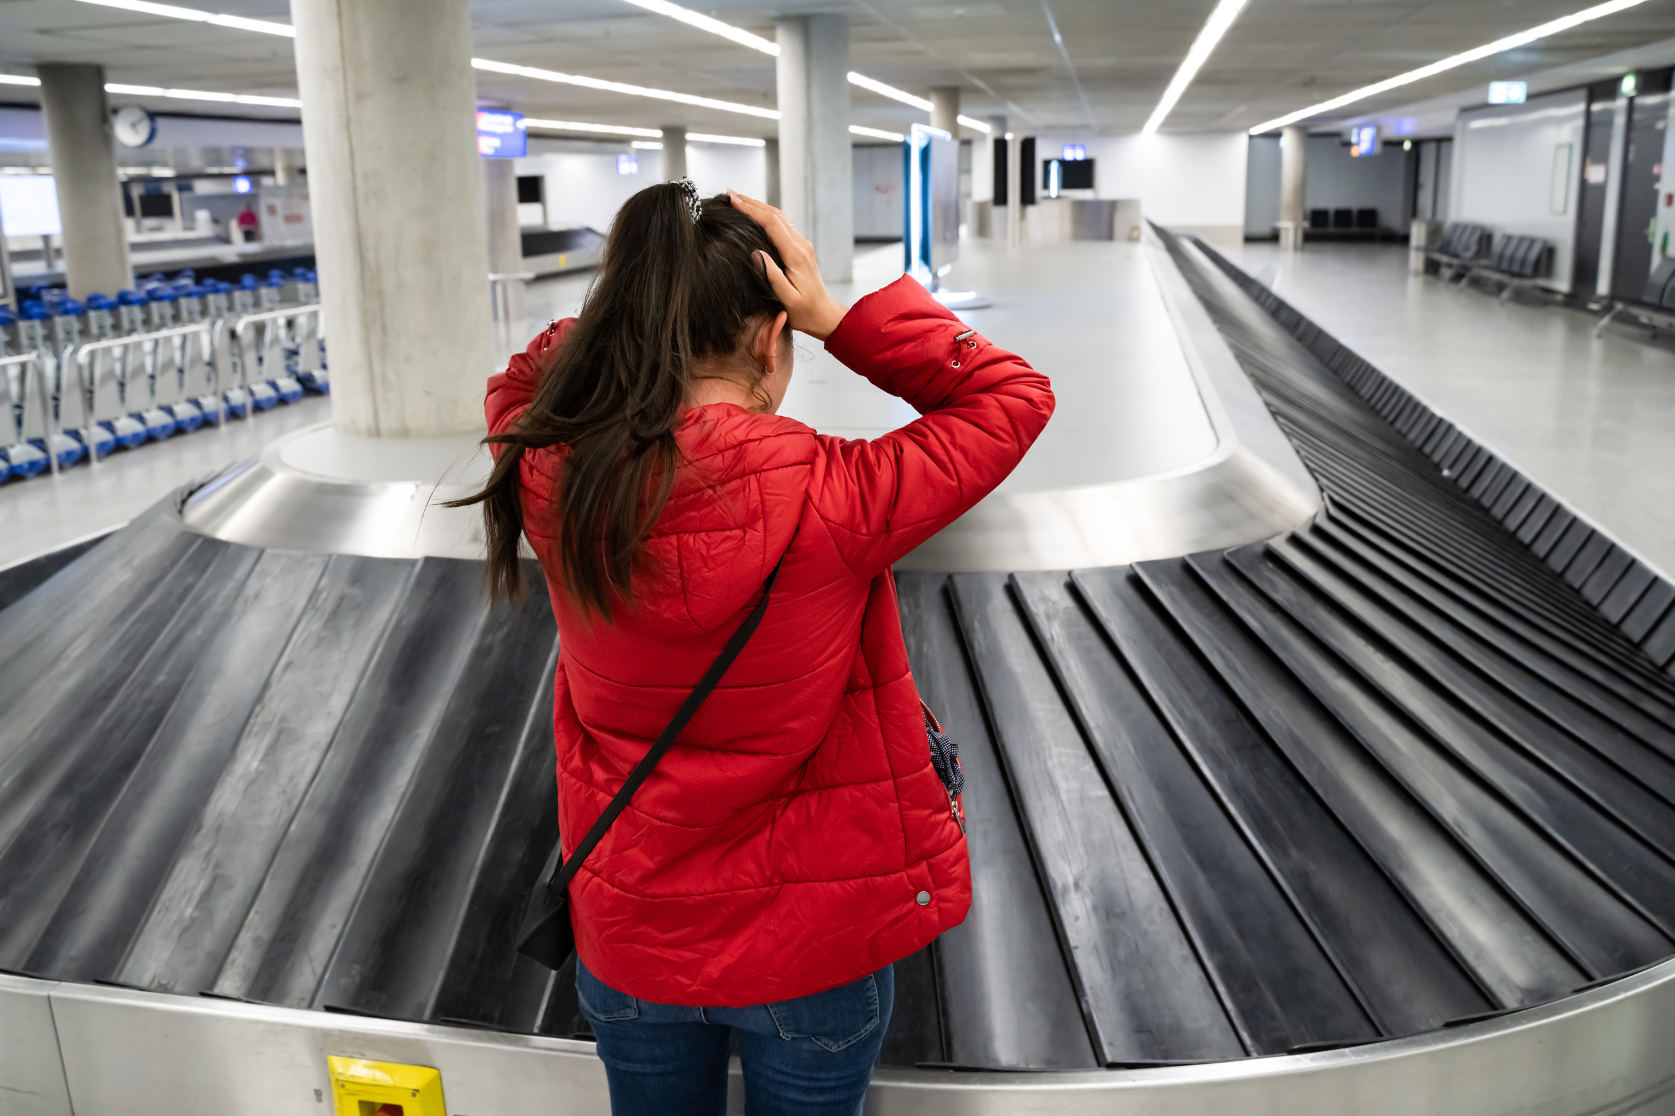



DISCUSSION
  Have you ever lost something?
  What did you do to find it?
  Were you successful?

Slide 3




MISSING HAT OWNER
NEW BRUNSWICK, CANADA
MISSING HAT!
Please message if you have seen this hat in the area. #lostwithoutit #Myheadfeelsbald

Slide 4
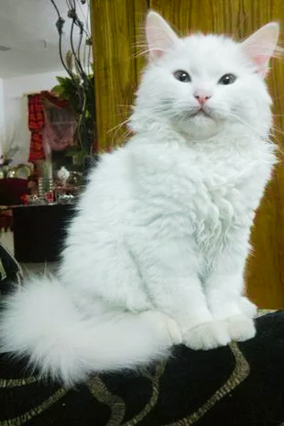
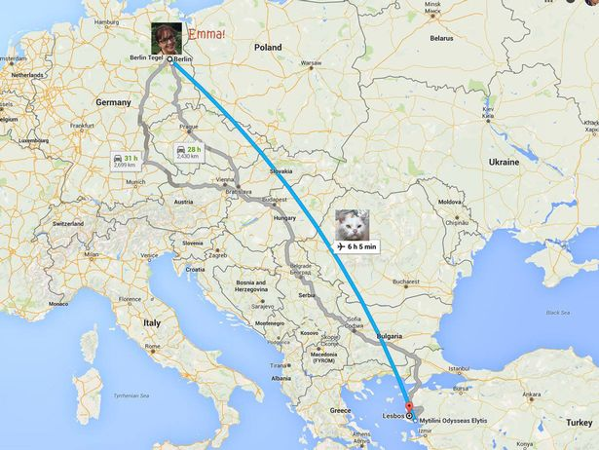
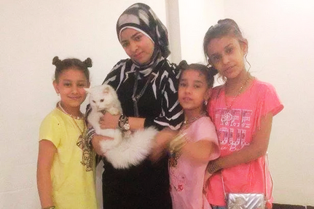

KUNKUSH'S INCREDIBLE JOURNEY
How many countries were Kunkush and her owners apart?

Slide 5
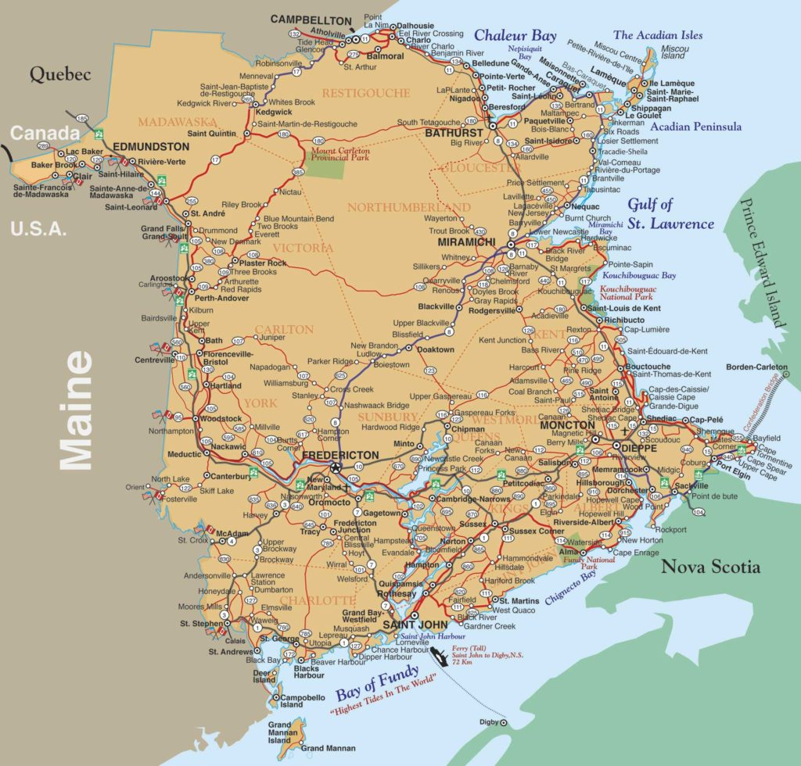
NEW BRUNSWICK
What do we know about our amazing province?

Slide 6
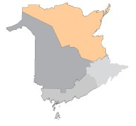
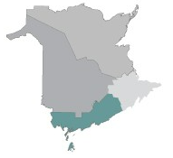
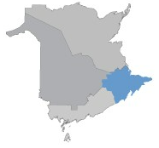
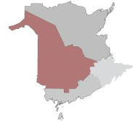
NB SCHOOL DISTRICT MATCH
Anglophone North
Campbellton, Bathurst, Miramichi and Rexton regions
Anglophone South
Sussex, Saint John, and St.Stephen regions
Anglophone East
Dieppe and Moncton Regions
Anglophone West Fredericton, Oromocto, Woodstock, and Edmundston regions

Slide 7


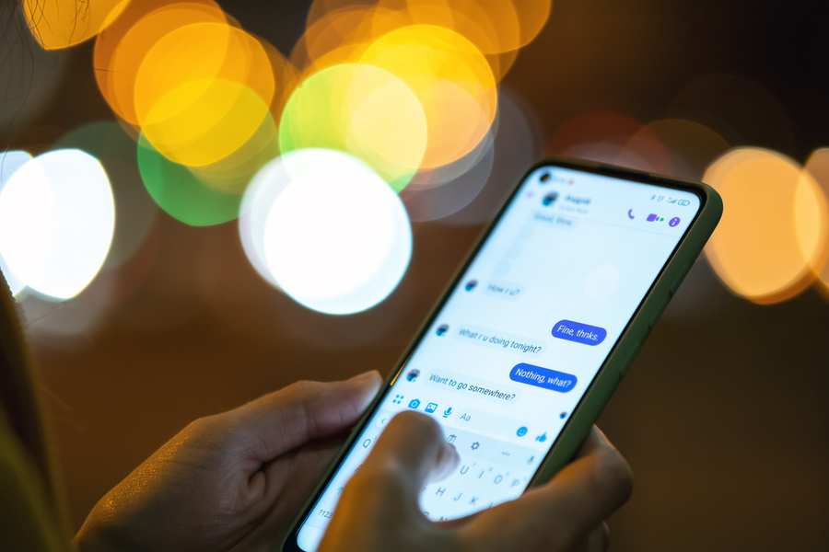



TECHNOLOGY: COMMUNICATION & COLLABORATION
VIRTUAL MEETINGS
INSTANT MESSAGING
People can meet from anywhere on the globe at anytime - for business, education, and even doctor appointments
Whether through email, Microsoft Teams, text or a social media site - instant communication
CO-AUTHORING
NETWORKING
Working on presentations, projects, documents, or excel sheets at the same time in different places
With the internet, meeting new businesses and new people have never been easier

Slide 8


THANK YOU!

