Slide 1






LEARNING ACTIVITY FOR GRADES K-2
Community Friends

Slide 2

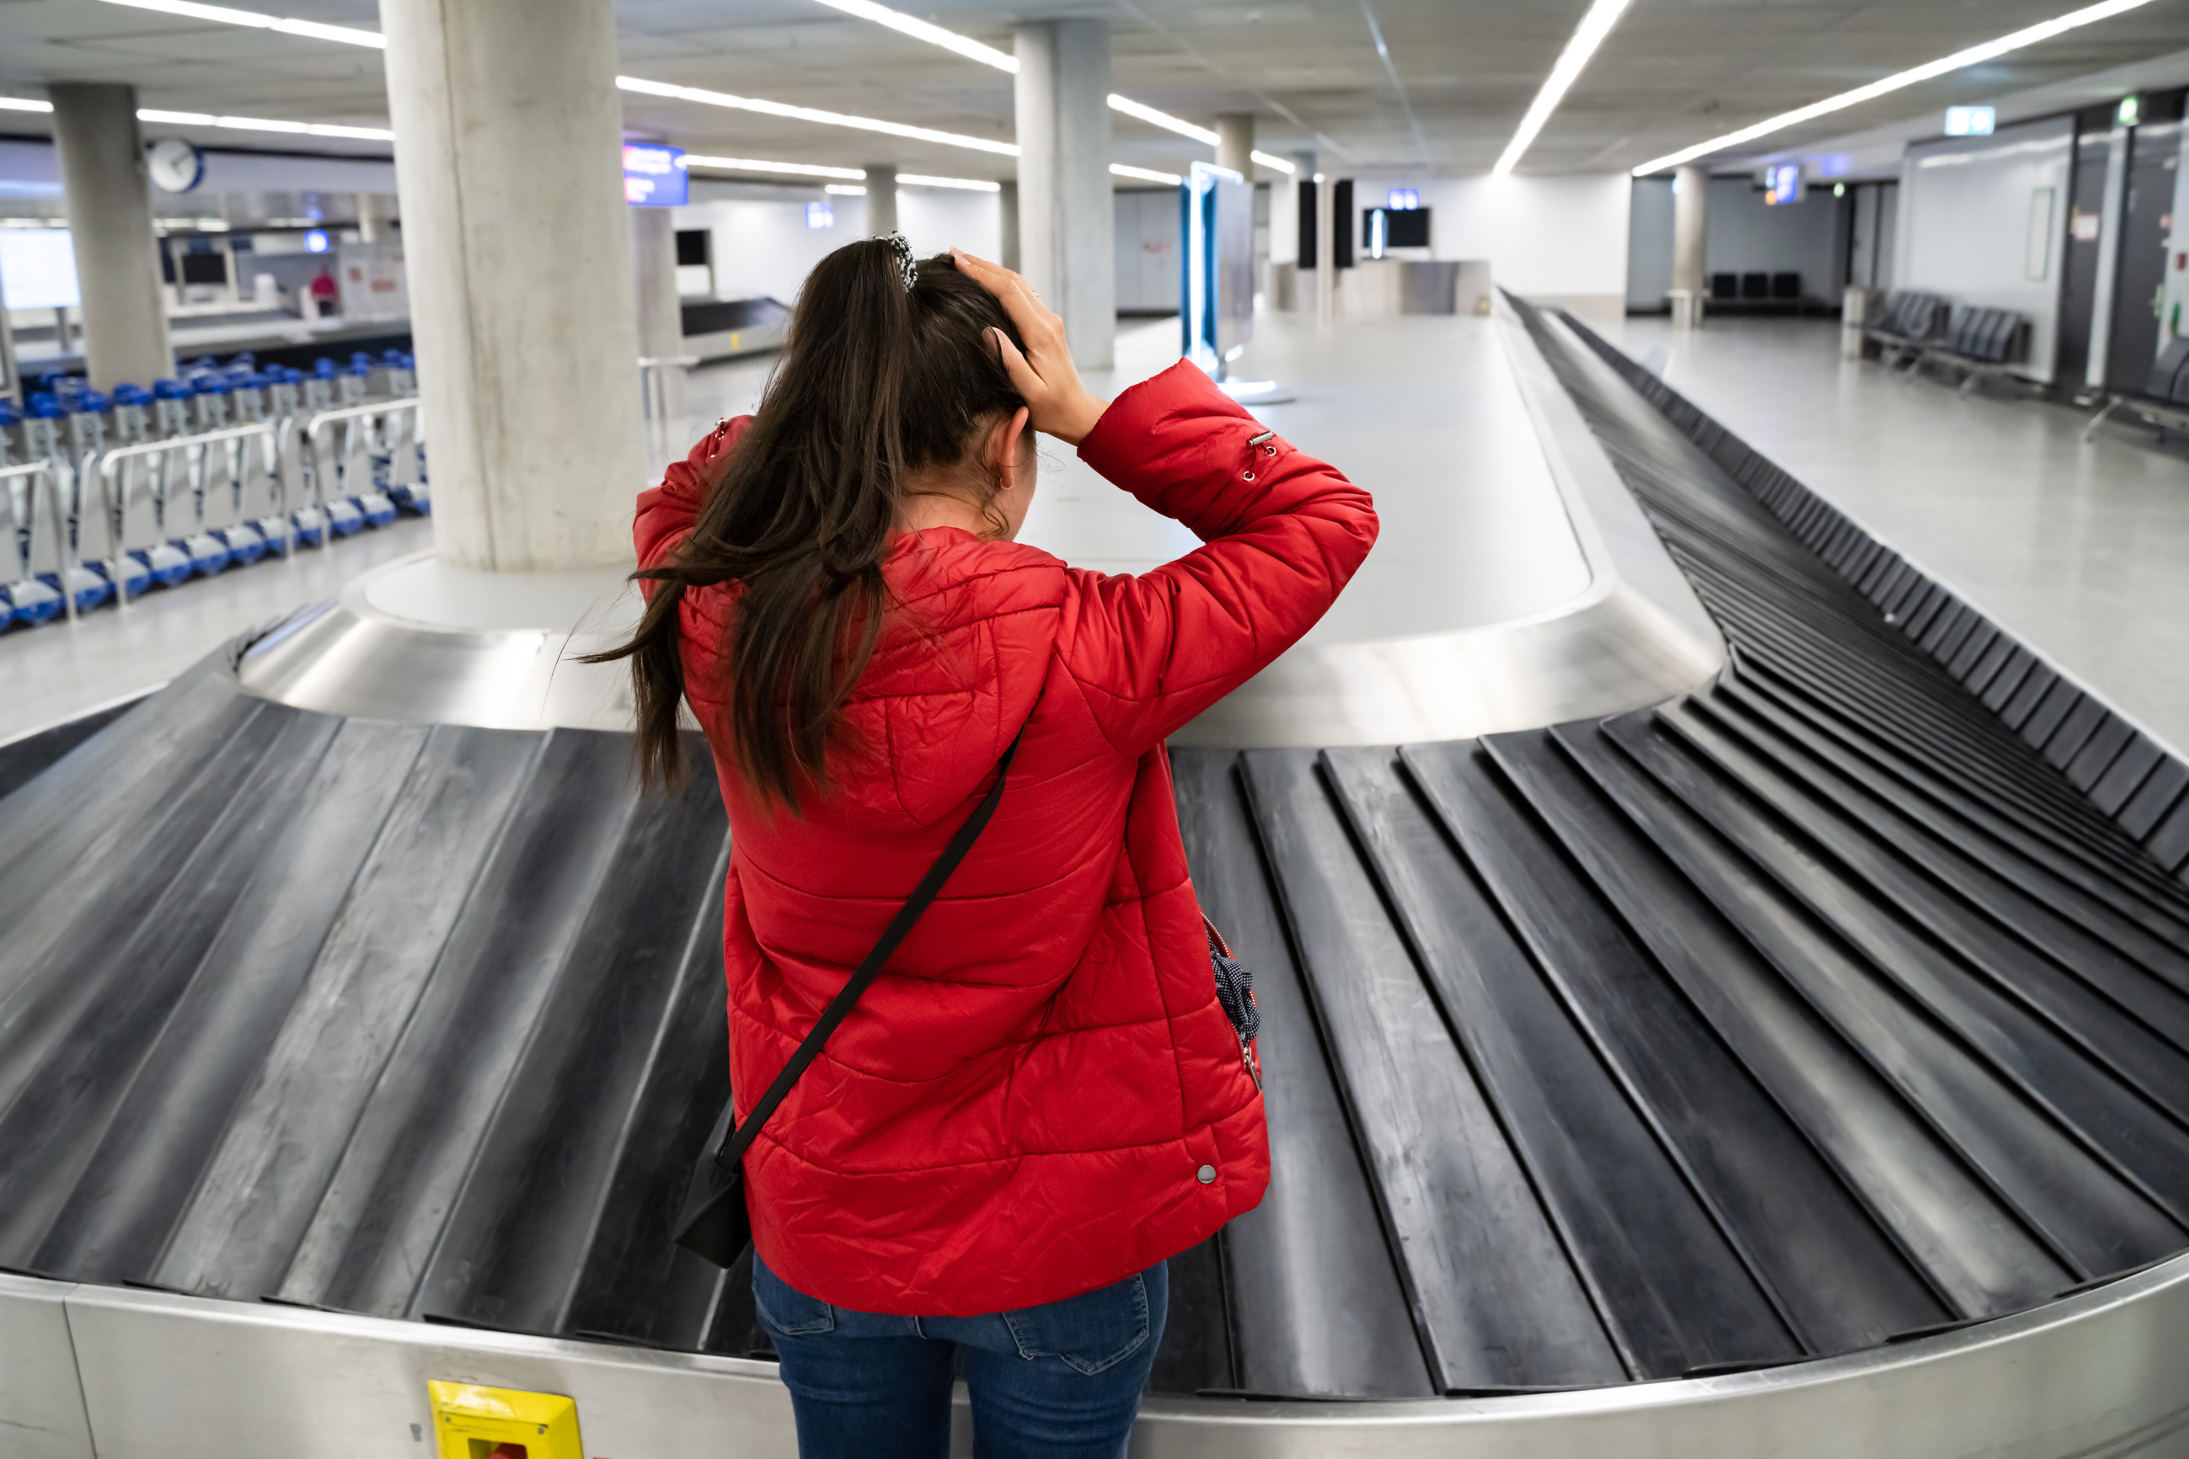



DISCUSSION
  Have you ever lost something?
  What did you do to find it?
  Were you successful?

Slide 3




MISSING Pencil OWNER
NEW BRUNSWICK, CANADA
MISSING PENCIL!
Please message if you have seen this pencil in the area. #lostwithoutit #Myhandiscoldnow

Slide 4
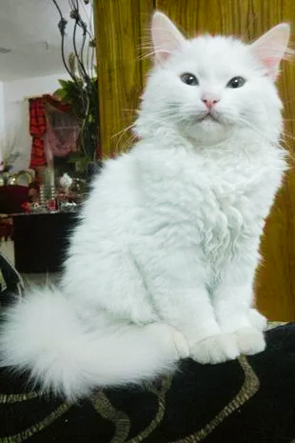
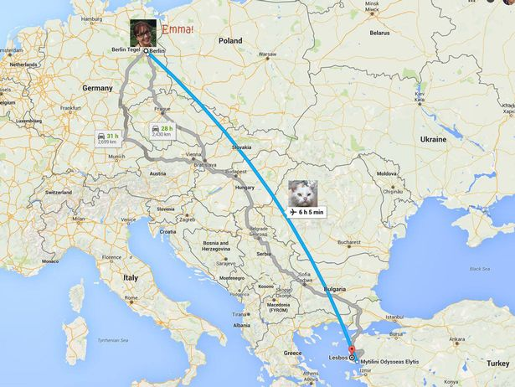
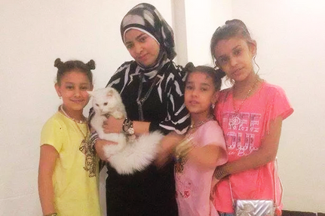

KUNKUSH'S INCREDIBLE JOURNEY
How many countries were Kunkush and her owners apart?

Slide 5


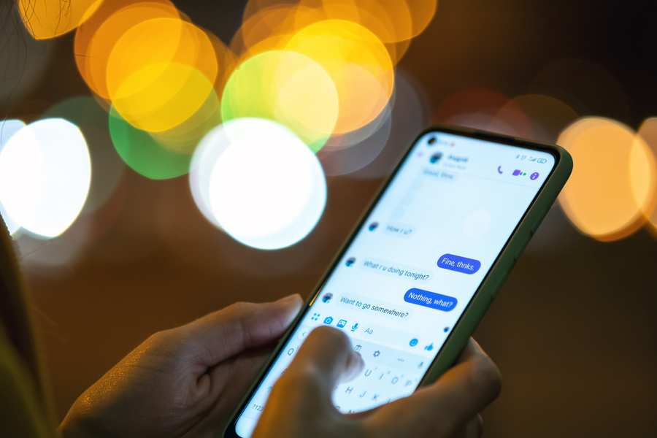


TECHNOLOGY: COMMUNICATION & COLLABORATION
VIRTUAL MEETINGS
INSTANT MESSAGING
People can meet from anywhere on the globe at anytime - for business, education, and even doctor appointments
Whether through email, Microsoft Teams, text or a social media site - instant communication
CO-AUTHORING
NETWORKING
Working on presentations, projects, documents, or excel sheets at the same time in different places
With the internet, meeting new businesses and new people have never been easier

Slide 6


THANK YOU!

