Slide 1



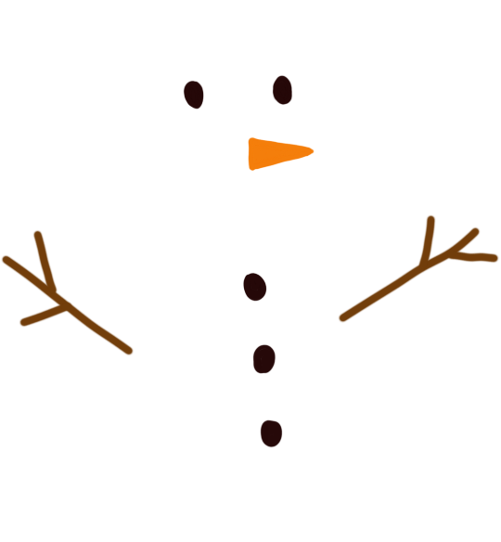


Do You Want to Code A Snowman?

Slide 2



Discuss: What must a snowman have to be a snowman?

Slide 3
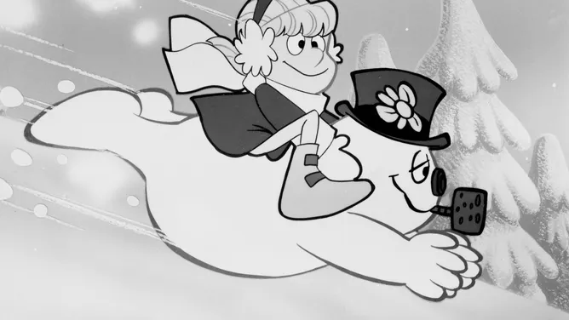
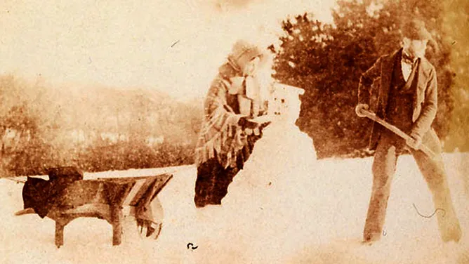
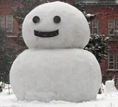
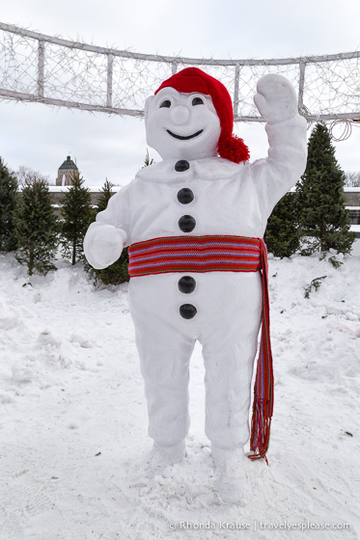
Is there only one way to build a snowman?
Frosty the Snowman, 1969 film
First known photograph of a snowman, 1853 in Wales
Yukidaruma (Japanese: 雪だるま) = Snowman
Bonhomme de neige, Quebec

Slide 4

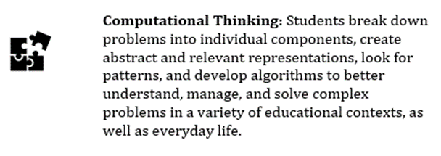
Computational
Thinking
Take a task and break it into smaller steps.

Slide 5
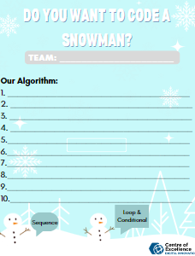

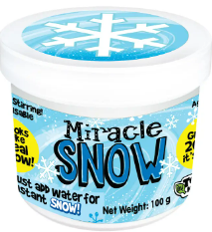
Challenge: Can you write an algorithm for a snowman in less than 10 steps?
Materials

Slide 6
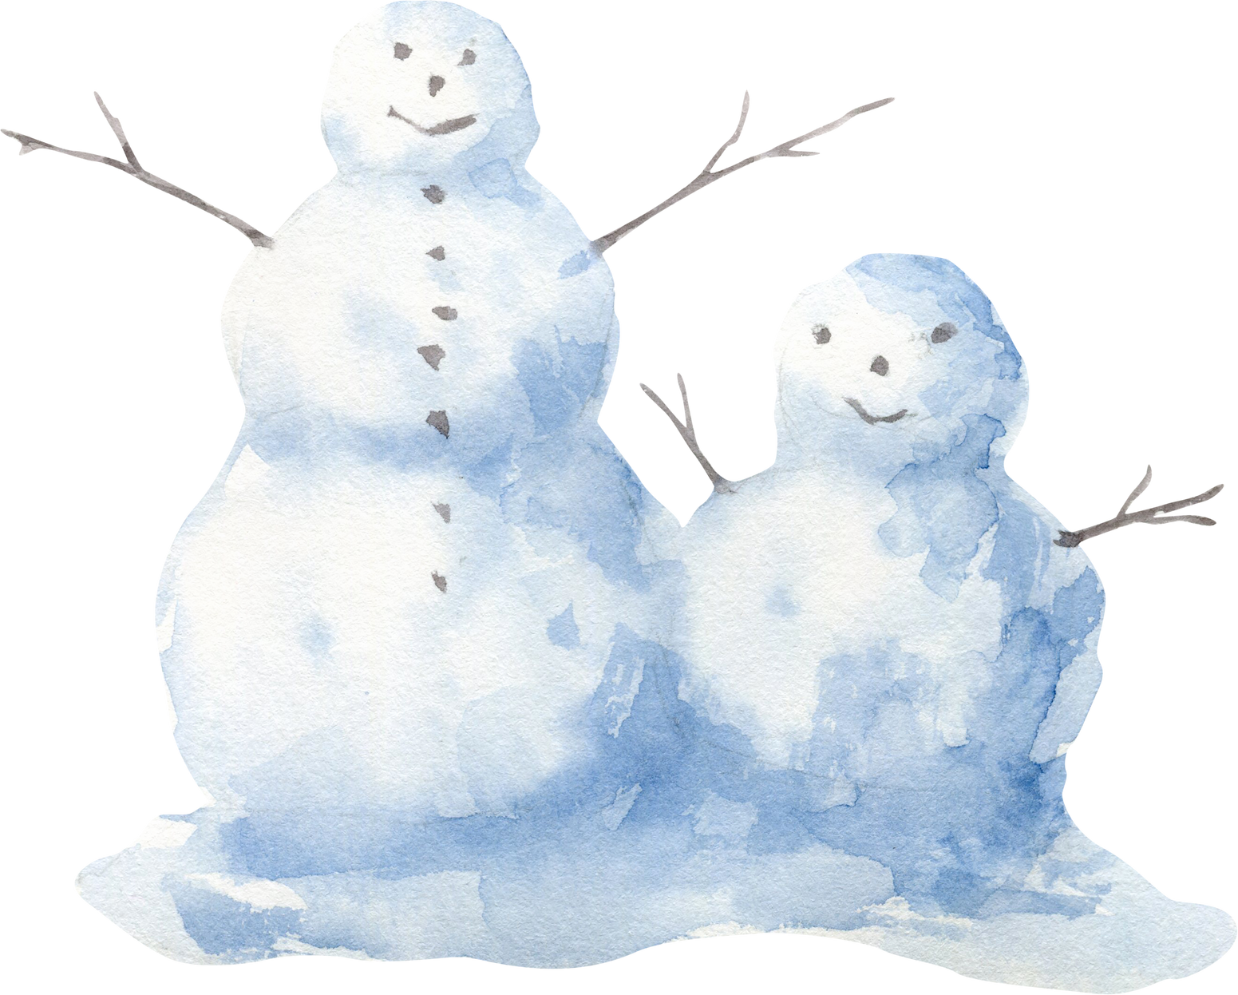
Show & Share

