Slide 1
Bouncy Ball
Boundary Challenge

Slide 2
What are bouncy balls created to do?

Slide 3
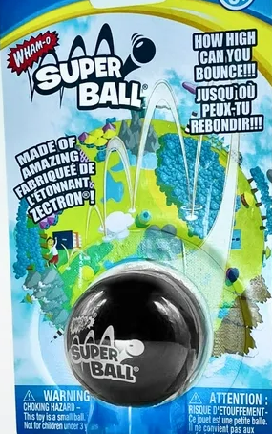
Did you know...
The company Wham-O (frisbee & Hula Hoop) created the first “Super Ball” out of plastic - the stuff inside of golf balls (polybutadiene)
Each bounce is 92% as high as the last
It was initially priced at 98¢. (That's a whopping $7.22 in today's money.)
The Super Bowl is named after the Super Ball.
A Super Ball reverses its spin with each bounce.

Slide 4
Bouncy Ball Boundary Challenge
You MUST create an arena (contained environment) which allows the bouncy ball to do all that it is created to do - AND keeps it safe, in sight, and undamaged.

Slide 5
How are we like a bouncy ball?

Slide 6
Recent Headlines

Slide 7
What effective boundaries do we need around our screen time?
1
2
3
Time
Location
Use

