Slide 1
Data Treasure Hunt
with

Slide 2
About Me:

Slide 3
Who am I?
Select a well-known person and research information about them.
What type of information could you find out?

Slide 4
What is your person’s..?
place of birth
age
first name
number of siblings
last name
date of birth
favourite food
favourite colour
nationality

Slide 5
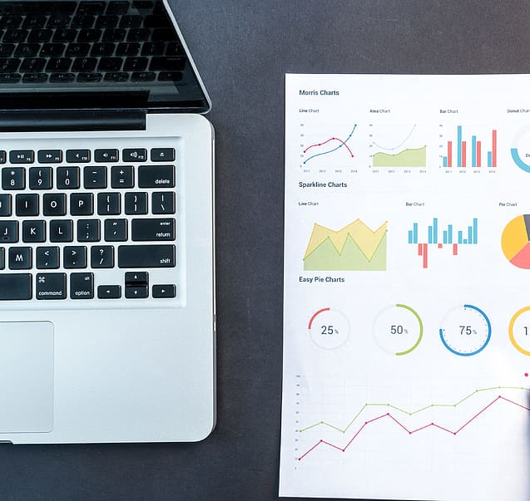
What is data?
Data is information collected for use elsewhere.
It is often stored in computers.
Data can be split into two parts
- the name and the value: e.g. Date of birth: 23.02.1987

Slide 6
Data names and data values
Examples of data names | Examples of data values

Slide 7
Grouping data
Discuss with your partner possible ways that your data could be grouped.
Think about:
How the data is written.
If the data will always be correct.

Slide 8
Grouping data
 | Will stay the same | Will / may change
Written in words
Written in numbers

Slide 9
Why is data important?
Data helps us make better decisions – like knowing what clothes to wear by checking the weather.
Data shows us patterns – like noticing that plants grow faster when they get more sunlight.
Data helps us solve problems – like figuring out which route to school is the fastest.

Slide 10
Who uses/collects data?
Everyone!
Computer programmers - make apps work better, like a game that gets harder as you get better at it.
Data scientists - find answers, like looking at how many people ride the bus each day to help plan better routes.
AI developers - train computers using data, like showing a robot lots of pictures of cats so it learns how to spot one.

Slide 11
How do we protect data?
Only share what you need to
Passwords
Encryption

Slide 12
How is data collected?
Requests for data
Giving permission to organizations to collect our data when we accept ‘terms and conditions’ on websites or when registering a new device.
Computers can help (sensors, spreadsheets, graphs)

Slide 13
What are sensors?
Sensors are devices that monitor a given thing.
When a change is sensed in the thing it is monitoring, the sensor can make something happen.
Temperature sensors monitor temperature.
Rain sensors monitor rain.
Play an alarm when motion detected
Turn on a light when it’s dark

Slide 14
The micro:bit sensors
We are going to make use of some of the micro:bit’s sensors.
What sensors do you think the micro:bit has?
Notes:
Establish that the micro:bit has sensors for light, temperature and movement. Explain that in this unit, the pupils will be making use of the light and temperature sensors.

Slide 15
Sensors and Features
Temperature
Light
Sound
Accelerometer (movement)
Pin connectors (connect to servos, motors, and additional sensors)

Slide 16
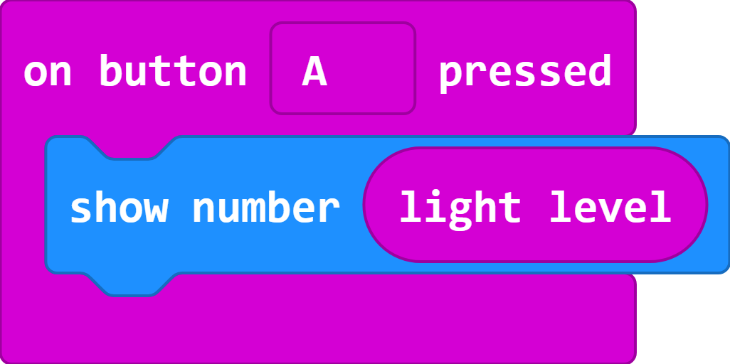
What do you think this program will do?
Link to code in MakeCode editor: https://makecode.microbit.org/#pub:_Fbmc40R6FACT

Slide 17
Collecting data with the micro:bit
Which areas of the school do you think are the darkest or brightest?
How could we use the micro:bit to find out which areas in the school is the darkest or brightest?
What if we modify the light sensor program to get the micro:bit to display the temperature instead of light level?

Slide 18
What do you think this program will do?

Slide 19
Collecting data
Build a program to use the micro:bit as a temperature detector
Download and transfer to your micro:bit
Connect the battery pack to the micro:bit
Visit selected areas of the school and record the data

Slide 20
Using our data
What temperatures did you record at your locations?
What do our results tell us?
Are there any patterns in our results?
Do any of the results look incorrect?
Why might we have recorded incorrect results?

Slide 21
How is your data collected?
Many of us have internet connected device in our homes such central heating systems, smart tv, digital assistants, etc.
What data might such devices be collecting?
How might they use this data?
Notes:
We are giving information on the types of programmes we like to watch, the music we listen to, the books we read, what time of day we get up, when we are away on holiday.

Slide 22
Who else has your data?
If you have loyalty cards (e.g. Game Rewards) or accounts with online retailers you will be sharing your data with them.
Why might a retailer want your data?
Notes:
Establish that by identify what they buy, the retailers can identify other similar products they may be interested in and target advertising.
Also knowing if you visit a certain shop more than others can be used to identify when and where you do your shopping.

Slide 23
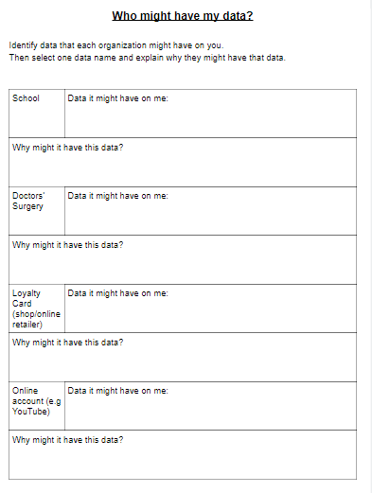
Who might have my data?
Complete the activity sheet by identifying the types of data each organisation might have about you.
Select one piece of data and give an example of how they might use this data.

Slide 24
Learning objectives revisited:
To understand what data is.
To classify data.
To identify ways that data might be used.

Slide 25
What data can you find?

Slide 26
What data can you find?

Slide 27
What data can you find?
place of birth: London
first name: Matilda
date of birth: 08.11.2001
number of siblings: 4
last name: Ramsay
favourite emoji: cherries
age:17
home: Los Angeles
favourite colour: green

Slide 28
Licensing information:
Published by the Micro:bit Educational Foundation microbit.org under the following Creative Commons licence:
Attribution-ShareAlike 4.0 International (CC BY-SA 4.0) https://creativecommons.org/licenses/by-sa/4.0/

