Slide 1
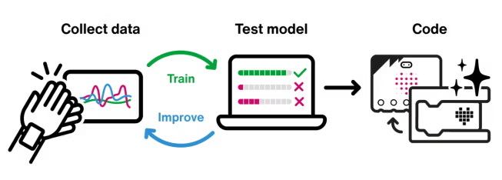

micro:bit CreateAI: Explore AI Through Movement
Sarah Rankin
Centre of Excellence – Digital Innovation Lead
EECD

Slide 2
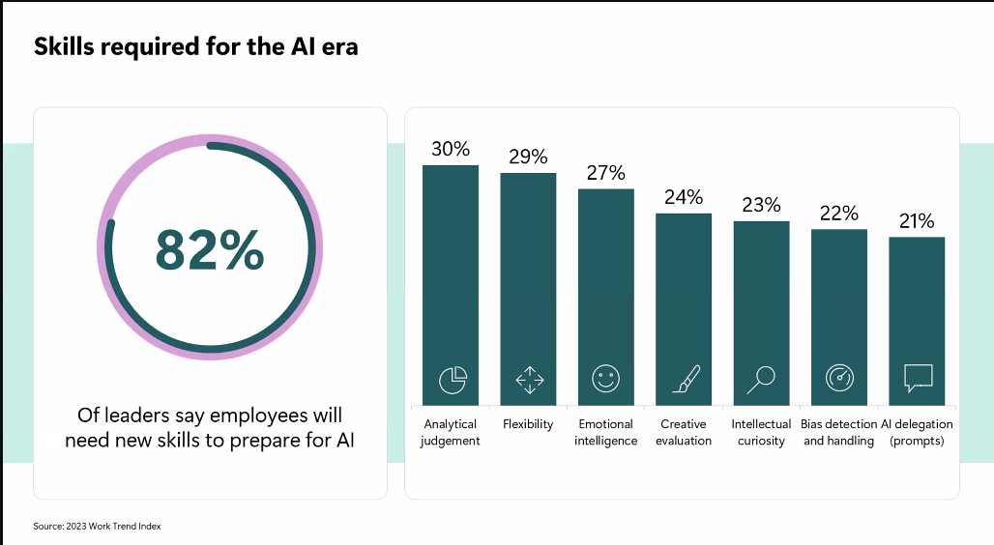

Slide 3
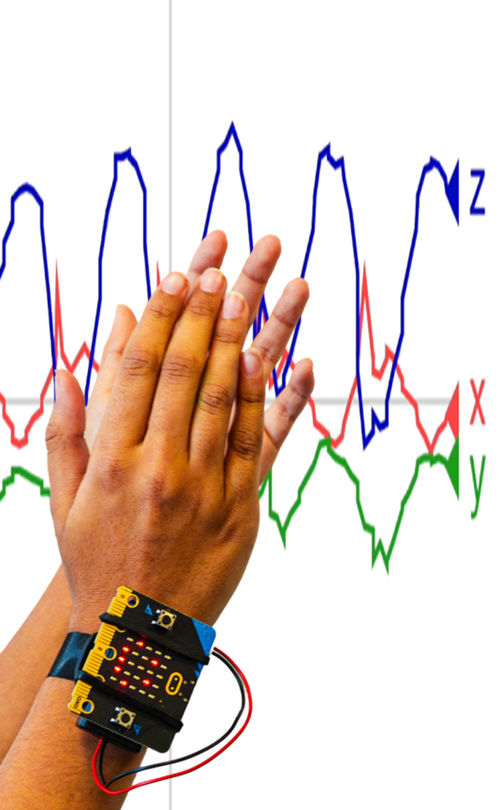



What is CreateAI?
micro:bit Powered
Web-based
Classify and collect accelerometer data
Nothing to download to add to micro:bit
Connects to MakeCode
Once the AI model is trained, import into MakeCode
for use in machine learning projects

Slide 4
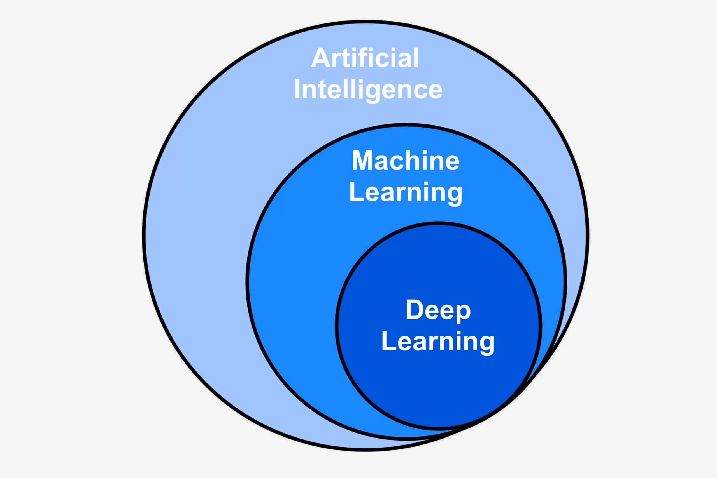
What is Machine Learning?
AI Technology
Real-World Uses
Machine learning lets computers learn from data and make decisions.
Powers smart fitness trackers and photo tagging systems.
Educational Value
Works with small data sets, making it ideal for classroom use.

Slide 5
What You Need
Hardware
Computer
Not Supported
micro:bit V2
Desktop, laptop or Chromebook
iPads or tablets
USB cable
Chrome or Edge browser
micro:bit classroom
Batteries and battery pack
micro:bit V1 for running models
Strap or holder for attachment (optional)

Slide 6
Connecting Your micro:bit
Connect micro:bit to laptop
Use Bluetooth, USB cable and battery pack
Follow On-Screen Instructions
CreateAI guides you through setup
Test Connection
Once connected, you're ready to record movement data.

Slide 7

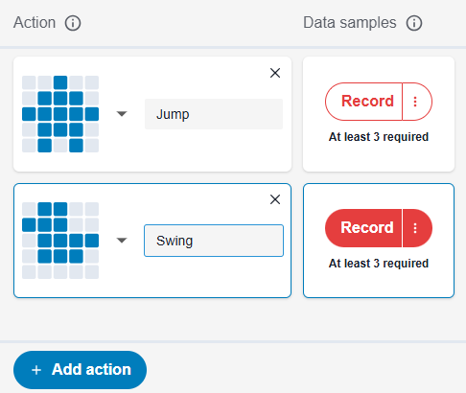



Recording Data Samples
Hold or Attach micro:bit
Secure to wrist, ankle, or hold in hand.
Name Your Actions
Choose movements like clapping, waving, or jumping.
Record Samples
Collect at least 3 samples per action.
Check Data Quality
Remove outliers and record more if needed.

Slide 8








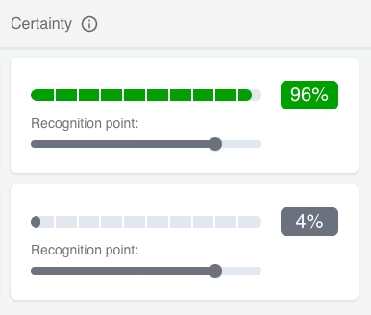
Training and Testing Your Model
Train Model
Test Recognition
Press "Train model" when you have enough data.
Try each action to see if the model recognizes it.
Improve Model
Adjust Settings
Add more samples or actions to enhance accuracy.
Change recognition threshold if needed.

Slide 9
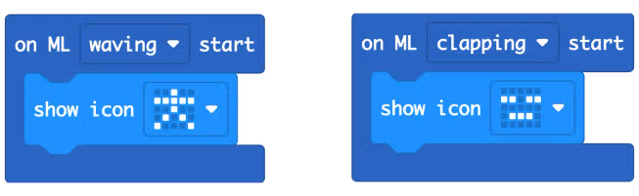
Coding with Your Model
Edit in MakeCode
ML Block Types
Download and Run
Use ML blocks that represent your trained actions. Add your own code to create interactive projects.
Use "on ML start," "on ML stop," "is ML detected," and "certainty %" blocks to build your program.
Transfer your model and code to the micro:bit V2. Use it anywhere, away from your computer.

