Slide 1
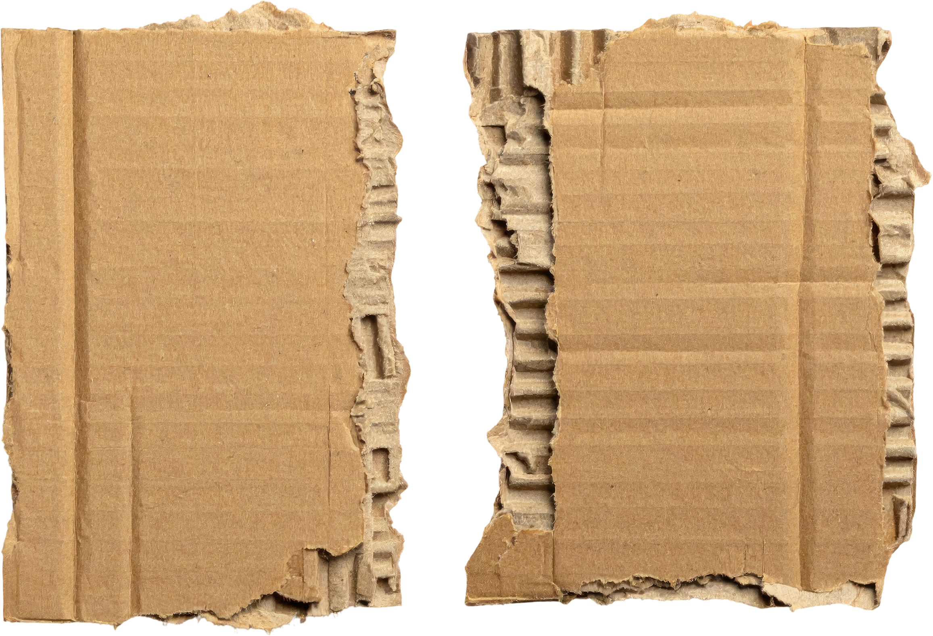
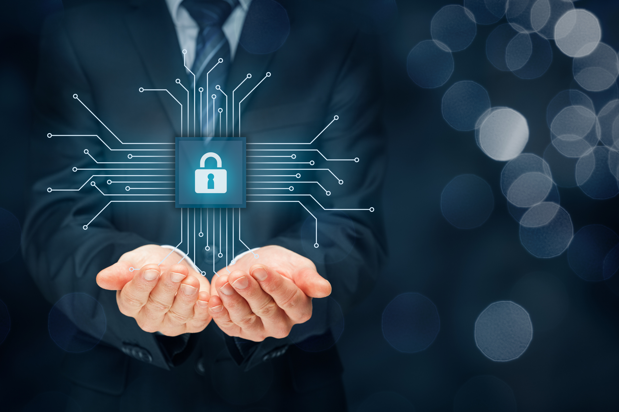
SECURE
STRUCTURES
CYBERSECURITY BUILDING CHALLENGE

Slide 2
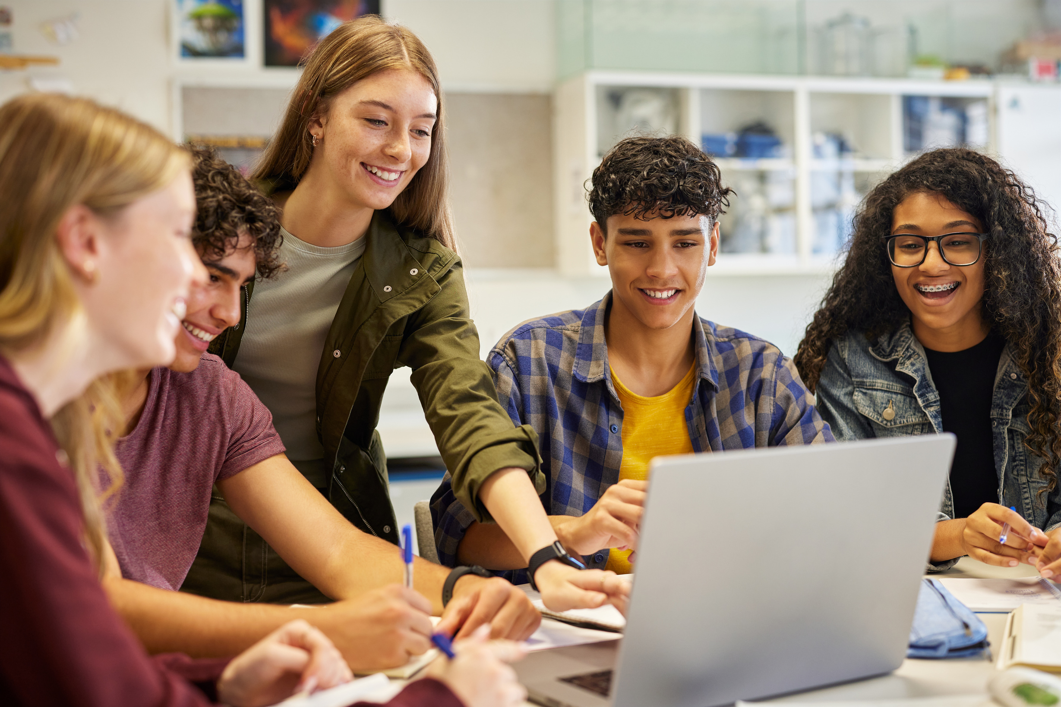
PROTECTING
PERSONAL
INFORMATION
Protecting your personal information online is important because it helps keep you safe and in control of your identity. When you share things like your full name, location, or other details, people you don’t know could use that information in ways you didn’t intend. Being careful about what you share helps protect your privacy, your safety, and your future.
Keep your personal details private.
Do not share your login info with others.
Think before posting on social media.

Slide 3
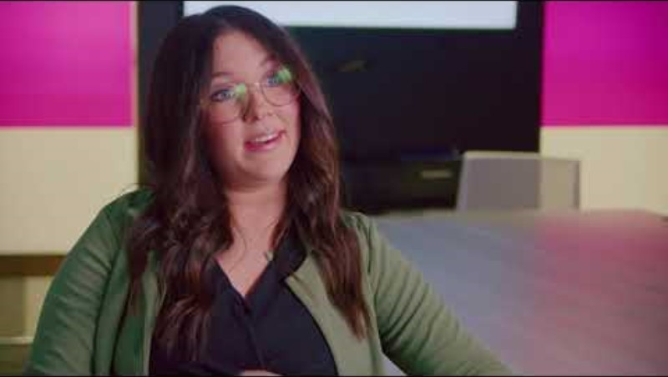
C
Cybersecurity specialists | Occupational Profile

Slide 4
HOW TO CREATE
STRONG PASSWORDS
Make it at least 8 characters
Don’t use your name or birthday
Change it often and don’t reuse
Mix letters, numbers, and symbols

Slide 5
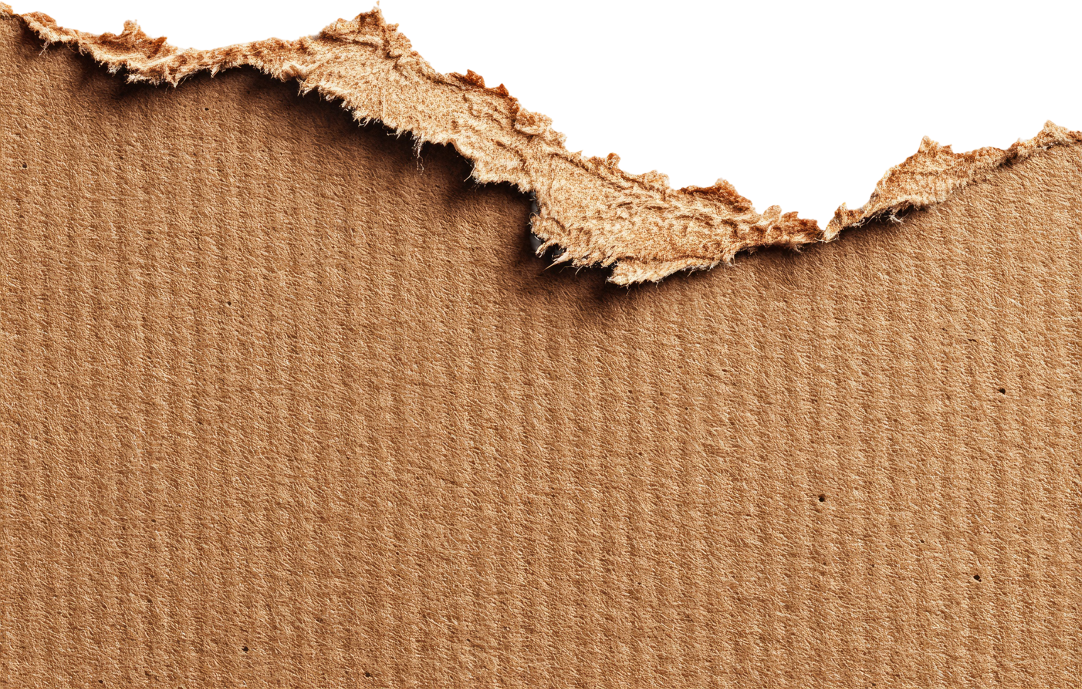
BUILDING
CHALLENGE
Work in groups to solve a cybersecurity challenge and develop innovative solutions to share with your peers.

Slide 6
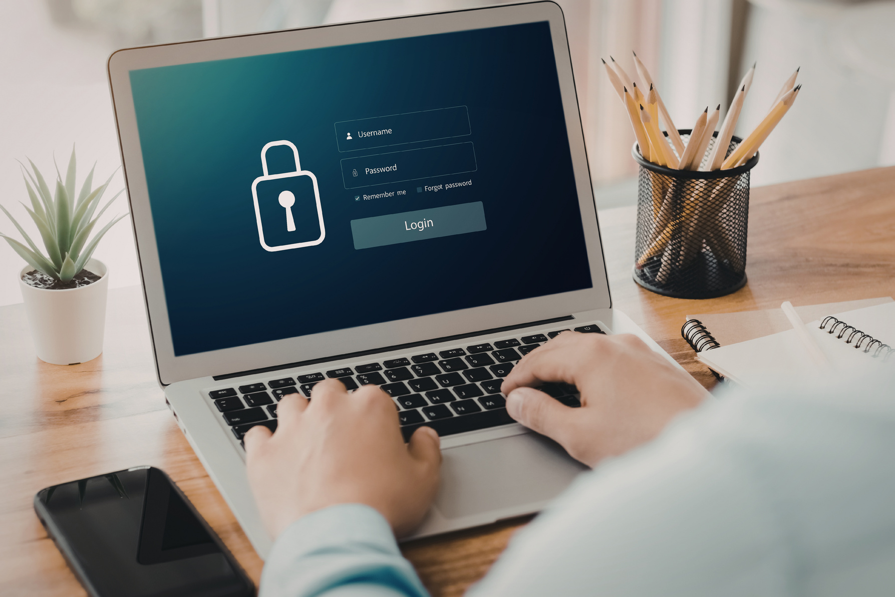
PROTECT THE PASSWORD
Scenario: Hackers are trying to steal user passwords.
Mission: Build a secure structure to protect a password card hidden inside.
Requirements:
  One protected entry point (Login Portal)
  Strong outer barrier (Firewall)
  Hidden compartment with password (Encryption)
Cybersecurity Definitions:
Firewall: A barrier that blocks unwanted access.
Encryption: Scrambling information so others cannot read it.
Login Portal: A place where users enter secure information.

Slide 7
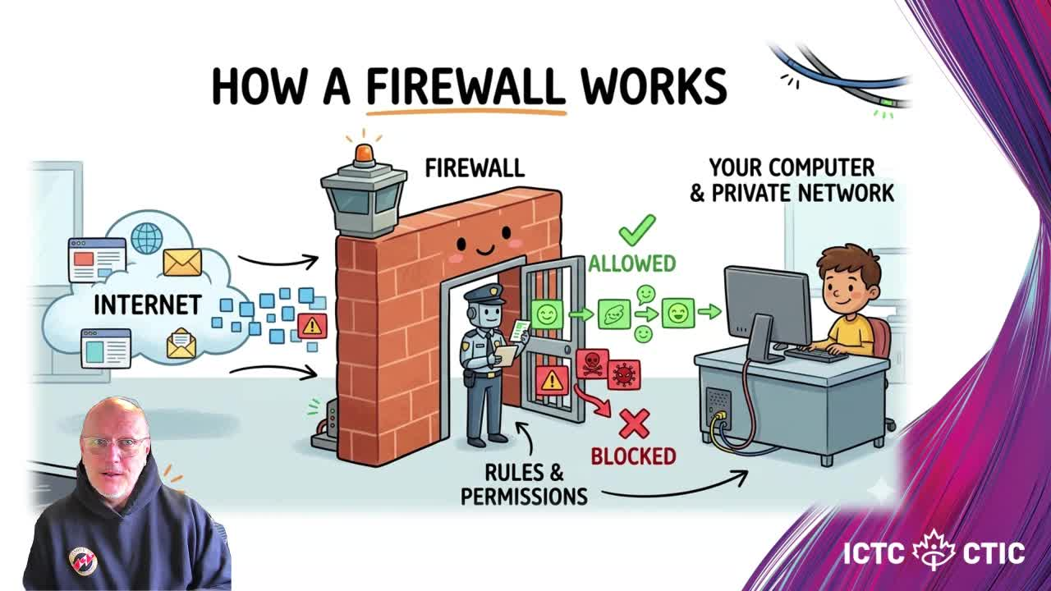
FIREWALL: A BARRIER THAT BLOCKS UNWANTED ACCESS.

Slide 8
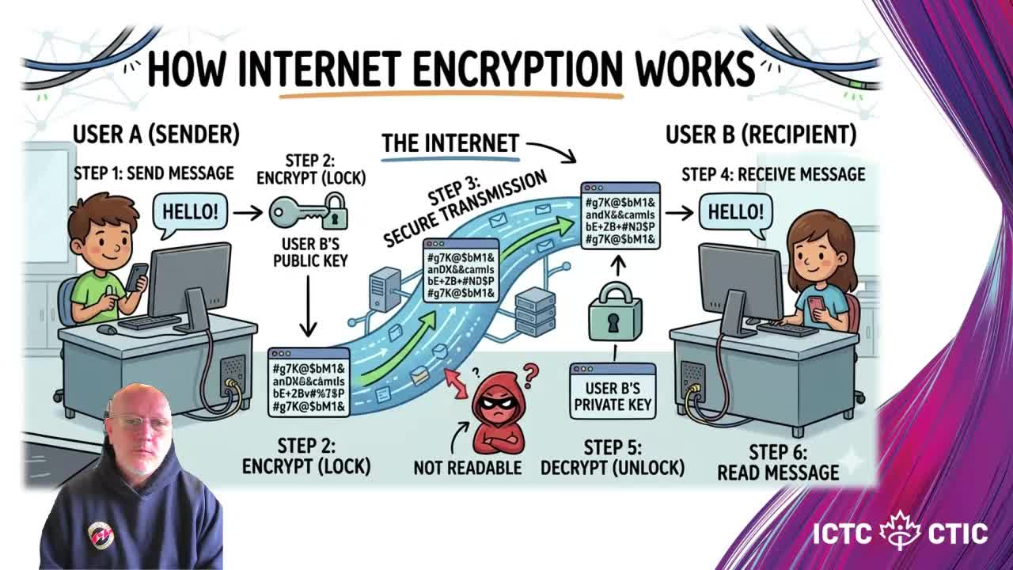
ENCRYPTION: SCRAMBLING INFORMATION SO OTHERS CANNOT READ IT.

Slide 9
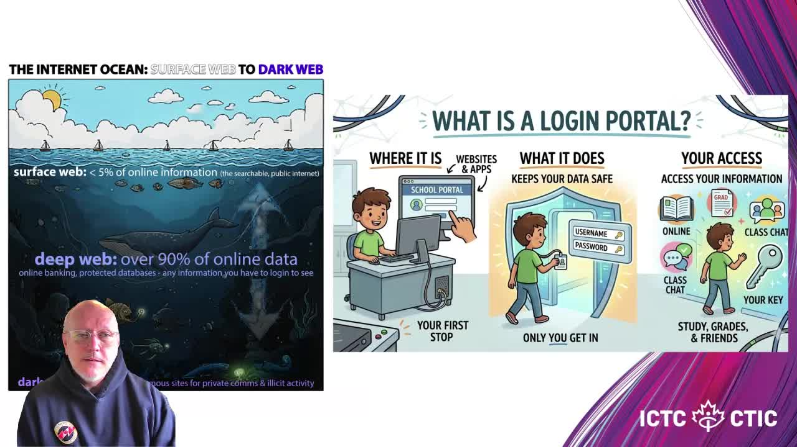
LOGIN PORTAL: A PLACE WHERE USERS ENTER SECURE INFORMATION.

Slide 10
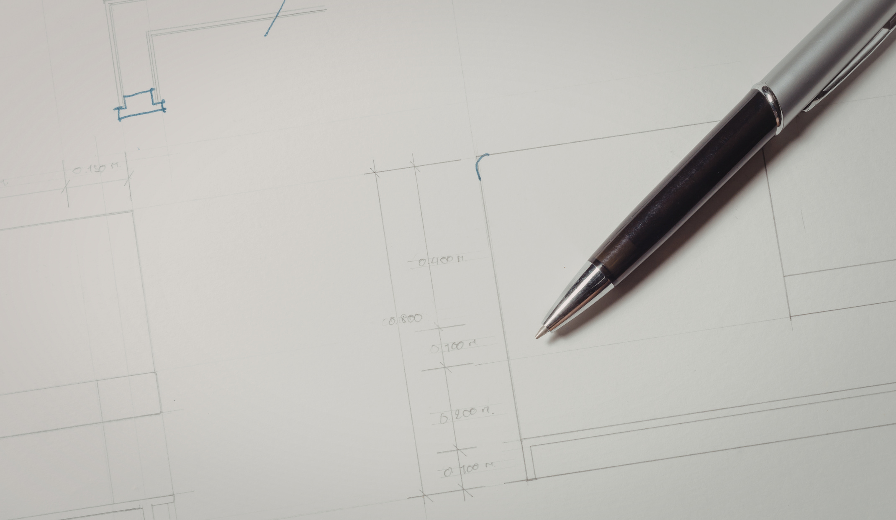
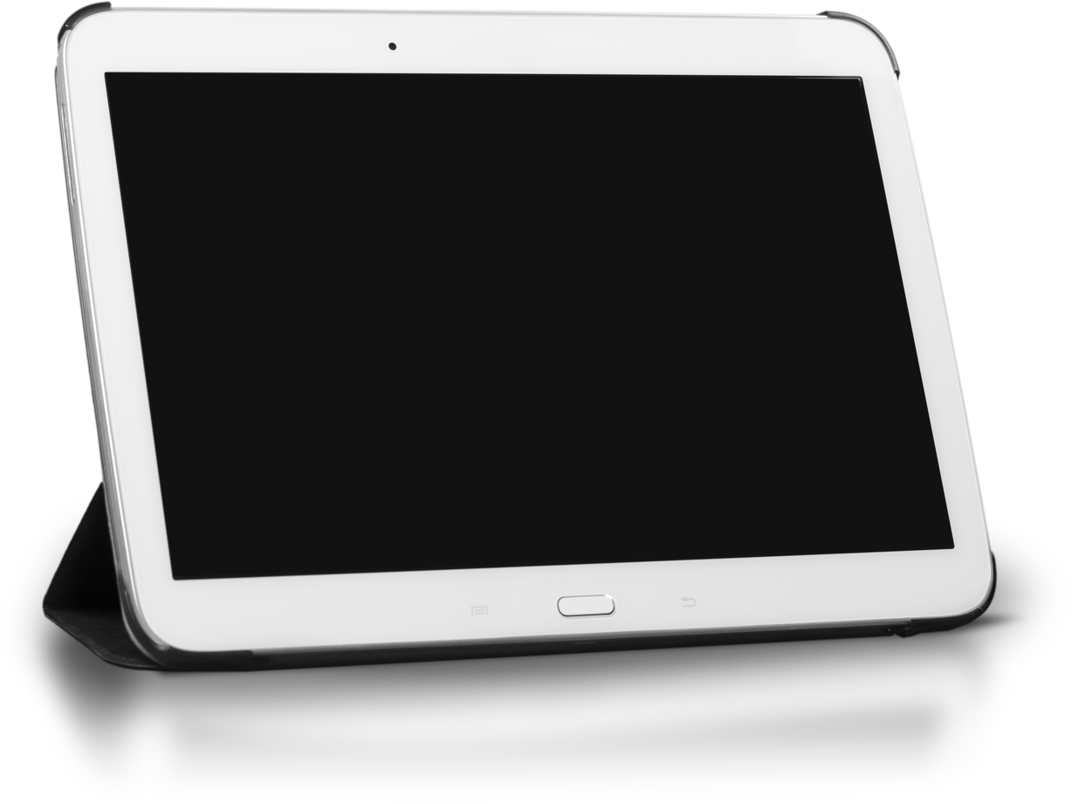
PLAN YOUR DESIGN

Slide 11
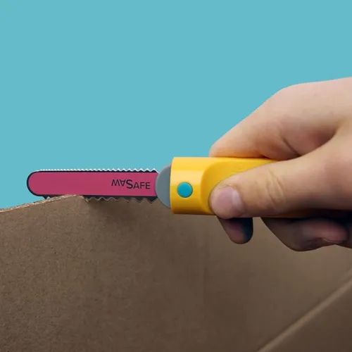
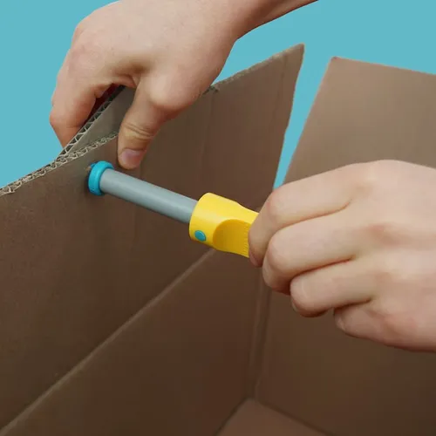
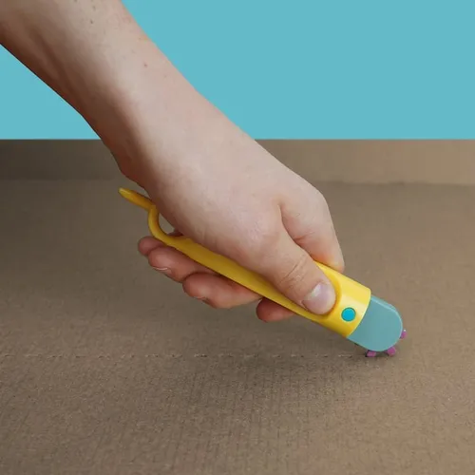
BUILD!
REVIEW SAFETY PROTOCOLS

Slide 12
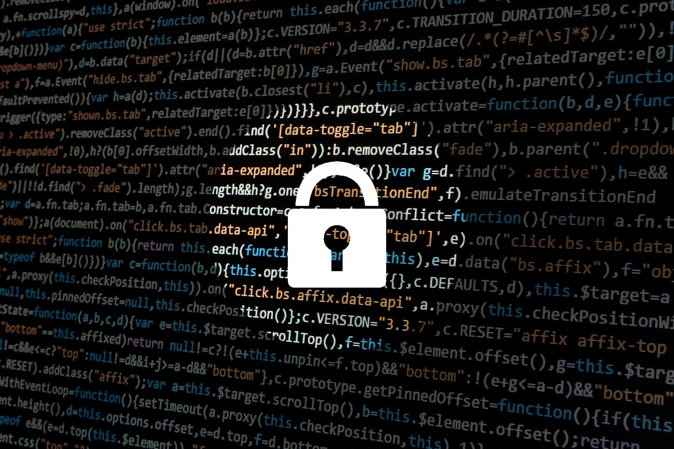
SHARE AND TEST
  ONE STRENGTH
  ONE VULNERABILITY
  ONE SUGGESTED IMPROVEMENT
WHAT IS?

Slide 13
REFLECT
Which security feature in your design do you think was the most effective at protecting the password? Why?
Where do you think your system was most vulnerable to attack? How might a hacker try to break in there?
How did building physical layers (like the firewall or encrypted compartment) help you understand digital security concepts?
What challenges did you face while designing or building your system, and how did you solve them?
If you were to improve your design, what would you add or change to make it stronger?

