Slide 1




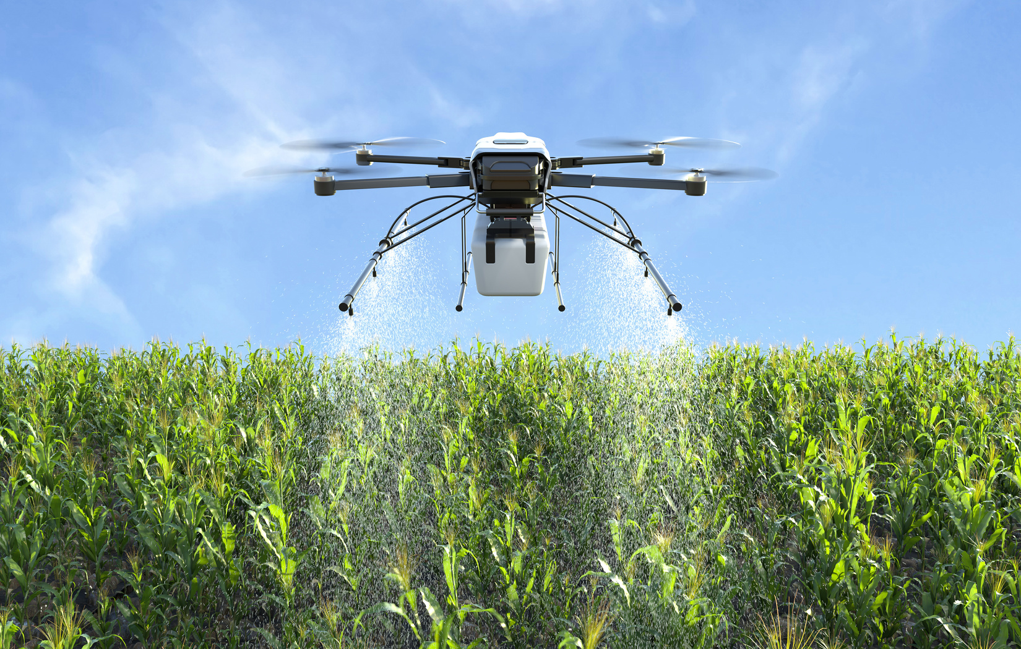

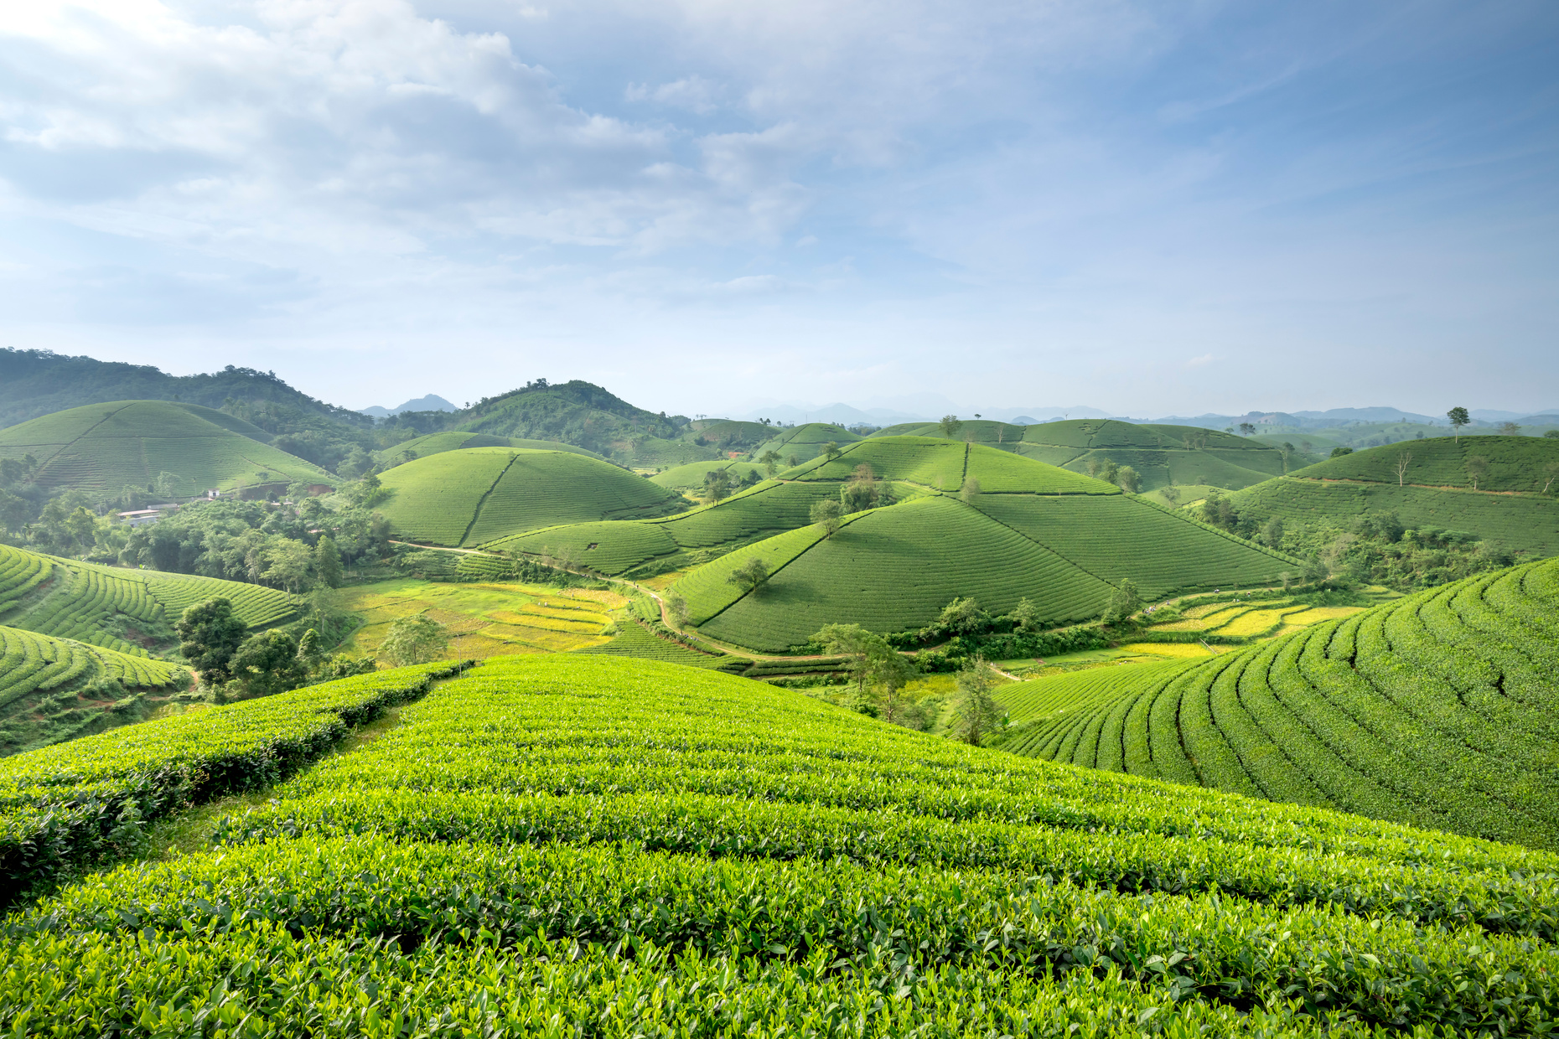
CLIMATE CHANGE AND AGRICULTURAL FUTURES

Slide 2
TERMS TO KNOW
GROWING DEGREE DAYS
A way to measure how much warmth a plant gets during the growing season. It's like counting "warm points" that plants need to grow and produce crops.
FROST-FREE DAYS
The number of days between the last spring frost and the first fall frost. This is your "safe growing window" when plants won't be killed by freezing temperatures.
SOIL DRAINAGE
How quickly water moves through soil after rain or irrigation. Good drainage means water doesn't pool on the surface or stay trapped underground.
SLOPE
How steep or tilted the land is. Flat land has 0% slope, while a steep hill might be 15-30% slope.

Slide 3


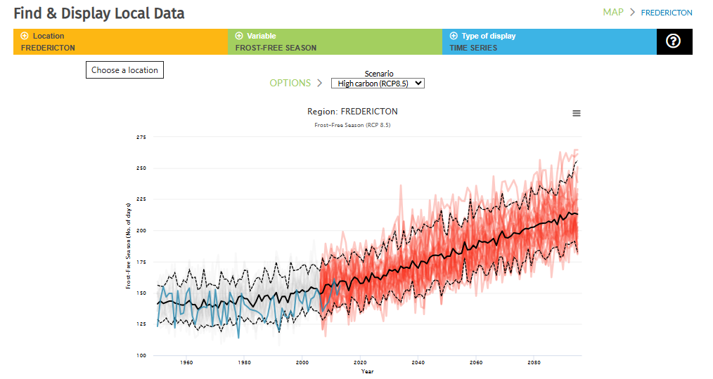

HISTORICAL DATA

Slide 4
HISTORICAL COMPARISON
FROST-FREE DAYS
Location | 1970s Frost-Free Days | 2020s Frost -Free Days | Change
Northern NB | ~110 Days | ~120 Days | +10 Days
Central NB | ~120 Days | ~130 Days | +10 Days
Southern NB | ~125 Days | ~135 Days | +10 Days

Slide 5
HISTORICAL COMPARISON
GROWING DEGREE DAYS
Location | Historical Average | Recent Average | Trend
Northern NB | ~1200 GDD | ~1350 GDD | Increasing
Central NB | ~1400 GDD | ~1550 GDD | Increasing
Southern NB | ~1500 GDD | ~1650 GDD | Increasing

Slide 6
FUTURE PROJECTION
2050
Location | Projected Frost-Free Days | Projected GDD
Northern NB | 135-145 Days | 1600-1700
Central NB | 145-155 Days | 1800-1900
Southern NB | 150-160 Days | 1900-2000

