Slide 1
3 - 5 Energy-Efficient Gingerbread House Challenge
Happy Building!

Slide 2
What is energy-efficiency?
Upgrade appliances and home products that use less energy
Change our daily habits
Spread the word
It’s like a GIFT to our Earth!
To: Earth

Slide 3
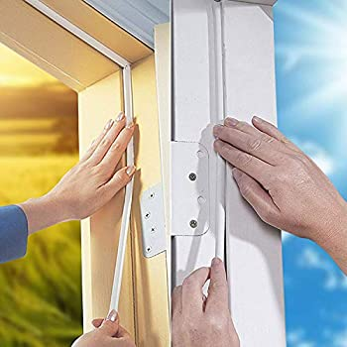
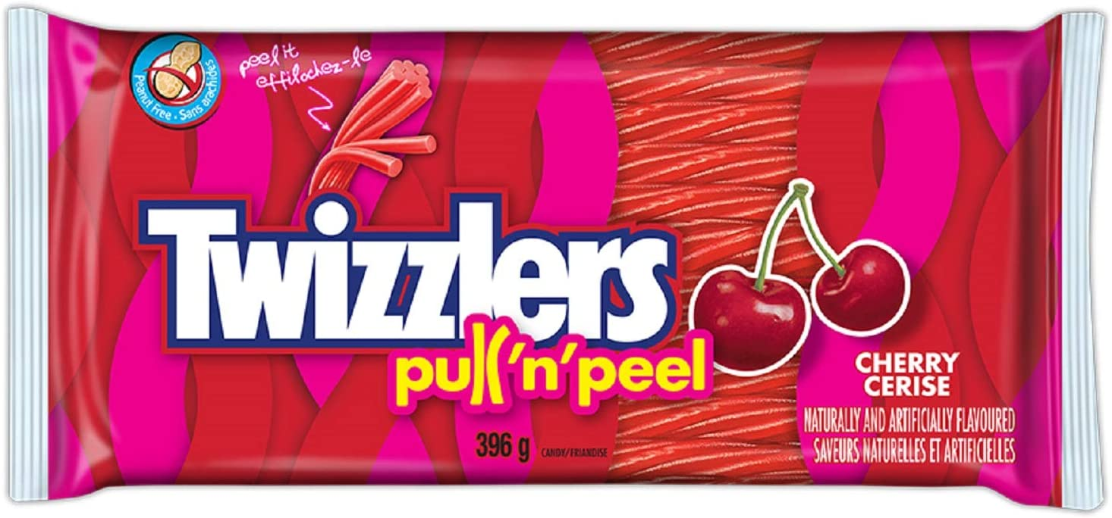
Weather Stripping

Slide 4
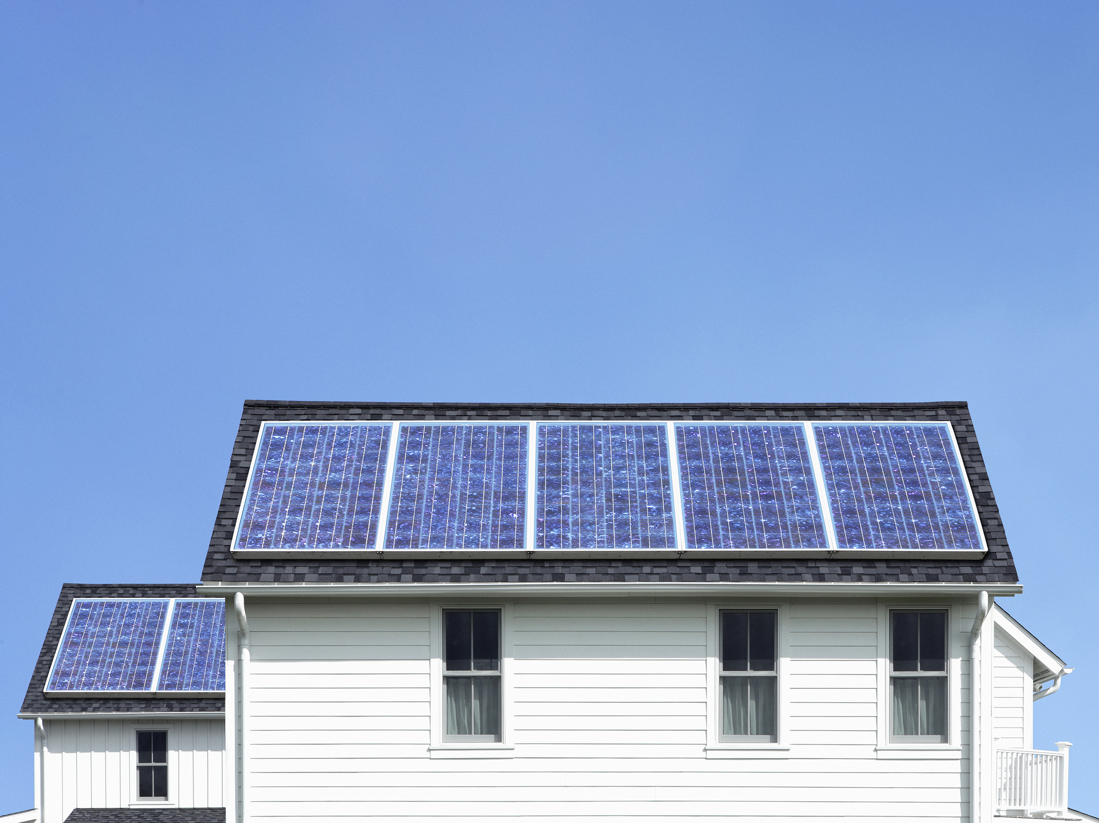
Solar Panels

Slide 5
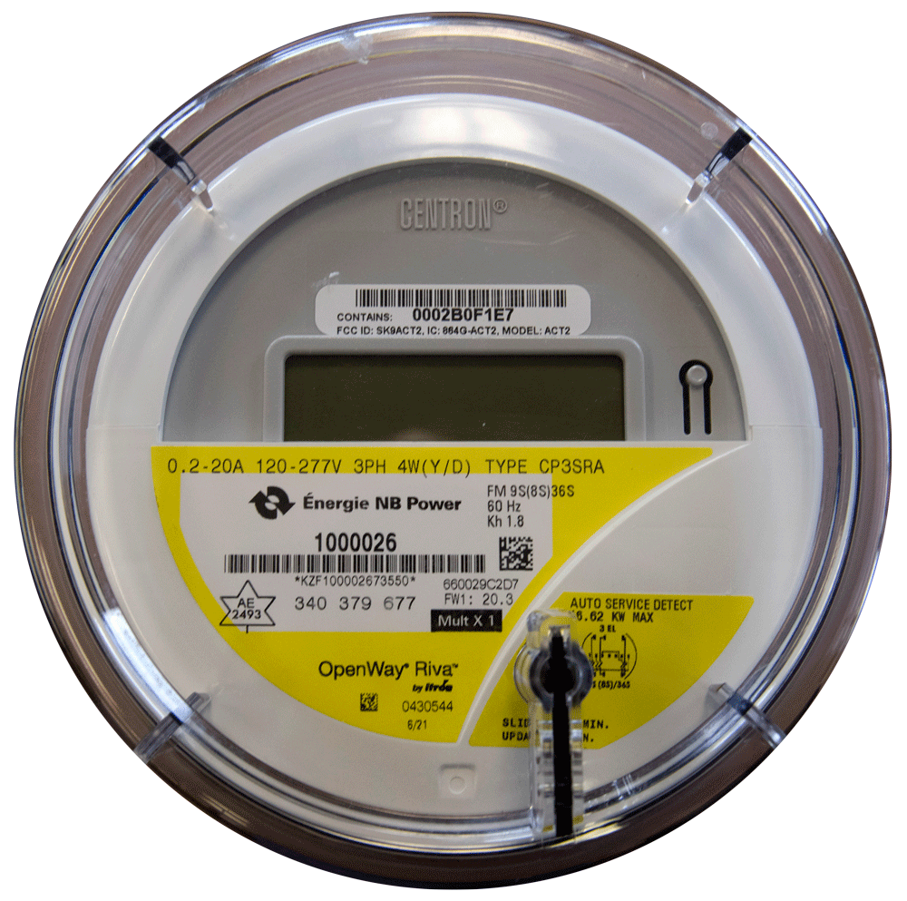
Smart Meter

Slide 6
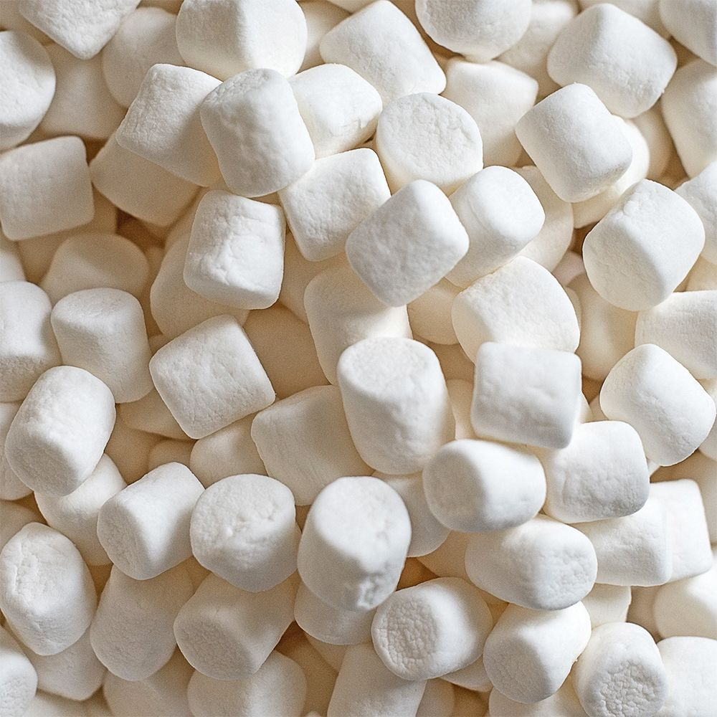
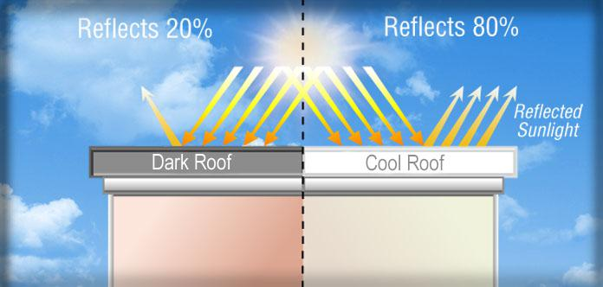
Cool Roof

Slide 7
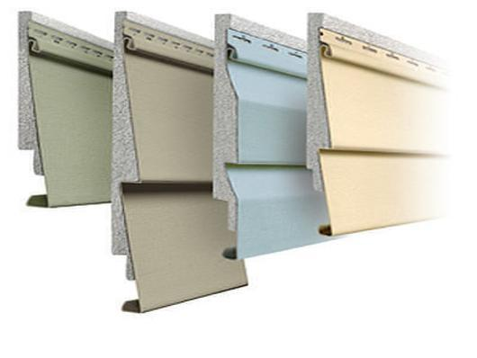
Insulated Vinyl Siding

Slide 8
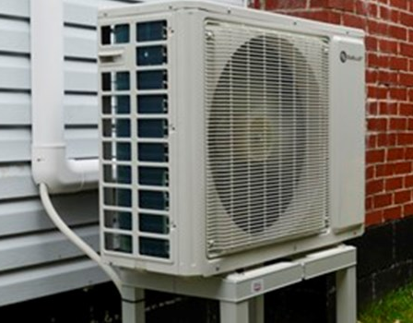
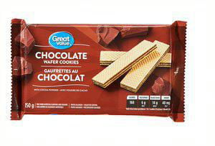
Heat Pump

Slide 9
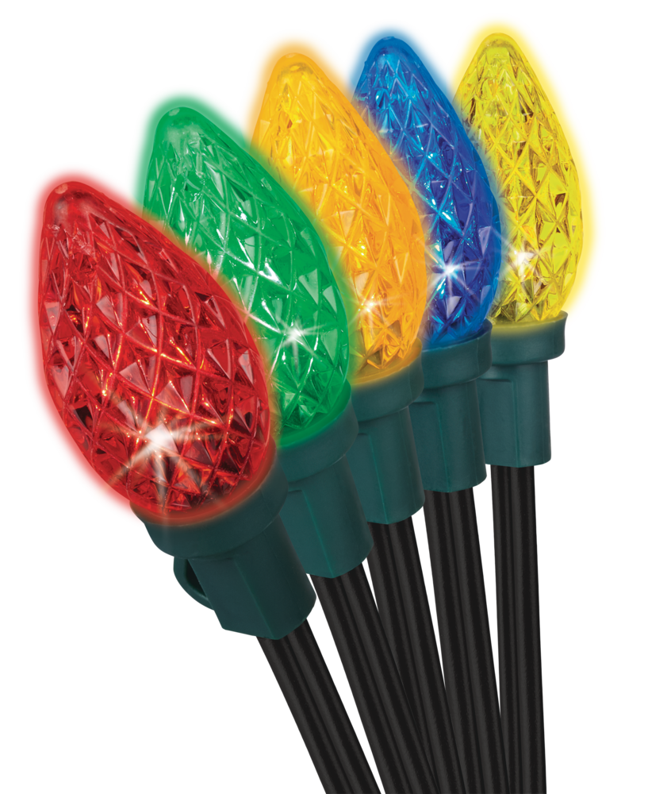
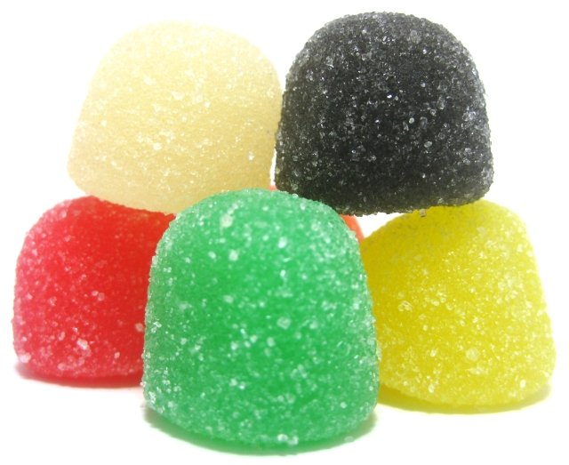
LED Lights

Slide 10
Bonus Energy-Efficient Products
Compost Box
Rain & Snow Barrel
Solar Landscape Lighting
Windmill
Your Own Idea

Slide 11
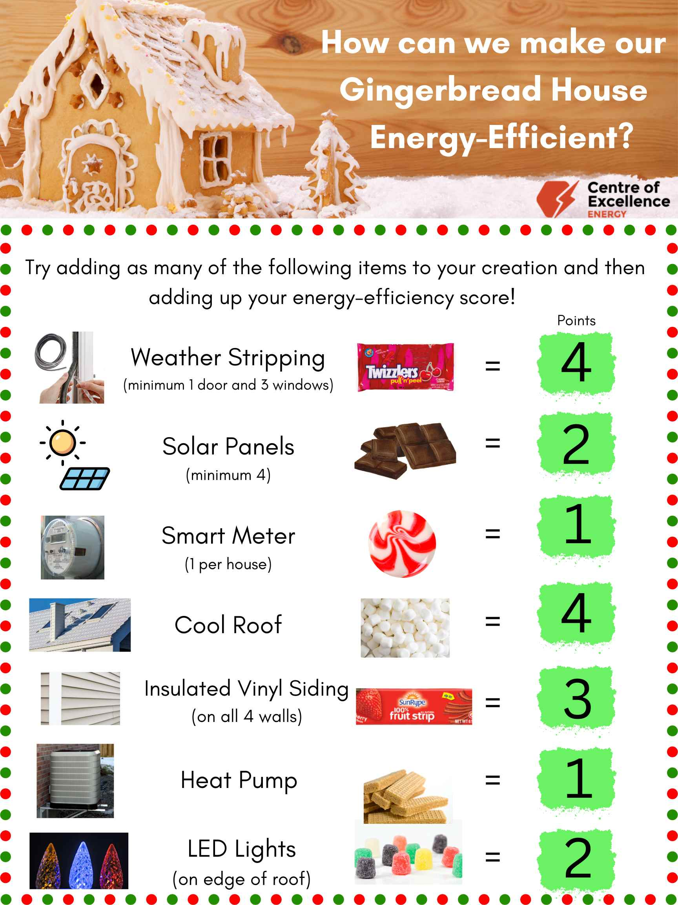
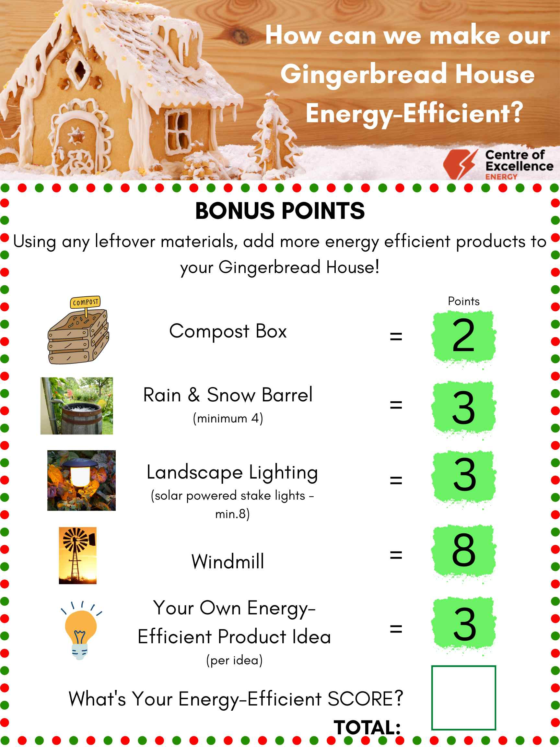
Building Time

Slide 12
3-5 Energy-Efficient Gingerbread House Challenge
Thank You & Happy Holidays!
For more opportunities like this, check out our website:
centresofexcellencenb.ca

