Slide 1
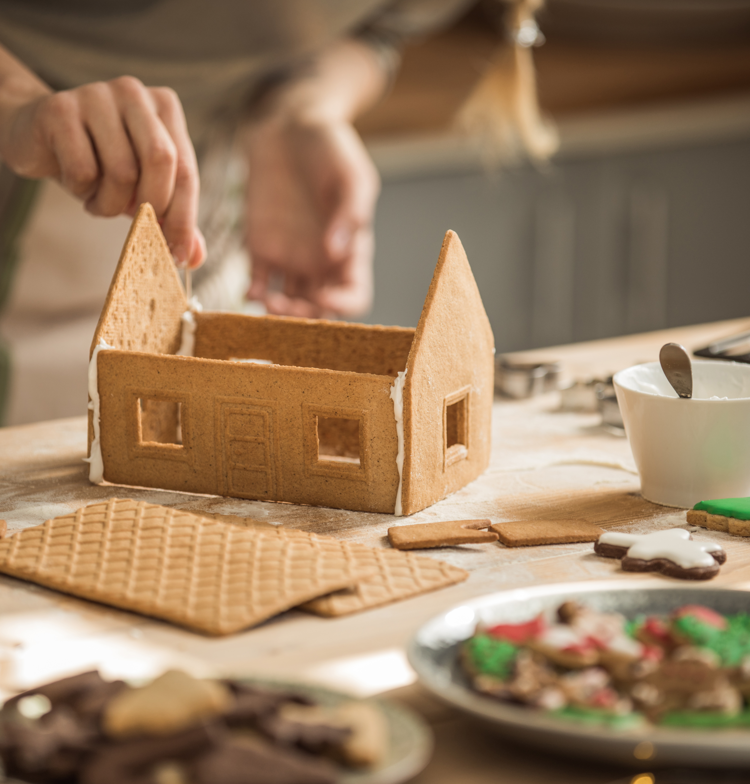

3 - 5 Energy Efficient Gingerbread House Challenge
Happy Building!

Slide 2



What is energy-efficiency?
Upgrade appliances and home products that use less energy
Change our daily habits
Spread the word
It’s like a GIFT to our Earth!
To: Earth

Slide 3

Energy Efficiency in NB
Miles Goff – NB Power

Slide 4
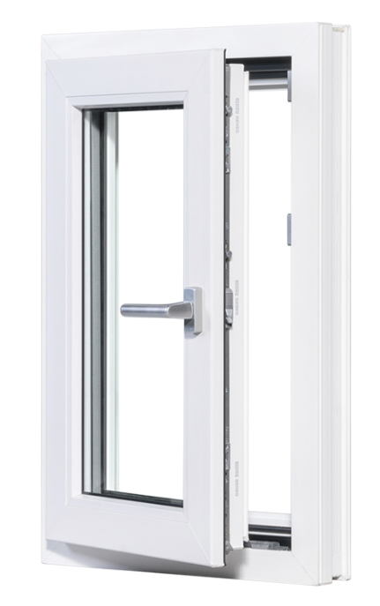
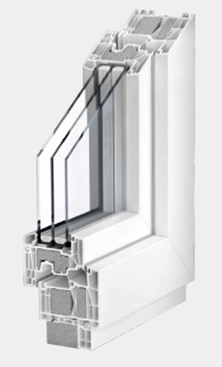
What is energy efficiency?
Using less energy to get the same job done
Image credit: NZP Fenestration

Slide 5



Renewables
Energy Efficiency
Energy Conservation
OFFSET
Renewables to offset efficient, necessary grid-energy
Built from the bottom up
USE
Upgrading equipment, using energy as efficiently as possible
WASTE
Habits, behaviour, how you operate (best way to save energy is to not use it)
7

Slide 6
Energy efficiency and the climate crisis
Notes:
Energy efficiency can slash energy use and greenhouse gas emissions by about 50% by 2050, getting us halfway to our climate goals. - ACEEE

Slide 7
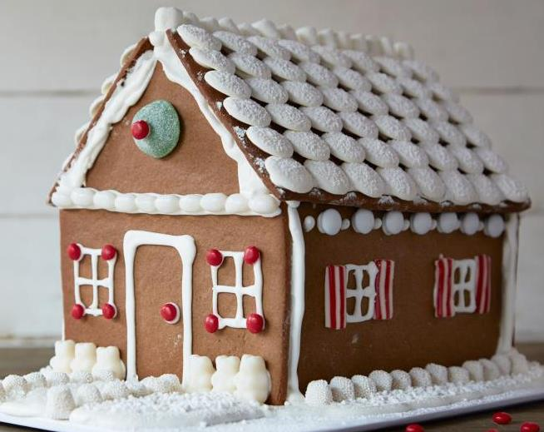
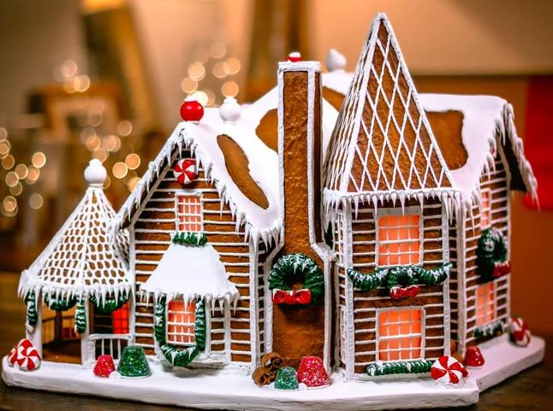
Which has more heat loss?
Image credit: The Food Network and Etsy

Slide 8
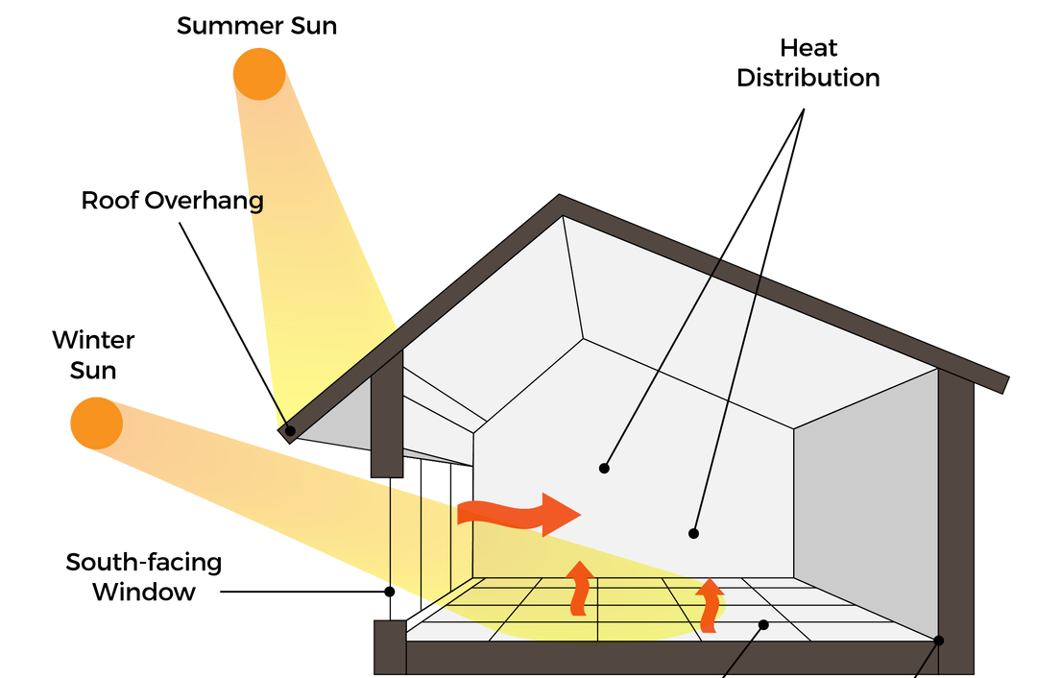
Image credit: M A Building

Slide 9
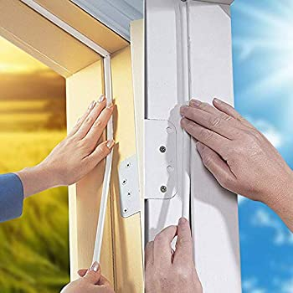
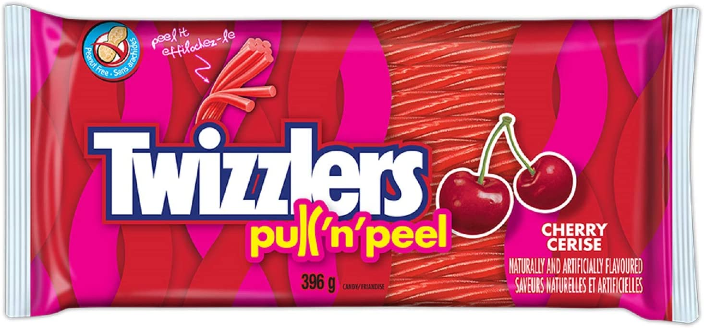
Weather Stripping

Slide 10
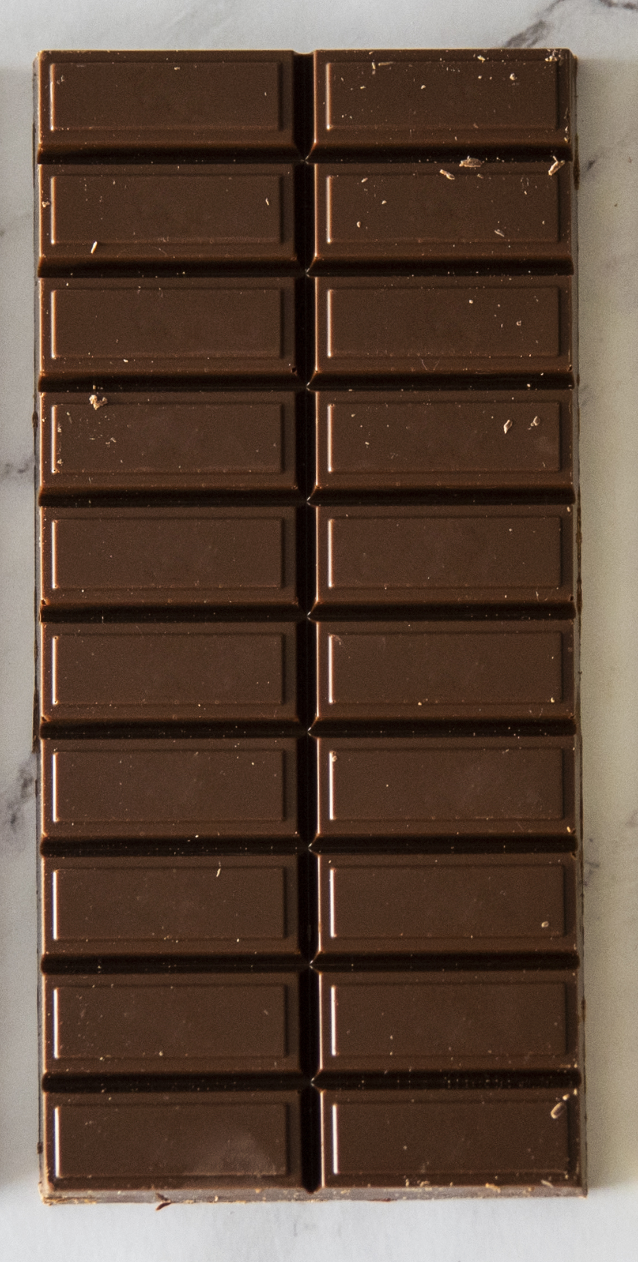
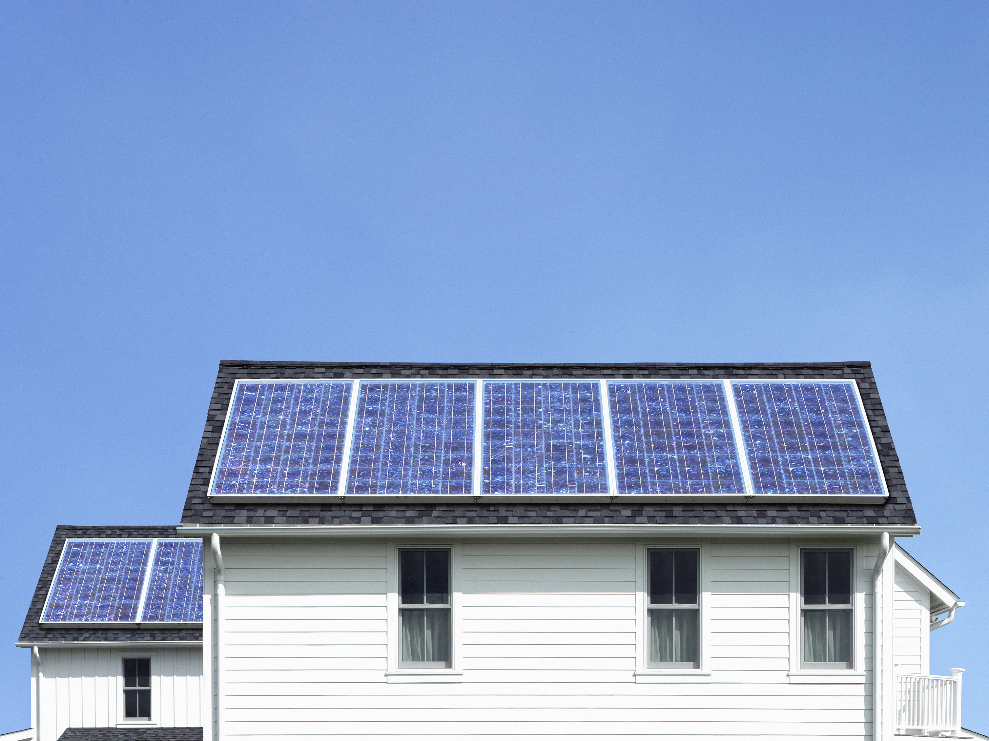
Solar Panels

Slide 11
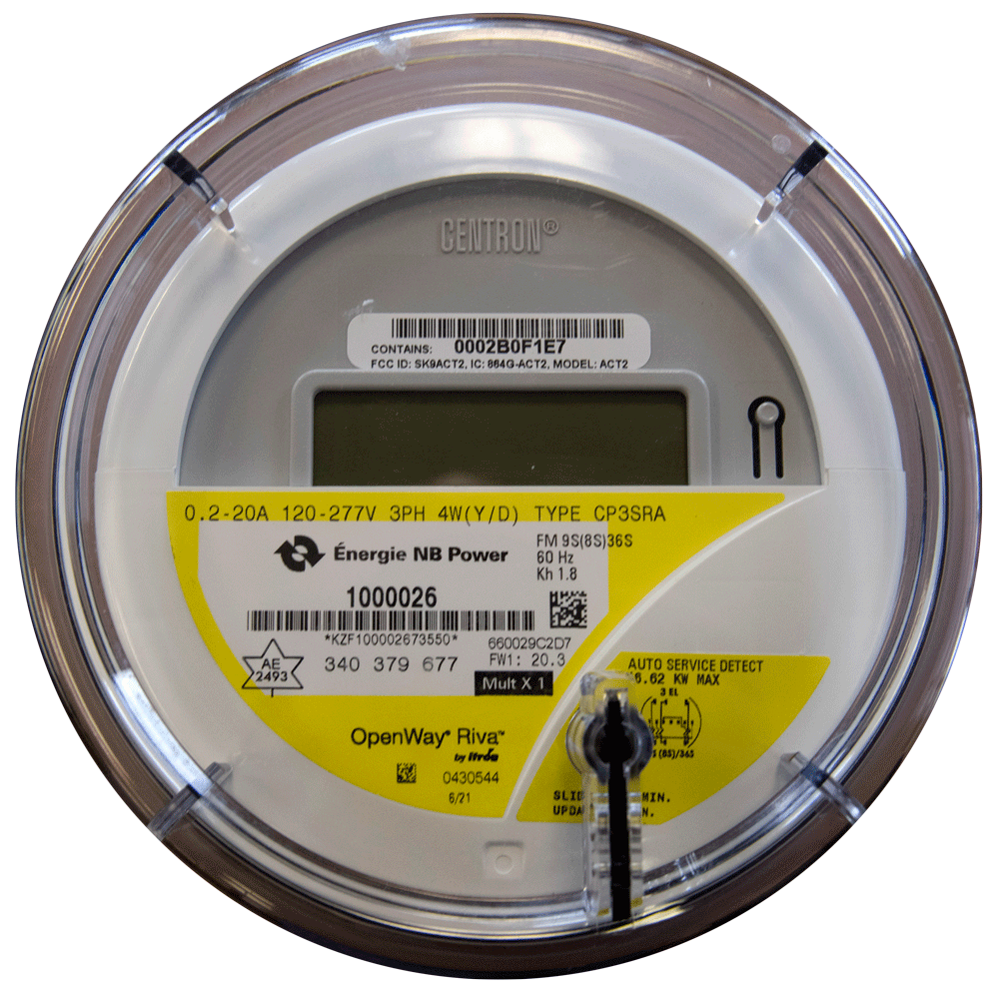
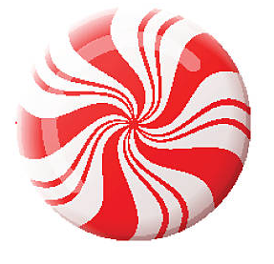
Smart Meter

Slide 12
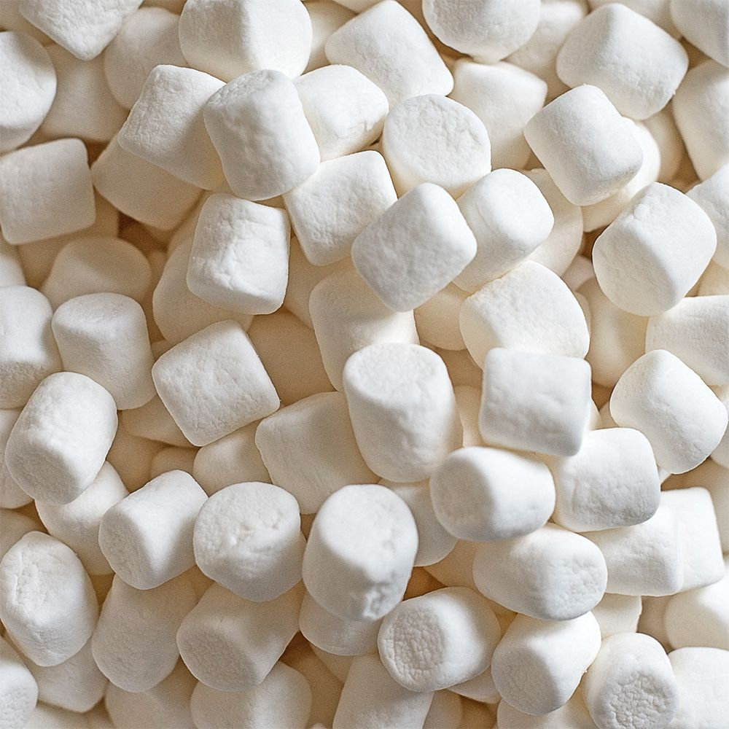
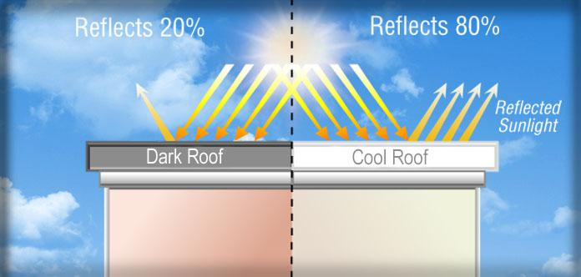
Cool Roof

Slide 13
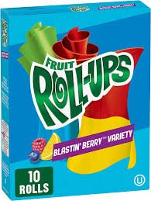
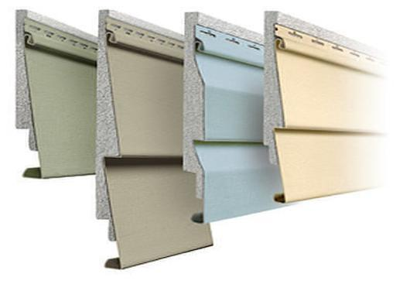
Insulated Vinyl Siding

Slide 14
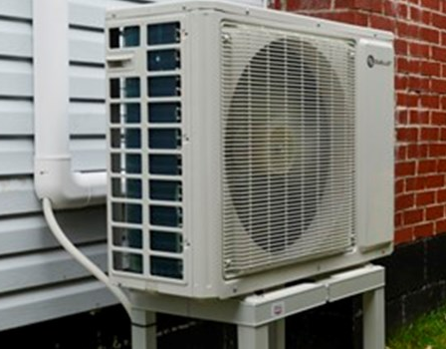
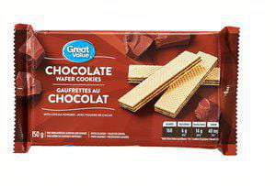
Heat Pump

Slide 15
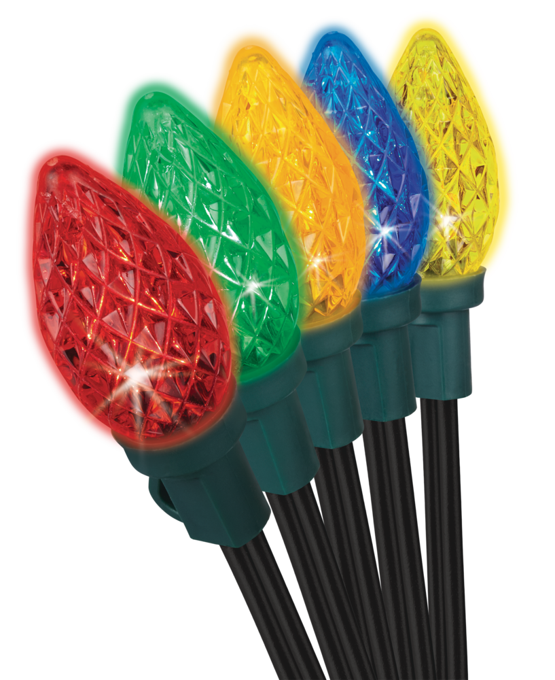
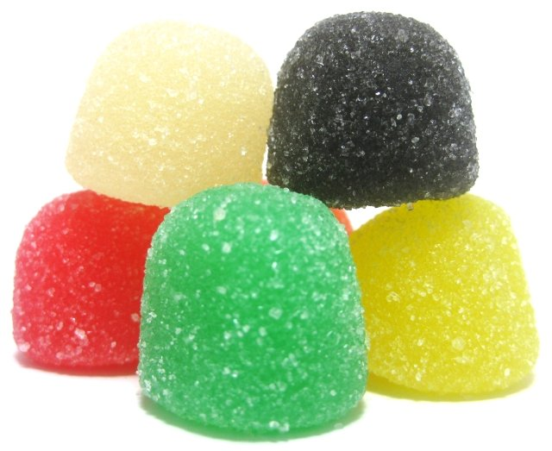
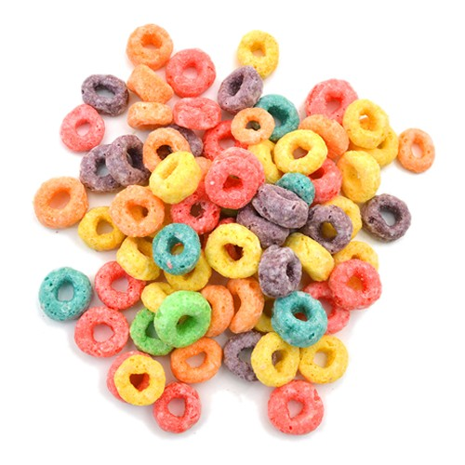
LED Lights

Slide 16
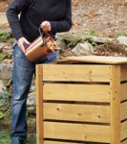
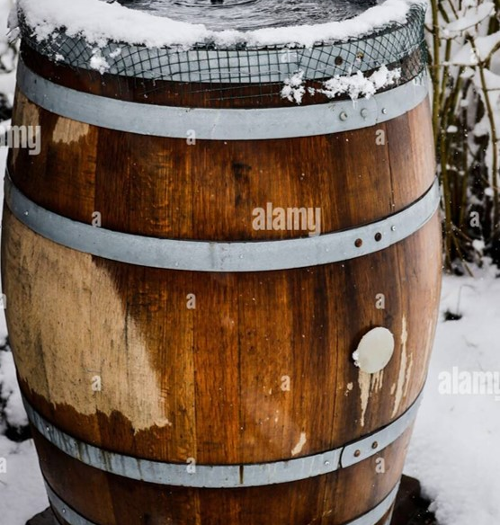
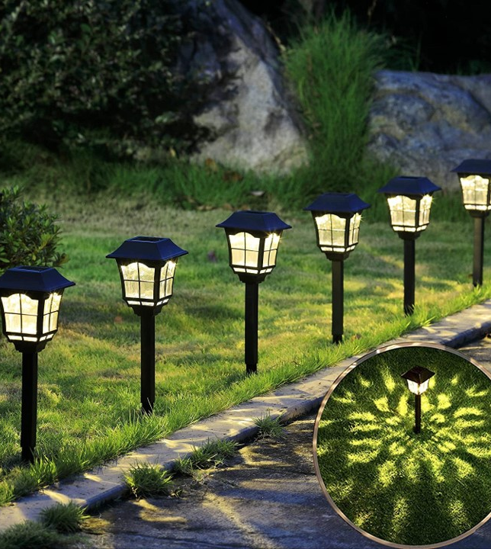
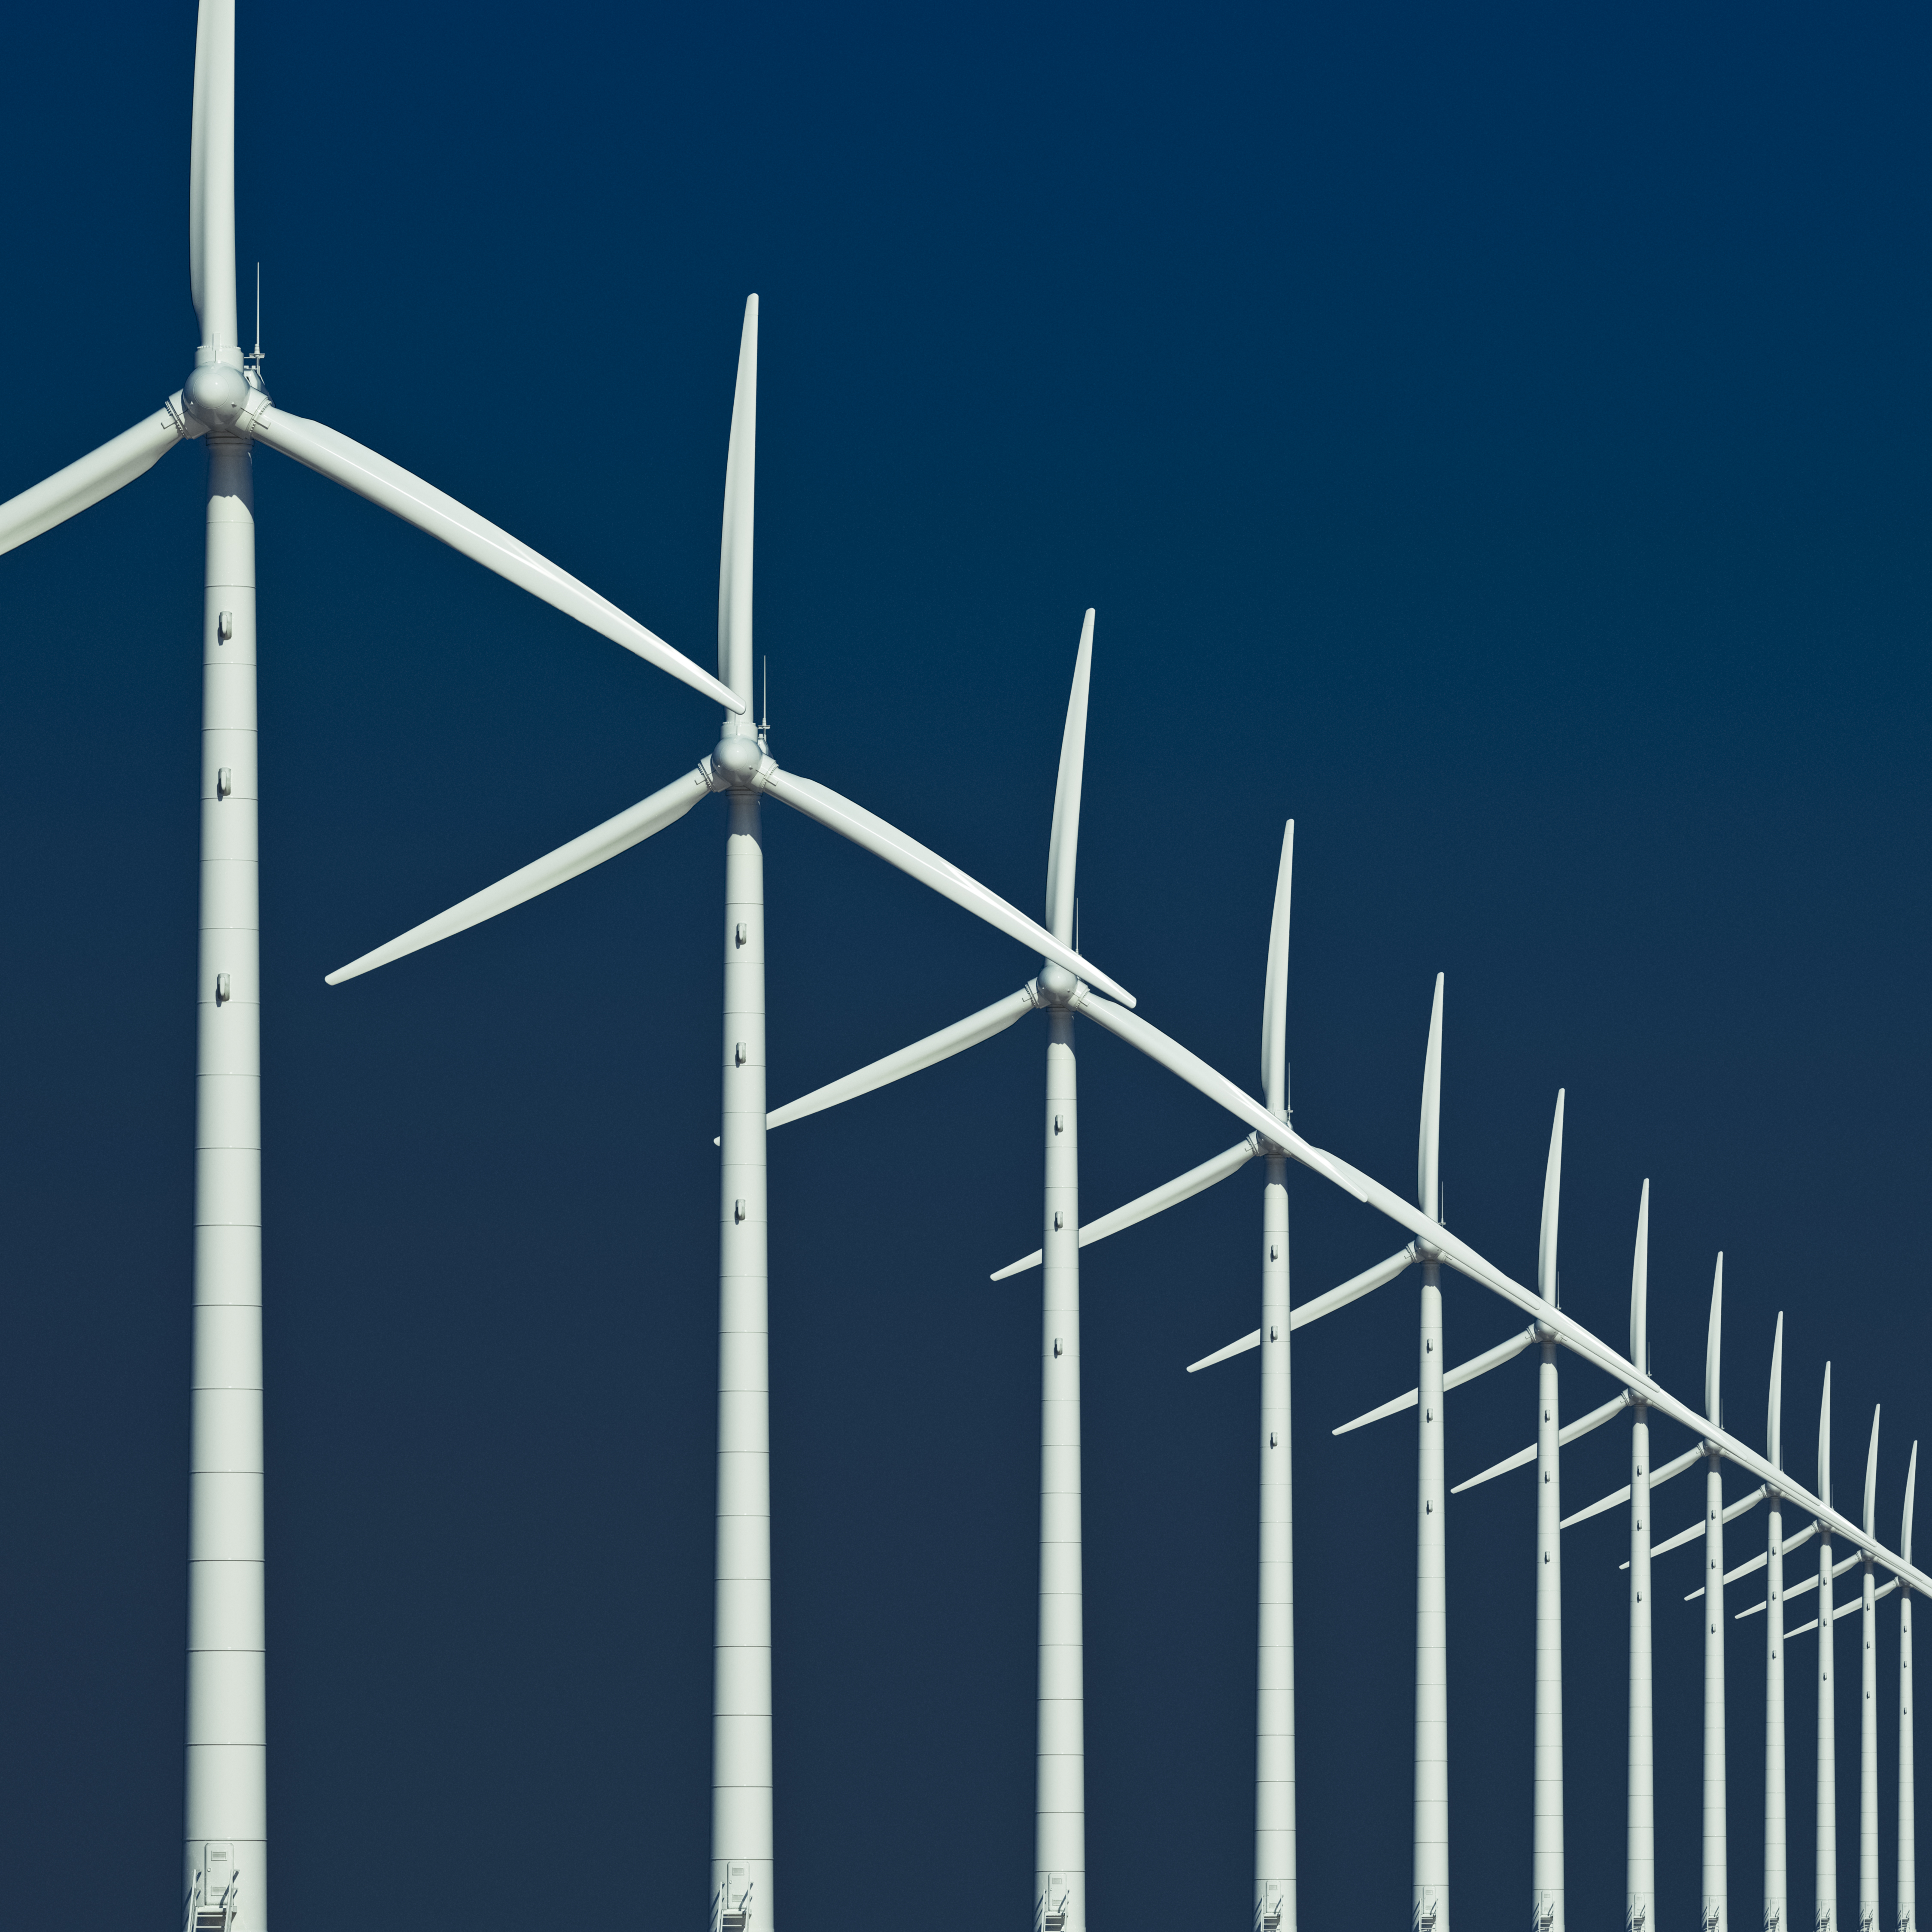

Bonus Energy-Efficient Products
Compost Box
Rain & Snow Barrel
Solar Landscape Lighting
Windmill
Your Own Idea

Slide 17
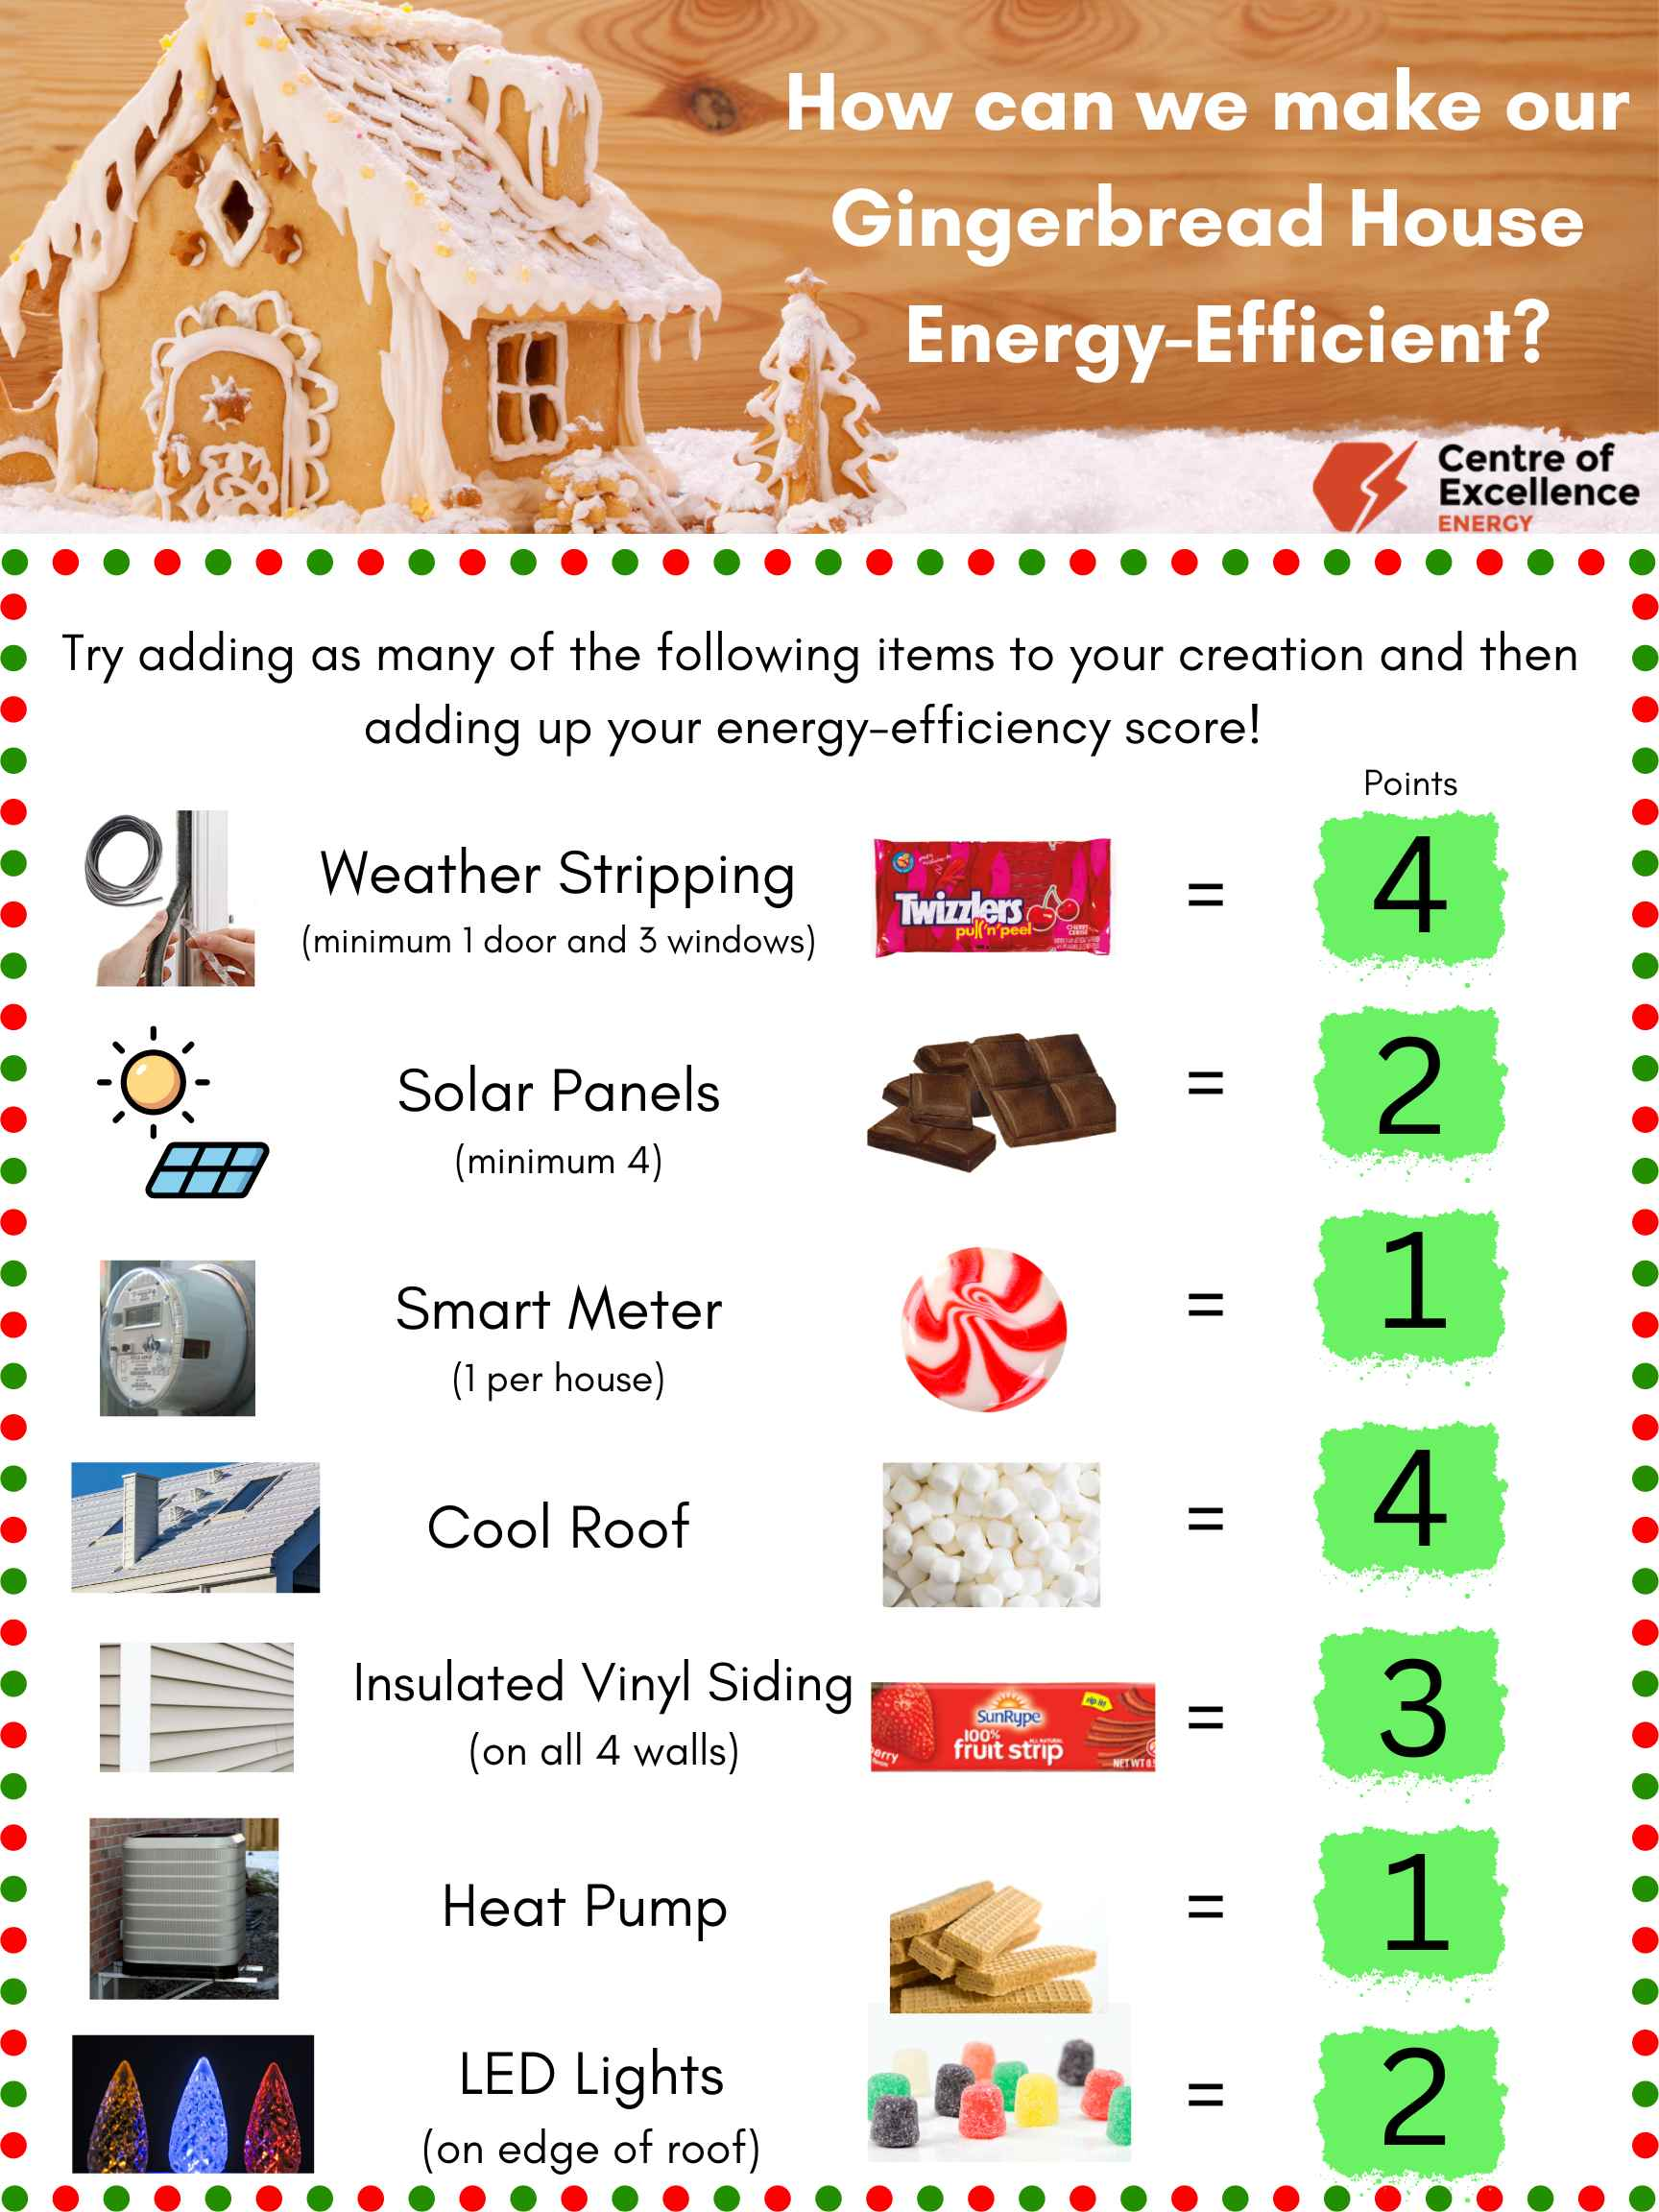
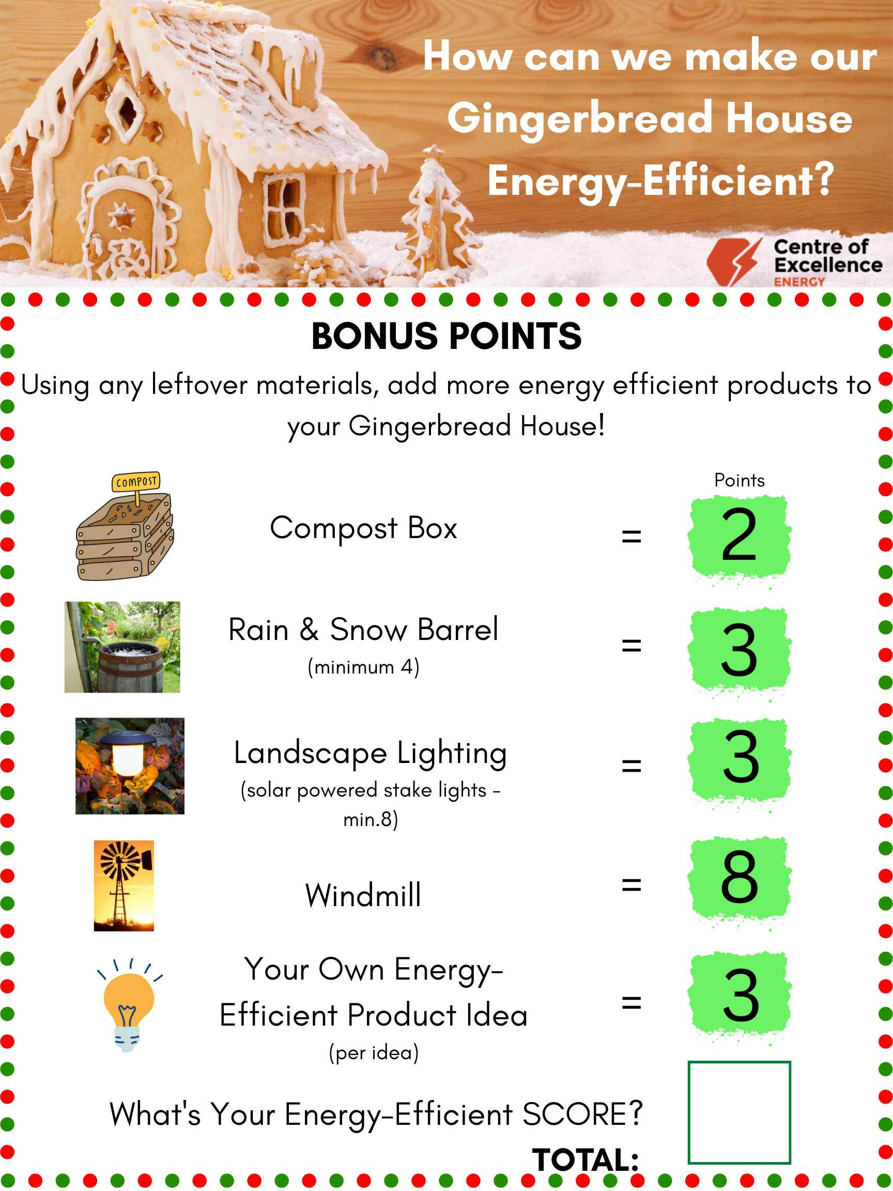
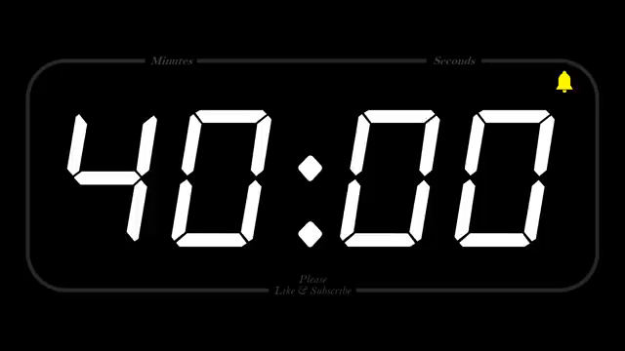
Building Time

Slide 18
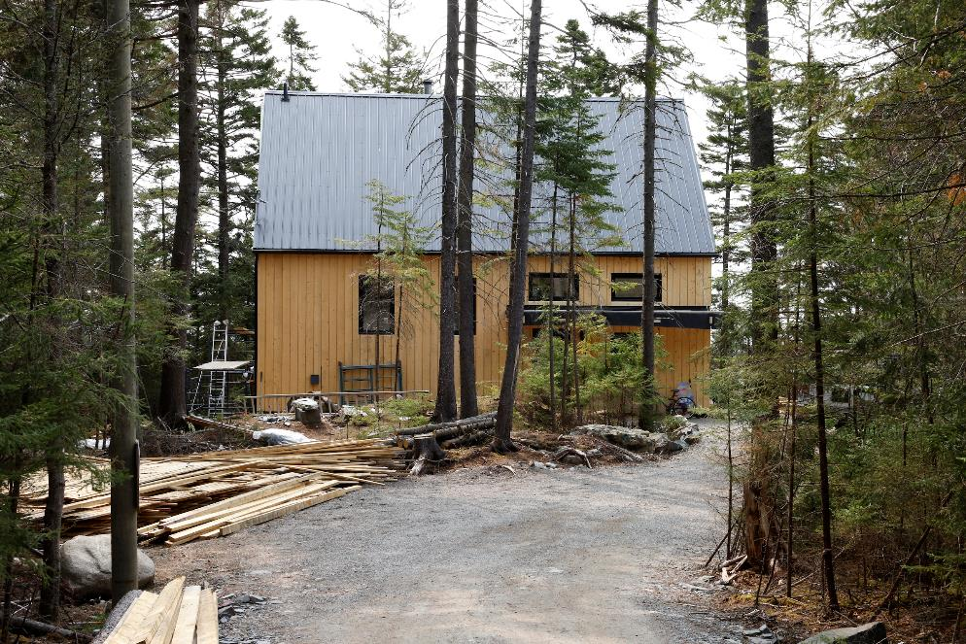
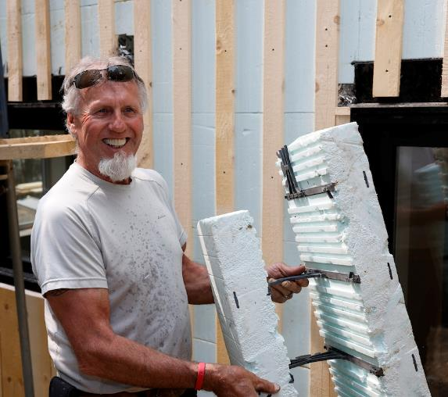
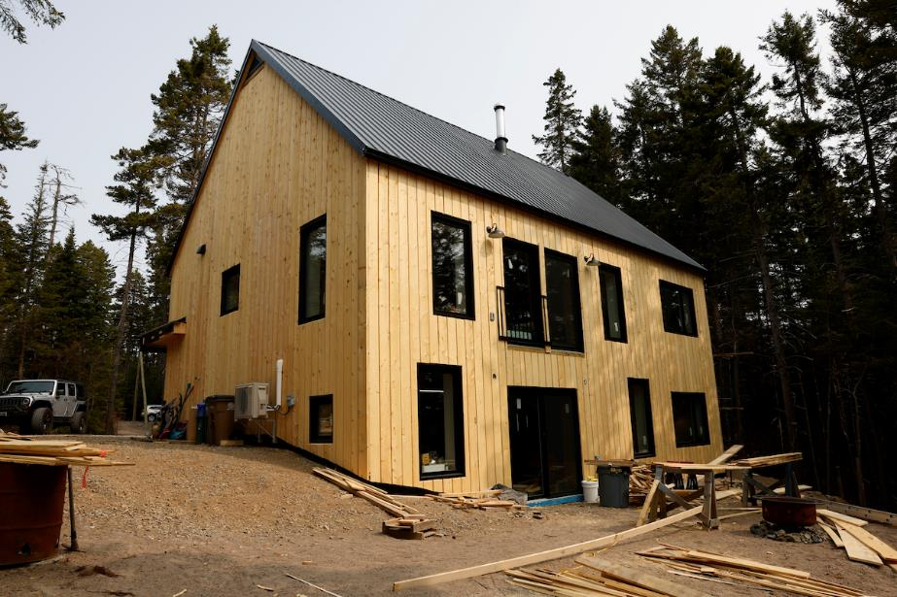
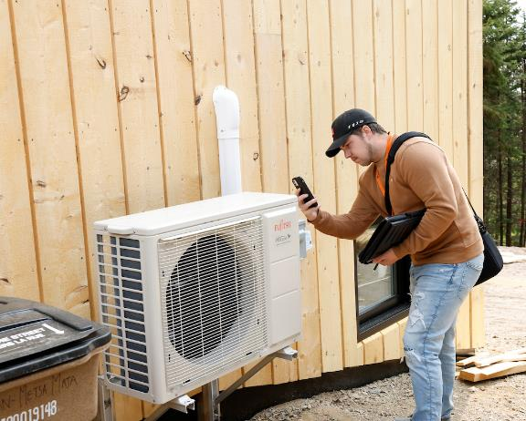

Slide 19


3-5 Energy-Efficient Gingerbread House Challenge
Thank You & Happy Holidays!
For more opportunities like this, check out our website:
centresofexcellencenb.ca

