Slide 1
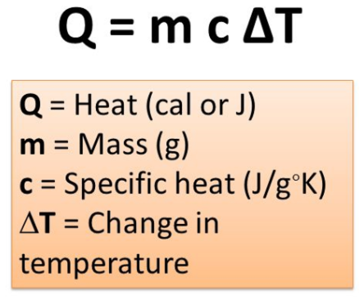
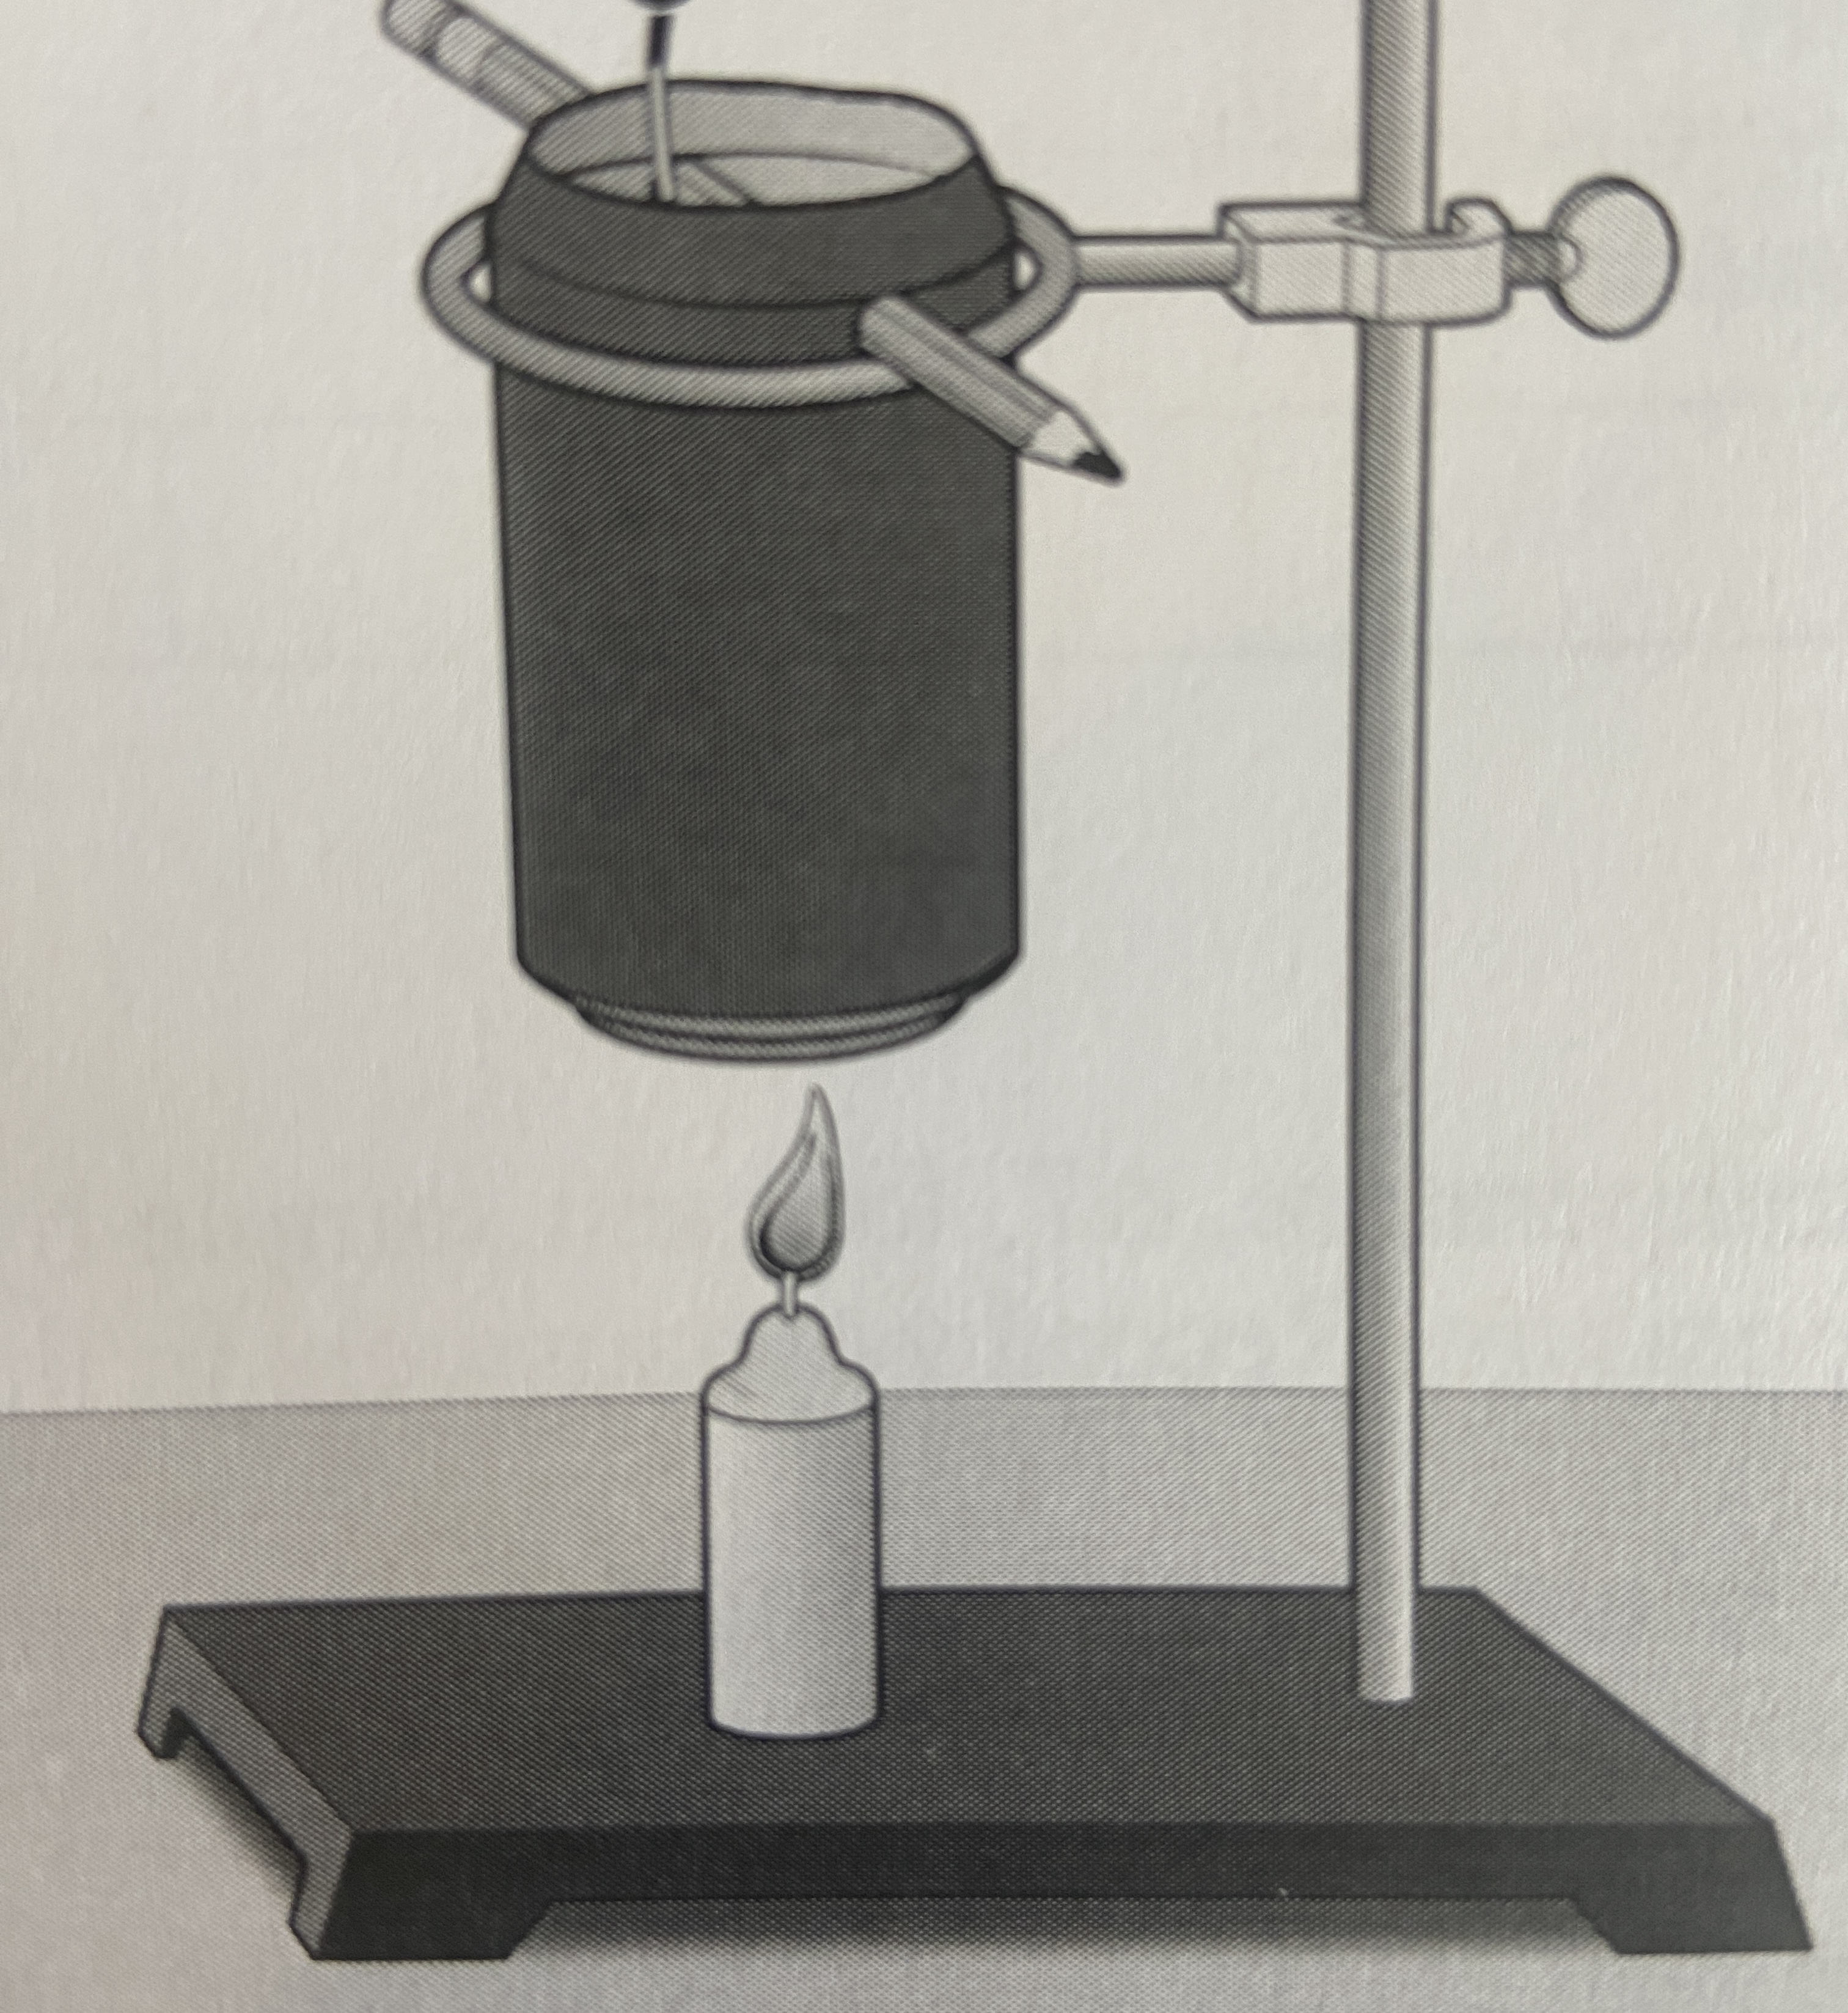
Lab: What is Energy
name: ________________ date: ______________
Energy is involved in everything that happens, from the tiniest insect moving one antenna to a massive eruption of a volcano that spreads ash around the globe. Energy is constantly being transferred and transformed.
In order to be able to compare energy sources more easily, conversion into measurements of a common unit is necessary. The SI unit for energy is the joule (J).
In this experiment, you will determine the energy content in J/g of a fuel. You will do this by burning a known mass of the fuel and calculating the heat transferred to a known mass of water in a can. If you measure the initial and final temperatures, the energy transferred can be calculated using the equation
The specific heat capacity c = 4.18 J/g⁰C for water.
Dividing the energy value by grams of fuel burned gives
the energy content per unit of mass.
Procedure
Set up apparatus to hold candle and can.
Measure and record the initial mass of the candle assigned to you.
Measure the mass of the empty can.
Place 50ml of cold water into the can.
Measure and record the mass of the can plus water.
Suspend the can about 5cm above the candle.
Use a clamp to suspend a thermometer in the water. The thermometer should not touch the bottom or sides of the can!
Monitor the temperature for about 20 seconds and record the initial temperature of the water in the data table.
Light the candle.
Heat the water, stirring with a stirring rod until the temperature stops rising (about 35⁰ C).
Extinguish the flame.
Record the final temperature.
Measure the final mass of the candle and record in the data table.

Slide 2
name: ________________ date: ______________
Data
Initial mass of candle (g)
Final mass of candle (g)
Mass of candle burned (g)
Mass of empty can (g)
Mass of can plus water (g)
Mass of water heated (g)
Initial water temperature (⁰C)
Final water temperature (⁰C)
Change in water temperature (⁰C)
Heat energy gained by the water (J)
Energy content of the candle fuel (J/g)
Calculations
Calculate the mass of the candle burned. Subtract the final mass from the initial mass. Record your answer in the data table.
Calculate the mass of water heated. Subtract the mass of the empty can from the mass of the can plus water. Record your answer in the data table.
Calculate the change in water temperature by subtracting the initial temperature from the final temperature. Record your answer in the data table.
Use the equation $Q=mcΔT$ to determine the heat energy gained by the water (in J). Remember that c = 4.18 J/g⁰C for water.
Calculate the energy content of the candle fuel. Divide the heat energy gained by the mass of candle burned.
Analysis Questions
Compare your results with a few other groups. Why might they be different.
Did all the energy from the candle get transferred into the water? Explain.
How do the energy content values for the fuels in the table on the right compare to the energy content of a candle?
Which fuel(s) do you use to heat your home?
Material | Energy Content
Natural gas | 53,600 J/g
Heating oil | 46,200 J/g
Wood | 16,000 J/g
Uranium | 500,000,000 J/g

