Slide 1
Solar Car KITS

Slide 2
Why Solar Kits?
Supports Inquiry Based Learning
Hands on learning
Can be adaptable to help students meet multiple achievement indicators as outlined in the New Holistic Curriculum
Can be scaled up or down depending on instructional goals
Ease of use
Low prep burden

Slide 3
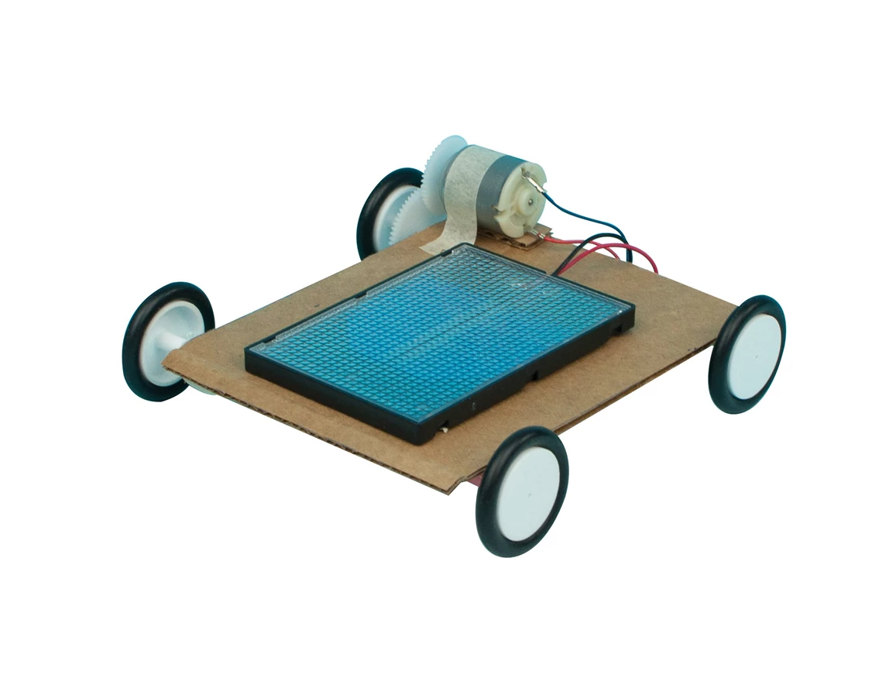
The Solar Car Kits
Each School in Anglophone South will be supplied with two class Solar Car Kits
Kits are created by Flynn Scientific
Your Kit looks a little different than the picture (Yours has a stand made of friction fitted PVC and no gears)

Slide 4
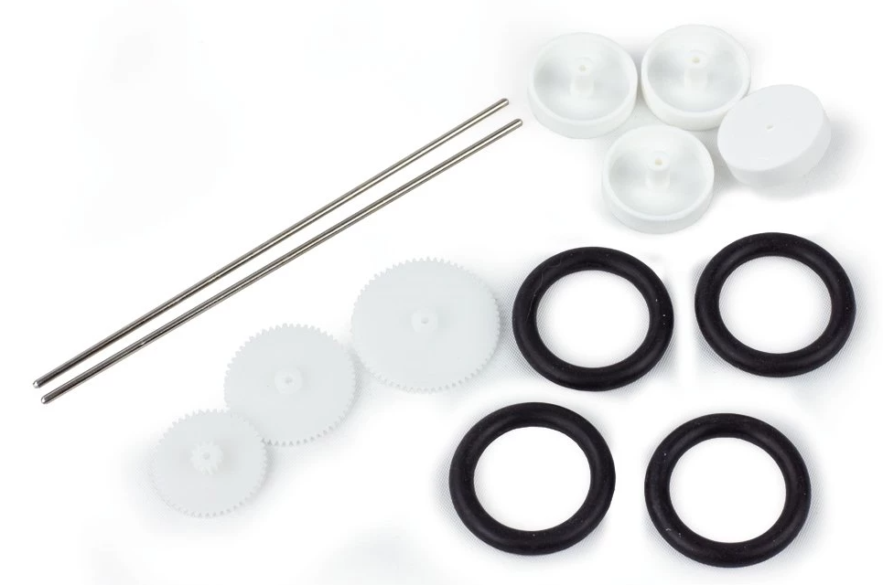
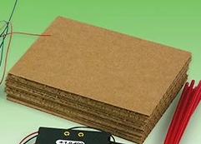
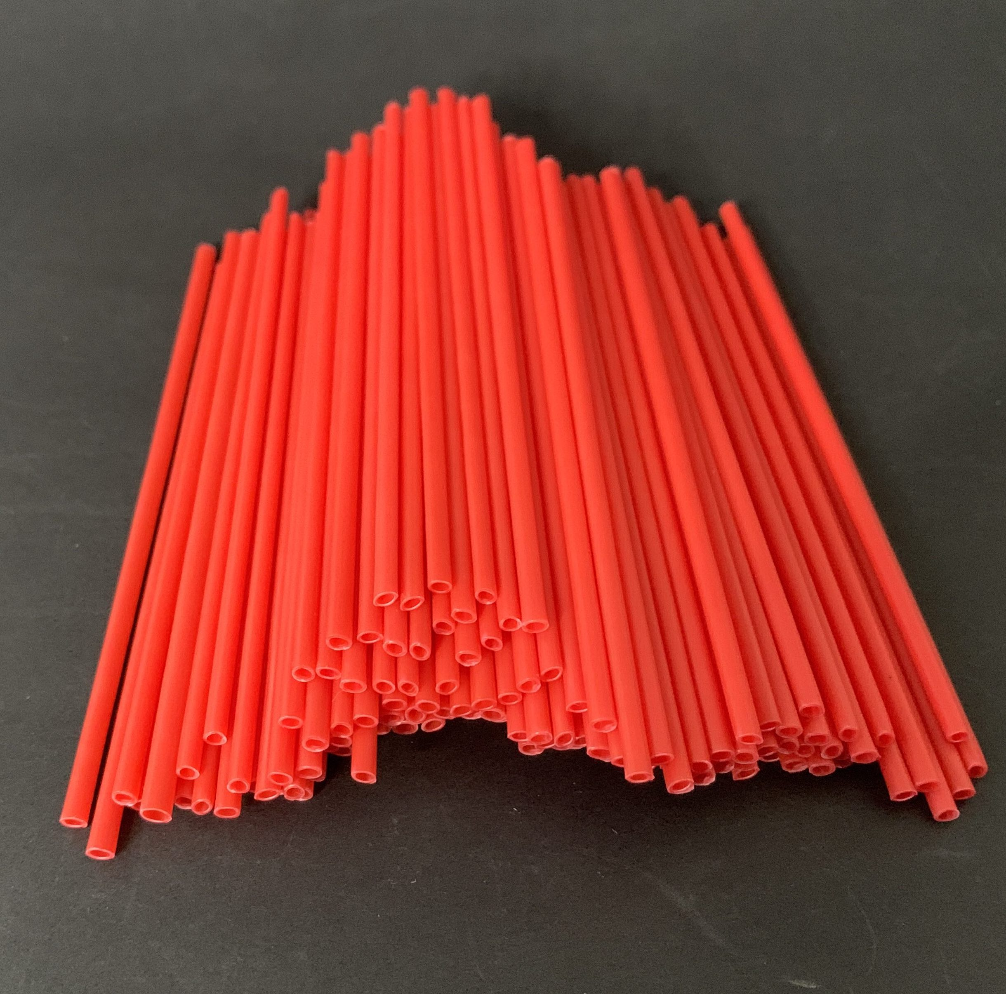
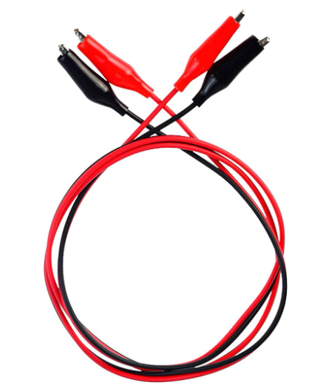
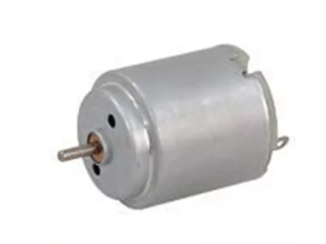
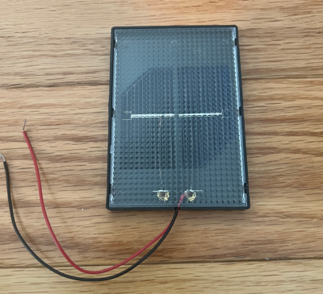
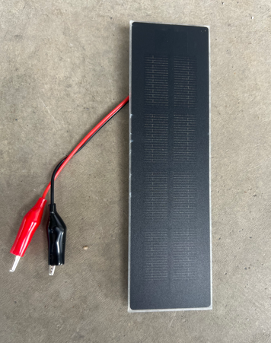
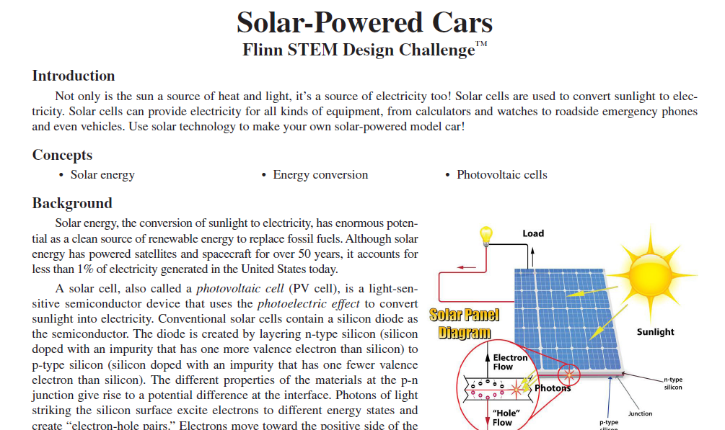
Materials | Consumable (can easily be r-epurchased from Veriner or a Hardwrae Store)
8 x Cardboard Base, 4 ½” x 5 ½” | 8 x Gears & Wheels bag
4 x Long Straws (cut in ½) | 3 x Set Alligator Clips
8 x DC Motor with Wires | 8 x Solar Mini Panel (1 V, 400 mA)
1 x Solar Mini Panel (2 V, 400 mA) | 1 x Instructional Documents

Slide 5
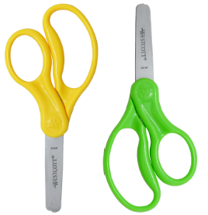
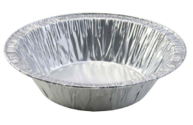
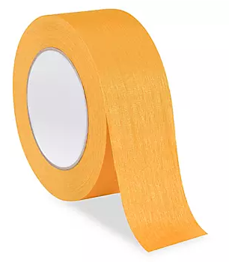
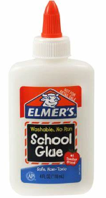
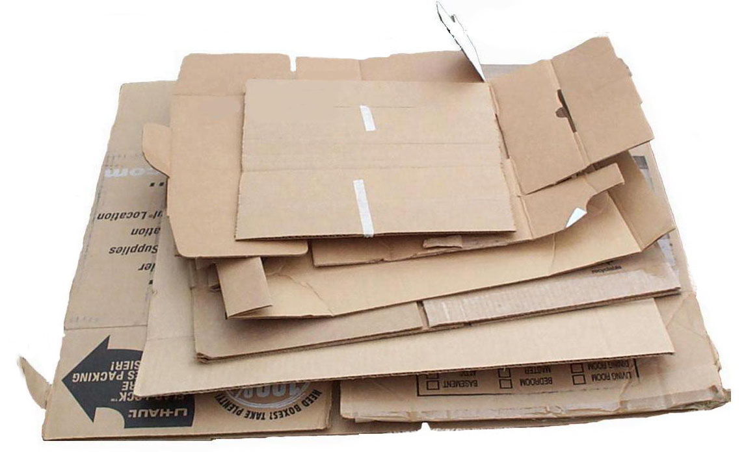

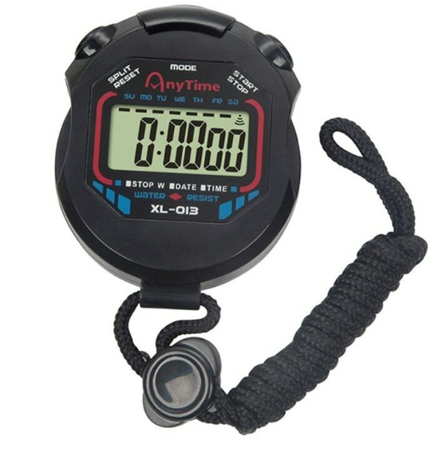
Classroom Materials (Not Included)
Scissors | Other Construction Materials
Glue / Tape | Box Board / Car Stock
Ruler | Stop-Watch

Slide 6
Curricular Alignment

Slide 7
Grade 10 Science
  Strand: Scientific Literacy - Big Idea: Investigation
    Skill Descriptor: Examine questions about relationships between and among observable variables to plan investigations.
  Strand: Scientific Literacy - Big Idea: Investigation
    Skill Descriptor: Collect and represent accurate data using appropriate tools and methods.

Slide 8
  Strand: Scientific Literacy - Big Idea: Sensemaking
    Skill Descriptor: Analyze and interpret qualitative and quantitative data to construct explanations and conclusions.
  Strand: Scientific Literacy - Big Idea: Communication
    Skill Descriptor: Develop scientific collaborative skills during investigations to communicate conclusions supported by data..

Slide 9
  Strand: Learning and Living Sustainably – Big Idea: Relationships Between Science and Technology
    Skill Descriptor: Apply scientific and technological knowledge and understanding of sustainable practices.
  Strand: Learning and Living Sustainably – Big Idea: Relationships Between Science and Technology
    Skill Descriptor: Apply an iterative process to challenges related to sustainable development goals.

Slide 10
SOLAR CAR
CHALLENGE

Slide 11
Instructional Materials
  The included instructions from the manufacturer (Flynn Scientific).
  I will e-mail instructional materials of my own design today which is a more condensed version of the manufactures instructions
  Each school can designate two members of staff to access online materials from Flynn.

Slide 12
The Challenge
The lesson is designed for groups to use the materials presented to design and build solar cars that will travel the fastest over a set amount of time.
This can be amended to your own classroom goals by include constraints
  Example focus on altering the angle of the solar panel
  Constrain what gears can be used
  Control other aspects of the design

Slide 13
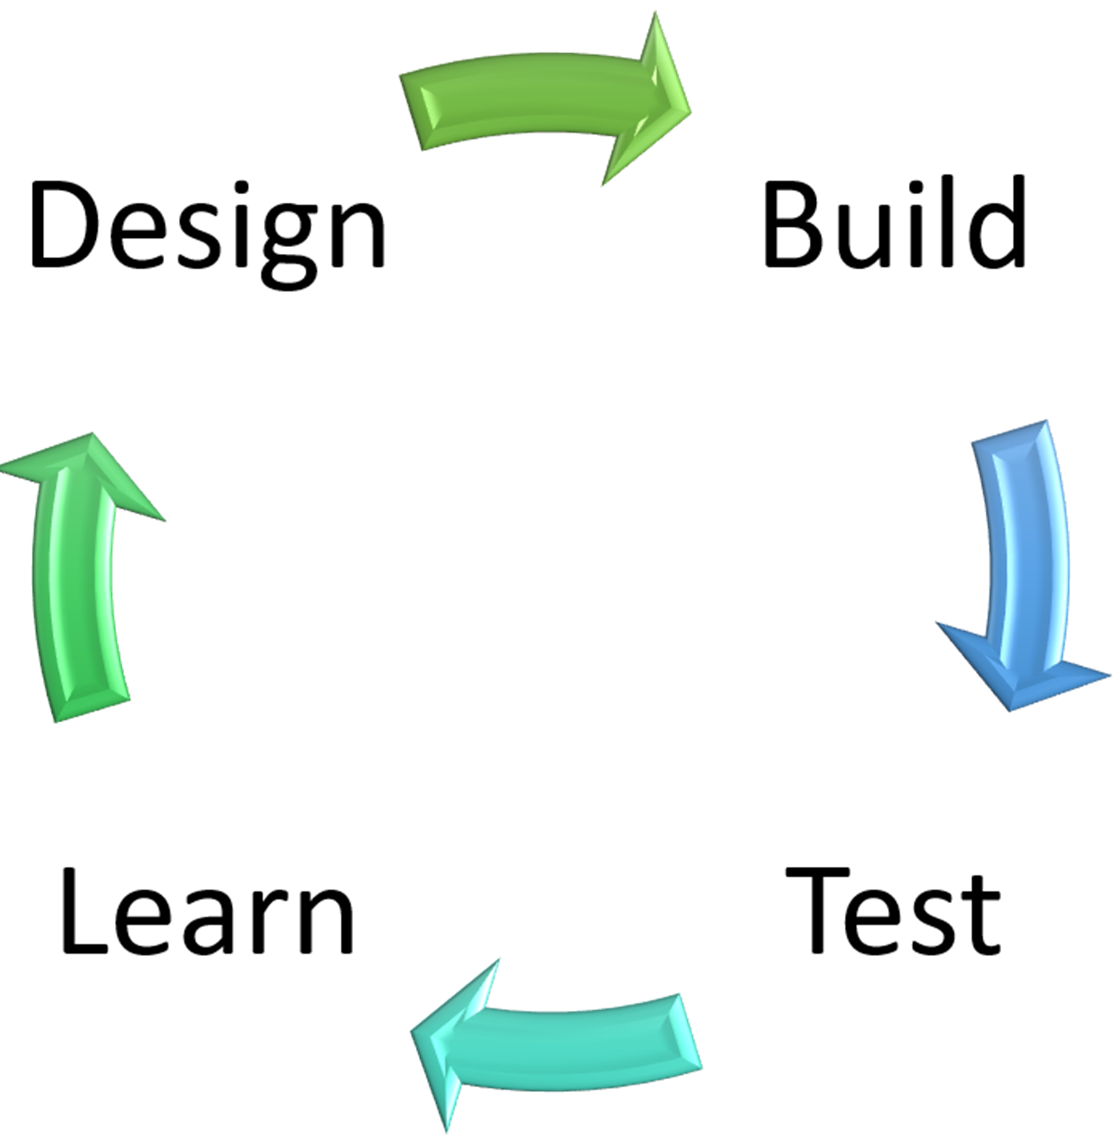
The Challenge
Sample Week Plan that uses the DBTL – Model
  Learn – Direct Instruction, Research
  Design – Use variables presented to make the best design
  Build – Make the Design
  Test – Measure and analysis

Slide 14
Sample Week Lesson Plan
Day 1 | Day 2 | Day 3 | Day 4 | Day 5
Learn Introduction to Solar Power Consider the following Videos: How do solar panels work? - Richard Komp (youtube.com) How do Solar cells work? (youtube.com) Have Students Research Solar Energy. Direct Instruction. | Design Break students into groups Students use research to inform a design. Have them design their car. | Build Break Students into their groups Build and test their designs. Have students test and take measurements of their designs and allow for changes | Learn Break students into their groups Conduct the race with the students designs. Talk about the designs that worked best and how they may change things. Share designs and data. | Reflection Class Discussion Share Data and Design. Share what was learned. Assessment Ideas.

Slide 15
For Best Results
  Make sure your materials are in a central location for students to easily obtain.
  Start small consider going through the design process with them as a sample, depending on your group or learner needs.
  Consider focusing on one variable while holding others constant.
  Make sure the challenge occurs on a sunny (preferably warm) day.
  Be sure to collect the materials for use with another class – so ask the students to handle with care.

Slide 16
Assessment
  Assessment can be done through the DBTL process through a rubric or checklist
  Formal Lab Report
  Essay on solar energy and renewable energy
  Class presentation on their results and why they choose their designs and how they improved over the process.

Slide 17
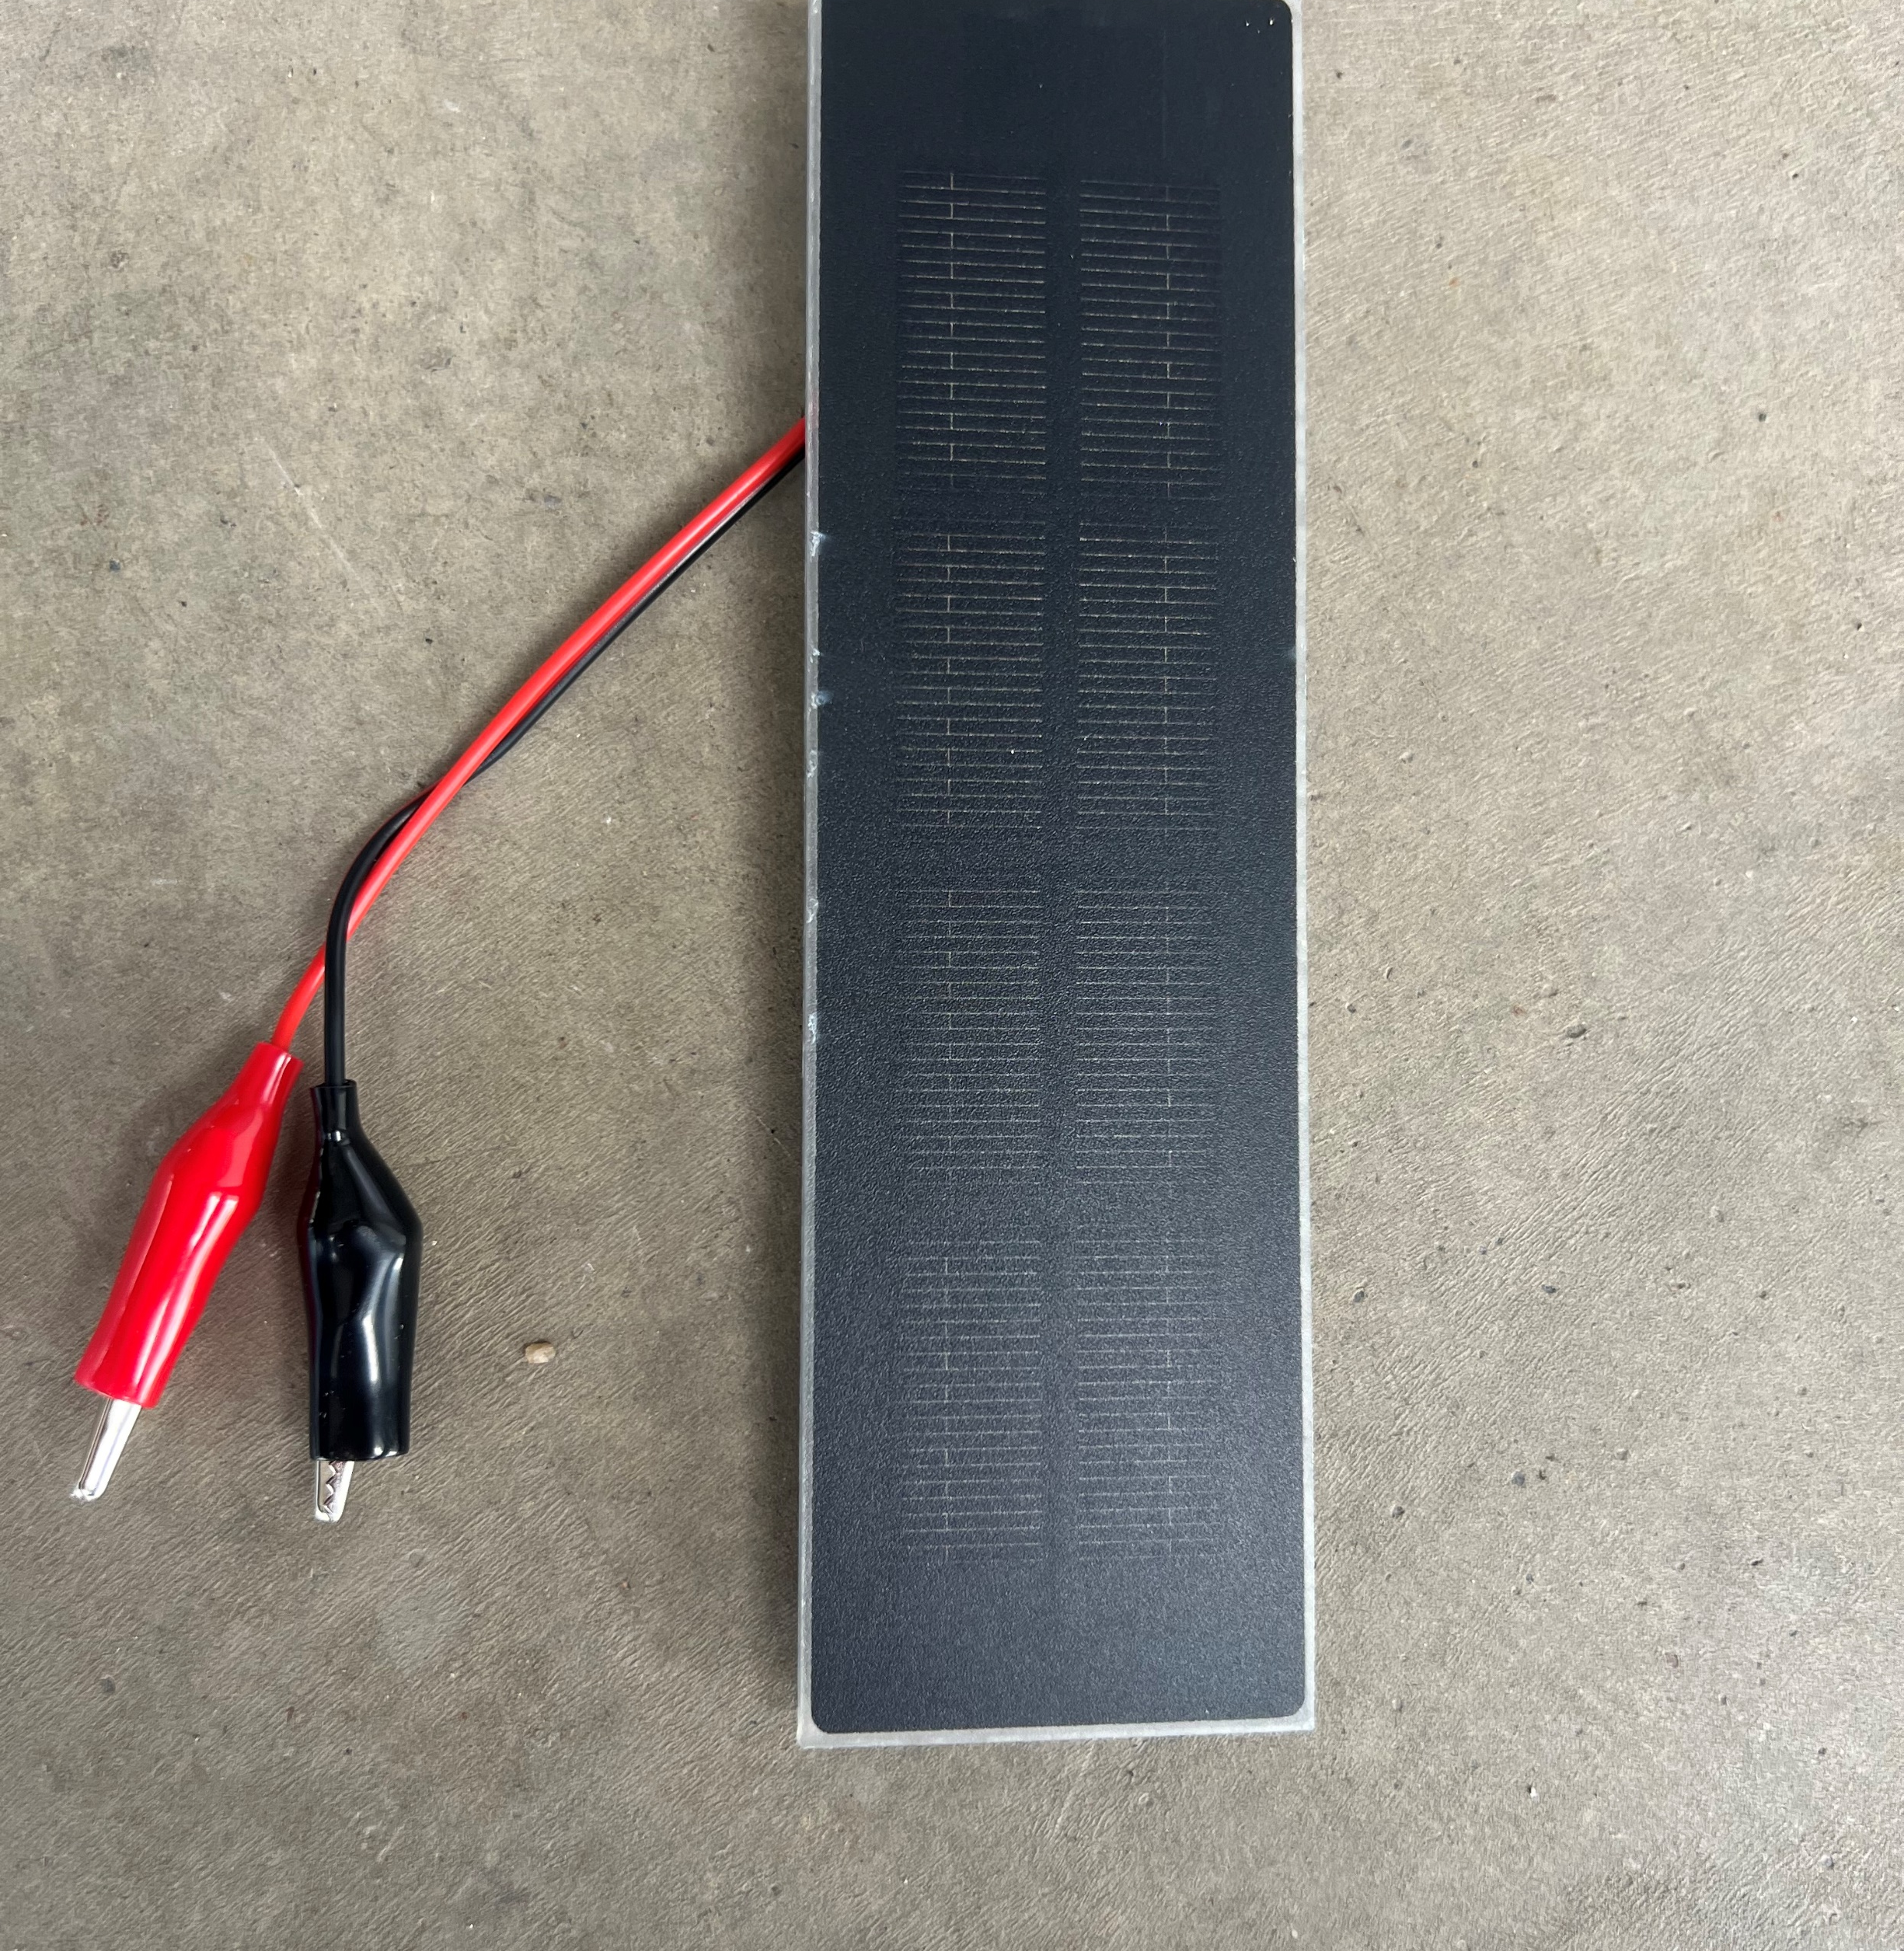
Extension
Each kit has also been included with 1 additional solar panel – 2V, 400 mA for those students that want more of a challenge.

Slide 18
Other Science 10 Resources on COE-Energy Website
  Horsepower Inquiry Activity Challange | Centre of Excellence for Energy (centresofexcellencenb.ca)
  What is Energy? Lab Activity for Grade 10 Science | Centre of Excellence for Energy (centresofexcellencenb.ca)
  Energy Content of a Dorito | Centre of Excellence for Energy (centresofexcellencenb.ca)
  Wind Energy Challenge | Centre of Excellence for Energy (centresofexcellencenb.ca)
  Science 10 Energy Unit Resources | Centre of Excellence for Energy (centresofexcellencenb.ca)
  Baseload vs Peak Demand | Centre of Excellence for Energy (centresofexcellencenb.ca)
  Build a Passive Solar Home | Centre of Excellence for Energy (centresofexcellencenb.ca)
  Scrappy Circuits | Centre of Excellence for Energy (centresofexcellencenb.ca)
  Build Your Own Hydroelectric Generator | Centre of Excellence for Energy (centresofexcellencenb.ca)
  Exploring Canada’s Energy Future | Centre of Excellence for Energy (centresofexcellencenb.ca)
  Mission Possible Energy Challenge | Centre of Excellence for Energy (centresofexcellencenb.ca)

Slide 19
Questions?
Website: Centre of Excellence for Energy
Email: warren.coombs@gnb.ca

