Slide 1
Centres of Excellence
Reimagining how students, across K-12, learn about New Brunswick career opportunities and increase career readiness through virtual and experiential learning, by connecting classrooms with real-world expertise.

Slide 2
Challenges to
New Brunswick
Population
Oldest population in Canada
Young people leaving New Brunswick
Seeking to grow population through immigration
Workforce
Labour shortages in key sectors
120,000 job openings in the next 10 years

Slide 3
Centre of Excellence Goals
+
=
Increase student and teacher focus on career-connected learning.
Make it easier for teachers and outside experts to connect.
Show students they can make a living, and a life, in New Brunswick.
Make learning more authentic and engaging by connecting it to real-world opportunities.
Remove barriers that make it difficult for teachers to include outside experts in their teaching.
Get students excited about opportunities they didn’t know existed within the province.

Slide 4
Centre of Excellence Structure
A single point of access for schools and partners
Sector Partners
Centre of Excellence
Centre of Excellence
Centre Lead
Supports
Website
Post-Secondary Education
K-12 School System
Other Government Departments
Other Partners
and Agencies

Slide 5
COE Learning and Engagement Model for K-12
Career Readiness
Direct sector-specific experiential learning; coop placements, mentoring, volunteering, capstone projects
Active Exploration
Deeper engagement in sector-specific experiences; problem and project-based learning, site visits, applied research
Career Readiness
Foundational Awareness
Introducing concepts, classroom connected supports: speakers, activities, virtual tours, research
Active Exploration
Foundational Awareness
Curriculum Focused
Builds across K-12 curriculum outcomes.
Augments existing curriculum using examples found in real-world practice
EECD’s 10-Year Education Plan Global competencies, SDGs, Essential Skills
Curriculum

Slide 6
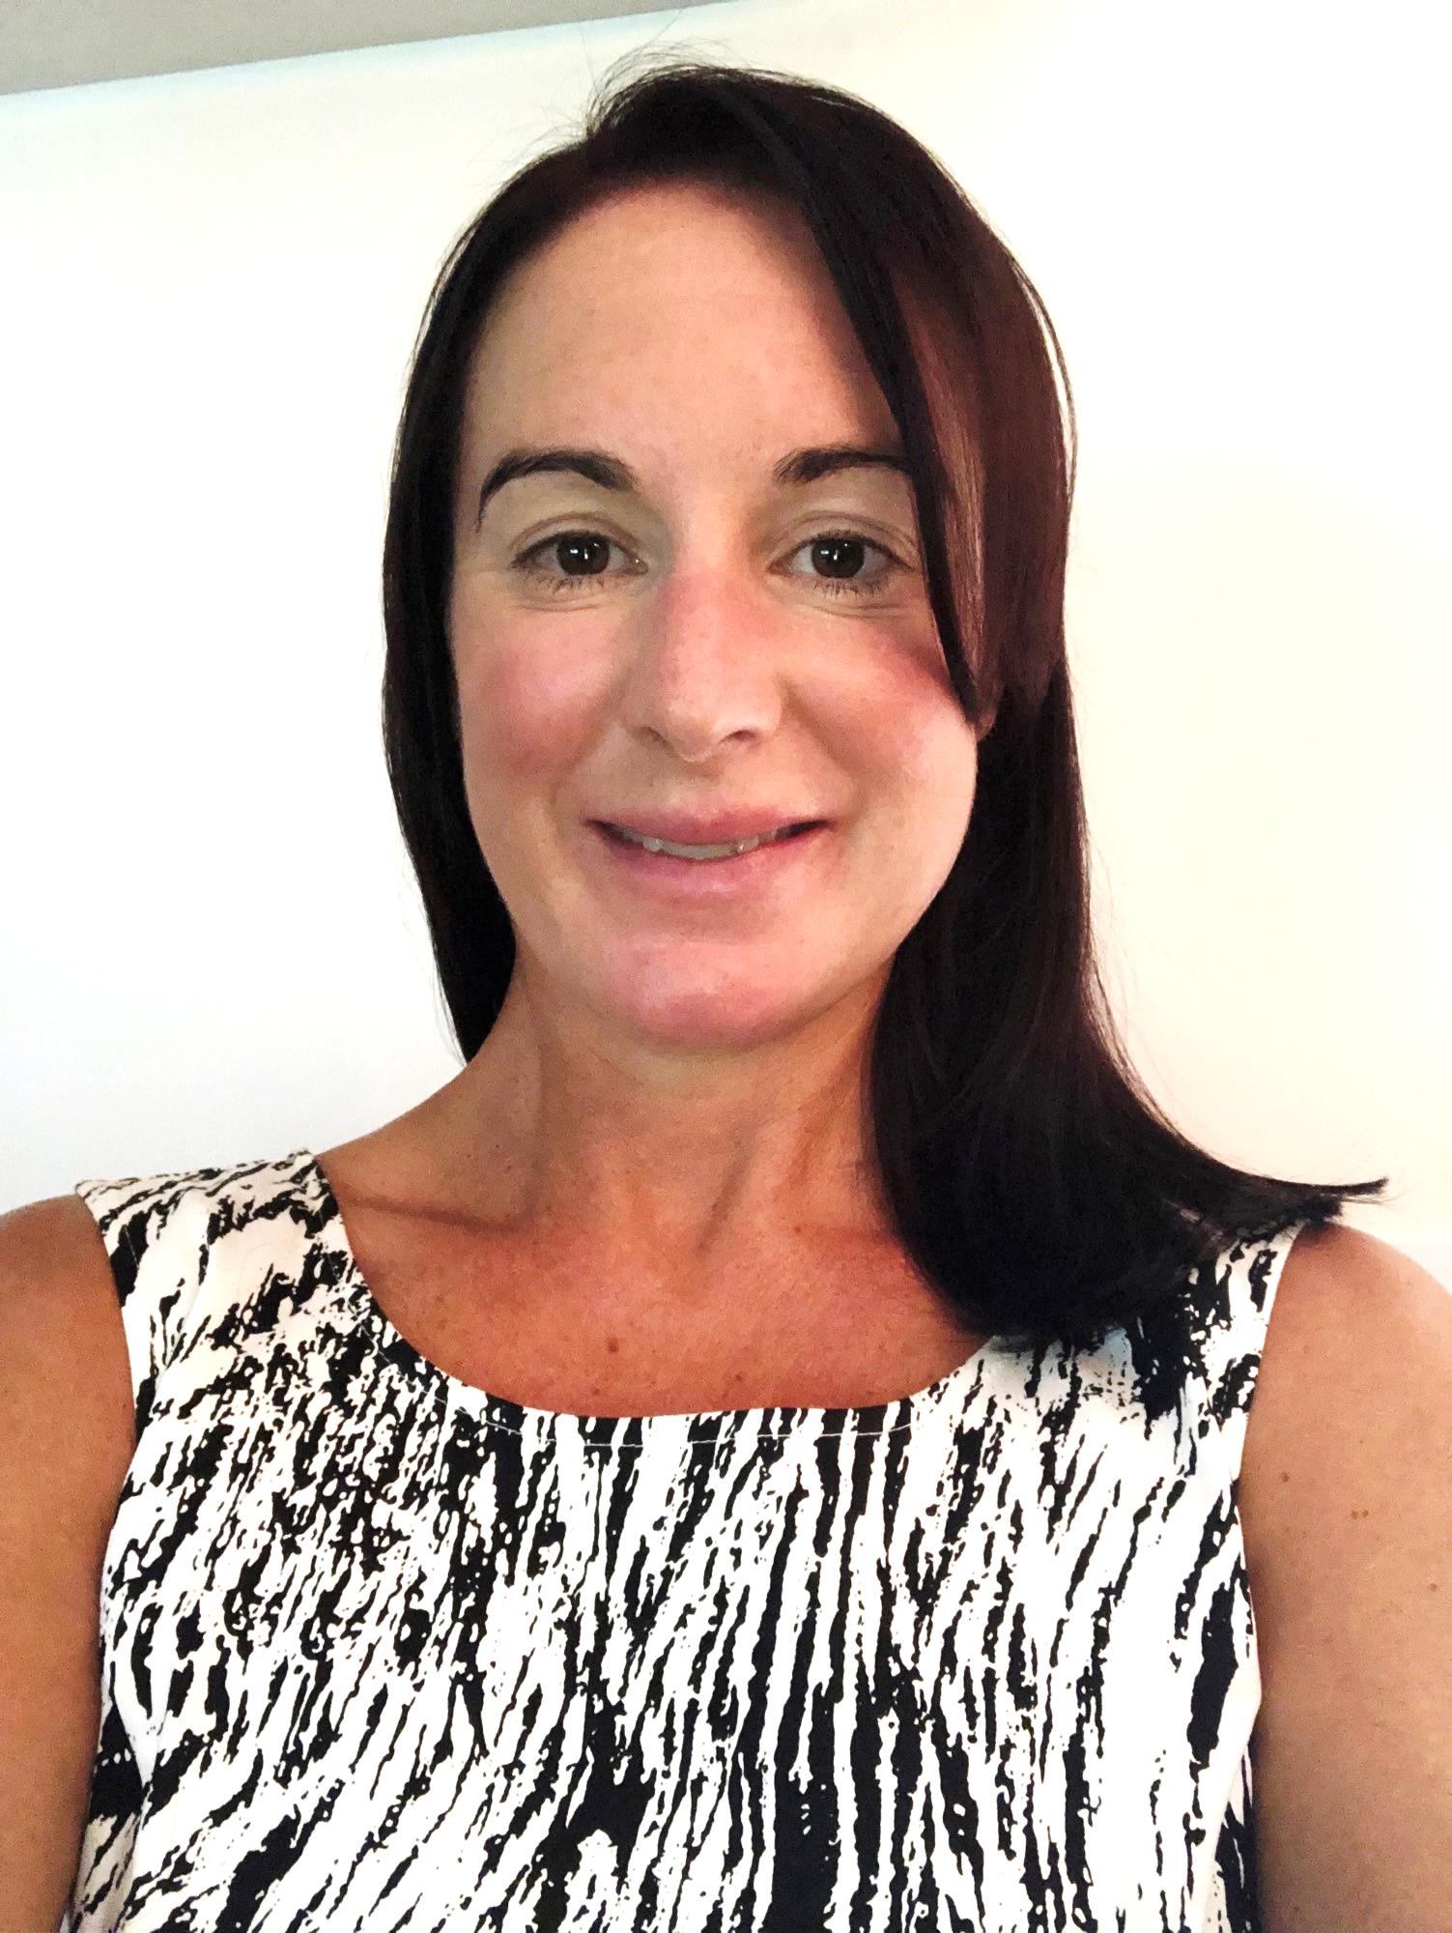
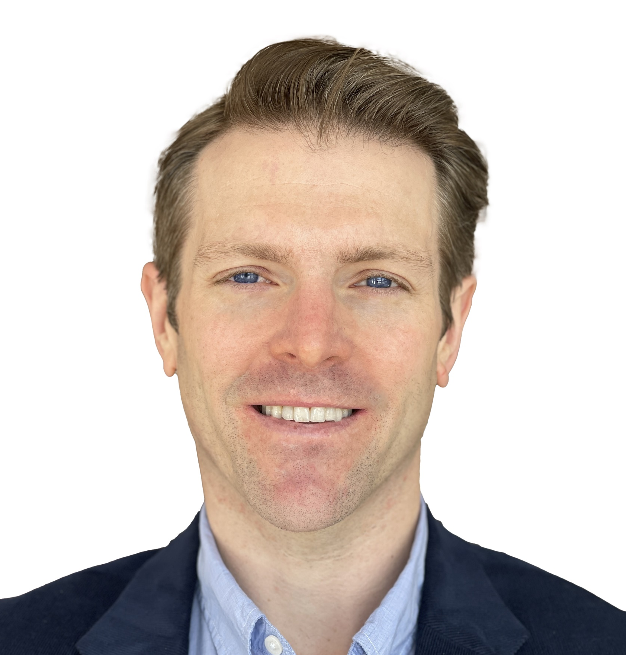
Warren Coombs
NB Power
Gaia Project
WiRE Women in Renewable Energy
SWEB Energy
ABO Wind
ARC Clean Technology
Saint John Energy
Daneen Dymond
Horizon Health Network
NB Association of Nursing Homes
Shannex
Departments of Health, Social Development, Tourism, Heritage and Culture
Teach Nutrition
NB Association for Social Work
Jill Shaw
Junior Achievement NB Chartered Professional Accountants of NB (CPA)
NB Financial and Consumer Services (FCNB)
Community Business Development Corporation (CBDC)
Venn Innovation
Adam Binet
The Information and Communications Technology Council (ICTC)
McKenna Institute
Brilliant Labs
Cisco Systems
Tech Impact
Canadian Centre for Cybersecurity
Nathan Langille
The Excellence in Manufacturing Consortium (EMC)
The Construction Association of NB
Opportunities NB
McCain Foods
Malley Industries
Skills Canada
Common Partners PETL / Opportunities NB / ACOA / NBCC / St. Thomas University / UNB / Inclusion NB / Oulton College

Slide 7
E
Energy literacy and climate education
Career pathways in the energy sector
Mental health literacy
Career pathways in health and social care
Growing entrepreneurial spirit and skills in N.B. youth
Financial literacy
Practical skills in trades and manufacturing
Career pathways in skilled trades & manufacturing
Career pathways in ICT and Cybersecurity
Strengthening digital literacy skills and empowering students to use technology to create positive change
KEY PRIORITY AREAS – Created in collaboration with our District Advisory Committee, these priority areas guide the development of learning supports provided though the COEs

Slide 8
Key Priority Areas:
Provide inclusive, innovative, and authentic experiential language learning opportunities.
Facilitate connections between educators, learners, experts, and community partners to support and enrich language learning education.
Promote the benefits of language learning as a global competency and expose learners to career opportunities in New Brunswick
Launched:
February 2024
Partnerships
Tourism Industry Association of New Brunswick
Tourism HR Canada
Secretariat of Official Languages
Union of Municipalities of New Brunswick
Canadian Parents for
French NB
Centre Lead:
Ginny Steeves

Slide 9
Centres of Excellence (centresofexcellencenb.ca)

Slide 10
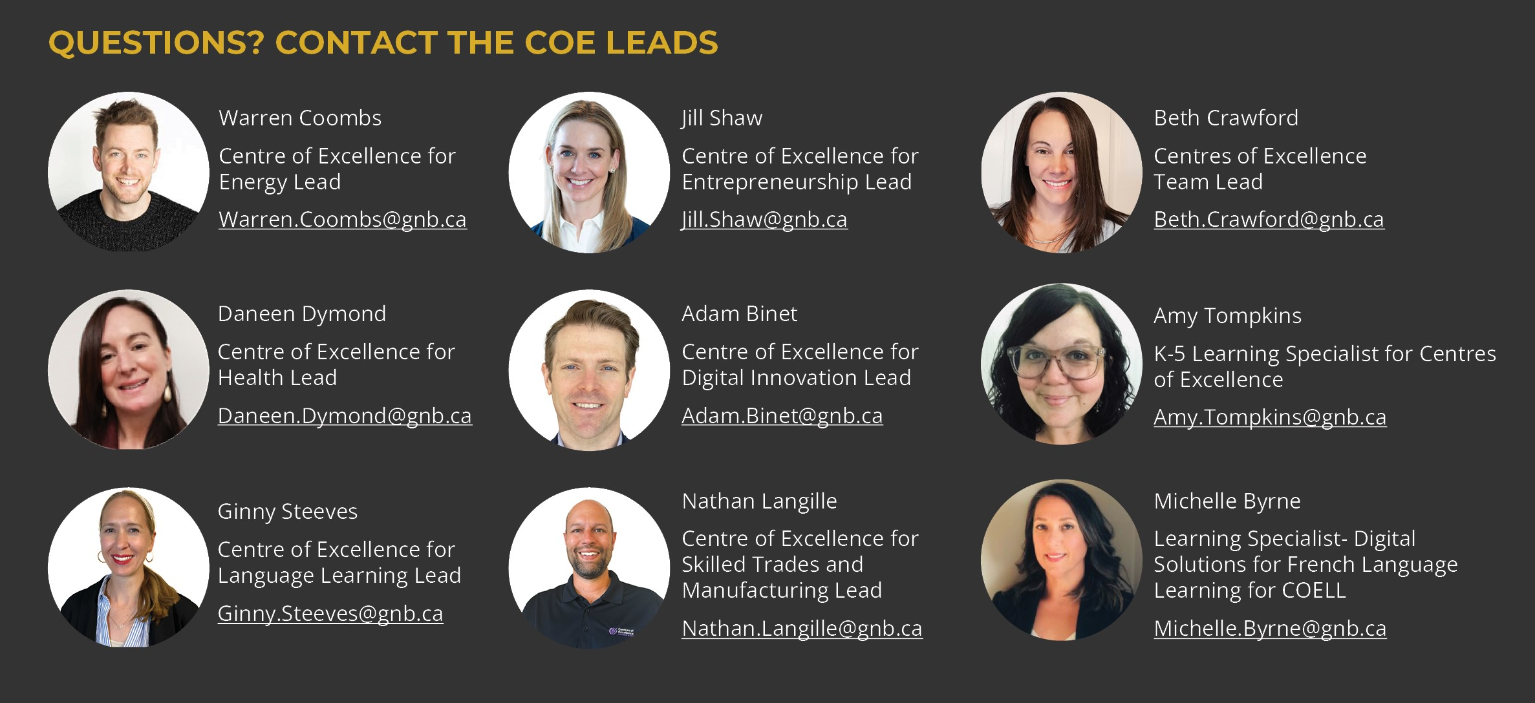

Slide 11
Solar Car KITS

Slide 12
Why Solar Kits?
Supports Inquiry Based Learning
Hands on learning
Can be adaptable to help students meet multiple achievement indicators as outlined in the New Holistic Curriculum
Can be scaled up or down depending on instructional goals
Ease of use
Low prep burden

Slide 13
The Solar Car Kits
Each School in Anglophone South will be supplied with two class Solar Car Kits
Kits are created by Flynn Scientific
Your Kit looks a little different than the picture (Yours has a stand made of friction fitted PVC and no gears)

Slide 14
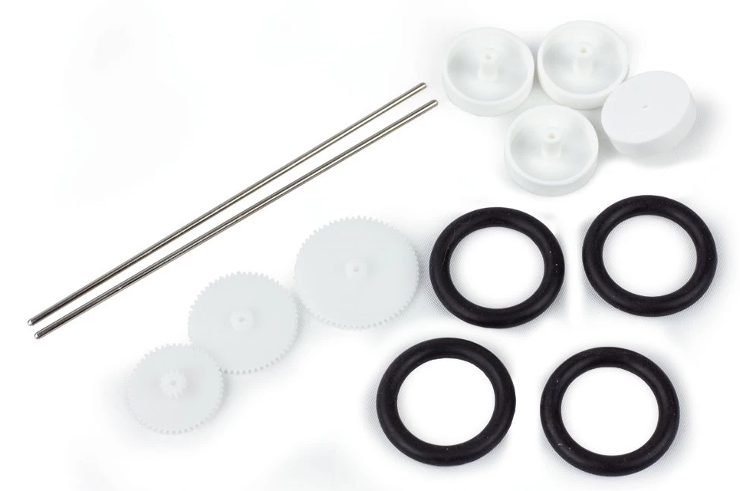
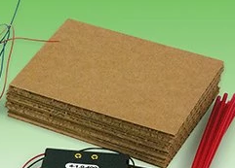
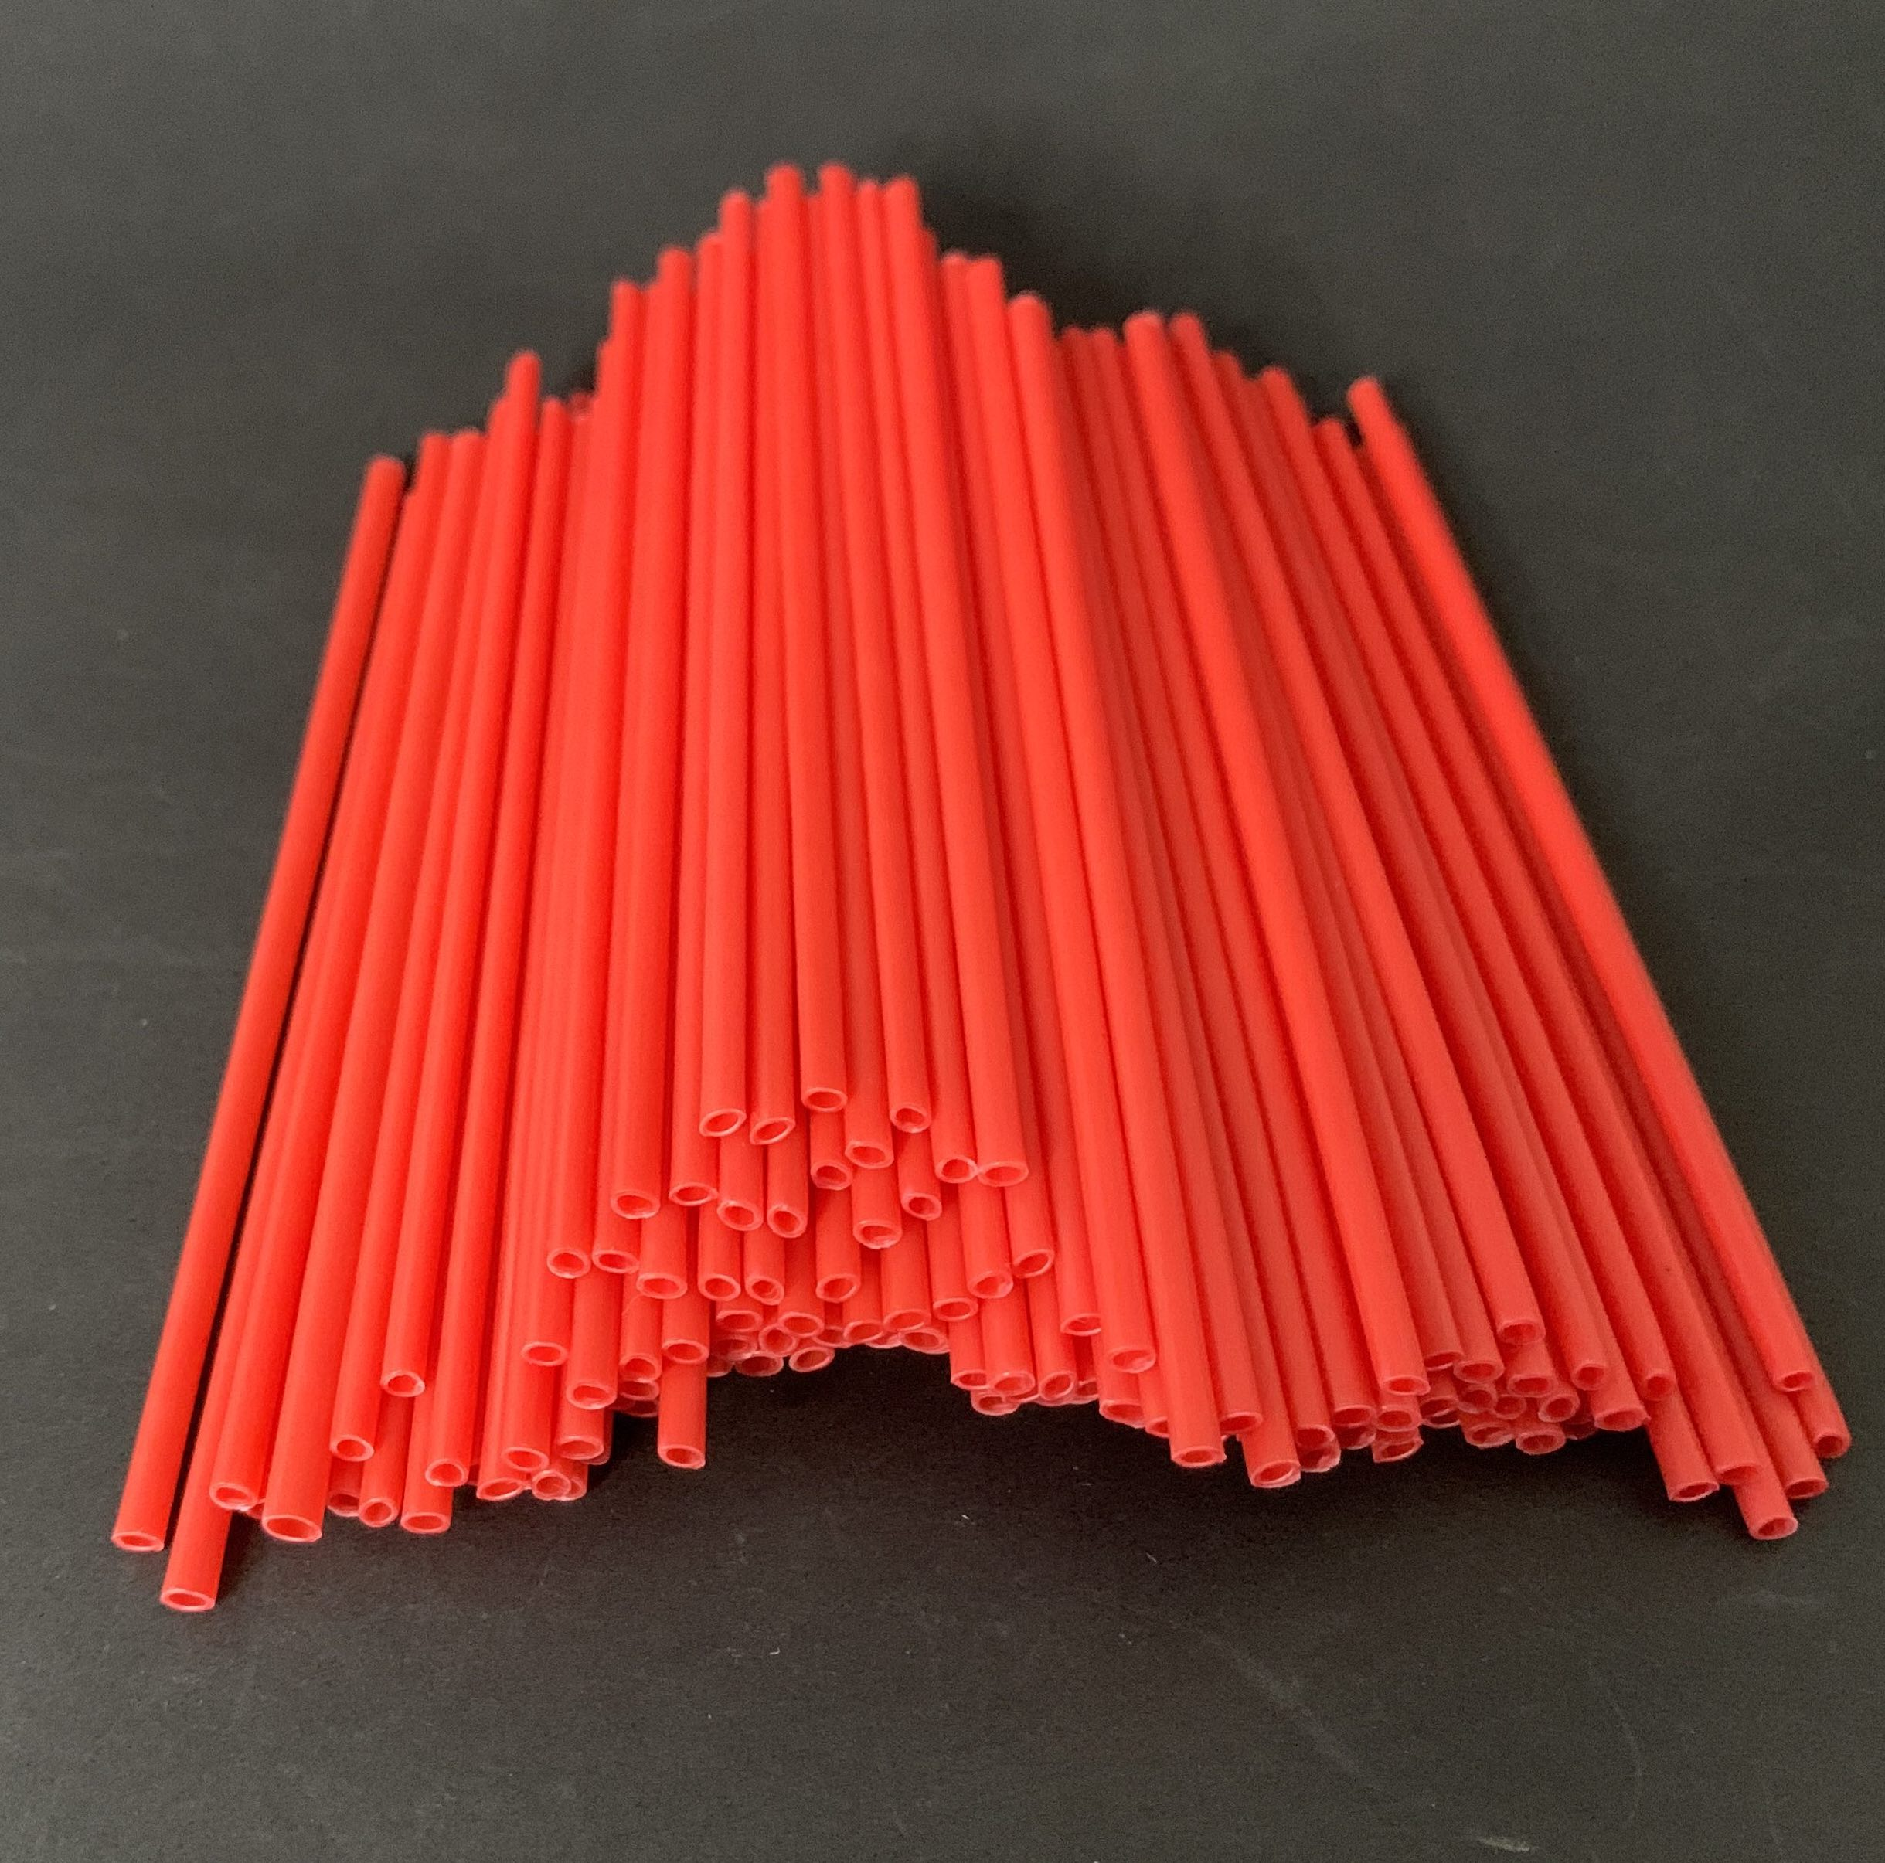
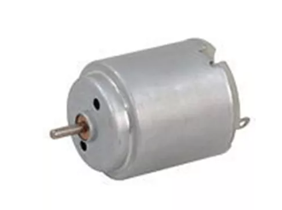
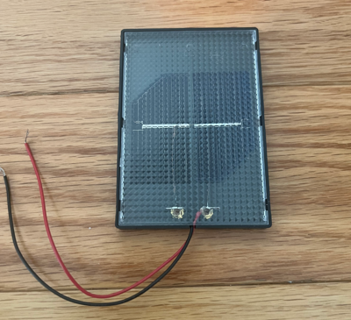
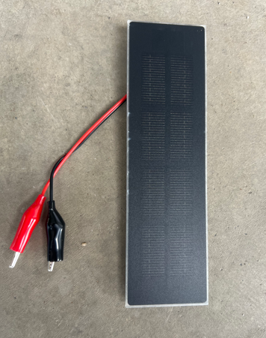
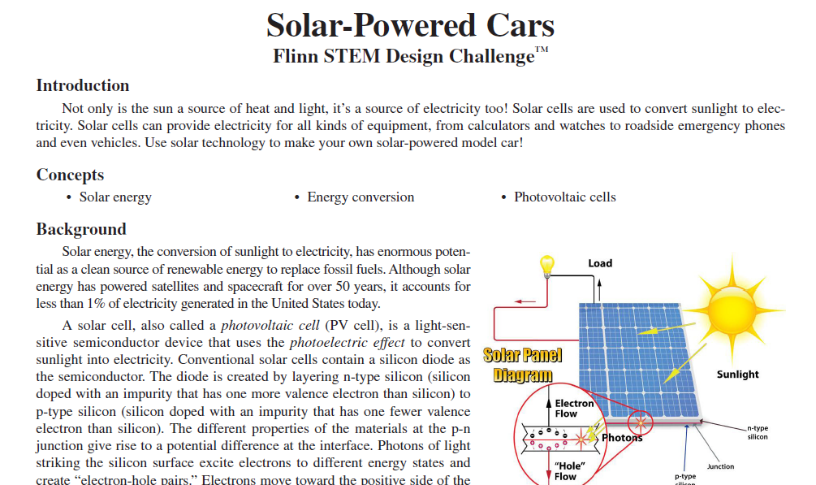
Materials | Consumable (can easily be r-epurchased from Veriner or a Hardwrae Store)
8 x Cardboard Base, 4 ½” x 5 ½” | 8 x Gears & Wheels bag
4 x Long Straws (cut in ½) | 3 x Set Alligator Clips
8 x DC Motor with Wires | 8 x Solar Mini Panel (1 V, 400 mA)
1 x Solar Mini Panel (2 V, 400 mA) | 1 x Instructional Documents

Slide 15
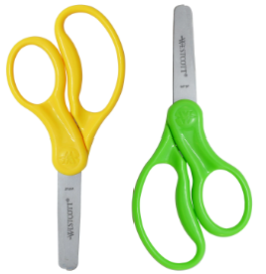
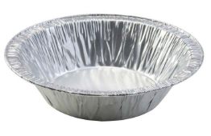
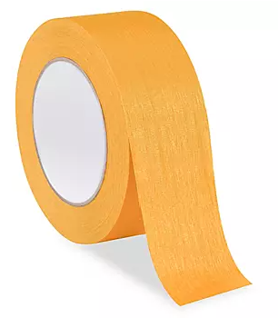
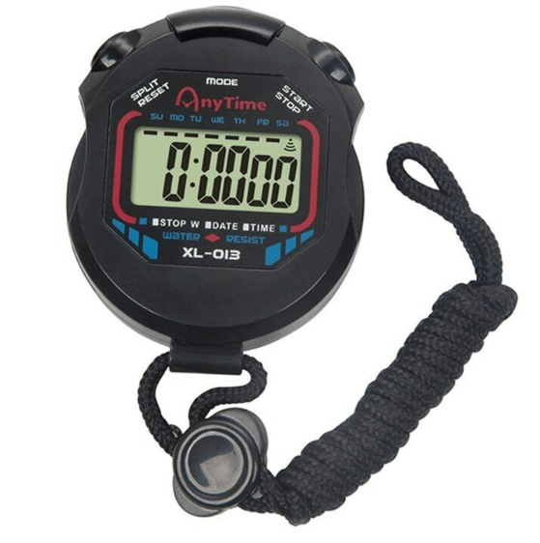
Classroom Materials (Not Included)
Scissors | Other Construction Materials
Glue / Tape | Box Board / Car Stock
Ruler | Stop-Watch

Slide 16
Curricular Alignment

Slide 17
Grade 10 Science
Strand: Scientific Literacy - Big Idea: Investigation
Skill Descriptor: Examine questions about relationships between and among observable variables to plan investigations.
Strand: Scientific Literacy - Big Idea: Investigation
Skill Descriptor: Collect and represent accurate data using appropriate tools and methods.

Slide 18
Strand: Scientific Literacy - Big Idea: Sensemaking
Skill Descriptor: Analyze and interpret qualitative and quantitative data to construct explanations and conclusions.
Strand: Scientific Literacy - Big Idea: Communication
Skill Descriptor: Develop scientific collaborative skills during investigations to communicate conclusions supported by data..

Slide 19
Strand: Learning and Living Sustainably – Big Idea: Relationships Between Science and Technology
Skill Descriptor: Apply scientific and technological knowledge and understanding of sustainable practices.
Strand: Learning and Living Sustainably – Big Idea: Relationships Between Science and Technology
Skill Descriptor: Apply an iterative process to challenges related to sustainable development goals.

Slide 20
SOLAR CAR CHALLENGE

Slide 21
Instructional Materials
The included instructions from the manufacturer (Flynn Scientific).
I will e-mail instructional materials of my own design today which is a more condensed version of the manufactures instructions
Each school can designate two members of staff to access online materials from Flynn.

Slide 22
The Challenge
The lesson is designed for groups to use the materials presented to design and build solar cars that will travel the fastest over a set amount of time.
This can be amended to your own classroom goals by include constraints
Example focus on altering the angle of the solar panel
Constrain what gears can be used
Control other aspects of the design

Slide 23
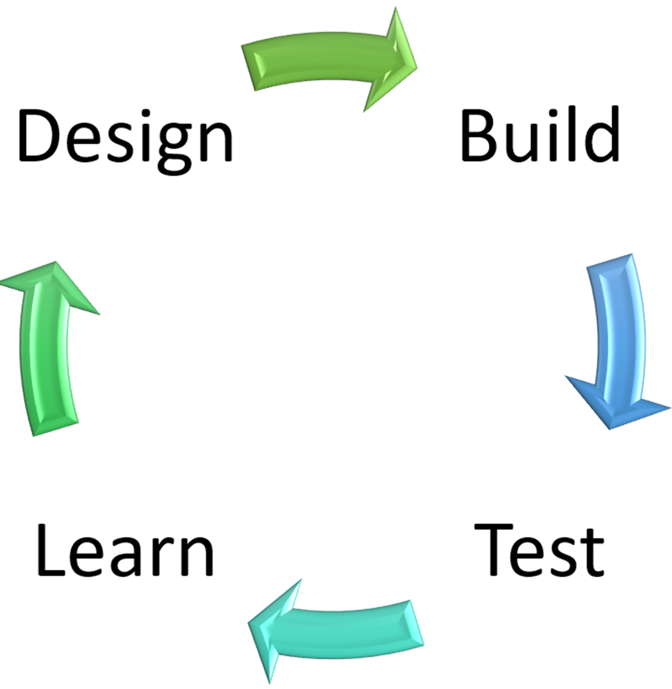
The Challenge
Sample Week Plan that uses the DBTL – Model
Learn – Direct Instruction, Research
Design – Use variables presented to make the best design
Build – Make the Design
Test – Measure and analysis

Slide 24
Sample Week Lesson Plan
Day 1 | Day 2 | Day 3 | Day 4 | Day 5
Learn Introduction to Solar Power Consider the following Videos: How do solar panels work? - Richard Komp (youtube.com) How do Solar cells work? (youtube.com) Have Students Research Solar Energy. Direct Instruction. | Design Break students into groups Students use research to inform a design. Have them design their car. | Build Break Students into their groups Build and test their designs. Have students test and take measurements of their designs and allow for changes | Learn Break students into their groups Conduct the race with the students designs. Talk about the designs that worked best and how they may change things. Share designs and data. | Reflection Class Discussion Share Data and Design. Share what was learned. Assessment Ideas.

Slide 25
For Best Results
Make sure your materials are in a central location for students to easily obtain.
Start small consider going through the design process with them as a sample, depending on your group or learner needs.
Consider focusing on one variable while holding others constant.
Make sure the challenge occurs on a sunny (preferably warm) day.
Be sure to collect the materials for use with another class – so ask the students to handle with care.

Slide 26
Assessment
Assessment can be done through the DBTL process through a rubric or checklist
Formal Lab Report
Essay on solar energy and renewable energy
Class presentation on their results and why they choose their designs and how they improved over the process.

Slide 27
Extension
Each kit has also been included with 1 additional solar panel – 2V, 400 mA for those students that want more of a challenge.

Slide 28
Other Science 10 Resources on COE-Energy Website
Horsepower Inquiry Activity Challange | Centre of Excellence for Energy (centresofexcellencenb.ca)
What is Energy? Lab Activity for Grade 10 Science | Centre of Excellence for Energy (centresofexcellencenb.ca)
Energy Content of a Dorito | Centre of Excellence for Energy (centresofexcellencenb.ca)
Wind Energy Challenge | Centre of Excellence for Energy (centresofexcellencenb.ca)
Science 10 Energy Unit Resources | Centre of Excellence for Energy (centresofexcellencenb.ca)
Baseload vs Peak Demand | Centre of Excellence for Energy (centresofexcellencenb.ca)
Build a Passive Solar Home | Centre of Excellence for Energy (centresofexcellencenb.ca)
Scrappy Circuits | Centre of Excellence for Energy (centresofexcellencenb.ca)
Build Your Own Hydroelectric Generator | Centre of Excellence for Energy (centresofexcellencenb.ca)
Exploring Canada’s Energy Future | Centre of Excellence for Energy (centresofexcellencenb.ca)
Mission Possible Energy Challenge | Centre of Excellence for Energy (centresofexcellencenb.ca)

Slide 29
Questions?
Website: Centre of Excellence for Energy
Email: warren.coombs@gnb.ca

