Slide 1
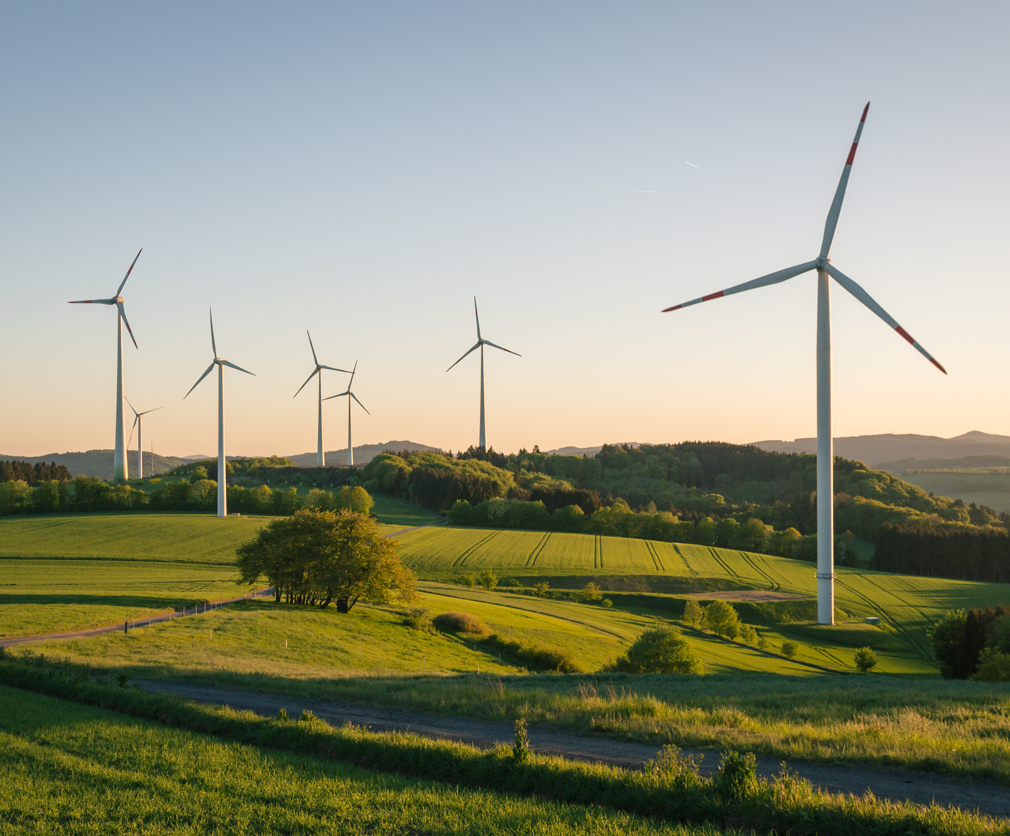
Wind Blade Design Science Inquiry Project
Introduction
Generating energy from wind is something that has been used since antiquity. In the past wind wills were used to power sawmills, and mill grain. Today we recognize that harnessing power from the wind is a renewable resource that is clean and does not produce carbon dioxide emissions. As the climate crisis intensives around the world, it is imperative to find other methods to produce power that does produce carbon dioxide.
Figure 1: Wind turbines in a field – adobe stock images
In New Brunswick, wind power is quickly becoming an important part of the province’s energy grid. Many of these projects are in partnership with First nations. The province currently has seven wind farms operating:
Wind Farm | Operator | Megawatts produced (MW)
Burchchill Wind Project | Natural Forces / Neqotkuk Maliseet Nation / Saint John Energy | 42
Caribou Wind Park | ENGIE / NB Power | 99
Lamèque Wind Farm | Acconia Energy / NB Power | 45
Kent Hills Wind Farm | Transalta / Natural Forces / NB Power | 96
Wisokolamson Energy Project | SWEB Development / Woodstock First Nation / NB Power | 18
Wocawson Energy Project | Natural Forces / Tobique First Nation / NB Power | 20
Oinpegitjoig (Richibucto) Wind Project | Natural Forces / Pabineau First Nation/ NB Power | 3.8
Cap-Pelé Wind | WKB Community / NB Power | 2.35

Slide 2
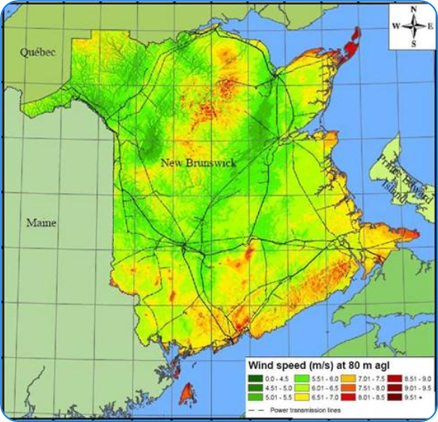
Wind Blade Design Science Inquiry Project
Introduction
When selecting a location for a wind farm, it is important to select a site that has enough wind to generate the most amount of energy. Below you will see a map of New Brunswick’s windiest places. Not surprisingly many of the wind farms have been built in these locations.
Selecting an appropriate site is just one concern for generating the most wind energy. Wind turbines work by using wind blades that capture the wind to spin a turbine to produce electricity. There are many wind turbine designs, and your task is to use the materials presented to make a wind blade design that produces the most amount of energy possible.
Figure 2: New Brunswick Wind Atlas – Government of New Brunswick
For this project you can choose one variable to manipulate: Blade Shape, Blade Material, Blade Angle (Pitch), Number of Blades, Blade Size. Just remember to select only one and control for all the others.
The first thing you should do is to research what designs work best. Here are some sites and videos that will help you with your research, but please find your own as well:
https://renewablesnb.ca/case-studies/wind/#:~:text=Wind%20power%20generates%20432%2C400%20MW,that%20is%20within%20New%20Brunswick.
https://www.youtube.com/watch?v=pBFCIxZfQ4s&t=12s
https://www.alternative-energy-tutorials.com/wind-energy/wind-turbine-blade-design.html

Slide 3
Wind Blade Design Science Inquiry Project
Step 1: Observing & Questioning
What did you find in your research?
What will be your Inquiry Question:
Draw a labelled diagram of your design or experimental set-up:

Slide 4
Wind Blade Design Science Inquiry Project
Step 2: What will I change?
One variable I will change:
I will measure or observe this result:
What will I not change? (List all the variables that will stay the same):

Slide 5
Wind Blade Design Science Inquiry Project
Step 3: What can I measure or observe?
What variable will be your Independent Variable? (think about what you are
changing)
What variable will be your Dependent Variable? (think about what you are trying to measure)
What are some variables that could affect the what you’re trying to measure or observe (Controlled Variables)?

Slide 6
Wind Blade Design Science Inquiry Project
Step 4: What is my hypothesis?
If the ______________________ is ____________________________
Then the ______________________ will _________________________
Independent variable
How will the independent variable change?
Dependent variable
How will the dependent variable be affected
I think this will happen because….

Slide 7
Wind Blade Design Science Inquiry Project
Step 5: Planning your experiment
How will you measure or observe your Independent Variable?
How will you measure or observe your Dependent Variable?
What materials do you need to conduct your experiment?

Slide 8
Wind Blade Design Science Inquiry Project
Step 6: How will you do your experiment?
Write down a procedure for your experiment. This should be exactly what you will do so that someone else could perform the experiment the same way.
Congratulations! At this point you should be ready to conduct your experiment. Please do so with teacher supervision and make sure to record any observations or measurements.

Slide 9
Wind Blade Design Science Inquiry Project
Step 7: Gathering Data
Gather your data and record it in a table format. Depending on what you chose to measure your data table may look different from other classmates.

Slide 10
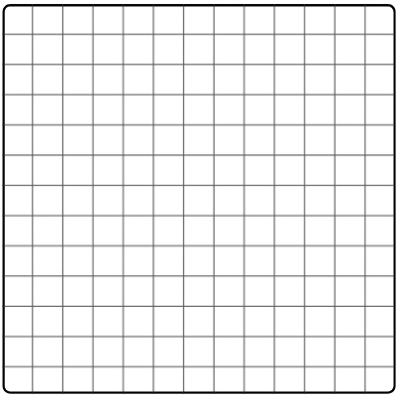
Wind Blade Design Science Inquiry Project
Step 8: Graphing your data
Use the graph paper below to graph your data. Make sure to use consistent spacing and pick an appropriate graph for your data (scatter plot graph, bar graph, etc.). Make sure to include a title and label your axis with units where applicable.

Slide 11
Wind Blade Design Science Inquiry Project
Step 9: Analyzing your results
Looking at your data and graph, what do you notice about your results?
Was your hypothesis correct given your results? Why or why not??

Slide 12
Wind Blade Design Science Inquiry Project
Step 10: Evaluating your results
What errors were made during your experiment? How could they have been
corrected for?
If you were to conduct this experiment again, what would you change?
Would you measure something different?
What implications does this have for Wind Blade design?

Slide 13
Wind Blade Design Science Inquiry Project
References
Smarter Science Framework
(For Educators - Youth Science Canada | Youth Science Canada)
NB Power
Wind Energy (nbpower.com)
Government of New Brunswick
The New Brunswick Wind Atlas (gnb.ca)
Kidwind
KidWind — Teaching the World about Renewables

