Slide 1
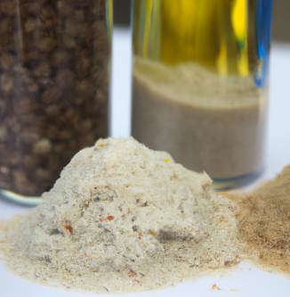
Yeast Fermentation Science Inquiry Project
Introduction
Fermentation is a process that has been used by humans for thousands of years. It involves converting sugars into other substances, like alcohol or acids, using microorganisms such as yeast or bacteria. This process is not only crucial for making many of the foods and drinks we enjoy, but it's also important in various industries, including energy production.
Fermentation begins with a simple chemical reaction. For example, when yeast ferments glucose, which is a type of sugar, it produces alcohol and carbon dioxide. The basic chemical equation for this process is:
Figure 1: Samples of fermented products – A.I. generated by DALL-E
$$C_{6}H_{12}O_{6}→2C_{2}H_{5}OH+2CO_{2}$$
glucose
alcohol
carbon dioxide
Fermented products are everywhere in our daily lives. Bread, for instance, rises because of carbon dioxide produced by yeast during fermentation. Beer and wine are made through the fermentation of sugars in grains and grapes, respectively. Even foods like sauerkraut and kimchi are fermented using bacteria that produce acids, giving these foods their tangy taste.
Fermentation is also used to create various chemicals and medicines. For example, antibiotics like penicillin are produced using fermentation. The process helps in producing not only delicious foods and drinks but also important medicines.

Slide 2
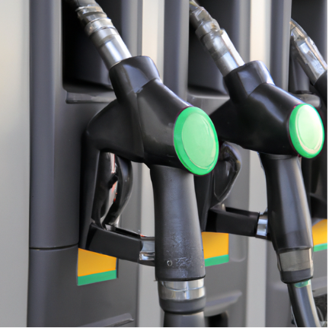
Yeast Fermentation Science Inquiry Project
Introduction
Today, fermentation is not only used for food and drink but also in the energy industry. One major application is the production of biofuels. Biofuels are fuels made from biological materials, such as crops. Ethanol, a type of biofuel, is produced by fermenting sugars found in plants like corn. This ethanol can then be mixed with gasoline to create a cleaner-burning fuel that reduces emissions.
In addition to ethanol, scientists are also exploring other ways to use fermentation to produce energy. For example, some researchers are investigating how to use fermentation to produce hydrogen gas, which could be a clean alternative to fossil fuels.
Figure 2: A gas pump that dispenses biofuel – A.I. generated using DALL-E
For this project you can choose one variable to manipulate. You will be measuring the amount of yeast fermentation using a simple set up provided by your teacher. You will be able to choose which variables to measure or observe and to control. Some of the variables are:
Amount of water, Amount of yeast, Amount of Water, Water Temperature, Duration (time), and Sugar Fuel (what your teacher has available -sucrose, glucose, etc.)
The first thing you should do is to research yeast fermentation, to determine what aspects produces the most amount of carbon dioxide. Here are a few key phrases that will help begin your research:
Yeast fermentation, how to measure yeast fermentation, factors affecting yeast fermentation

Slide 3
Yeast Fermentation Science Inquiry Project
Step 1: Observing & Questioning
What did you find in your research?
What will be your Inquiry Question:
Draw a labelled diagram of your design or experimental set-up:

Slide 4
Yeast Fermentation Science Inquiry Project
Step 2: What will I change?
One variable I will change:
I will measure or observe this result:
What will I not change? (List all the variables that will stay the same):

Slide 5
Yeast Fermentation Science Inquiry Project
Step 3: What can I measure or observe?
What variable will be your Independent Variable? (think about what you are
changing)
What variable will be your Dependent Variable? (think about what you are trying to measure)
What are come variables that could affect the what you’re trying to measure or observe (Controlled Variables)?

Slide 6
Yeast Fermentation Science Inquiry Project
Step 4: What is my hypothesis?
If the ______________________ is ____________________________
Then the ______________________ will _________________________
Independent variable
How will the independent variable change?
Dependent variable
How will the dependent variable be affected
I think this will happen because….

Slide 7
Yeast Fermentation Science Inquiry Project
Step 5: Planning your experiment
How will you measure or observe your Independent Variable?
How will you measure or observe your Dependent Variable?
What materials do you need to conduct your experiment?

Slide 8
Yeast Fermentation Science Inquiry Project
Step 6: How will you do your experiment?
Write down a procedure for your experiment. This should be exactly what you will do so that someone else could perform the experiment the same way.
Congratulations! At this point you should be ready to conduct your experiment. Please do so with teacher supervision and make sure to record any observations or measurements.

Slide 9
Yeast Fermentation Science Inquiry Project
Step 7: Gathering Data
Gather your data and record it in a table format. Depending on what you chose to measure your data table may look different from other classmates.

Slide 10

Yeast Fermentation Science Inquiry Project
Step 8: Graphing your data
Use the graph paper below to graph your data. Make sure to use consistent spacing and pick an appropriate graph for your data (scatter plot graph, bar graph, etc.). Make sure to include a title and label your axis with units where applicable.

Slide 11
Yeast Fermentation Science Inquiry Project
Step 9: Analyzing your results
Looking at your data and graph, what do you notice about your results?
Was your hypothesis correct given your results? Why or why not??

Slide 12
Yeast Fermentation Science Inquiry Project
Step 10: Evaluating your results
What errors were made during your experiment? How could they have been
corrected for?
If you were to conduct this experiment again, what would you change?
Would you measure something different?
What implications does this experiment have?

Slide 13
Yeast Fermentation Science Inquiry Project
References
Smarter Science Framework
  (For Educators - Youth Science Canada | Youth Science Canada)
Images generated using A.I. powered DALL-E
  https://openai.com/
University of Waterloo
  https://uwaterloo.ca/chem13-news-magazine/april-2015/activities
  /fermentation-sugars-using-yeast-discovery-experiment

