Slide 1
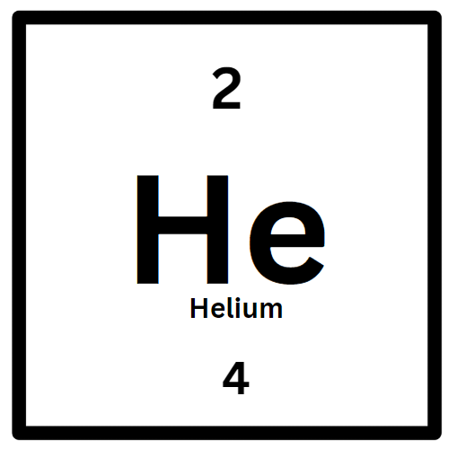
Atom Building Activity
Find the number of protons, neutrons and electrons
Protons =
Electrons =
Neutrons =
Build your atom below by putting the colored dops in the circles below!

Slide 2
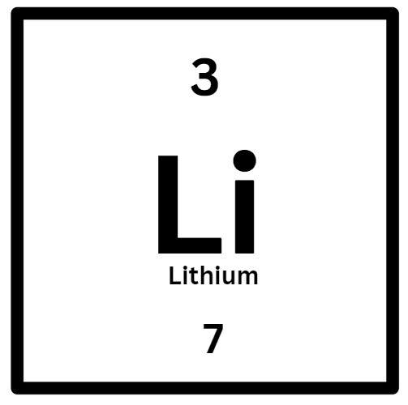
Atom Building Activity
Find the number of protons, neutrons and electrons
Protons =
Electrons =
Neutrons =
Build your atom below by putting the colored dops in the circles below!

Slide 3
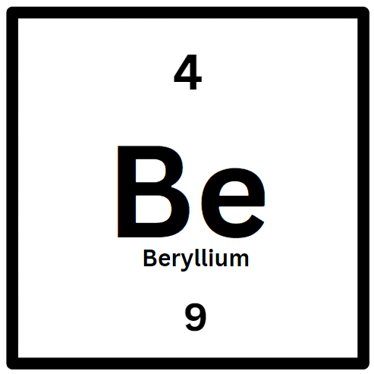
Atom Building Activity
Find the number of protons, neutrons and electrons
Protons =
Electrons =
Neutrons =
Build your atom below by putting the colored dops in the circles below!

Slide 4
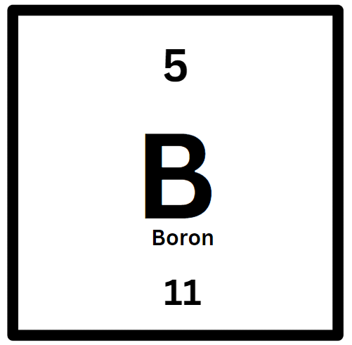
Atom Building Activity
Find the number of protons, neutrons and electrons
Protons =
Electrons =
Neutrons =
Build your atom below by putting the colored dops in the circles below!

Slide 5
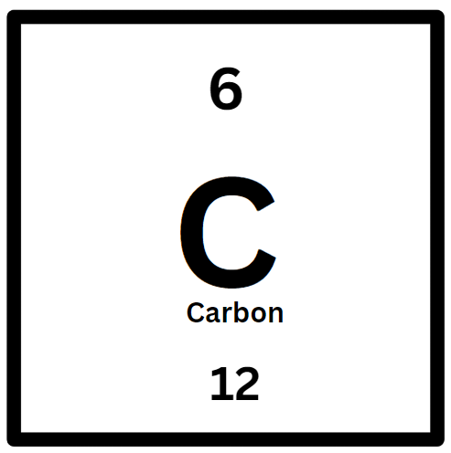
Atom Building Activity
Find the number of protons, neutrons and electrons
Protons =
Electrons =
Neutrons =
Build your atom below by putting the colored dops in the circles below!

Slide 6
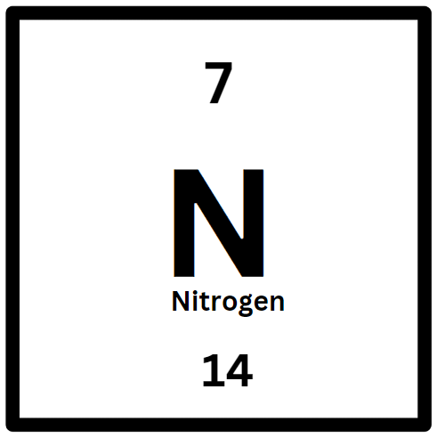
Atom Building Activity
Find the number of protons, neutrons and electrons
Protons =
Electrons =
Neutrons =
Build your atom below by putting the colored dops in the circles below!

Slide 7
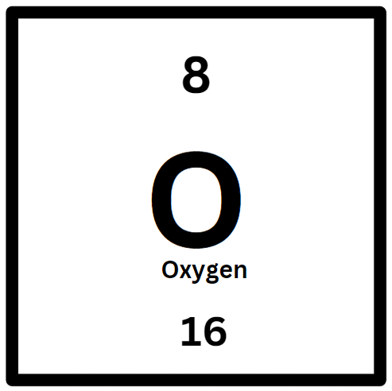
Atom Building Activity
Find the number of protons, neutrons and electrons
Protons =
Electrons =
Neutrons =
Build your atom below by putting the colored dops in the circles below!

Slide 8
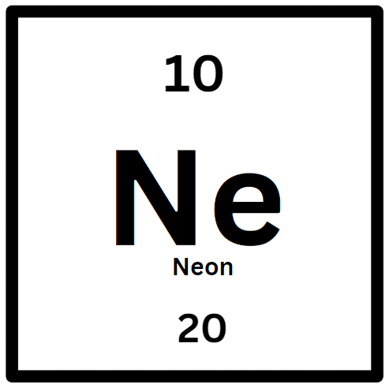
Atom Building Activity
Find the number of protons, neutrons and electrons
Protons =
Electrons =
Neutrons =
Build your atom below by putting the colored dops in the circles below!

Slide 9
Atom Building Activity
Find the number of protons, neutrons and electrons
Protons =
Electrons =
Neutrons =
Build your atom below by putting the colored dops in the circles below!

Slide 10
Atom Building Activity
Find the number of protons, neutrons and electrons
Protons =
Electrons =
Neutrons =
Build your atom below by putting the colored dops in the circles below!

