Slide 1
What is
Nuclear Power?
Notes:
Warren

Slide 2
What is Nuclear Power?
We need electricity to power all of the things in our home!
One way we can make electricity is through using the power of atoms!
Notes:
Warren

Slide 3
What are Atoms?
Atoms are the smallest piece of anything
By splitting some atoms we can release
Energy!
Notes:
Warren

Slide 4
How do we use energy from atoms?
We change the energy from splitting atoms into electricity using a nucellar power plant
There is a nuclear power plant located right here in New Brunswick. Do you know where?
Notes:
Warren

Slide 5
Point Lepreau
Right here in New Brunswick we have our own Nuclear Power Plant located in Lepreau, New Brunswick. Not far from Saint John
Notes:
Alex

Slide 6
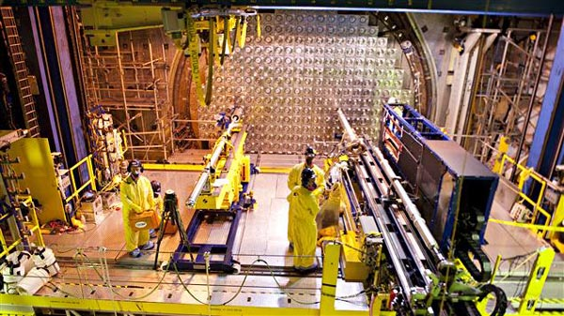
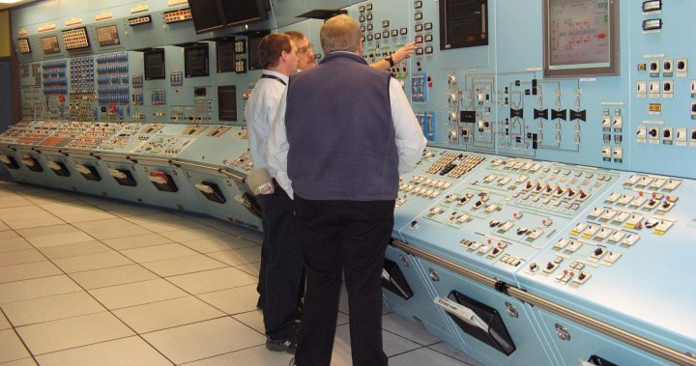
Point Lepreau
Notes:
Alex

Slide 7
Nuclear Energy Science for Kids
Notes:
Alex

Slide 8
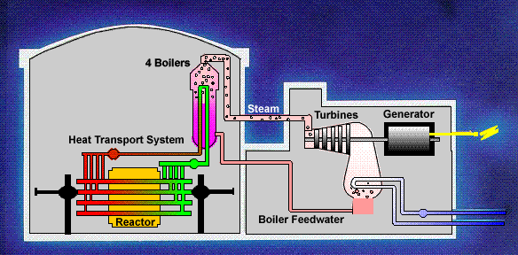
Notes:
Alex

Slide 9
Notes:
Warren

Slide 10
BODY BREAK
Let’s pretend to be
Neutrons!
Notes:
Warren

Slide 11
How Small are Atoms?
To understand where nuclear energy comes from we have to understand atoms!
See how small they really are!
Notes:
Warren

Slide 12
Build your own Atoms!
To understand atoms better lets build our own atoms
For this we will be using information from the periodic table of elements and some math to help us!
Notes:
Warren

Slide 13
Atoms
Protons
Neutrons
Electrons
Notes:
Warren Ipad

Slide 14
How Many Protons, Neutrons, and Electrons? Lets Count!
Protons
Neutrons
Electrons
3
4
3
Notes:
Warren Ipad

Slide 15
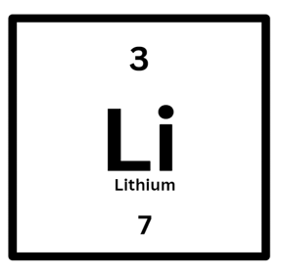
How Many Protons, Neutrons, and Electrons?
Protons
Neutrons
Electrons
Notes:
Warren Ipad

Slide 16
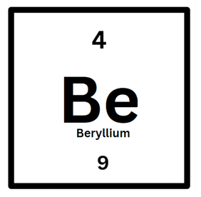
You Try! How Many Protons, Neutrons, and Electrons?
Protons
Neutrons
Electrons
Notes:
Warren Ipad

Slide 17
Thank You!!
Notes:
Warren

