Slide 1
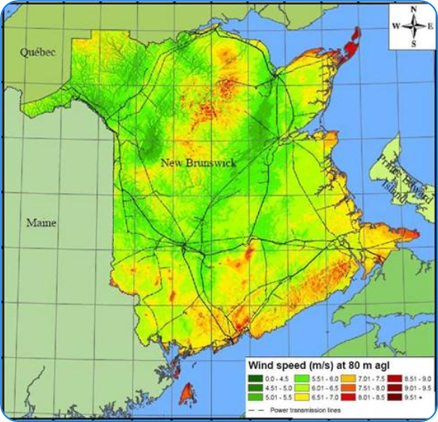
Wind Blade Energy Challenge
Introduction
Generating energy from wind is something that has been used since antiquity. In the past wind wills were used to power sawmills, and mill grain. Today we recognize that harnessing power from the wind is a renewable resource that is clean and does not produce carbon dioxide emissions. As the climate crisis intensives around the world, it is imperative to find other methods to produce power that does produce carbon dioxide.
In New Brunswick, wind power is quickly becoming an important part of the province’s energy grid. Many of these projects are in partnership with First nations. The province currently has seven wind farms operating:
Figure 1: New Brunswick Wind Atlas – Government of New Brunswick
Wind Farm | Operator | Megawatts produced (MW)
Burchchill Wind Project | Natural Forces / Neqotkuk Maliseet Nation / Saint John Energy | 42
Caribou Wind Park | ENGIE / NB Power | 99
Lamèque Wind Farm | Acconia Energy / NB Power | 45
Kent Hills Wind Farm | Transalta / Natural Forces / NB Power | 96
Wisokolamson Energy Project | SWEB Development / Woodstock First Nation / NB Power | 18
Wocawson Energy Project | Natural Forces / Tobique First Nation / NB Power | 20
Oinpegitjoig (Richibucto) Wind Project | Natural Forces / Pabineau First Nation/ NB Power | 3.8
Cap-Pelé Wind | WKB Community / NB Power | 2.35

Slide 2
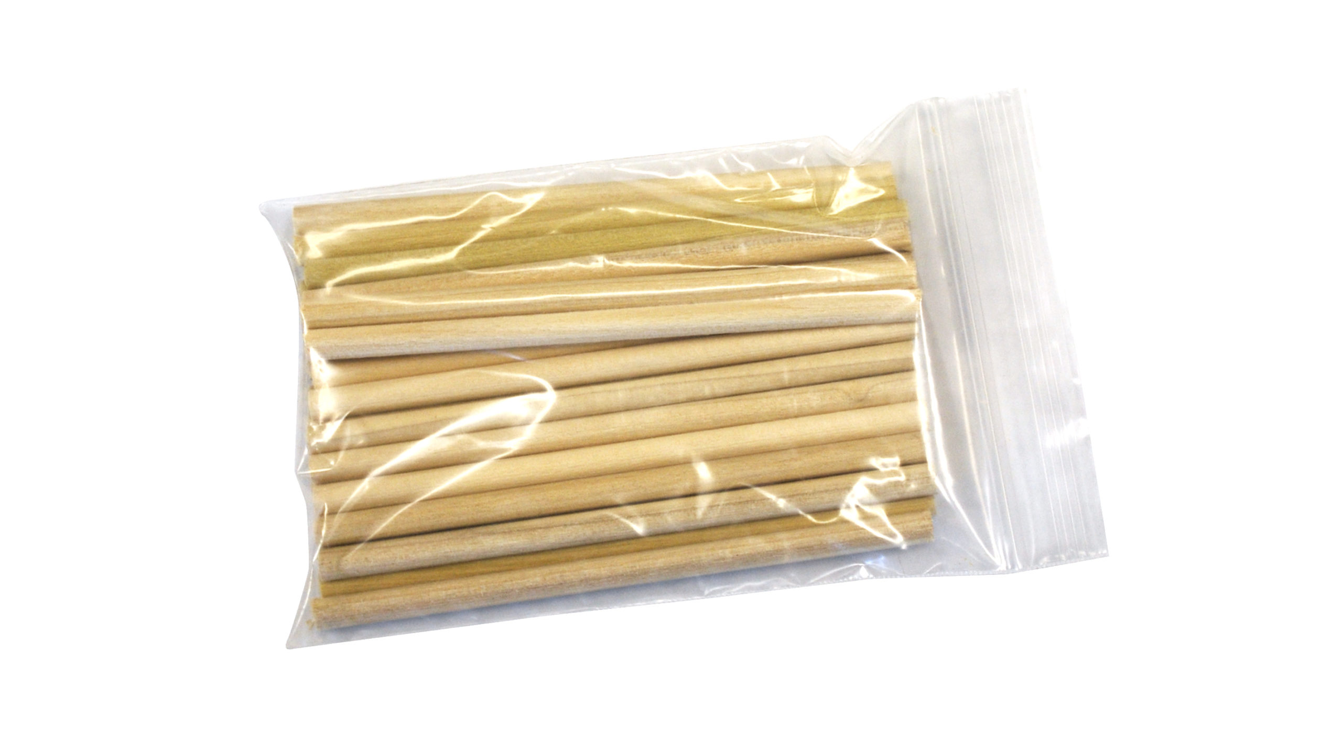
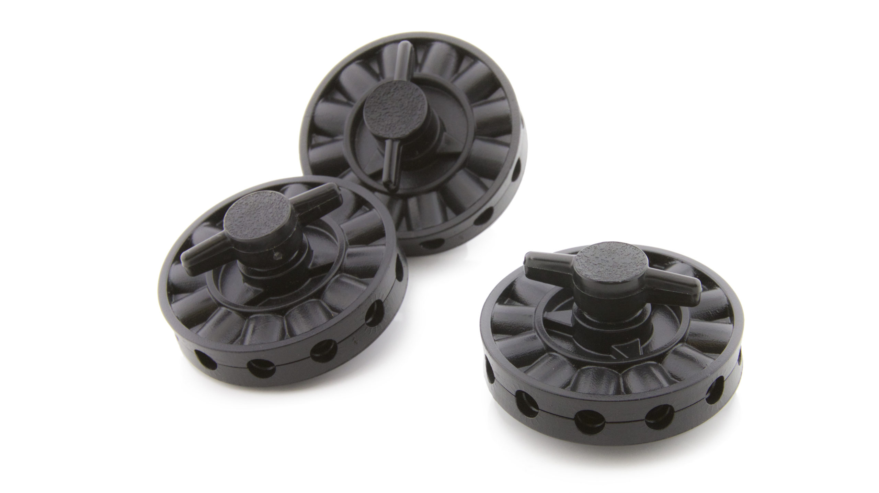
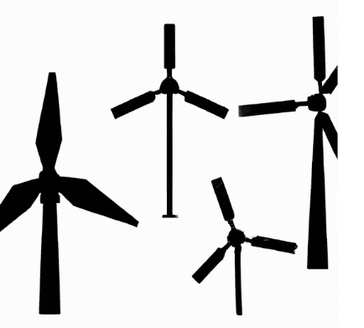
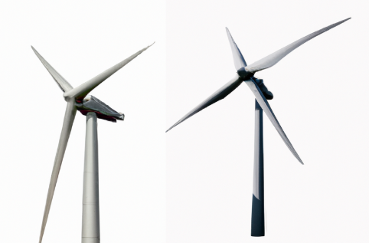
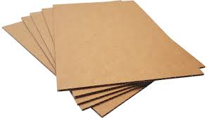
Wind Blade Energy Challenge
Introduction
Wind turbines work by using wind blades that capture the wind to spin a turbine to produce electricity. There are many wind turbine designs, and your task is to use the materials available to make a wind blade design that produces the most amount of energy possible.
For this activity you will be put into groups of 4 or 5. You will be able to use scissors, tape, pens, and pencils to make your own Wind Blade Design.
Each group will be given Wind Turbine Hubs and Wooden Dowels. After your first design is complete you can come up and test your design on the central wind tower.
For this activity you can choose one variable to manipulate: Blade Shape, Blade Material, or Number of Blades. Just remember to select only one and control for all the others.
Blade Material
Use different blade materials, but keep the shape and number of blades the same
Blade Shape
Change the shape but keep the material and number of blades the same
Number of Blades
Use different number of blades but keep the material and blade shape the same.

Slide 3
Wind Blade Energy Challenge
Step 1: Planning Your Experiment
What variable is your group going to change?
Why do you think this will produce the most energy?
Draw a diagram of your wind blade designs:

Slide 4
Wind Blade Energy Challenge
Step 2: Building & Testing Your Design
Now that you know what variable you will change. Build your design with the provided materials, then test your design on the wind tower.
After that make, your changes and test again!
Make sure to record your data below!
Gather your data and record it in a table format. Depending on what you chose to measure your data table may look different from other classmates.
Circle Your Blade Variable Material Shape Number | Energy Output Voltage (V)

Slide 5
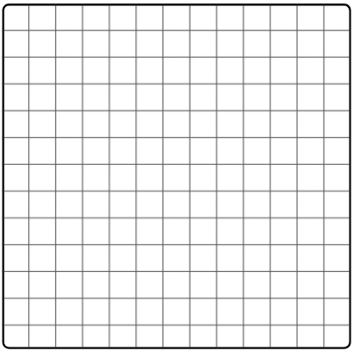
Wind Blade Design Science Inquiry Project
Step 3: Graphing your data
Use the graph paper below to graph your data. Make sure to use consistent spacing and pick an appropriate graph for your data (scatter plot graph, bar graph, etc.). Make sure to include a title and label your axis with units where applicable.

Slide 6
Wind Blade Design Science Inquiry Project
Step 4: Analyzing your results
Looking at your data and graph, what happened when you changed your
design? Did it get better or worse?
Which variable do you think had the biggest impact on energy output,
Blade Material, Blade Shape, or Blade Number? Why?
If you were to conduct this experiment again, what would you change?
Would you measure something different?

