Slide 1
MODULE 1: The Entrepreneurial Spirit
ENTREPRENEURIAL
VIDEO CLIPS

Slide 2
Your Host
Vincent-Luc Brouillard Owner

Slide 3
THESE VIDEO CLIPS ARE PRESENTED BY :

Slide 4
WHY ARE WE HERE?
-Entrepreneurs are very important individuals in our economies and communities.
-They create wealth, value and employment.
-Innovators and change makers.

Slide 5
The themes of this series of video clips
1. The Entrepreneurial Spirit
2. The Business Plan and the Business Model Canvas
3. Finances
4. Marketing
and Branding

Slide 6
The Entrepreneurial Spirit
What’s an Entrepreneur?
The various styles of entrepreneurship?
Where do you start?

Slide 7
Whats an ENTREPRENEUR?
Entrepreneur -> Entreprendre
Designating a person who undertakes a project.

Slide 8
An entrepreneur is an individual who starts a new business, bearing most of the risks and enjoying most of the rewards. The entrepreneur is generally seen as an innovator, a source of new ideas, goods, services and activities / or processes.

Slide 9
The Various Styles of Entrepreneurship.
Product
Service
Content (web)
Artist
Social
Intrapreneurs

Slide 10
Where do you start?
Idea
You

Slide 11
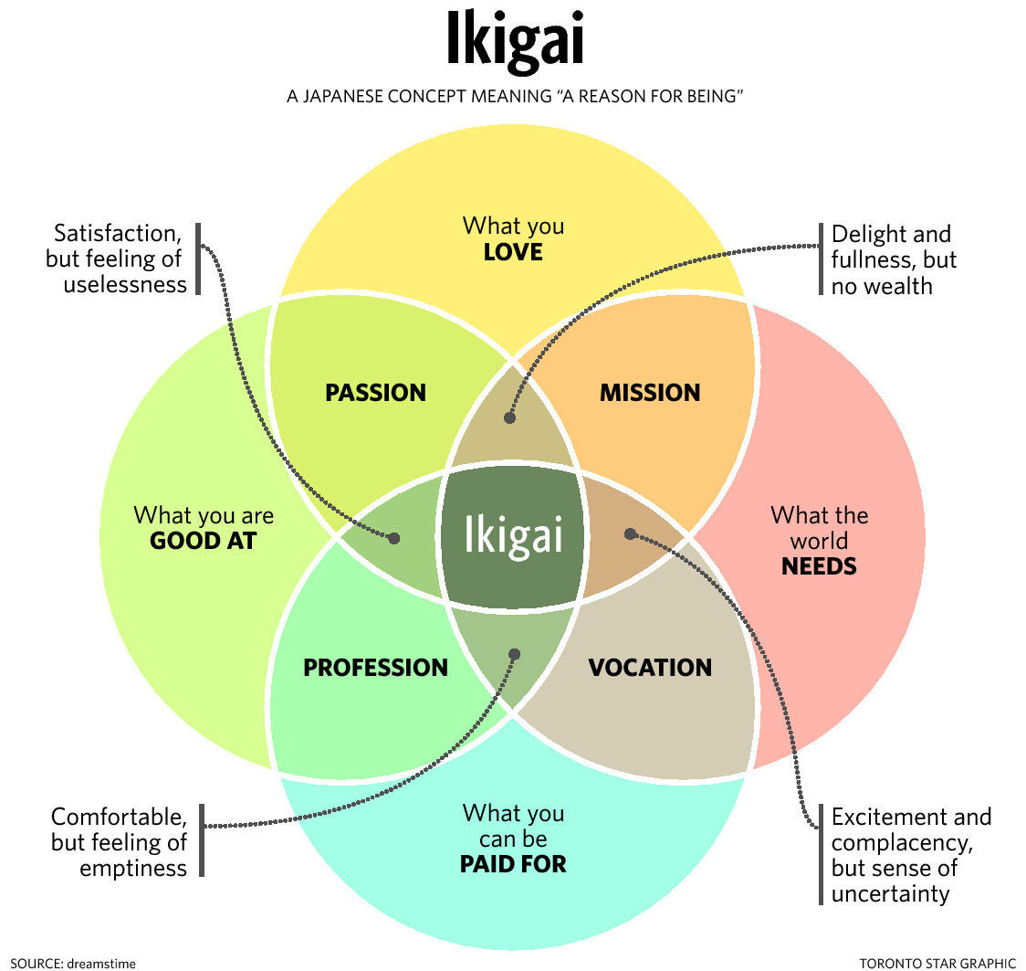
Start with yourself.

Slide 12
The Importance of Networking.

Slide 13
Master
Your Money

Slide 14
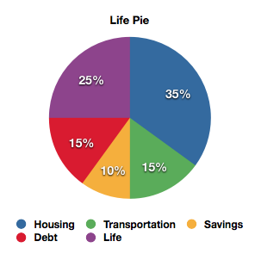
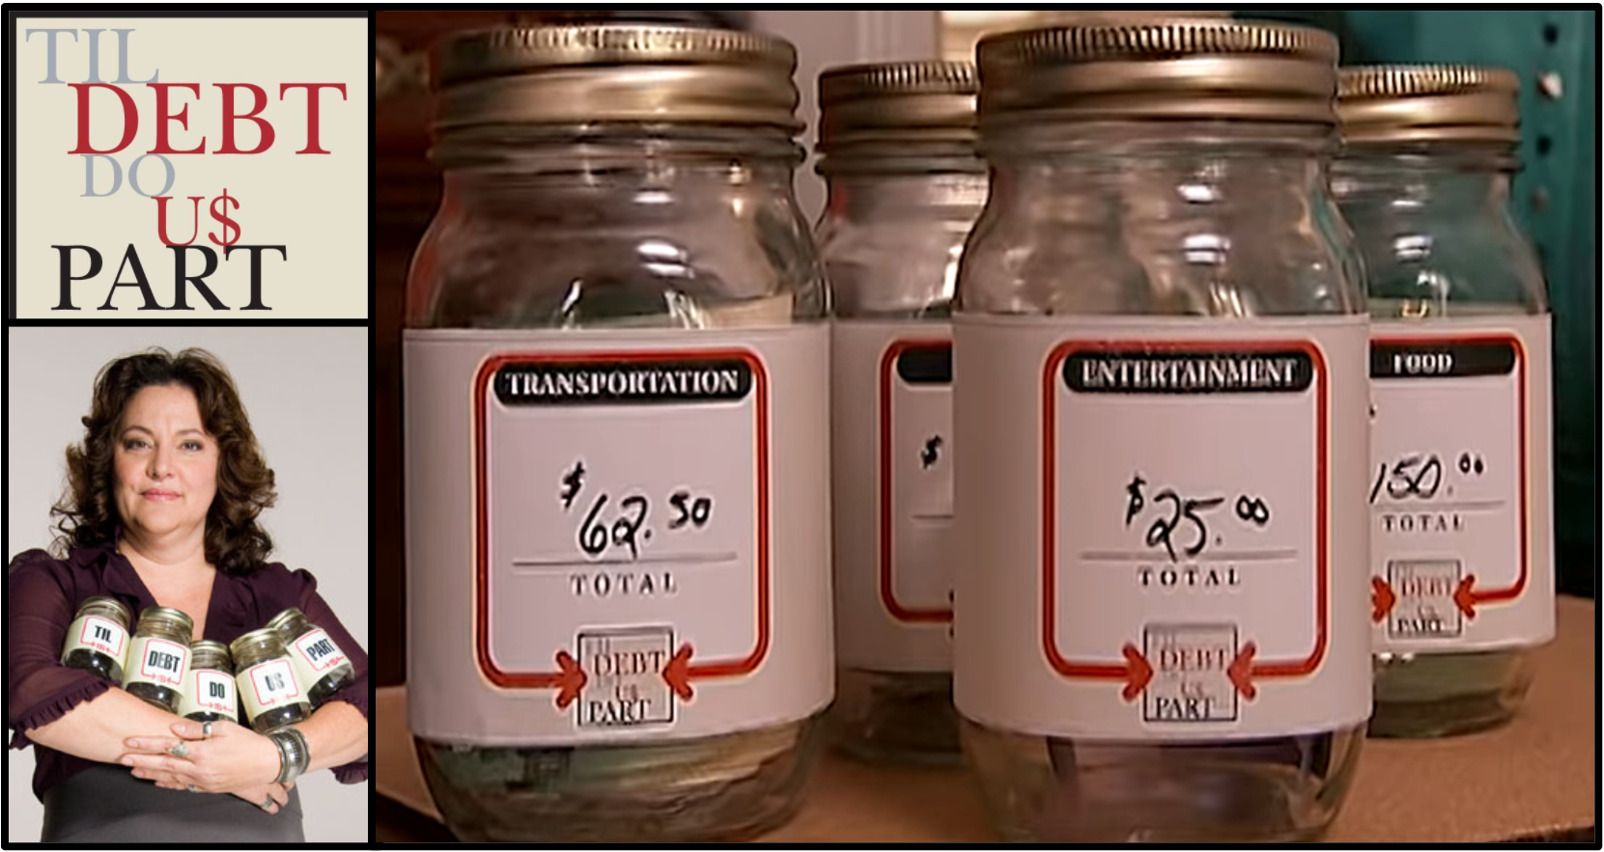

Slide 15
Accounts
G = Groceries
T = Transportation
G = Gas
M = Maintenance
E = Entertainment
R = Restaurant
M = Movies
C = Clothing & Gifts
L = Clothes
P = Pharmacy
O = Other
Date | Compte | Description | $$$

Slide 16
Date | Account | Description | $$$
2 | T-G | Irving @ Moncton | 24,95
5 | G | Wal-Mart | 63,04
5 | G | Sobey’s | 49,87
6 | E-R | Caffée @ Startbucks | 6,13
7 | Telus | Cellulaire Nov 2020 | 100
8 | E-R | Diner avec amis Pub | 23,33
8 | T-G | Shell Miramichi | 35,77
9 | C-P | Shoprz Contact solution | 12,96
10 | E-R | McDo @ Bathurst | 27,54
11 | E | Netflix | 9,99
12 | G | SuperStore | 89,02
14 | T-G | Ultramart Bathurst | 29,46
14 | C-L | Winners | 23,78
14 | NB Power | Power Bill Dec. 2019 | 150
Accounts
G = Groceries
T = Transportation
G = Gas
M = Maintenance
E = Entertainment
R = Restaurant
M = Movies
C = Clothing & Gifts
L = Clothes
P = Pharmacy
O = Other

Slide 17
Variable |  |  |  |  | Fixed
Groceries |  |  | $380.56 |  | Loyer | $580.00
Transportation |  |  | $287.89 |  | Cell | $100.00
 | Gas | $235.11 |  |  | NB Power | $150.00
 | Maintenance | $52.78 |  |  | Internet | $100.00
Entertainment |  |  | $246.39 |  | Inssurance | $125.00
 | Restaurant | $211.12
 | Movie | $35.27 |  |  | Total | $1,055.00
Clothing & Gifts |  |  | $83.12
 | Clothing | $52.76 |  |  | Revenues
 | Pharmacy | $15.32
 | Gifts | $15.04 |  |  | Salairy | $2, 800.00
Other |  |  | $25.00
 |  |  |  |  |  | $722.04
Total |  |  | $1,022.96

Slide 18
 | Grocery | Transportation | Entertainment | Clothing & gifts | Autres | TOTAL
Jan | $250.00 | $300.00 | $400.00 | $60.00 | $1,500.00 | $2,510.00
Feb | $300.00 | $200.00 | $600.00 | $65.00 | $40.00 | $1,205.00
Mar | $325.00 | $350.00 | $300.00 | $75.00 | $35.00 | $1,085.00
Apr | $400.00 | $1,000.00 | $250.00 | $100.00 | $85.00 | $1,835.00
Mai | $285.00 | $240.00 | $300.00 | $150.00 | $30.00 | $1,005.00
Jun | $290.00 | $220.00 | $350.00 | $85.00 | $95.00 | $1,040.00
Jul | $315.00 | $310.00 | $285.00 | $200.00 | $200.00 | $1,310.00
Aug | $410.00 | $280.00 | $500.00 | $100.00 | $40.00 | $1,330.00
Sep | $350.00 | $360.00 | $215.00 | $75.00 | $65.00 | $1,065.00
Oct | $295.00 | $1,000.00 | $340.00 | $50.00 | $80.00 | $1,765.00
Nov | $375.00 | $275.00 | $205.00 | $200.00 | $35.00 | $1,090.00
Dec | $450.00 | $385.00 | $350.00 | $300.00 | $105.00 | $1,590.00
TOTAL | $4,045.00 | $4,920.00 | $4,095.00 | $1,460.00 | $2,310.00 | $16,830.00

Slide 19
Thank you!
Please keep this slide for attribution.

