Slide 1
A Presentation of the Saint John Community Loan Fund

Slide 2
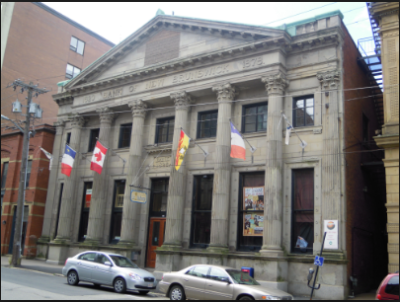

Slide 3
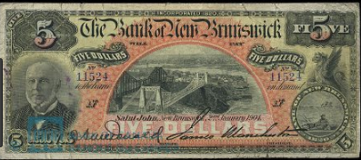

Slide 4
Where to bank your $$$

Slide 5
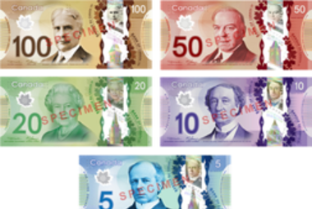
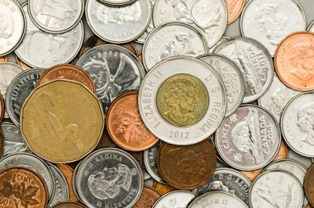

Slide 6
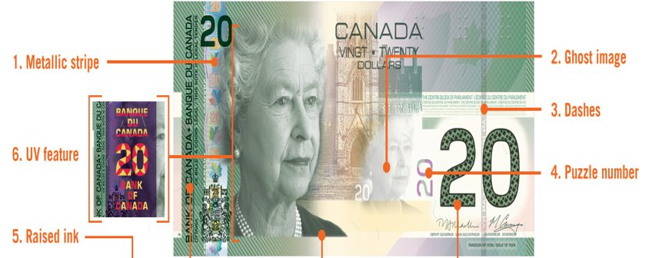

Slide 7
Viola Desmond

Slide 8
Who “Governs” These Banks?

Slide 9
Who “Governs” These Banks?
FCNB.ca

Slide 10
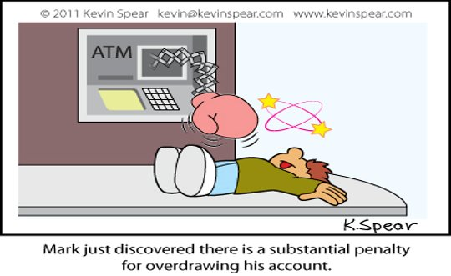
HOW DO BANKS MAKE MONEY?

Slide 11
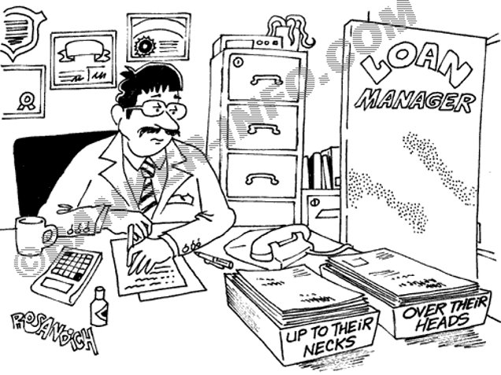

Slide 12
Relationship with money

Slide 13
Relationship with money

Slide 14
Environment

Slide 15
What is a Budget
A budget is a plan that tells your money where it should go; instead of you wondering where it went.
- Dave Ramsey

Slide 16
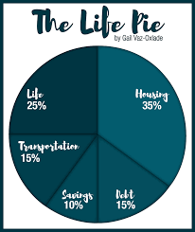
How Much IS too Much?

Slide 17
Wages

Slide 18
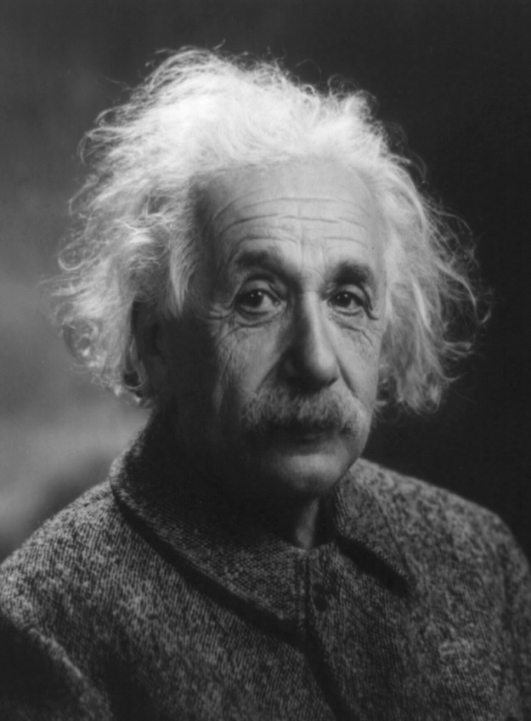
Compound interest
The greatest force in the universe today is compound interest
-Albert Einstein

Slide 19
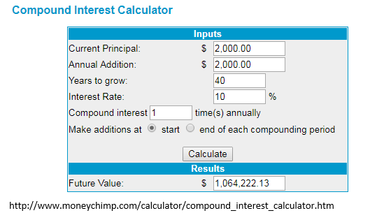
Compound interest

Slide 20
Rule of 72

Slide 21
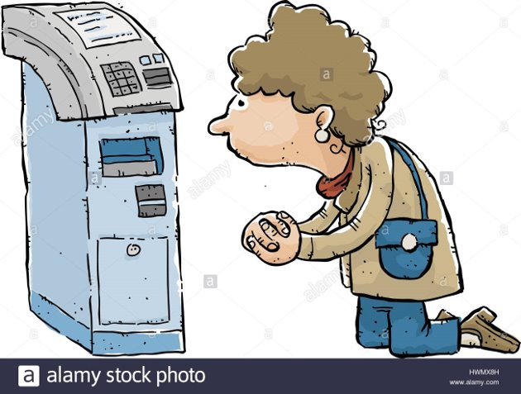

Slide 22
