Slide 1
Workplace Etiquette

Slide 2
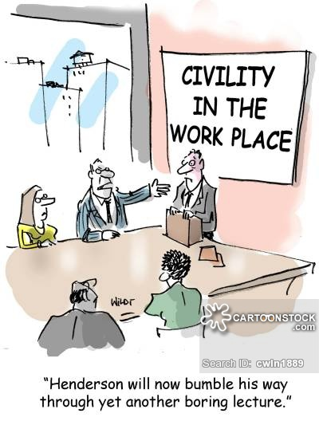
Workplace Civility

Slide 3
Workplace civility
Civility is more than just good manners. It is behavior that preserves the norms for mutual respect. It is demonstrated through manners, courtesy, politeness, and awareness of others’ rights and feelings.

Slide 4
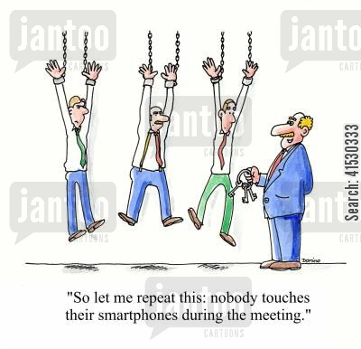

Slide 5
10 tips to enhance workplace civility
Pay attention
    put away cell phones
    Limit personal conversations

Slide 6
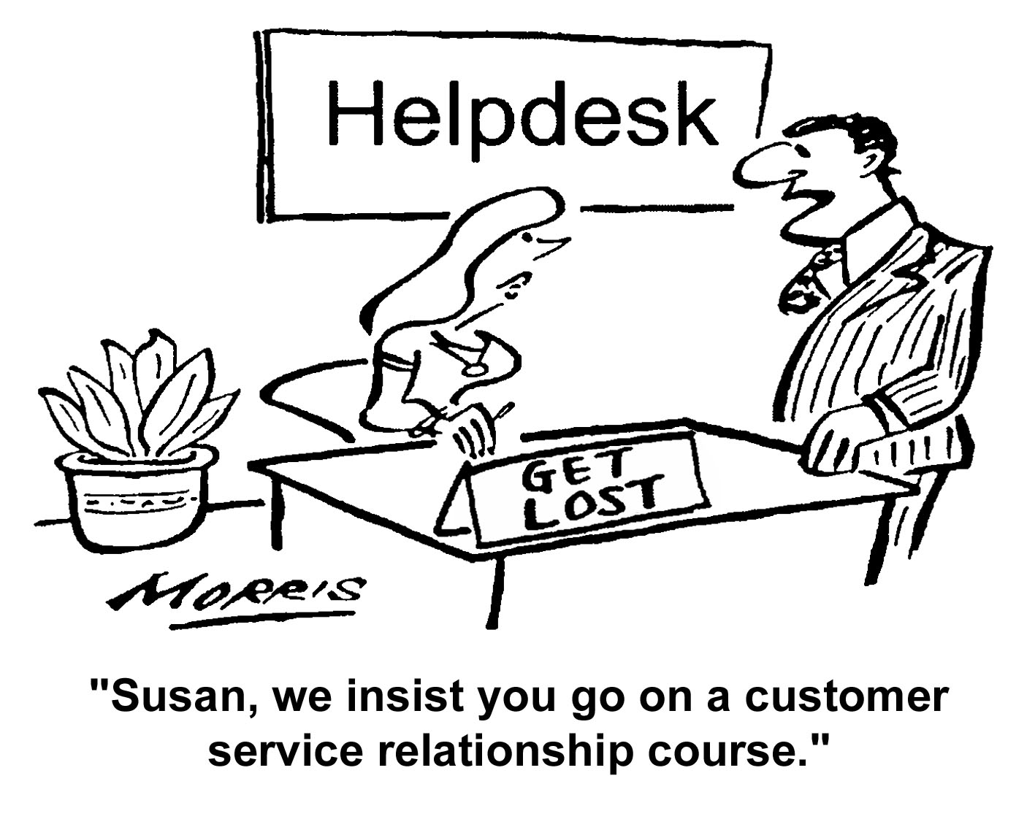

Slide 7
10 tips to enhance workplace civility
Please …. Thank you ….excuse me…I’m sorry
  Treat co-workers, superiors, clients, and the public with respect
  Don’t hesitate to acknowledge mistakes

Slide 8
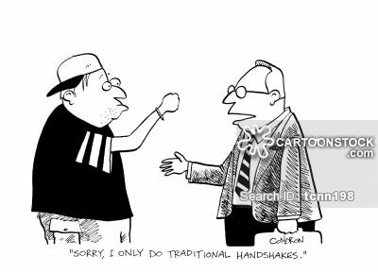

Slide 9
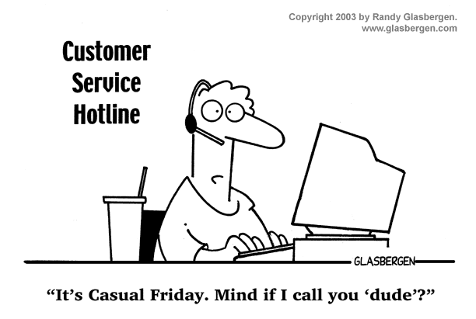

Slide 10
10 tips to enhance workplace civility
Address people correctly and with courtesy
  Always shake hands ….with a firm grasp
  Stand when being introduced
  Say hello and goodbye,
  Eye contact when speaking with someone
  Use Mr., Mrs., and Ms. When appropriate
  Avoid “dear”, “honey”, and nicknames

Slide 11
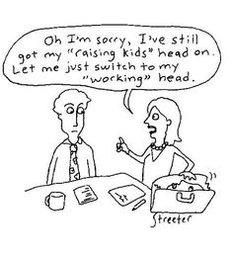

Slide 12
10 tips to enhance workplace civility
Think before you speak
  Humour contributes to a healthy workplace….ensure it is respectful and welcome by all
  Be sure to be taken seriously
  Be cautious about how much you share of personal life

Slide 13
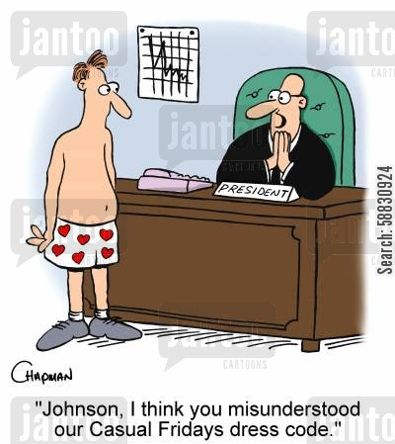

Slide 14
10 tips to enhance workplace civility
Take care of yourself
  Adhere to company dress codes
  Attend to personal hygiene ….clean body and clean clothes
  Seek help for personal issues
  Being stressed and busy is not an excuse for poor workplace manners

Slide 15
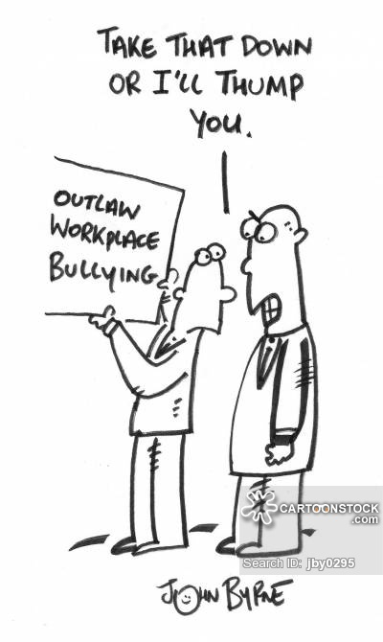

Slide 16
10 tips to enhance workplace civility
Don’t react…respond
  Understand your own triggers …is the behavior intended to offend? Take a minute before responding to examine your feelings
  Respond appropriately ……Avoid passive –aggressive behaviours
  Develop Assertive behavior….”I” statements to clearly express your feelings

Slide 17
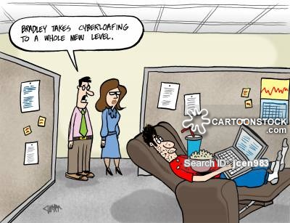

Slide 18
10 tips to enhance workplace civility
Use email and Social media responsibly
  Follow company Guidelines (email and internet use)
  CONDUCT SENSITIVE EXCHANGES FACE TO FACE
  Avoid Social media at work and sharing work related events on Social Media…. Unless part of the job
  “Beware of what you share”

Slide 19
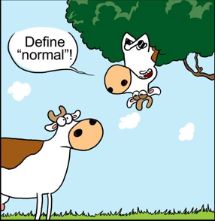

Slide 20
10 tips to enhance workplace civility
Be inclusive
  Respect diversity
  Include co-workers in conversations, lunches, get-togethers
  Follow the “Kindergarten rules of sharing”

Slide 21
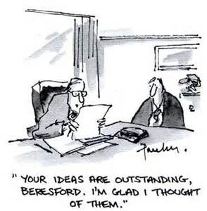

Slide 22
10 tips to enhance workplace civility
Give credit
  Be generous with genuine praise for co-workers’ accomplishments
  Let your own work speak for itself

Slide 23
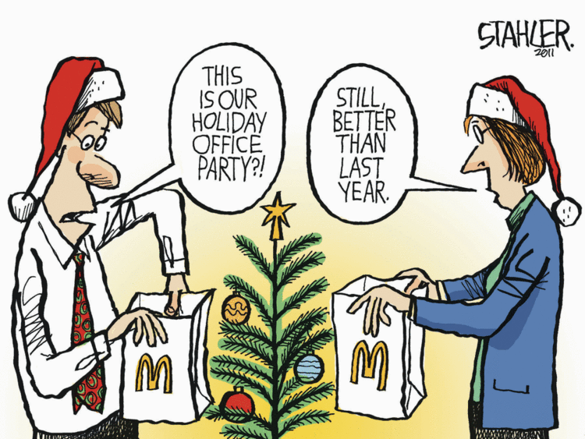

Slide 24
10 tips to enhance workplace civility
Be a positive Influence
  Address situations when they arise…gossip, inappropriate joking, etc
  Get involved (volunteer opportunities, social committee, etc.)

Slide 25
“people forget that they are not only hired to do a good job at their assigned tasks, but to be a positive influence on the team they work with ….this is also an important part of what they are being paid to do.”

Slide 26
10.1 Social Media
Keep life and work separate,…..Ask before tagging,
keep it clean,…..use humour appropriately
Avoid aggressive online debate or offensive posts
Build a legacy for the future….your online presence should inspire pride , not regret
https://www.sportsnet.ca/hockey/nhl/blues-goaltender-jordan-binnington-addresses-controversial-tweets/

Slide 27
Blues goaltender Jordan Binnington addresses controversial tweets

