Slide 1
Eggs Away!
A Learning Activity for K-2

Slide 2
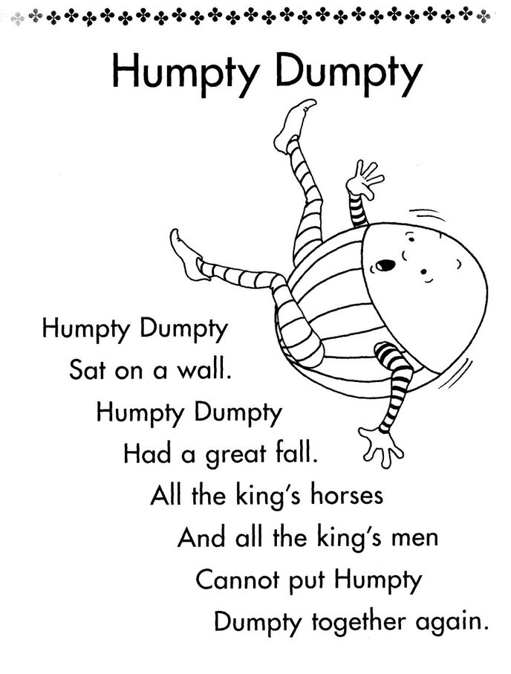
Poem

Slide 3
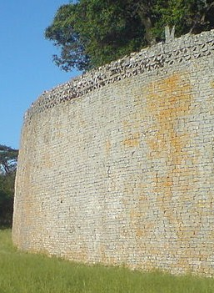
Walls from the Past

Slide 4
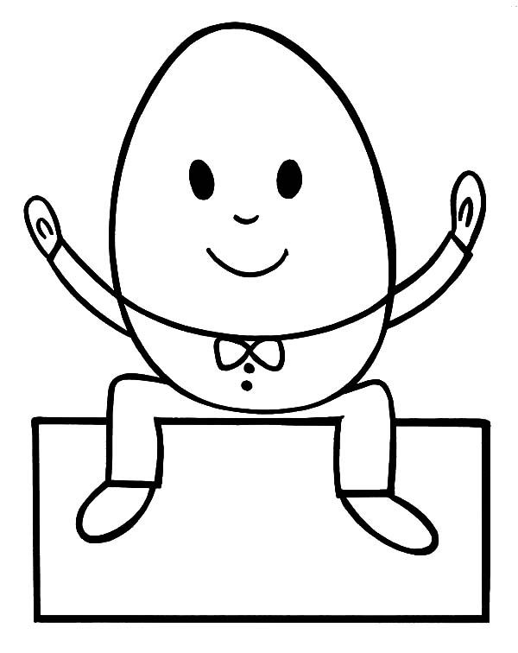
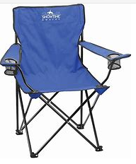
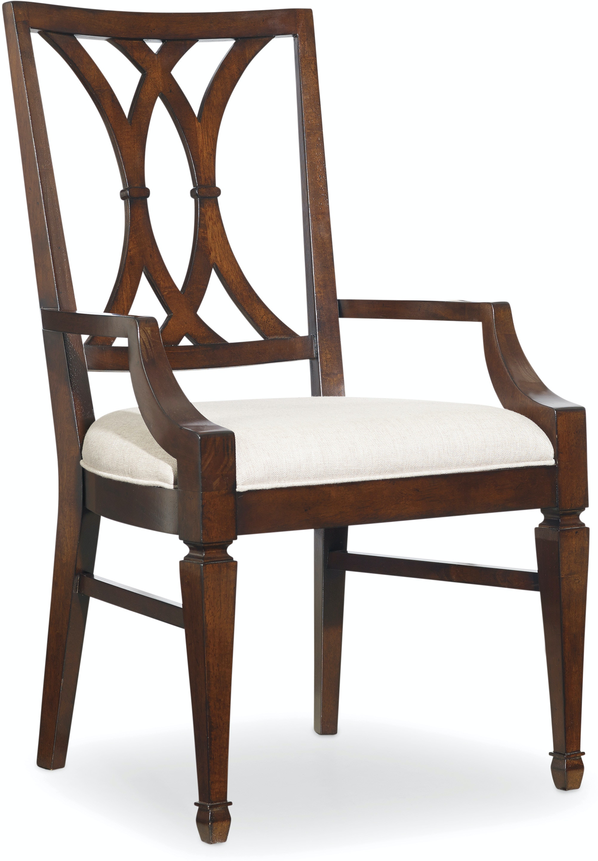
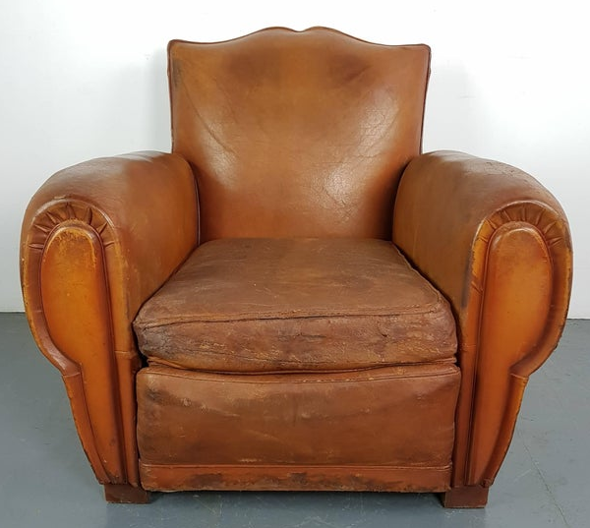
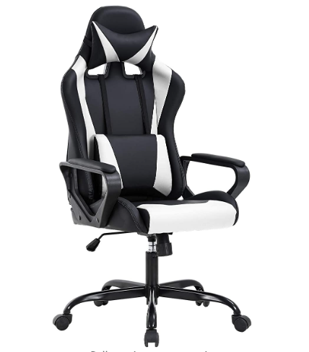
CHALLENGE: To create a chair for Humpty Dumpty
With your chair, he will be able to sit comfortably and safely on top of the wall anytime without worrying about falling again!
Your Chair MUST:
Have legs
Have a seat
Hold up against wind & rain

Slide 5
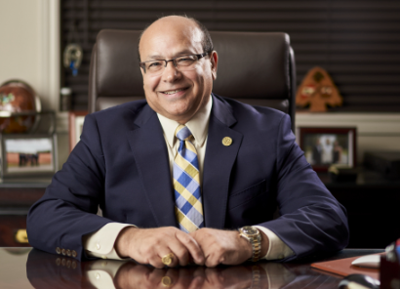
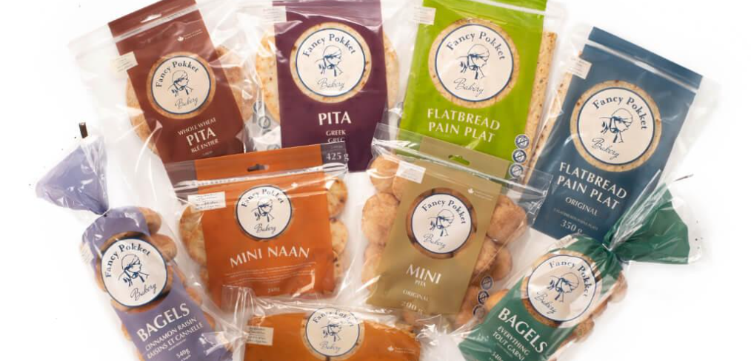
Entrepreneur
begins or organizes a business or businesses with risk
Entrepreneurs: dream big to solve problems, listen, and then TRY! (and fail and try again!)
Meet Mike Timani – the President and founder of Fancy Pokket in Moncton, New Brunswick. Coming to Canada in 1976, from Lebanon, Mike opened a small bakery in Moncton featuring Pita Bread – something that he couldn’t find at other restaurants or stores. Overcoming many obstacles, Fancy Pokket is now Atlantic Canada’s largest producer of pita bread, bagels, flatbread, and tortilla wraps.
Could you be the next entrepreneur?

