Slide 1


Classroom-SIZED Monopoly
A Learning Activity for Grades 3-5

Slide 2



Allowance & Spending
What is an allowance? Do you get one?
How else do you get money?
If you don’t have enough money to buy the things that you want:
Would you buy something cheaper?
OR
Would you save up money to buy it later?
(Take a Class Vote!)
Credit: Getty Images/iStock photo

Slide 3
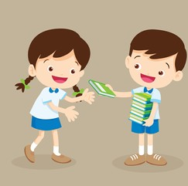
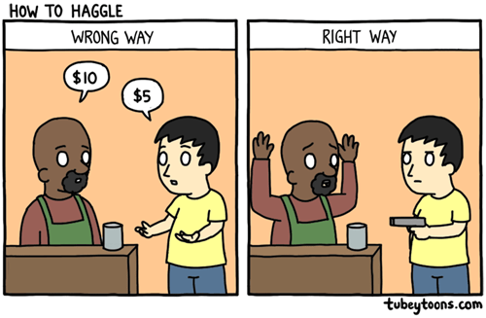


loaning
What do each of these terms mean?
Bargaining
Bartering/trading

Slide 4

Shopping Spree
Shopping Spree Game:
Students take turns subtracting the sum (or product) of 2 dice from 100. Players keep subtracting their “purchases” until one player reaches 0 exactly. Be creative – you can even name what you purchased each time! The first person to reach zero WINS!
100
Player 1: _________
Player 2: _________
0

Slide 5
Choose a color!
Each team choose a color
Purple
BLUE
Yellow
Black
Red
Green

Slide 6
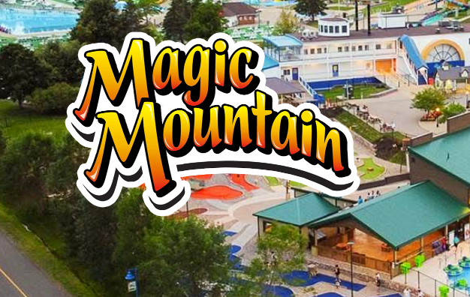
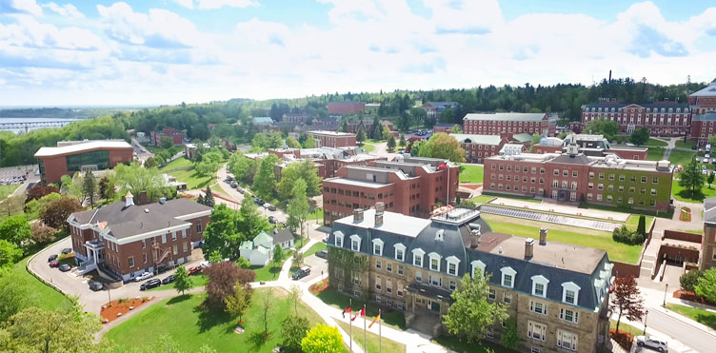

Where did you land?
Magic Mountain Amusement Park Moncton
$350
An Unowned Space: You can buy or pass. If you buy it, pay the amount listed. Place your group’s color block on it and collect its property card.
An Owned Space: You must pay rent (the amount written on the property paper).
An Owned Space with an Investment: You must pay the owner rent + $50 for each extra investment.
  Rent = $ 100
  You have to pay = $ 100+ $50 = $150
University of New Brunswick
Fredericton Campus
$250
McCabe’s Ice Cream Shop Cambridge-Narrows
$ 150

Slide 7



Where did you land?
Trade space: You can ask to trade a property with another group.
  If all agree to trade: Switch color block
  If all disagree: Nothing happens
  Storm Chips FEE: Pay $100 to have Storm Chips on hand – prepared for any nasty New Brunswick weather
  Go space: Earn $200 from the bank every time you pass or land on the space

Slide 8


WIN
Bankrupt
After a group declares bankruptcy, each group counts their leftover money and the value of their properties.
Add the money and property value (sale price + investment) together, whichever group has the most, WINS!
When a group doesn’t enough have money to pay rent or a bathroom fee.

Slide 9

WE NEED A PLAN!
Within a group, decide on jobs: money keeper, game piece on the board, investor, etc.
Strategy: What do you want to buy first? How much money should we set aside for the parking fee or unexpected costs? …
This Photo by Unknown Author is licensed under CC BY-SA-NC

Slide 10

Game time!

Slide 11



New Brunswick Career Connections
Did you enjoy playing this game? Check out real-life career opportunities here in New Brunswick:
Project Manager
Plans and executes projects while working with budgets and schedules
Sees the completion of investments to the end (like in our game)
Marketing, Communication, & Event Planner
Promotes and advertises a business (or city) via Social Media, email, tv, and other outlets
Designs and creates special events to bring in more visitors
Risk Assessment Officer
- Researches current trends and current needs
- Reports on what and when to make an investment (like in our game)

