Slide 1
From Mystery to Must-Have
A Learning Activity for K-2​

Slide 2
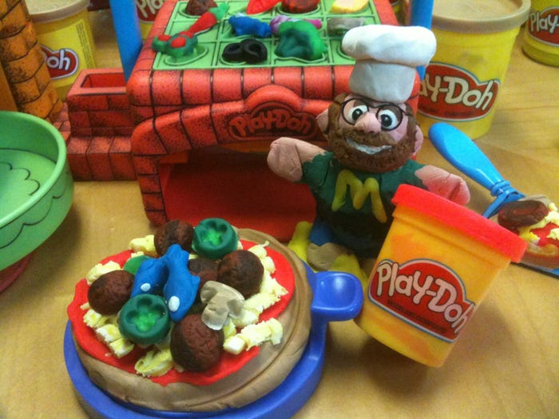
Can you guess what this famous product was first created for?
Wallpaper Cleaner – it gets the small bits of dirt off of the walls.
Play-Doh

Slide 3
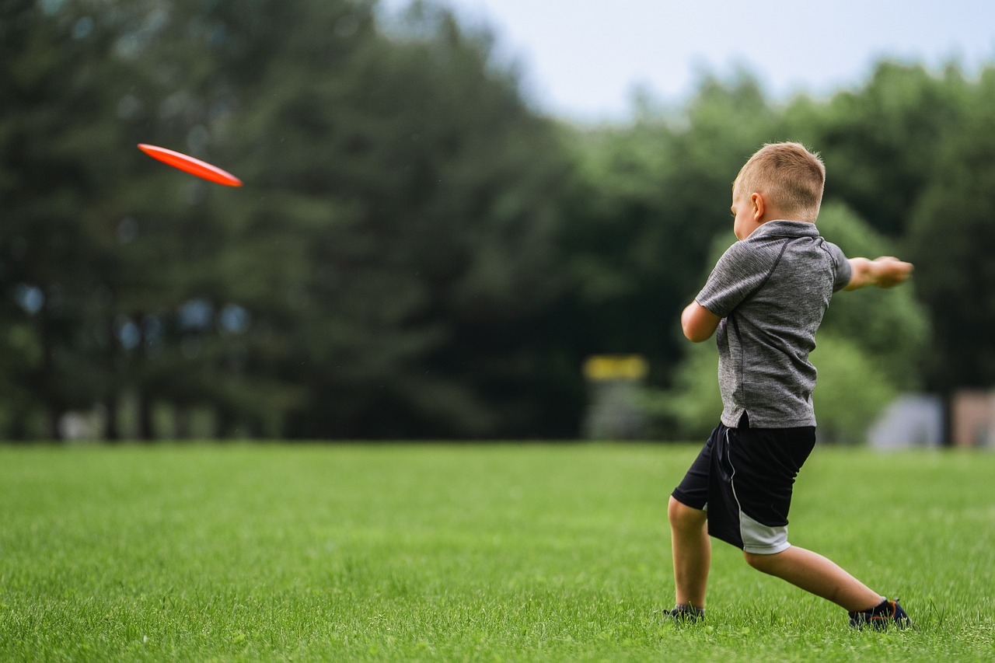
Can you guess what this famous product was first created for?
Pie Plates – college students started throwing the “frisbees” after they ate their pie.
Frisbee

Slide 4
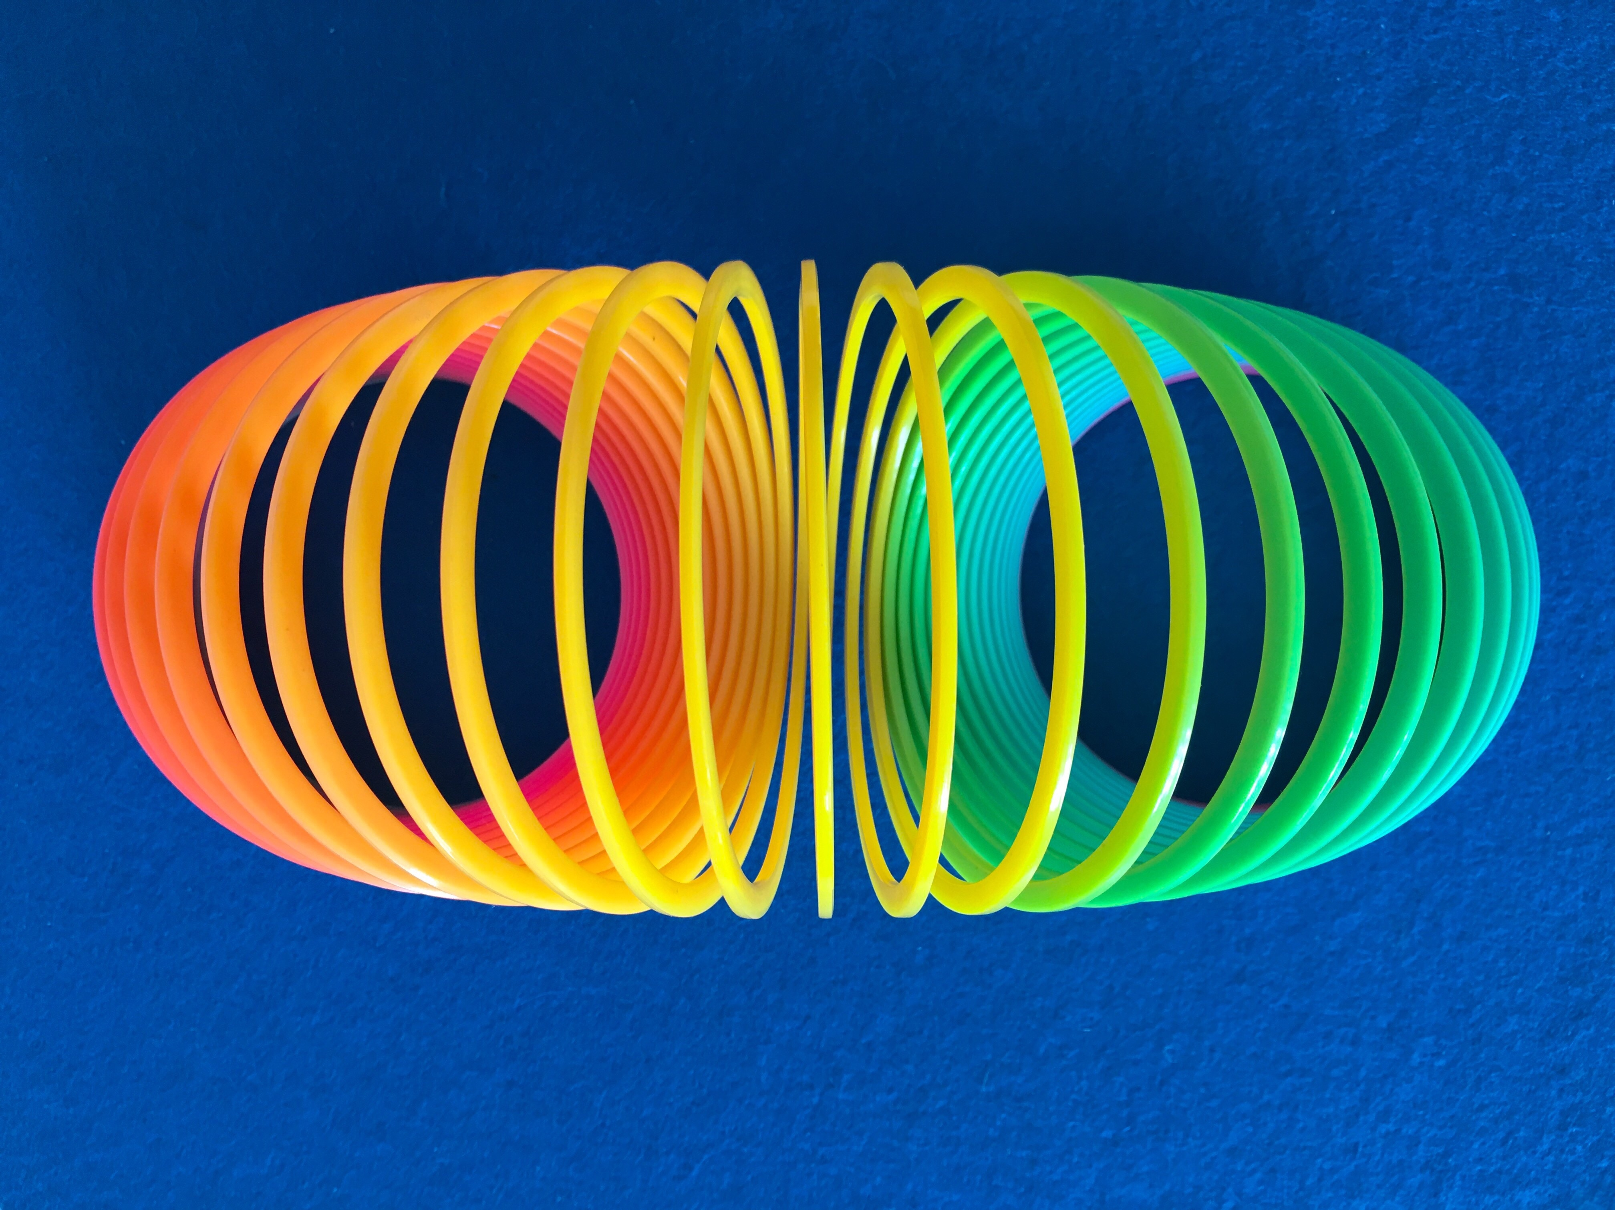
Can you guess what this famous product was first created for?
Navy Ship Equipment Stabilizer – it kept devices steady during rough seas.
Slinky

Slide 5
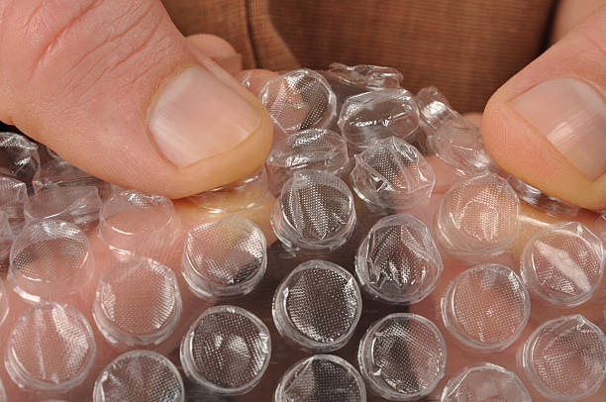
Can you guess what this famous product was first created for?
Wallpaper – original designers put two shower curtains together and air pockets formed. It didn’t sell very well and many years later, it was used to pack items safely.
Bubble Wrap

Slide 6
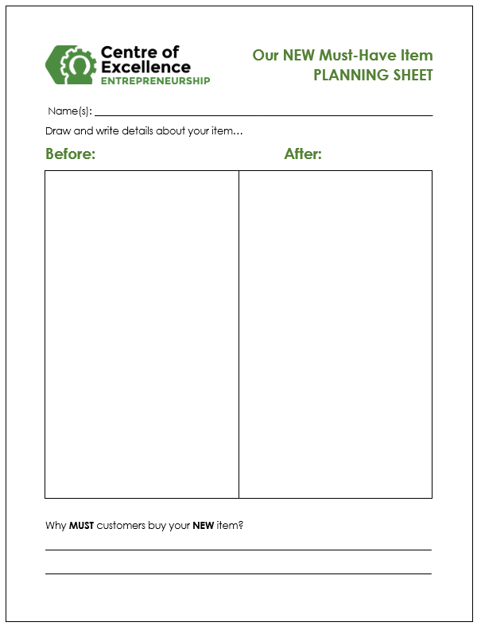
Your Turn!
Your Mystery Object

Slide 7
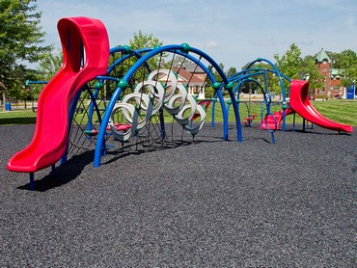
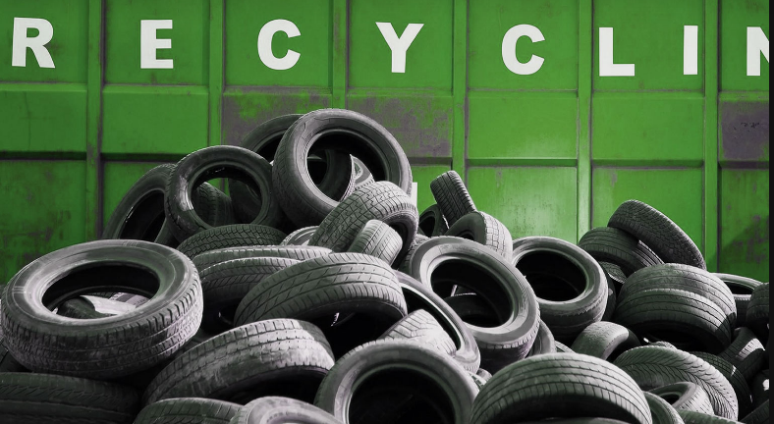
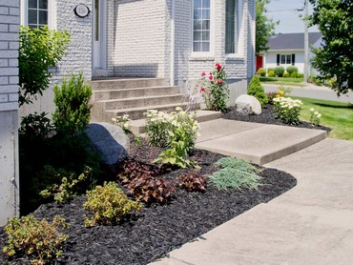
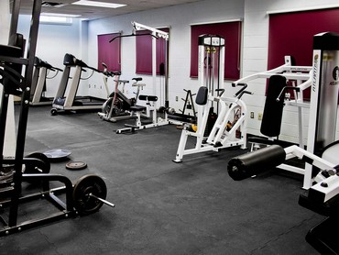
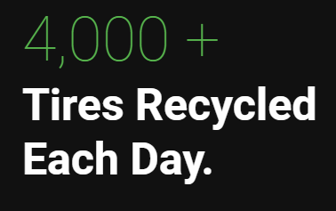
NB Entrepreneur (Minto)
Safe-Play Playground Surfaces
Mulch for Gardens
Old Tires
Rubber Matting for floors

