Slide 1
How would you like to pay?
Let’s shop till we drop class! Come shopping with me!
Wallet Wiggles!
Shopping Game
Click here to get started
I can describe the advantages and disadvantages of various methods of payment that can be used to purchase goods and services.

Slide 2
To Play:
Click on a shopper and they will take you to shop.You will decide how their cash flow will buy the items of choice. To help them make a decision, read the price, and look inside the wallet. You decide how do they purchase the items from what they have in their wallets….
Pick a friend and see where they lead you!

Slide 3
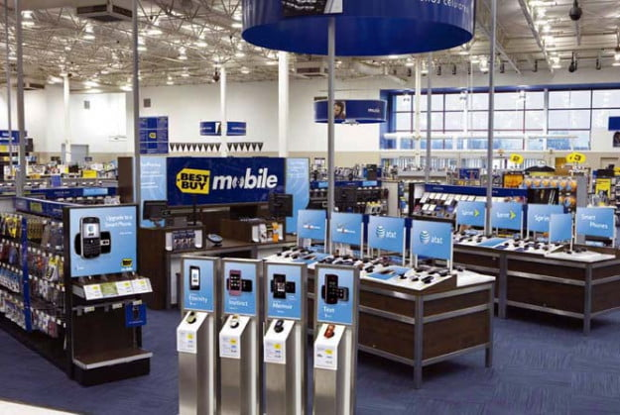
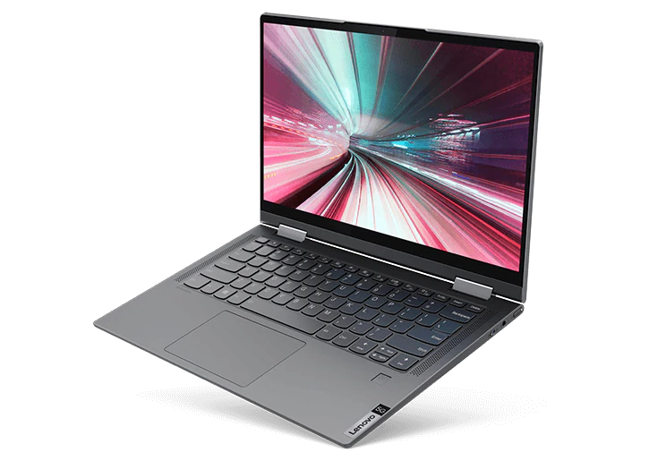
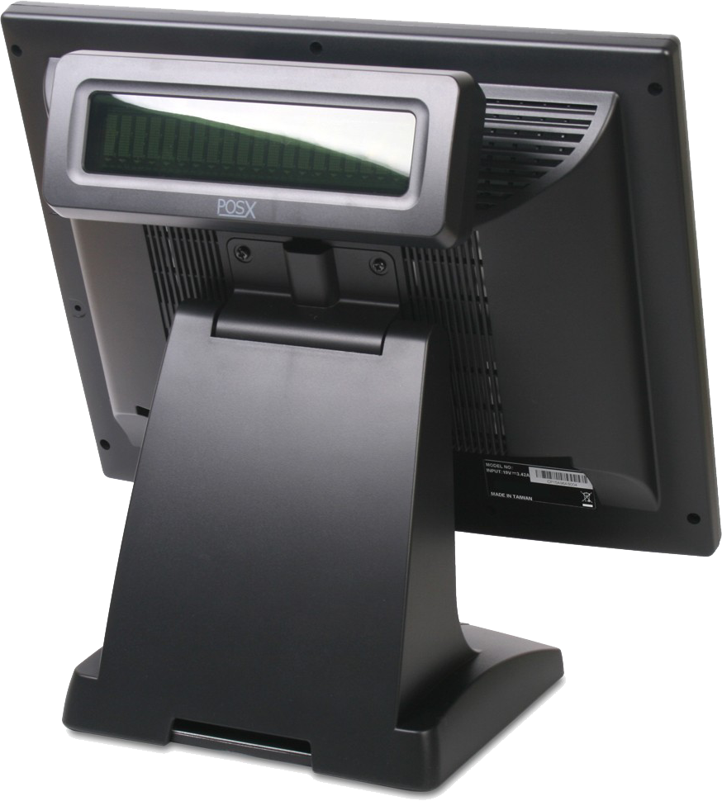
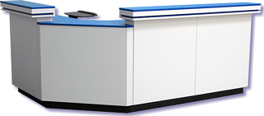
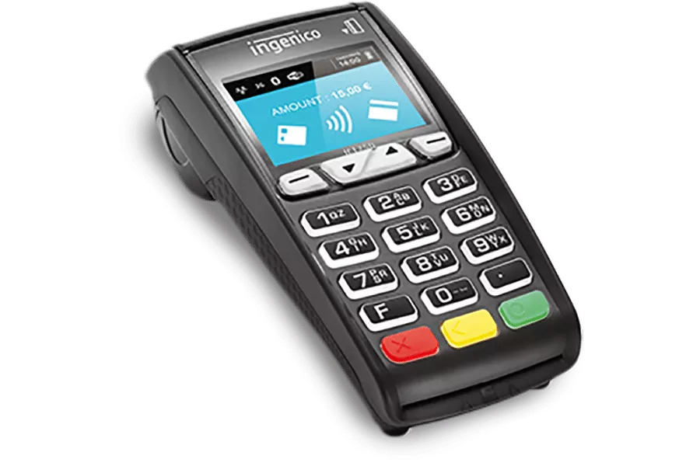
Click on the item in the shopper’s hand to view pricing. Click on the wallet to help her decide on the best means of purchase.

Slide 4
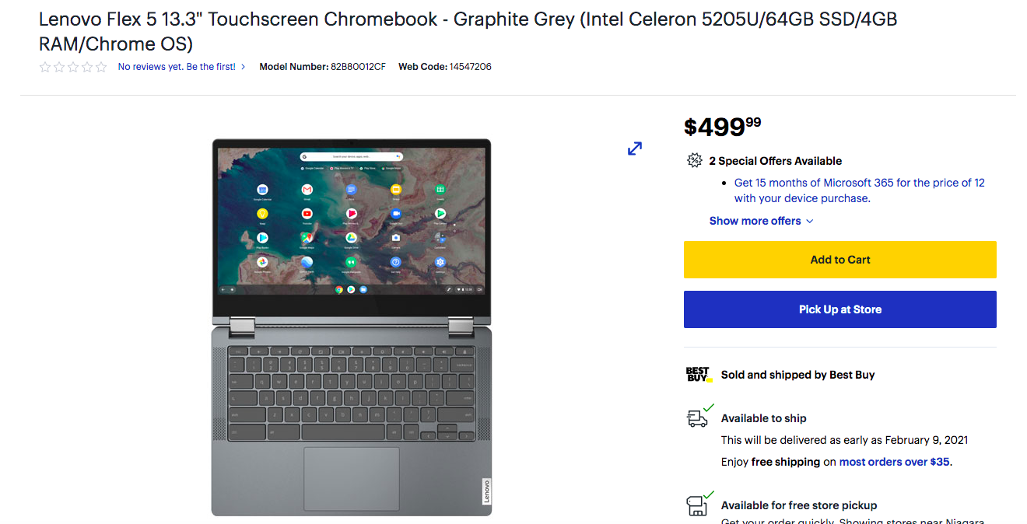
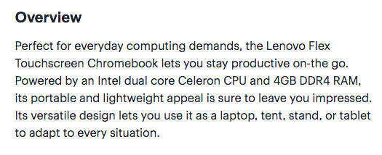
Plus 15% ($574.99)

Slide 5
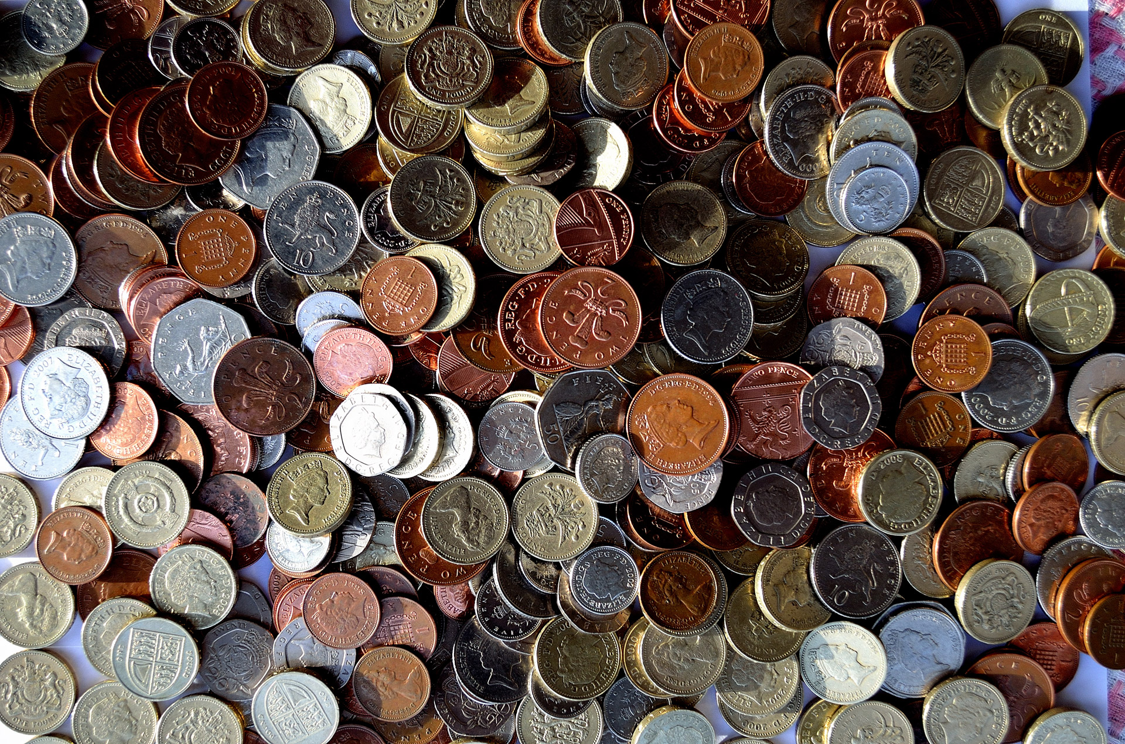
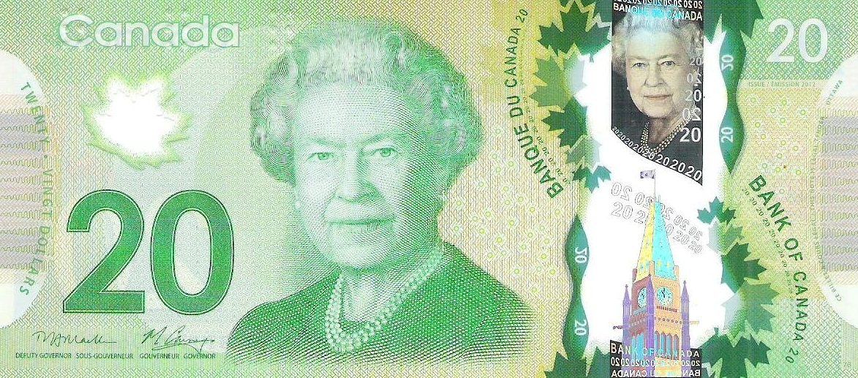
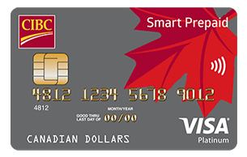
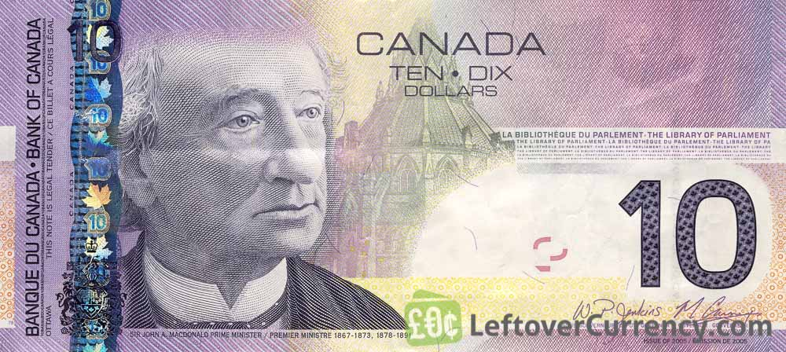
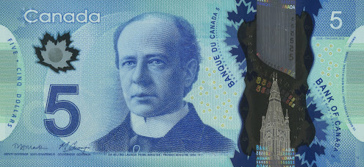
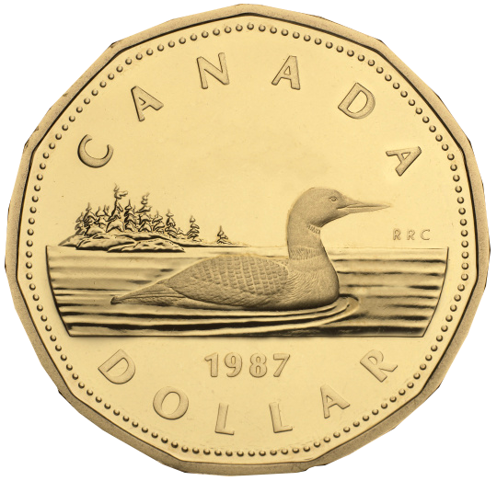
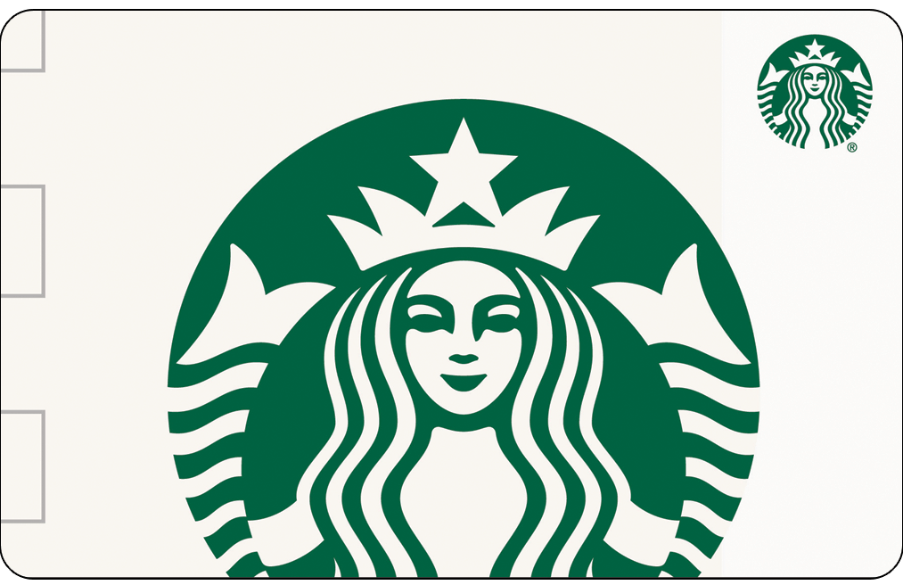
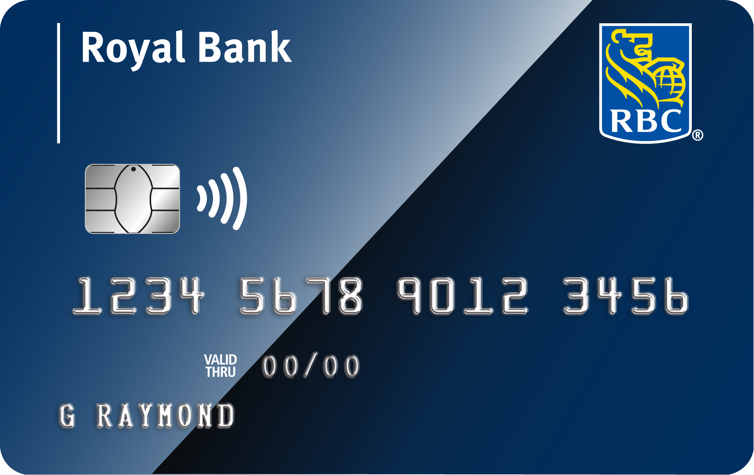
VISA Credit Card
Credit Card Limit: $1000.00
Current Charges
Rogers Phone Bill -$119.55
Skip The Dishes -$28.45
Cash
$78.00
Debit Card
Account Balance:
$400.17
E-Transfer App (from Debit Card)
Account Balance:
$400.17
Starbucks Gift Card
$17.57

Slide 6
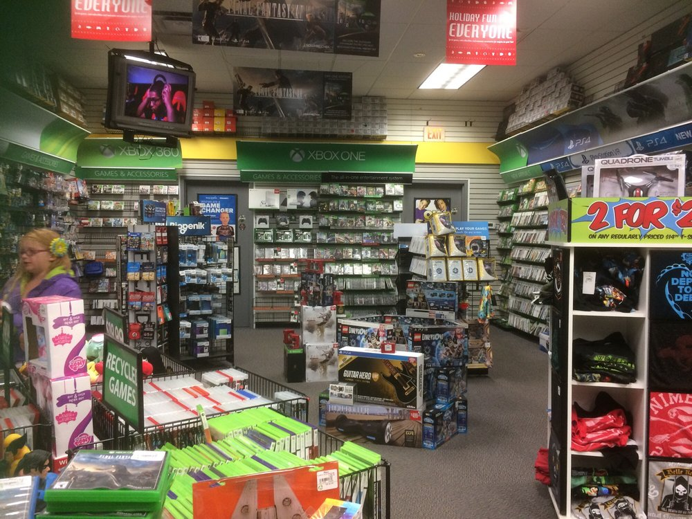
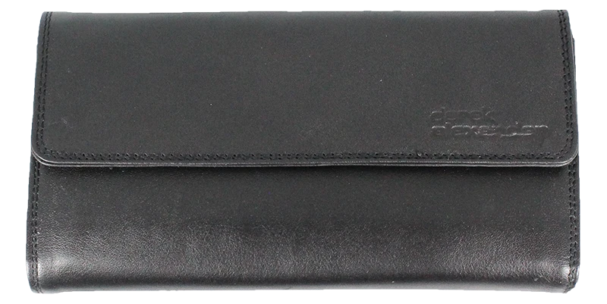
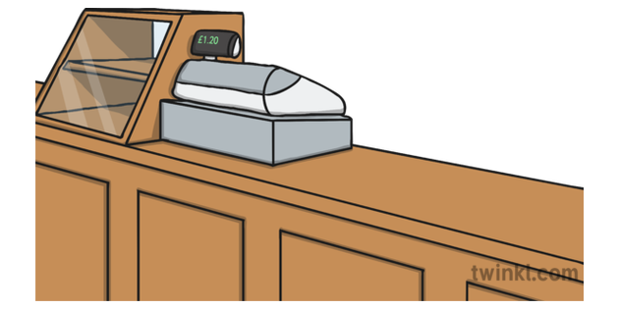
Click on the item in the shopper’s hand to view pricing. Click on the wallet to help him decide on the best means of purchase.

Slide 7
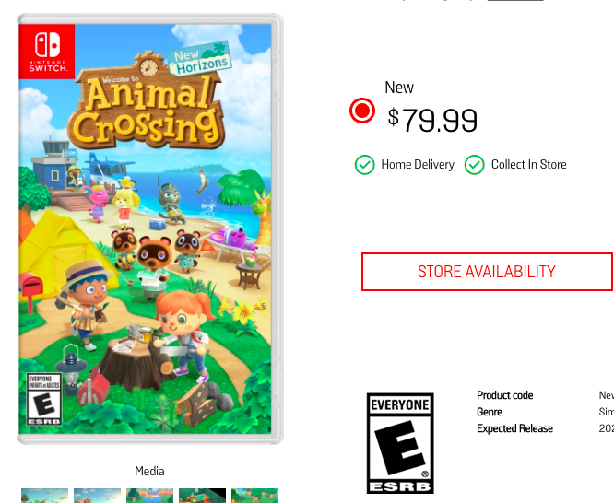
Plus 15% tax
$91.99
Plus 15% tax
$91.99

Slide 8
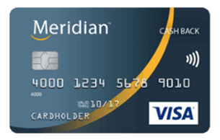
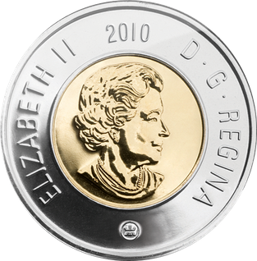
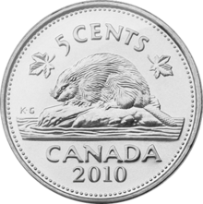
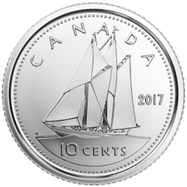
VISA Credit Card
Credit Card Limit: $500.00
Current Charges
N/A
Cash
$102.25
Debit Card
Account Balance:
$677.33
EB Games Gift Card
$50.00

Slide 9
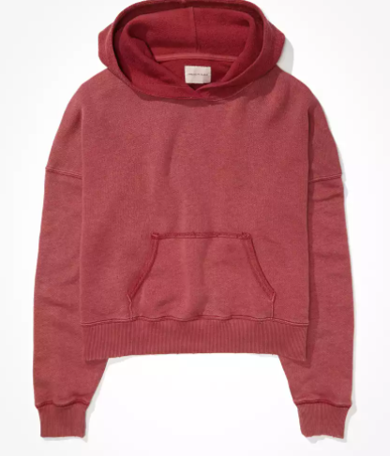
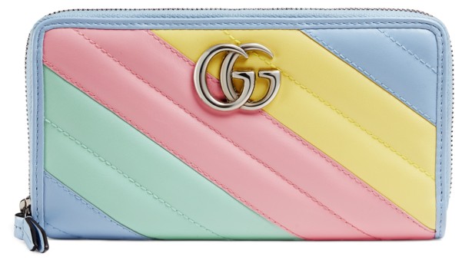
Click on the item in the shopper’s hand to view pricing. Click on the wallet to help her decide on the best means of purchase.
Hey Mel, found the cute sweater from American Eagle that you loved. It is on sale, want me to buy it for you?
YOU ARE AMAZING! How much?
$40.00 plus 15% tax is $46.00!!!!

Slide 10
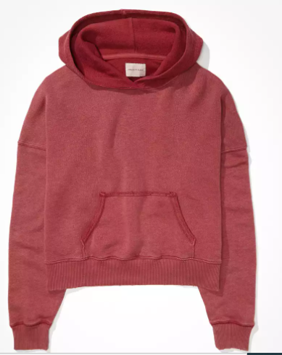
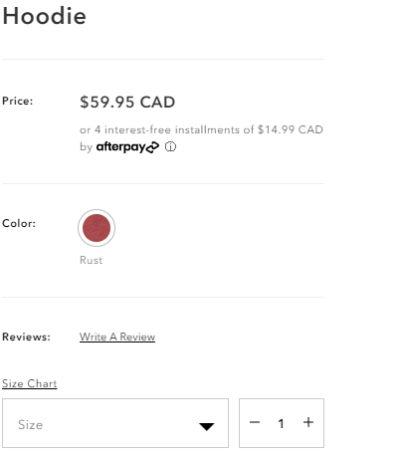
$40.00
$39.05
Plus 15% Tax
$46.00

Slide 11
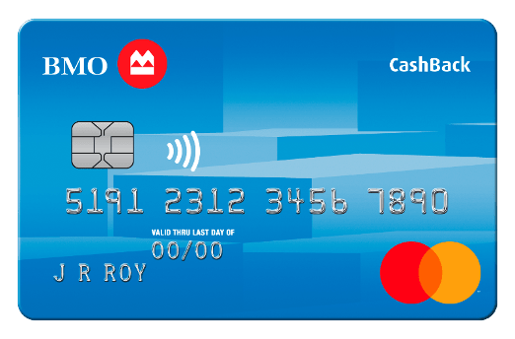
Debit Card
Account Balance:
$317.95
Cash
$40.00
PayPal Account Transfer
Account Balance:
$29.57
American Eagle
Gift Card
$25.00
E-Transfer App (from Debit Card)
Account Balance:
$317.95

Slide 12
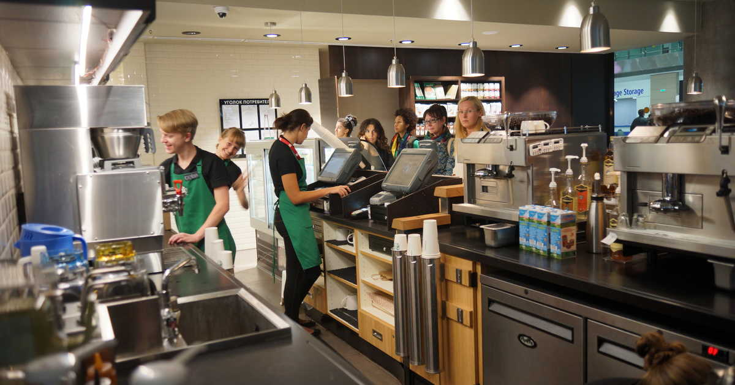
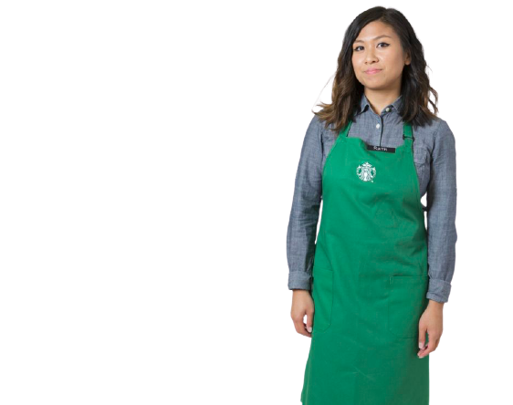
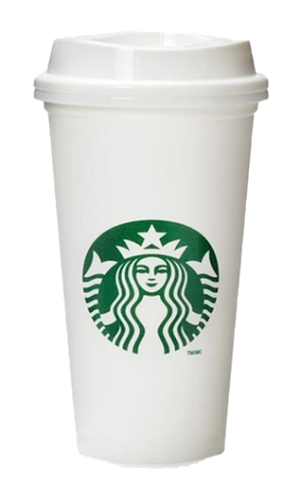
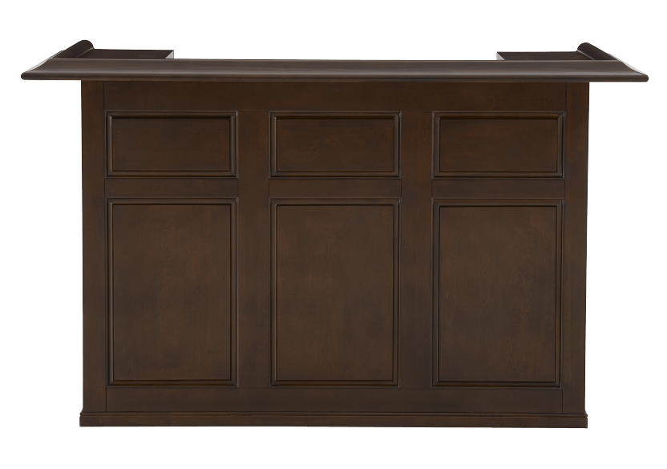
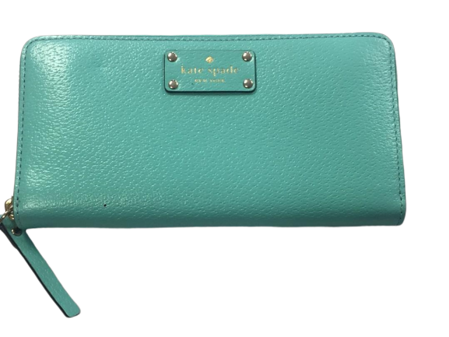
Click on the item in the shopper’s hand to view pricing. Click on the wallet to help her decide on the best means of purchase.

Slide 13
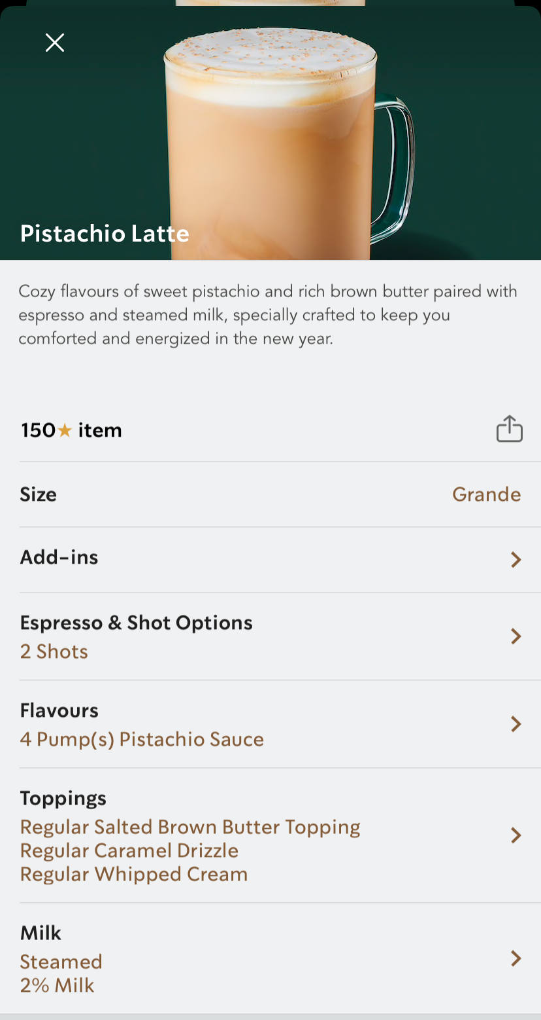
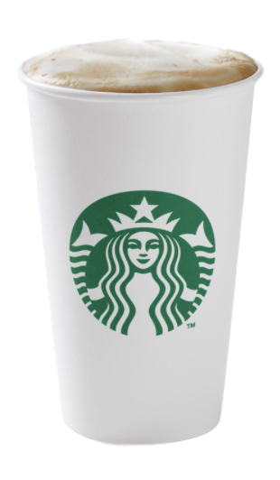
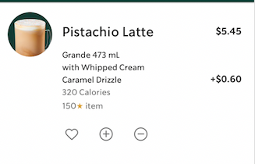
$6.05
15% tax
$6.95

Slide 14
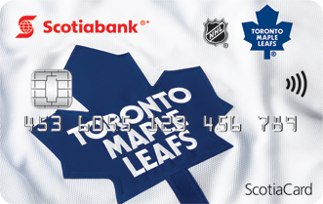
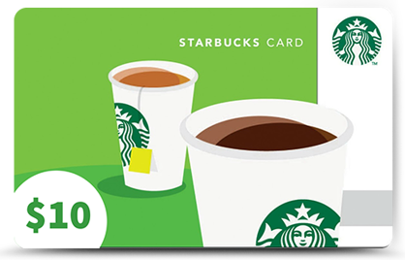
Debit Card
Account Balance:
$730.22
Cash
$8.00
PayPal Account Transfer
Account Balance:
$57.13
Starbucks Gift Card
$10.00
E-Transfer App (from Debit Card)
Account Balance:
$730.22

Slide 15
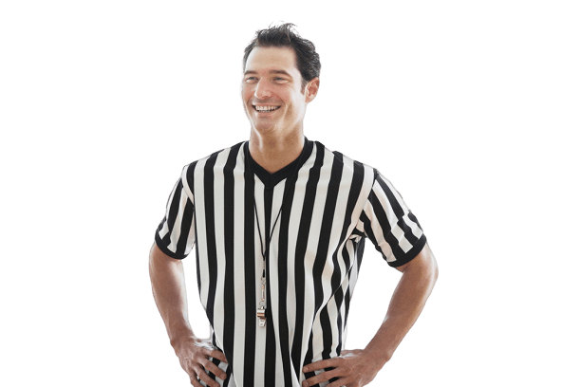
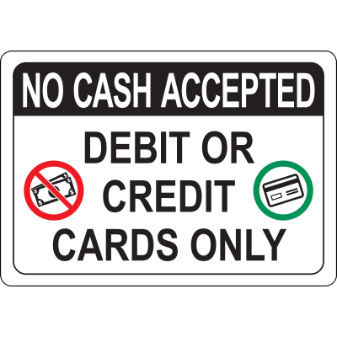
Click on the item in the shopper’s hand to view pricing. Click on the wallet to help her decide on the best means of purchase.

Slide 16
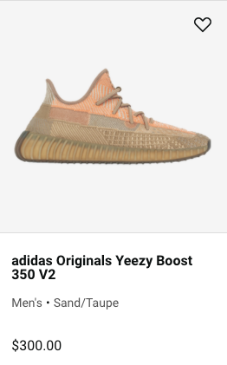
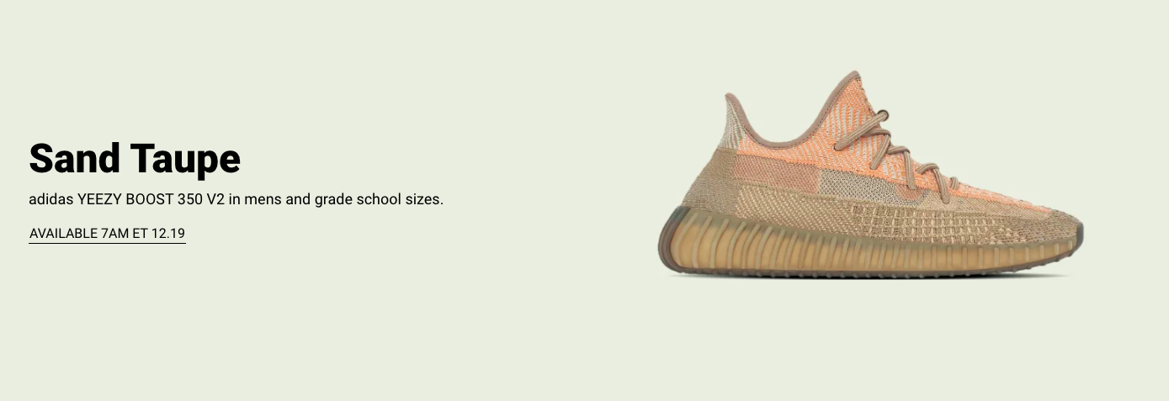
15% Tax
$345.00

Slide 17
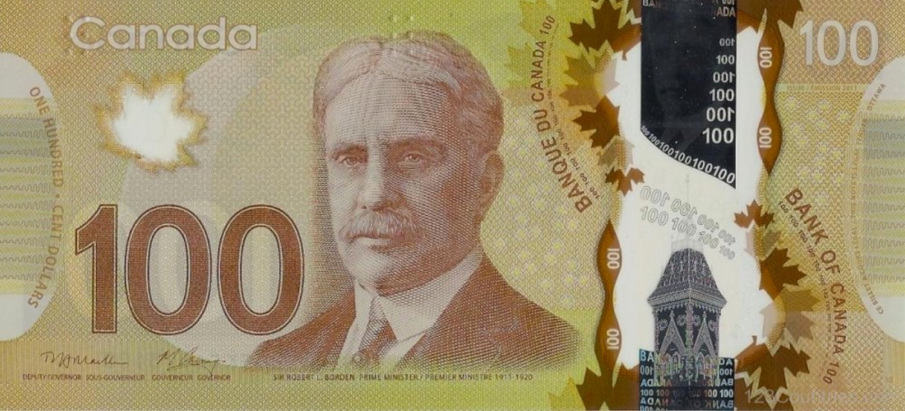
Debit Card
Account Balance:
$505.34
Cash
$342.00
VISA Credit Card
Credit Card Limit: $500.00
Current Charges
Netflix Monthly Subscription -$18.99
Spotify Premium -$9.99
Telus Phone Bill -$109.99
Walmart -$63.05

Slide 18
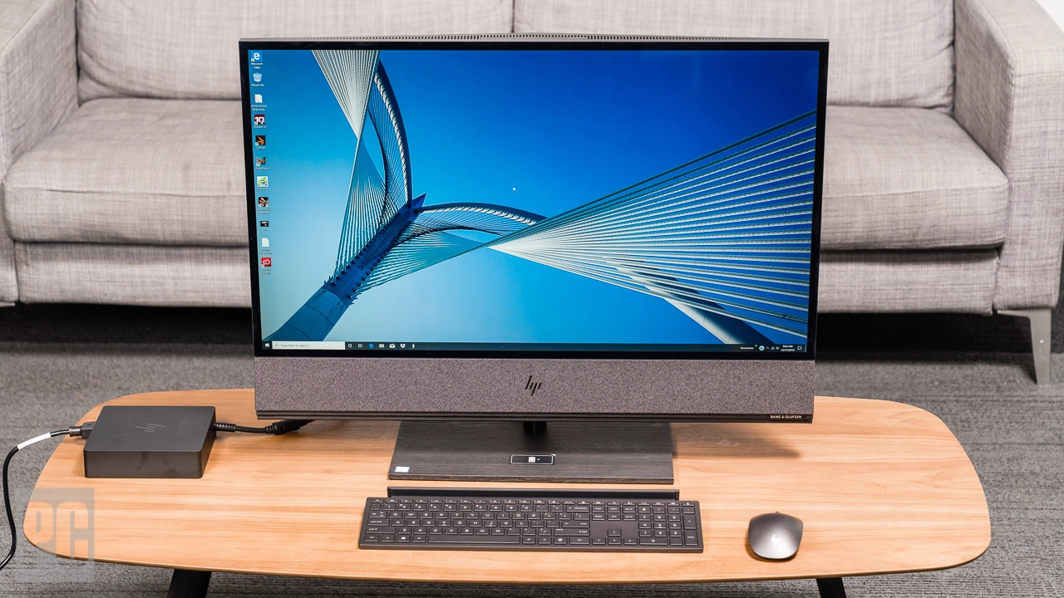
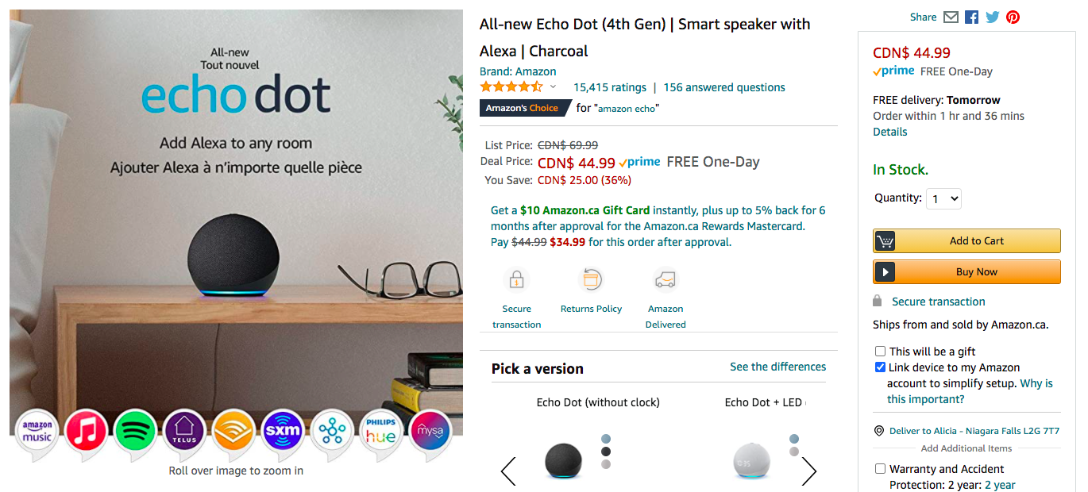
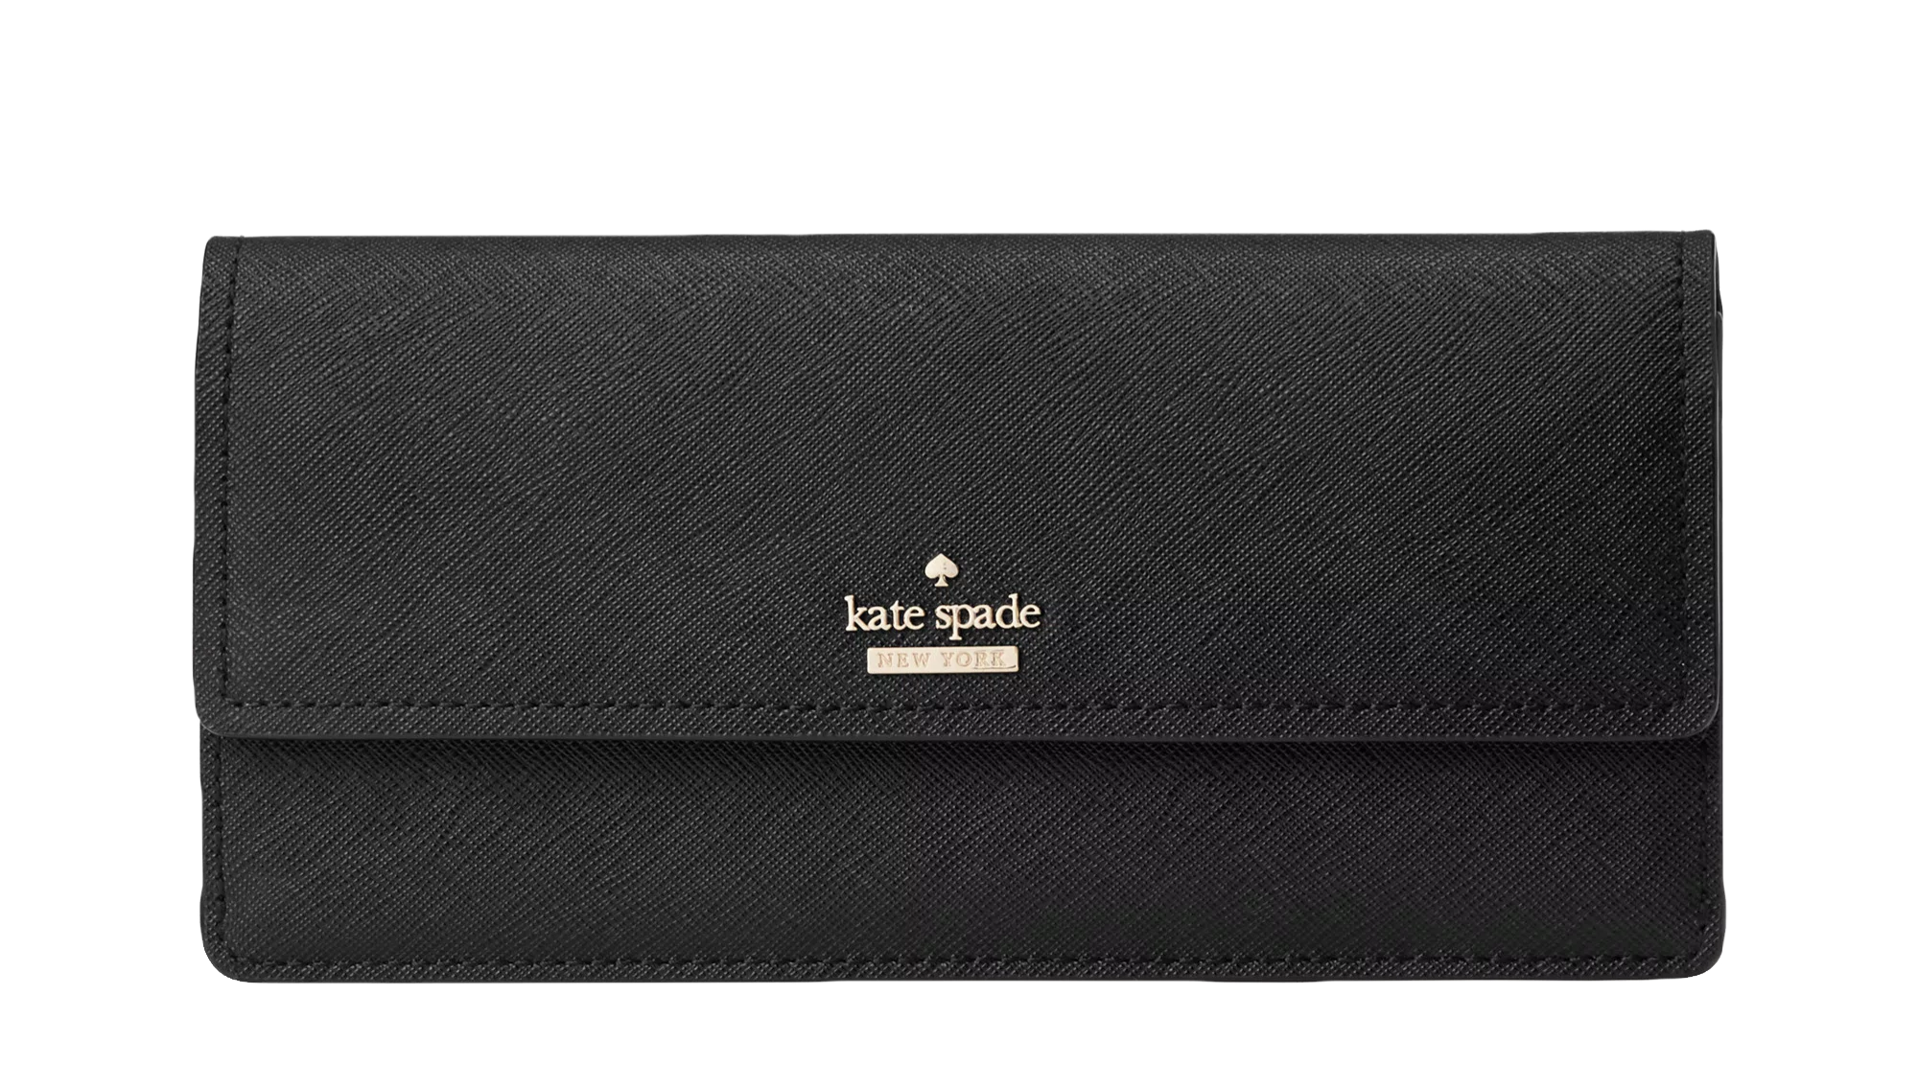
Click on the item in the shopper’s hand to view pricing. Click on the wallet to help him decide on the best means of purchase.

Slide 20
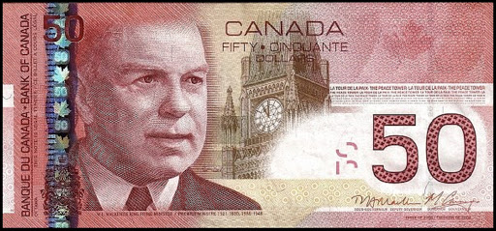
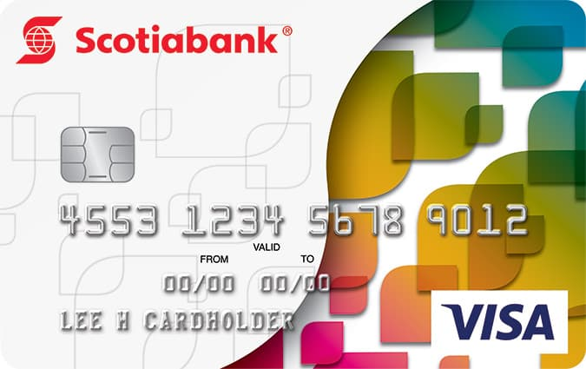
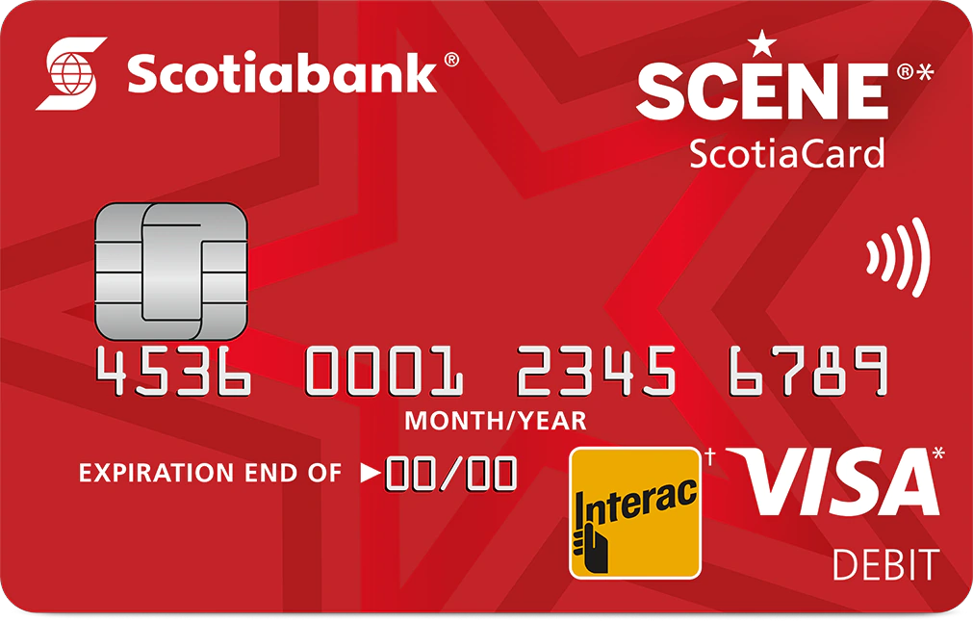
E-Transfer App (from Debit Card)
Account Balance:
$89.97
Cash
$70.00
VISA Credit Card
Credit Card Limit: $10,000.00
Current Charges
Adidas -$68.77
Scotiabank Debit Card
Account Balance:
$89.97

