Slide 1
Balance Sheet Basics

Slide 2
Things that are owned and have value Example: - Furniture - Vehicle - Bank savings *can we put a picture?
WHAT IS AN ASSET?

Slide 3
What is a LIABILITY?
Things that are debts that you do NOT own
Example:
Car loan
Credit card bill
Mortgage
Picture? Haha this is so bad

Slide 4
What is Net Worth?
Assets minus
What you own subtract what you owe = net worth
Liabilities.

Slide 5
Cash​ I-pod​ Bicycle​ Mortgage​ Bank Loan​ House​ Furniture​ IOU to Friend/Parent *can we put a picture?
Asset or Liability?

Slide 6
Cash​ I-pod​ Bicycle​ Mortgage​ Bank Loan​ House​ Furniture​ IOU to Friend/Parent *can we put a picture?
Asset or Liability?

Slide 7
Why Should an Entrepreneur know about a balance sheet? Knowing about a balance sheet is like having a financial report card for your business. It shows how much money you have (assets), how much you owe (liabilities), and what's left over for you (net worth). This helps you make smart decisions, like if you can buy cool stuff for your business or need to save money.

Slide 8
Can you think of your own?

Slide 9
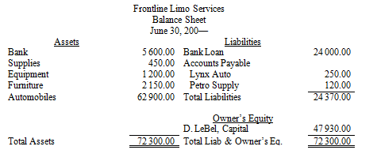
Balance Sheet Example

