Slide 1
Income and Loss

Slide 2
So, you’ve got an idea… How do you know that your idea will be profitable? What if your great idea makes you broke?

Slide 3
1. What percentage of new businesses survive three years? 2. What percentage of new businesses survive ten years?
Think…

Slide 4
1. What percentage of new businesses survive three years? 50% 2. What percentage of new businesses survive ten years? 20% Source: https://publications.gc.ca/collections/Collection/Statcan/61-526-XIE/61-526-XIE1999001.pdf

Slide 5
What does the word revenue mean?
How does a company earn revenue?

Slide 6
Revenue and Sales Transactions:
Revenue: Total income generated by a company through its sales transactions.
Sales Transactions can take place in a store, online, or through e-transfer on someone’s front steps as you pay for a Marketplace item.

Slide 7
Expense
What does the word expense mean?
What would be some examples of expenses that a restaurant would have?

Slide 8
Net Income vs. Net Loss
Net income is a gain that occurs when the total revenue is higher than expenses.
Net loss occurs when the total expenses of a business exceed its total revenue.

Slide 9
Expense: Money flowing out of a company in order to create sales.
A restaurant would have to pay for ongoing items such as:
Cost of food and drinks
Cooks and servers
Electricity
Repairs to equipment
Soap to wash dishes
Rent or mortgage
Initially, a restaurant would have to buy furniture, equipment, dishes, etc. Because these items are expected to last several years, they would go into the category of assets and not expenses.

Slide 10
Question:
Ling owns a mechanic shop. Last year, she ​had a revenue of $100 000. She had expenses of $60 000. What was her net income?

Slide 11
Answer:
Ling owns a mechanic shop. Last year, she ​had a revenue of $100 000. She had expenses of $60 000. What was her net income?
$40 000

Slide 12
Question:
John owns a bakery. So far this year, he has sold $13 000 of cakes, $7 800 of cookies and $5 000 of other baked goods.
He has accumulated $12 000 in expenses.
1. What is John's total revenue?
2. What is John's net income?

Slide 13
Answer:
John owns a bakery. So far this year, he has sold $13 000 of cakes, $7 800 of cookies and $5 000 of other baked goods.
He has accumulated $12 000 in expenses.
1. What is John's total revenue?
$25 800
2. What is John's net income?
$13 800

Slide 14
Expenses can be broken down into two types:
Cost of Goods Sold (COGS)
Operating Expenses
These are the costs that are directly used to make your product. For example, if you sold shirts your COGS could include the costs of material, thread and buttons.
These are ongoing costs to run the business. They include things like, rent, electricity, labor, etc.

Slide 15
THINK:
Think about a pizza restaurant. What are some examples of expenses would be cost of goods sold? What are some examples of expenses that would be considered operating expenses?

Slide 16
Cost of Goods Sold (COGS):
Flour, yeast, oil, cheese, tomato sauce and other ingredients to make the pizza
Boxes, napkins and other items that are part of what goes to the customer as part of their order.
Operating expenses:
Rent, electricity for the ovens, the cost of paying cooks and servers, cost of providing wifi, phone costs, website/app maintenance costs, advertising expenses, cleaning supplies, etc.
NOTE: The portion of labour directly associated with producing the pizza would normally go into COGS, but we will ignore that for our simple example.

Slide 17
Financial Information: Income Statement
Entrepreneurs need to develop financial information to share with potential investors that projects what their income will be for their proposed business.
They also need to keep track of income and expenses once they begin operating their business.
An income statement is a financial document that shows this information in a professional way. It’s prepared in a consistent format so that it can be widely understood.

Slide 18
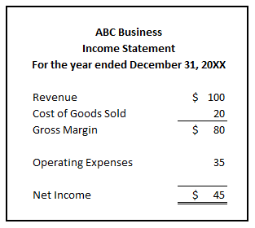
Income Statement Format

Slide 19
Income Statement Activity Your group will be given pieces of information about the Capstone Company. Using this information, create an income statement for this business.
PLEASE LEAVE THIS SLIDE UP WHILE STUDENTS WORK ON THE ACTIVTY.

Slide 20
Answer to the Income Statement Activity

Slide 21
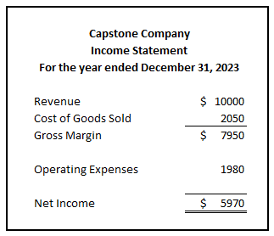
Notes: Revenue = 50 widgets x selling price of $200 = $10 000 Cost of goods sold for one widget = $20 for wood + $10 for five screws + $8 for glass + ($1 x 3) for decals = $41 Cost of goods sold for 50 widgets = $41 x 50 = $2 050 Operating expenses = $1 200 for rent + $300 for advertising + ($40 x 12) for electricity = $1 980

