Slide 1
Innovate
K-5 IDEA Market Kit

Slide 2
Definitions
1
2
3
Passion
Strength
Skill
A topic or interest that is SO important to me, that it causes me to feel BIG emotions.
Something that I am naturally gifted at and it’s a part of who I am.
Something that I have spent many hours learning and practicing, and now, I could help others with it.

Slide 3
Pictograph
Fruit That George Ate This Week

Slide 4
Bar Graph

Slide 5
In small groups, how would you answer this question:
What is a problem?

Slide 6
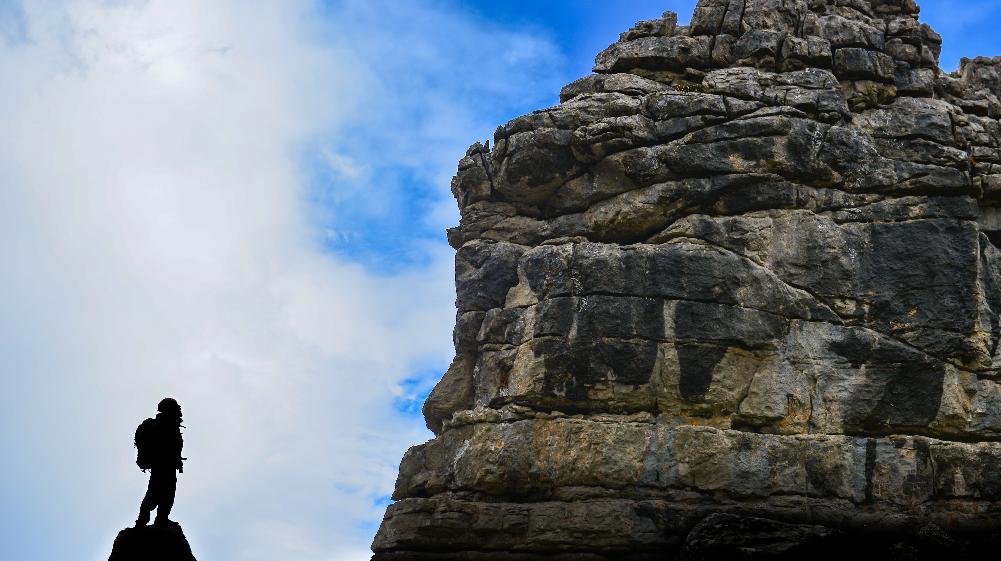
A problem is an
OBSTACLE -
something is in the
way - and it needs
a solution

Slide 7
BIG problem
Small problem
Not A Problem
Plastic In Our Ocean

Slide 8
BIG problem
Small problem
Not A Problem
A Broken Arm In the Summer

Slide 9
BIG problem
Small problem
Not A Problem
Bird and Puppy

Slide 10
BIG problem
Small problem
Not A Problem
Not Getting Along With a Friend

Slide 11
BIG problem
Small problem
A Broken Fingernail
Not A Problem

Slide 12
BIG problem
Small problem
Not A Problem
A Large Forest Fire

Slide 13
What makes a problem BIG, small, or not a problem at all?

Slide 14
Problem
Opportunity

Slide 15
THANK YOU
Check out the K-5 IDEA Market
Unit 2: Design

