Slide 1
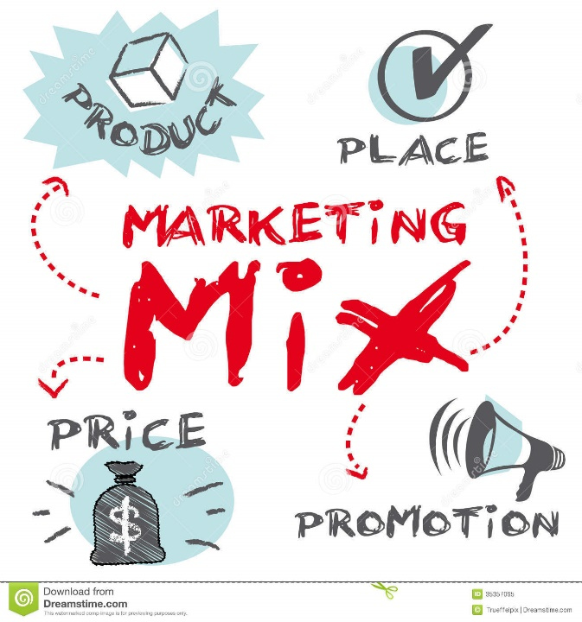
The Four P’s of Marketing
CEREAL CRAZE

Slide 2
The 4 P’s of Marketing
An Entrepreneur must have an understanding of each as it applies to their business.
An entrepreneur must also have an understanding of how each of these pieces work together.
The 4 P’s are:
Product
Price
Promotion
Place

Slide 3
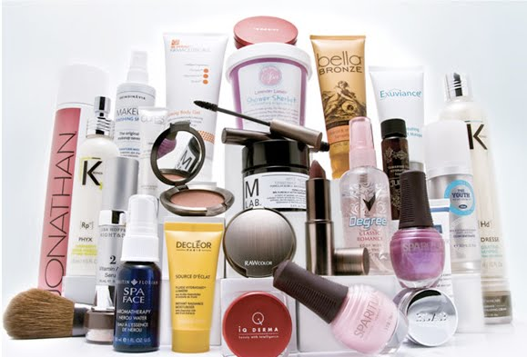
Product /Service
What product or service are you providing?
How is it unique?
How will it benefit customers?
Will it meet a need or want for your customers

Slide 4
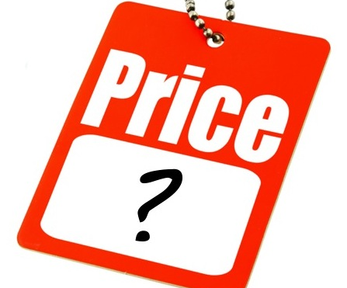
Price
Questions to Consider:
How much will you charge?
How much are customers willing and able
to pay?
How much profit do you need/want to make?

Slide 5
Promotion
Letting people know about products and services in a positive way so they will want to make a purchase.
Promotion is used to tell potential customers:
How to use a product or service
The quality of a product or service
Where the product or service is available

Slide 6
Promotion
How will you let your customers know about your product/service?
What type of promotion will you use?
Advertising - Any paid form of promotion ( internet, newspapers, TV, radio, magazines, billboards, flyers, etc.)
Social Media – Instagram, Snap Chat, Facebook, Twitter, TiKToK
Publicity - Free promotion (press releases or news reports describing how the company sponsored events or donated to a cause.)

Slide 7
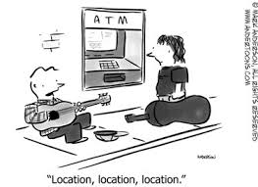
Place
Where will you be located?
How will you receive your products?
Will you sell on the internet?
How will the product or service get to the customers?

