Slide 1
Balance Sheet Basics

Slide 2
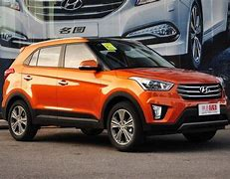
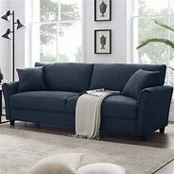
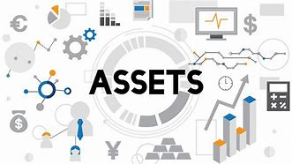
An asset is something that is owned and has value. Examples: -Vehicle -Furniture -Bank Savings
What is an Asset?

Slide 3
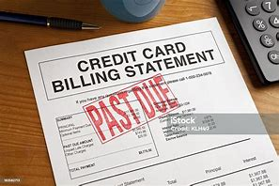
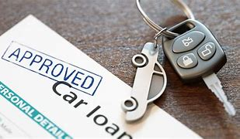
Things that are debts that you do NOT own. Examples: -Car loan -Credit Card Bill -Mortgage
What is a Liability?

Slide 4
Net Worth:
Assets:
What you own
Liabilities:
What you owe
Assets – Liabilities = Net Worth

Slide 5
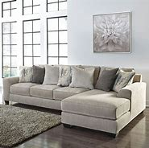
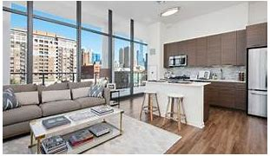
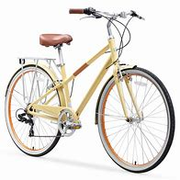
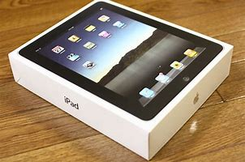
Asset or a Liability?
THINK…
Cash
iPhone
Bicycle
Apartment
Mortgage
Bank Loan
House
Furniture
Student Loan
iPad
IOU to a Friend/Parent

Slide 6
Practice Question:
Leah owns a house worth $90 000, and she just got a mortgage on another property for $150 000. Leah has a car loan for $40 000. The furniture in her home is worth $5 000.
Her credit card bill is $2500. What is her net worth?

Slide 7
Balance Sheet
A balance sheet is a financial statement that shows a company’s financial position at a certain time.
Balance sheets provide a summary of a company's assets, liabilities and its net worth.

Slide 8
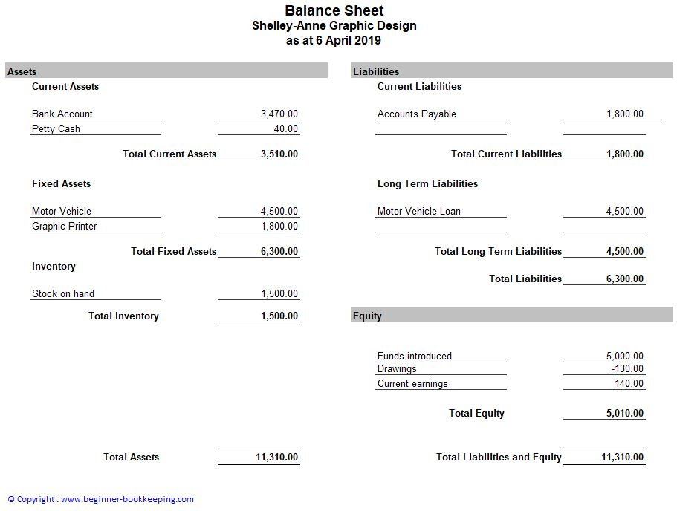

Slide 9
Why Should an Entrepreneur know
about a Balance Sheet?
Net Worth:
Knowing about a balance sheet is comparable to having a financial report card for your business
It shows how much money you have (assets), how much money you owe (liabilities), and what is left over for you (net worth)
This helps entrepreneurs make smart financial decisions and decide if you can purchase new things, or you need to save money.

Slide 10
A New Brunswick Tech Company has compiled its financial information for the year. The company owns $50 000 worth of electronic equipment, $20 000 in cash sales, and has $15 000 in a bank account from customers.
However, the company owes $10 000 to an Engineering company, and $5 000 to various suppliers.
What is this company’s net worth?

