Slide 1
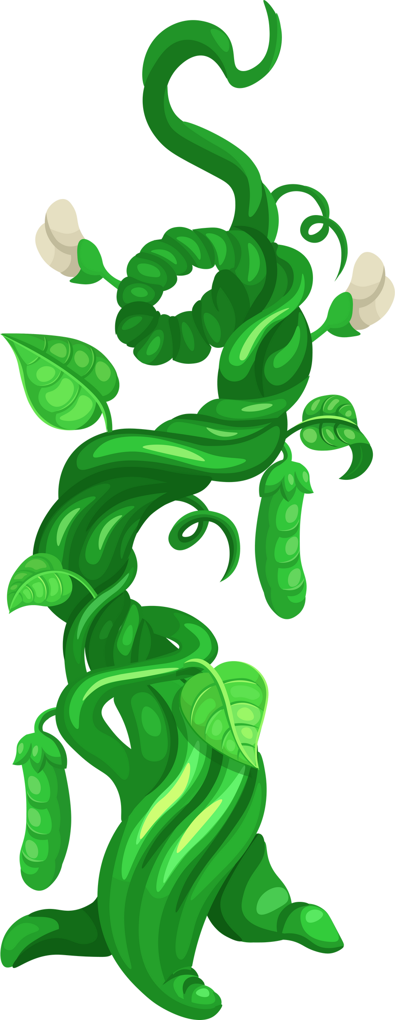



No MORE
Beanstalks!
3-5 Learning Activity

Slide 2
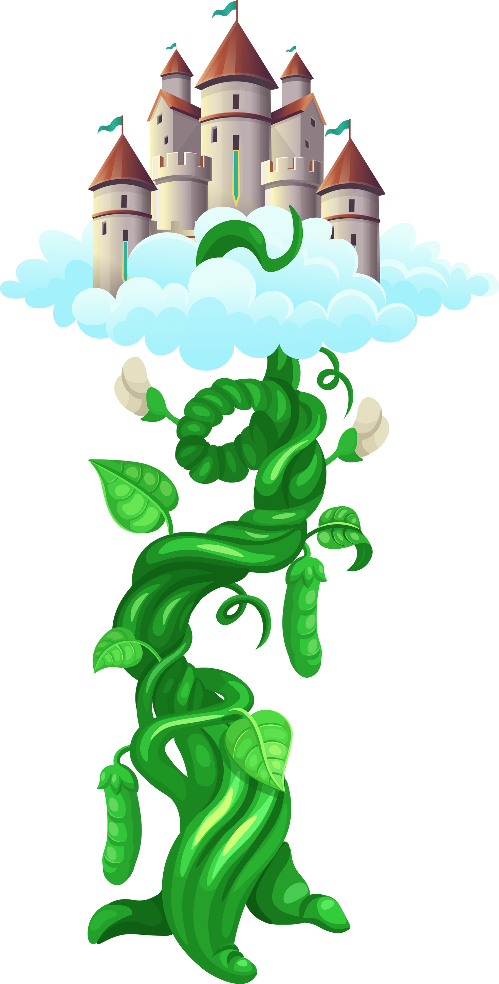


presume - to believe that something is true with some evidence, or based on probability.
(yourdictionary.com, 2023
Has anyone ever presumed something about you that simply wasn’t true? How did this make you feel?

Slide 3





Presuming In Action:

Slide 4

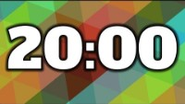

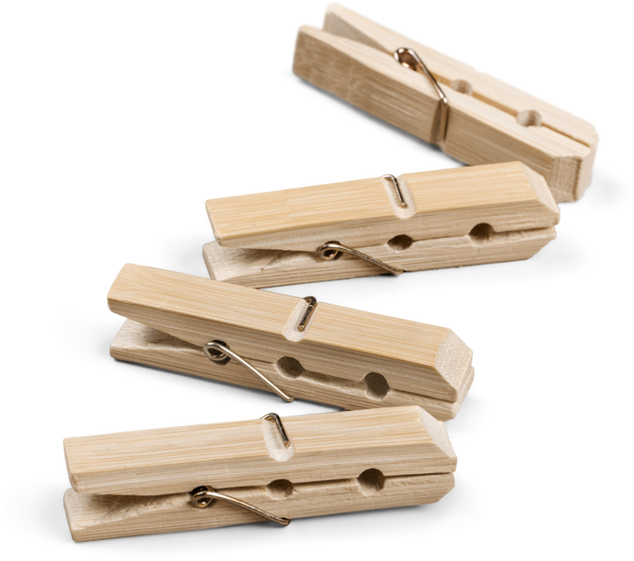
Descent Design Challenge
  must build an alternative travel method, specifically for Jack
  “Clothespin Jack” cannot fall out
  at least a 5 second descent time

Slide 5
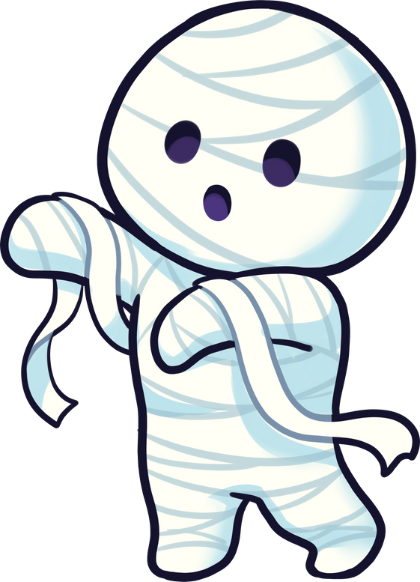
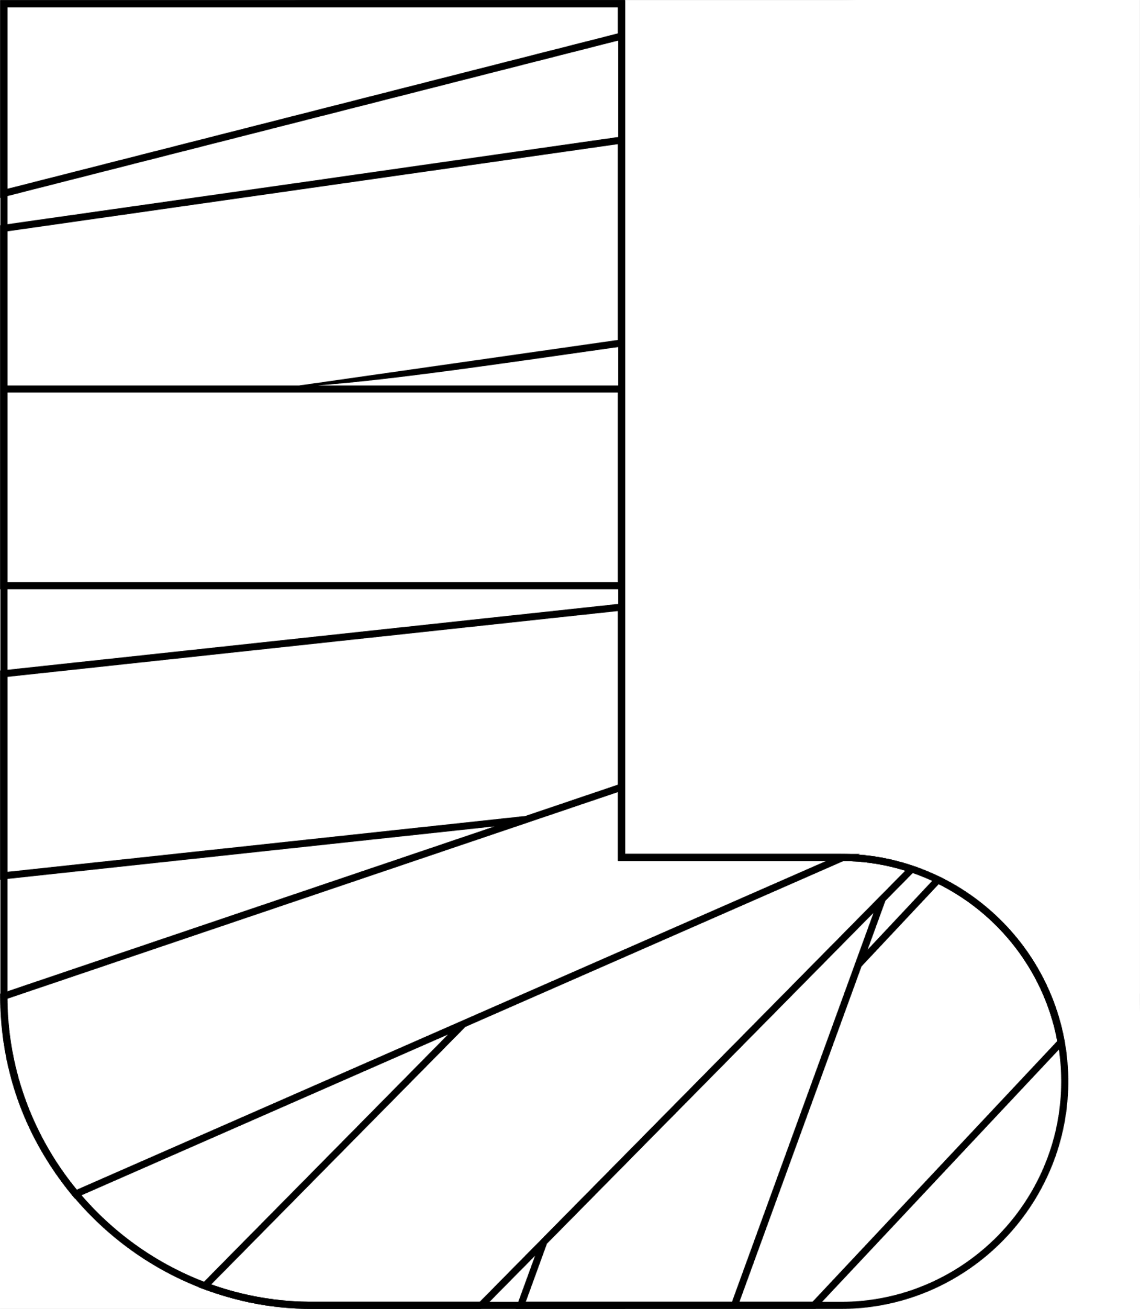


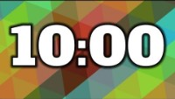
Descent Design TEST
From your classroom “beanstalk”, test your design:
1-2 seconds - Jack has broke every bone in his body
3-4 seconds - Jack has 2 broken legs
5-6 seconds - Jack loved the thrill of the ride!
7+ seconds - Jack felt like Superman!

