Slide 1
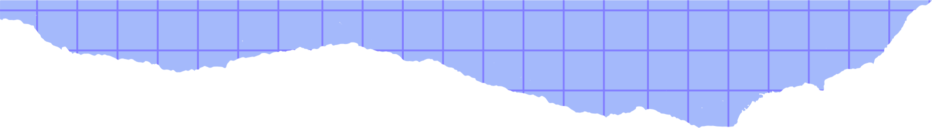
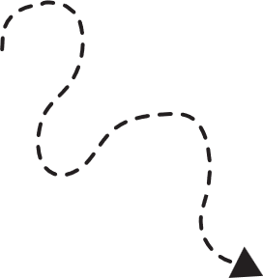



Someone
BUILDS THE DREAM
By Lisa Wheeler
illustrated by Loren Long

Slide 2

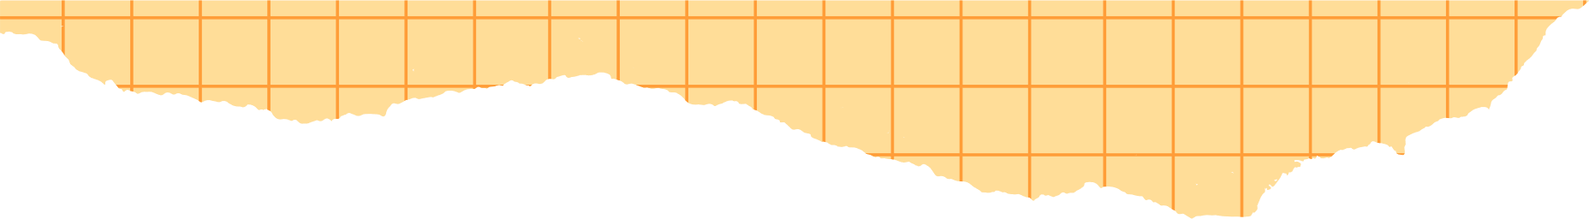



I have learned how every person has a role in shaping the future of work and society.
What will we learn?
I have learned about a variety of career pathways that can help to solve problems in the world.
I am learning how the global competencies (collaboration / communication) are helpful in life and work.

Slide 3
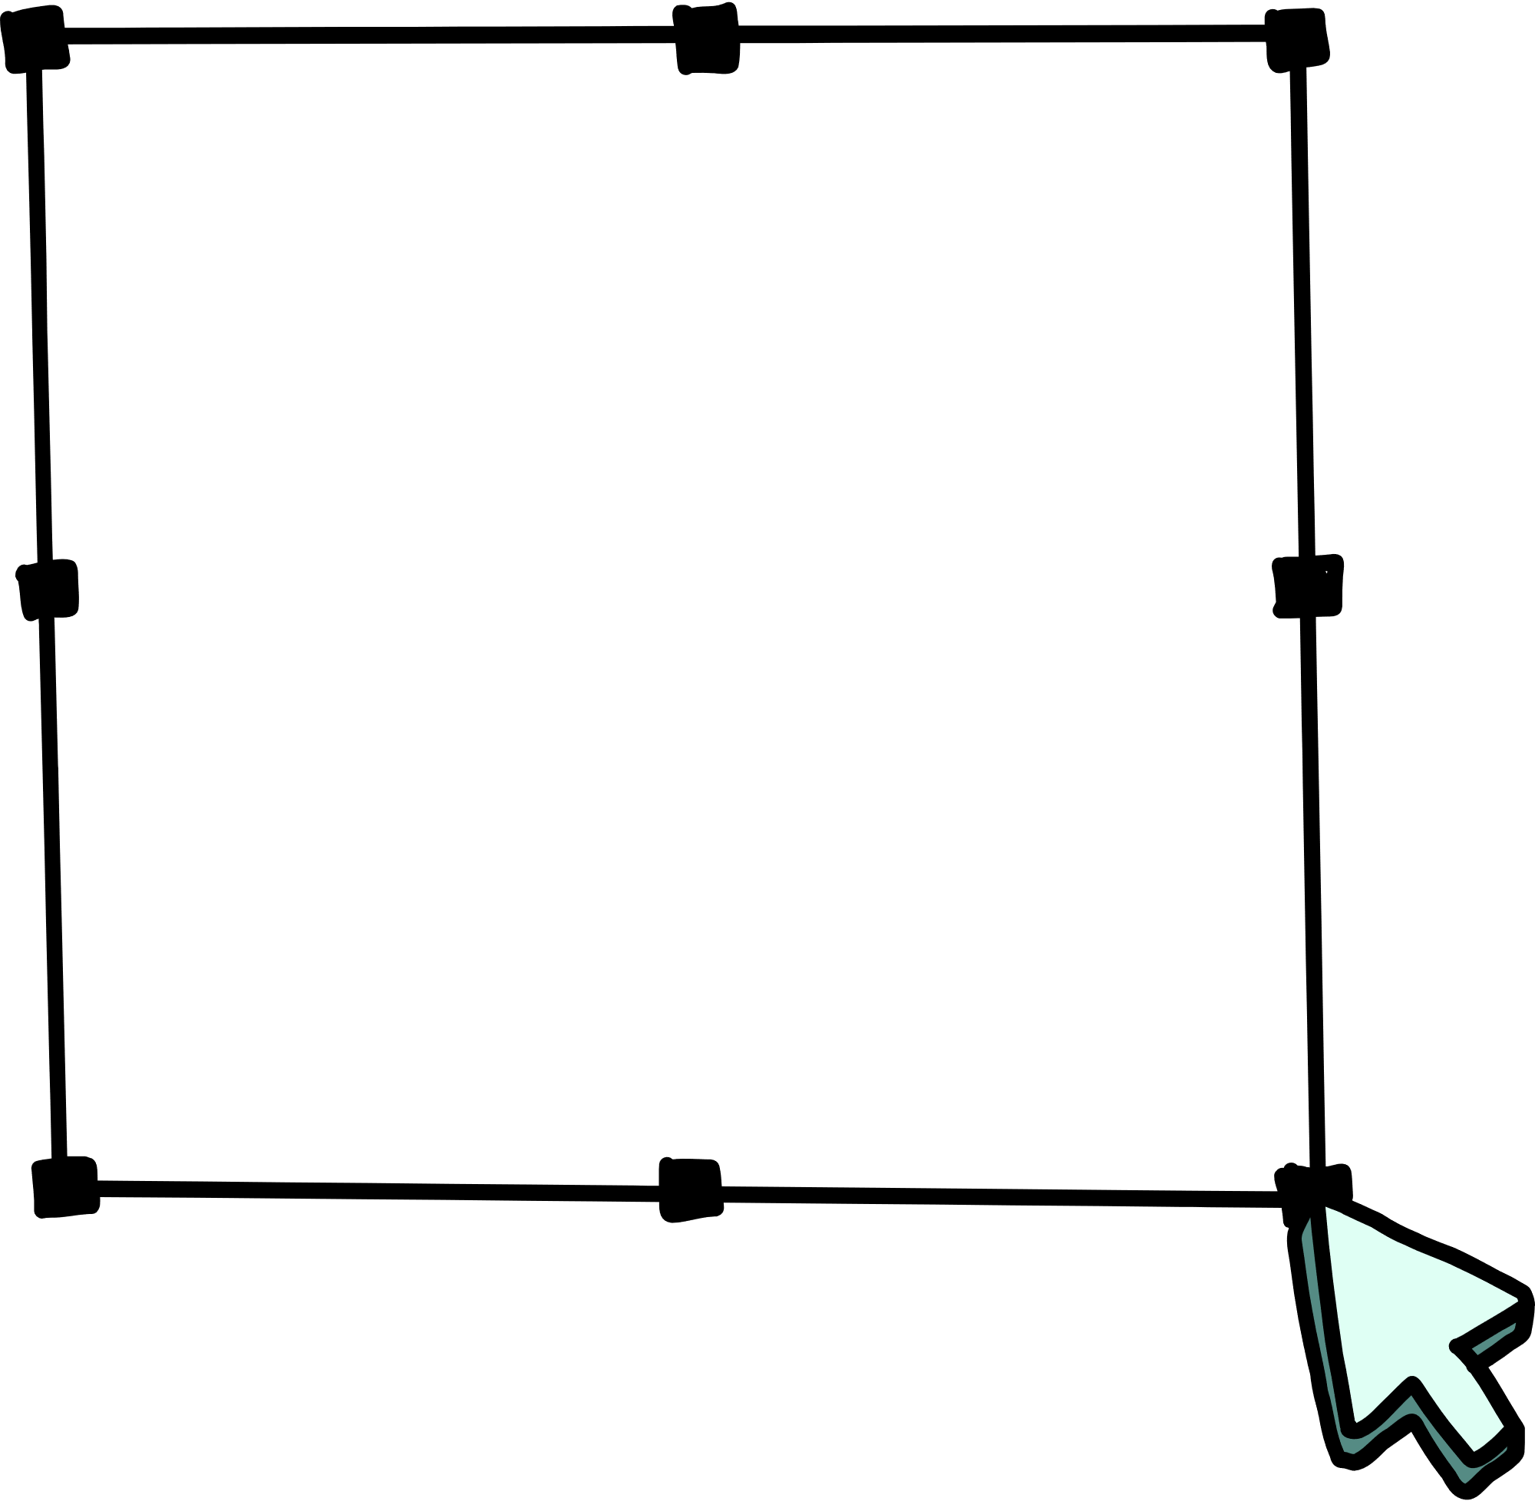


Brainstorm
Think of your school....
  What kind of work was needed to build the school?
  What kind of work was needed to build the playground?
  How did a team work together to build the school? The playground? Who do you think was involved?

Slide 4
LET’S DISCUSS

Slide 5
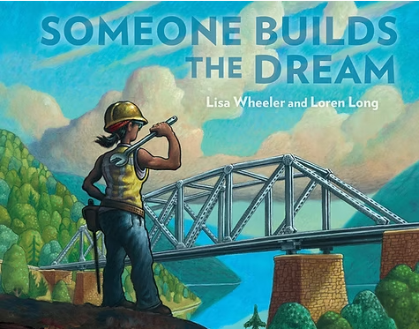

Slide 6
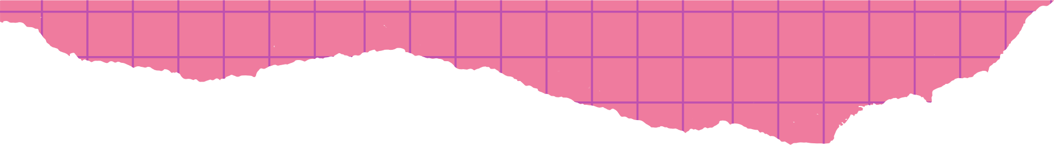
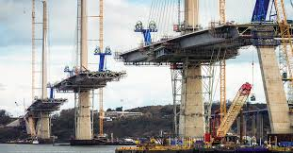
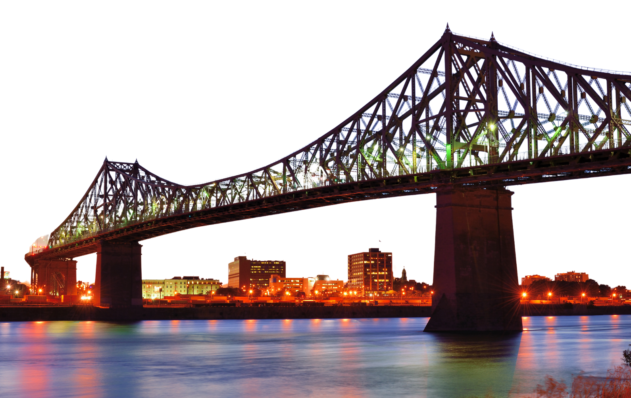
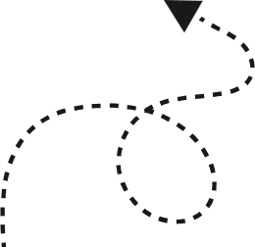
What kinds of workers do you need to build a bridge?

Slide 7

ARCHITECT
Designs what the bridge should look like.
ENGINEER
Figures out how to make it strong and safe.
BUILDER
Uses tools to put the bridge together.
TRUCK DRIVER
Delivers materials like wood, metal, and concrete.
CRANE OPERATOR
Lifts heavy materials.
Joins metal parts together.
WELDER
Makes sure no one gets hurt.
SAFETY CHECKER

Slide 8
IT TAKES A TEAM TO BUILD A DREAM!

Slide 9


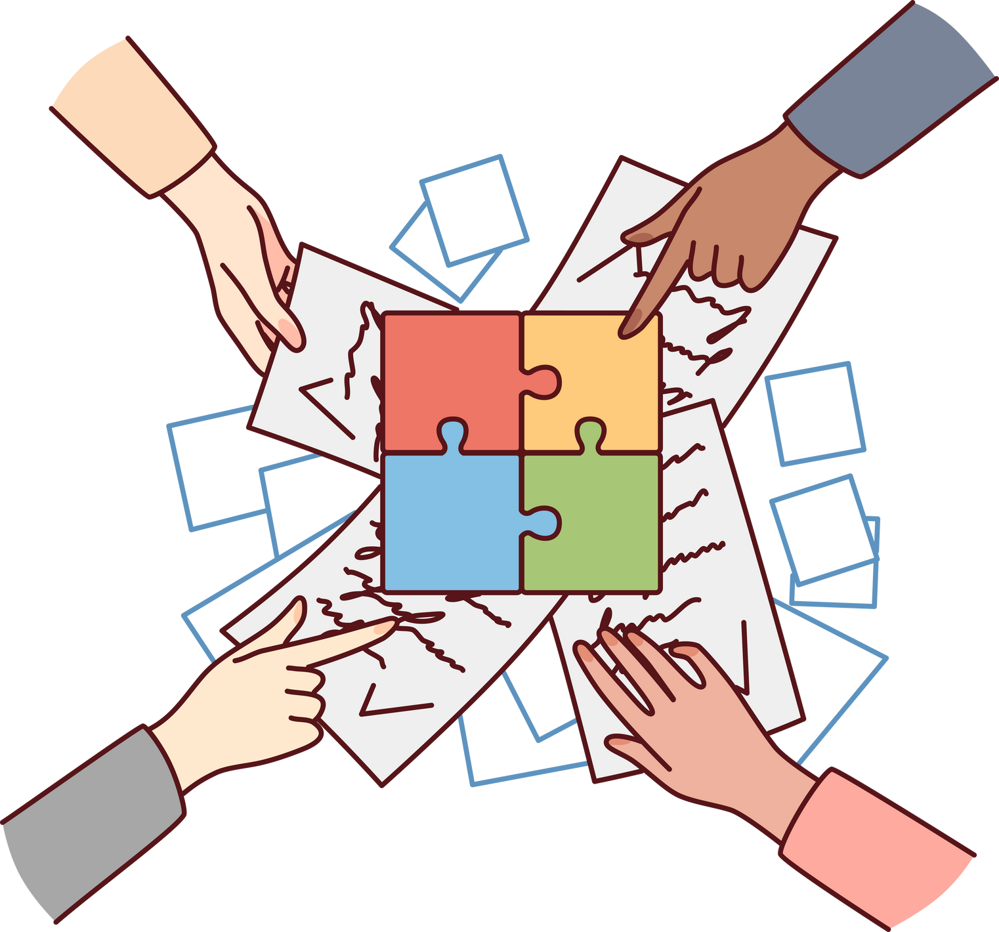

TEAMWORK
In many jobs, one person can’t do it alone.
Everyone needs to:
Listen to each other
Share ideas
Help out
Working as a team helps everyone succeed together!

Slide 10
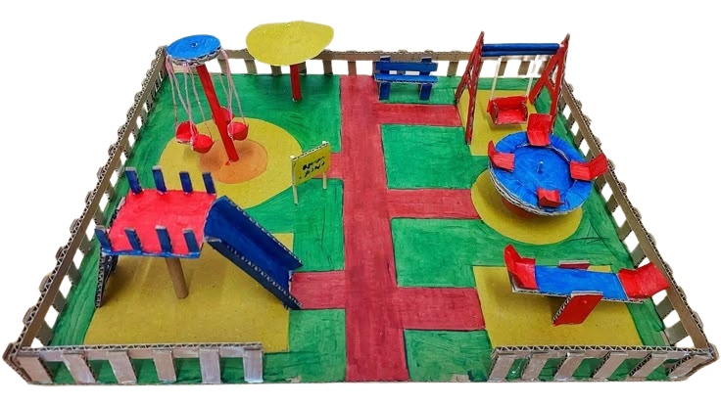
TIME TO TRY IT!
Recyled Creations Project
Use your imagination and teamwork to create something you would like to see in your community! You can use cardboard, plastic bottles, paper scraps, fabric, cans, and more. Be creative!

Slide 11
Our Community
What do you love most about our community?
What buildings or structures are in our community? Why are they important?
If you could design something new for your community, what would it be?

Slide 12




GROUPS OF 3-4
YOUR
TURN
With your team, plan and build something you would like to see in your community!
Plan
Design
Create
BUT FIRST

Slide 13


BUT FIRST...
TEAMWORK MAKES THE DREAM WORK
SILENT LINEUP
How to play: Without speaking, students must line up by eye color, number of siblings, or favorite animal (with gestures only).
Goal: Get in correct order without verbal communication.
Teamwork Skill: Non-verbal cues, patience, attention.

Slide 14


Planning
Step 1 Examples
Park
Sculpture
School
Step 2 Examples
Kids
Adults
Pets
1
What are you creating?
2
Who will use it? Can everyone use it (is it accessible to all)?
3
What will it be used for?
Step 3 Examples
Kids will play with their friends.
Step 4 Examples
Monkey bars
Slide
Swings
4
What needs to be included?
5
How will your team work together?

Slide 15
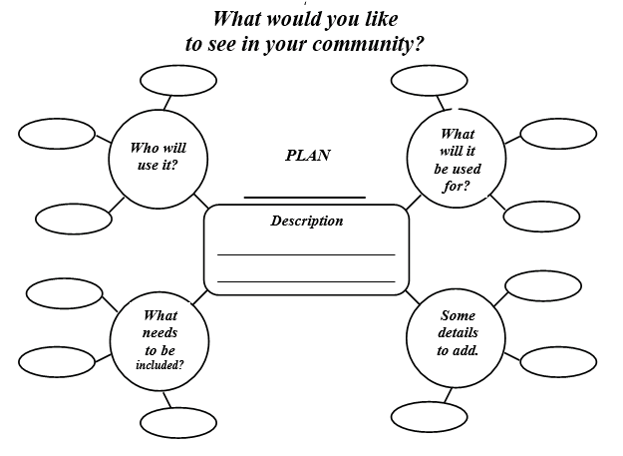
COMPLETE YOUR PLAN....

Slide 16

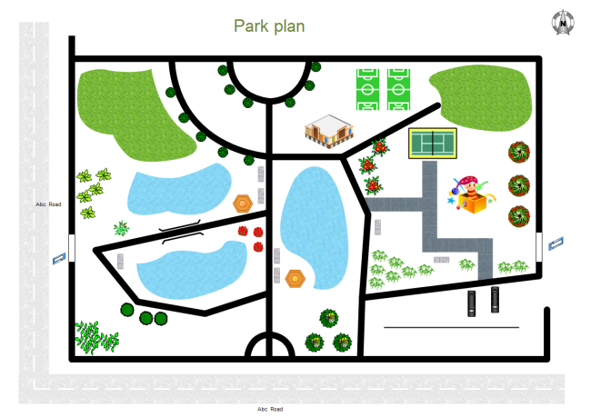





EXAMPLES OF BLUEPRINTS
WILLOW WATERS PARK
Socccer Field
Socccer Field
Changing Room
Swimming
Bathrooms
Water Park
Swimming
Canoes and
Kayaks
Canoes and
Kayaks
Changing Room
Water Park
Bathrooms
Umbrellas
Hiking Trails

Slide 17

TIME TO CREATE YOUR DESIGNS!
  Choose your graph paper
2. Create and label the floor plan.
3. Consider location and size of the elements you add to your design.
4. Add a legend or key to explain any symbols used to represent parts of the design.

Slide 18
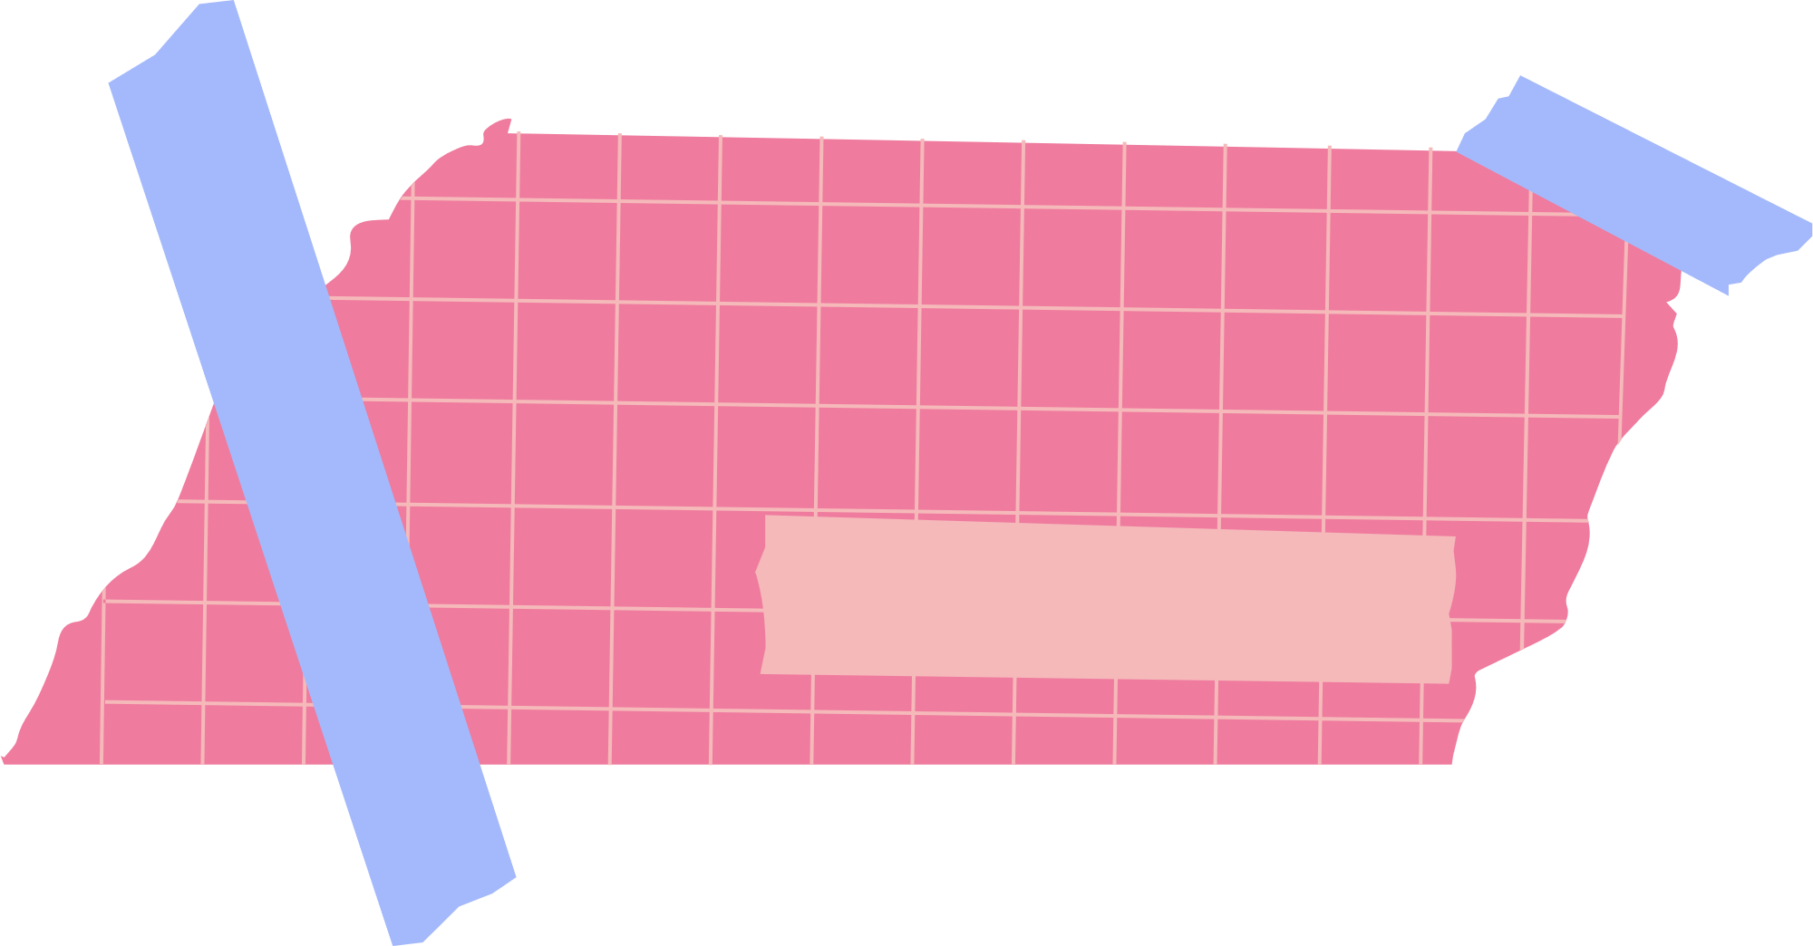



Time to
Choose roles for team members based on interests and passions
1
Create!
Researching and selecting materials
Building the structure
Adding details
Choose one or more parts of your design to build collaboratively. Consider roles for each person in the group.
Keeping the project on-track
Documenting the building process
Adding colour or texture

Slide 19

LET’S SHARE AND REFLECT!
QUESTION 1
QUESTION 2
QUESTION 3
What did you build and why?
How did you work together to build your creation?
What do you like best about your project and why?

