Slide 1







WHO DO YOU
WANT TO BE?
Career Education Framework NB

Slide 2




LEARNING GOALS
I have discussed the things I most like to do, and not to do, and explored the ways in which I might prefer different types of career pathways when I am older.
Goal
Goal
I understand why some people might like some roles more than others.
Goal
I can identify some skills and strengths that I have and how they would be helpful in life and work.

Slide 3




OH, THE POSSIBILITIES
Let’s brainstorm...
What do you think the question means?
Who do you want to be
when you grow up?

Slide 4


READ-A-LOUD
Book #1

Slide 5




LET’S
REVIEW:
Why is it important to consider WHO we are when making plans for the future?
How can understanding our interests, strengths, and passions help us find
a path that fits?

Slide 6




LET’S
REVIEW:
In the story, cousin Jamie wants to be many things! What interests, strengths, or passions might Jamie have that sparked an interest in these career ideas?
Web Designer - Robot Trainer - Nurse - Smoothie Tester

Slide 7
LET’S
BRAINSTORM:
Jamie
They want to be someone who uses creative ideas to solve problems
Let’s create a web....
Cicles: Find a classmate and write each other’s names in a circle on your webs.
Rectangles: Ask your classmate WHO do they want to become. Write 1 idea in the shape.
Pentagons: Brainstorm together ideas for careers that might be a good fit based on that answer. Write 1 idea in the shape.
An Architect uses creativity to design buildings.

Slide 8
LET’S
BRAINSTORM:
Andie
They want to be someone who is a great listener
Let’s create a web....
Cicles: Find a classmate and write each other’s names in a circle on your webs.
Rectangles: Ask your classmate WHO do they want to become. Write 1 idea in the shape.
Pentagons: Brainstorm together ideas for careers that might be a good fit based on that answer. Write 1 idea in the shape.
A Therapist or Counsellor listens and helps people

Slide 9

READ ALOUD
BOOK #2

Slide 10


WHAT ARE YOUR POSSIBILITIES?
Possibilities | Why? | Do I already?
HELPING OTHERS | I LOVE TALKING TO PEOPLE AND HELPING THOSE IN NEED
Status :
Sometimes
Always
Never

Slide 11
YOUR
PROJECT
CAREERS THAT FIT FOR YOU!
RESEARCH AND PLANNING STAGE
Ideas
Explain
Learn
Think of careers that fit with your possibilities, your interests, your passions! Come up with 3-5 career possibilities.
Choose one career to explore.
How is this career a good fit for you?
Give 3-5 reasons.
The career you chose:
Explain 3-5 skills you will need to learn or practice.
Explain 1-2 ideas about how you could start building these skills now

Slide 12

CAREER RESEARCH
NBJobs.ca Videos and Snapshots
Cybersecurity Specialists
Main duties:
  protect computer networks, devices and information from security threats
  keep track of who has access to information on computer systems
  Install and test software and tools
  Help people protect their privacy and keep information safe
Interests/Skills
  working with computers
  helping people
  solving problems

Slide 13
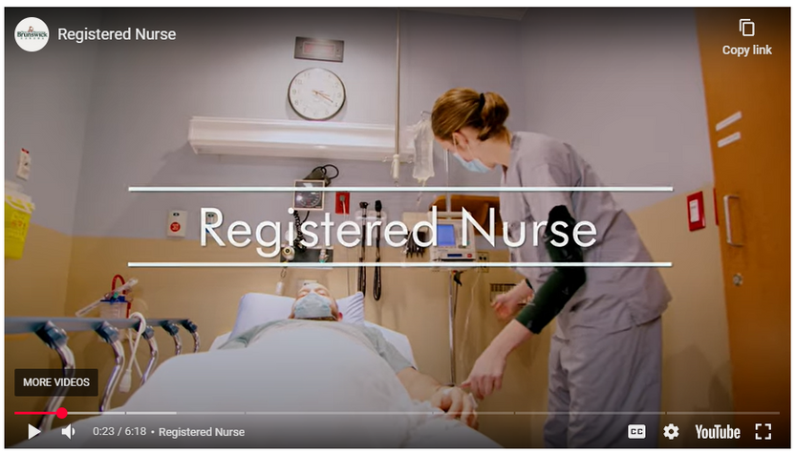
CAREER RESEARCH
NBJobs.ca Videos and Snapshots
Registered Nurse
Main duties:
  assessing patients
  working with colleagues to support the health of patients (plan and carry out the best patient care)
  giving medications and treatments
  monitoring patient symptoms
  working together with doctors and other hospital staff
Interests/Skills
  helping others
  communication
  empathy
  organized
  attention to detail

Slide 14
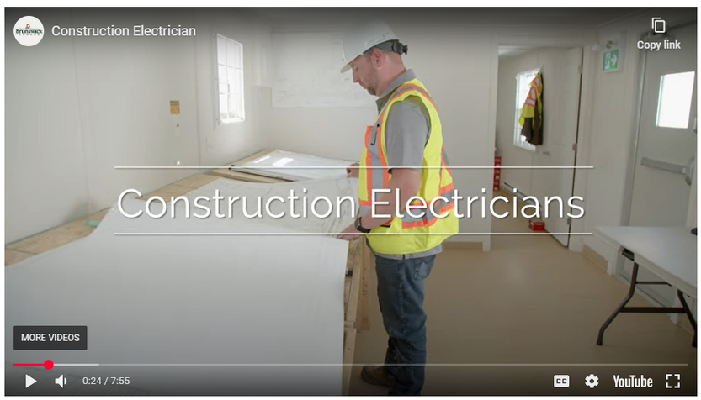
CAREER RESEARCH
NBJobs.ca Videos and Snapshots
Electricians
Main duties:
  installing and fixing electrical systems that provide heat, light, or power in all types of buildings and structures
  reading circuit diagrams and electrical code
  working with colleagues and clients to get jobs done well and on time
Interests/Skills
  working with your hands
  attention to detail
  problem solving

Slide 15



PREPARE TO PRESENT!
Canva
PowerPoint
Brochure
Video
Book
Poster
Other ideas?

Slide 16
CHECKLIST
3-5 career possibilities
Choose one career of interest:
3-5 reasons why the career is a good fit for you
3-5 skills you will need to learn for this career
1-2 ideas for how you might start building these skills now

