Slide 1
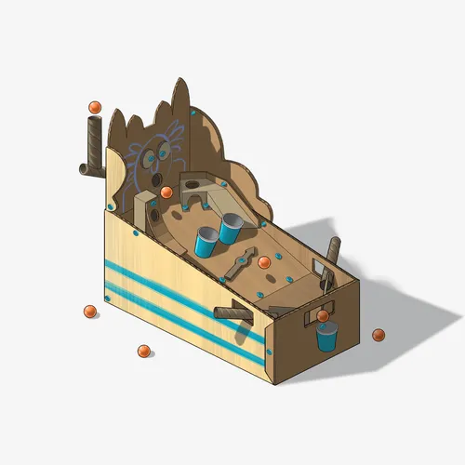
design thinking
Challenge

Slide 2
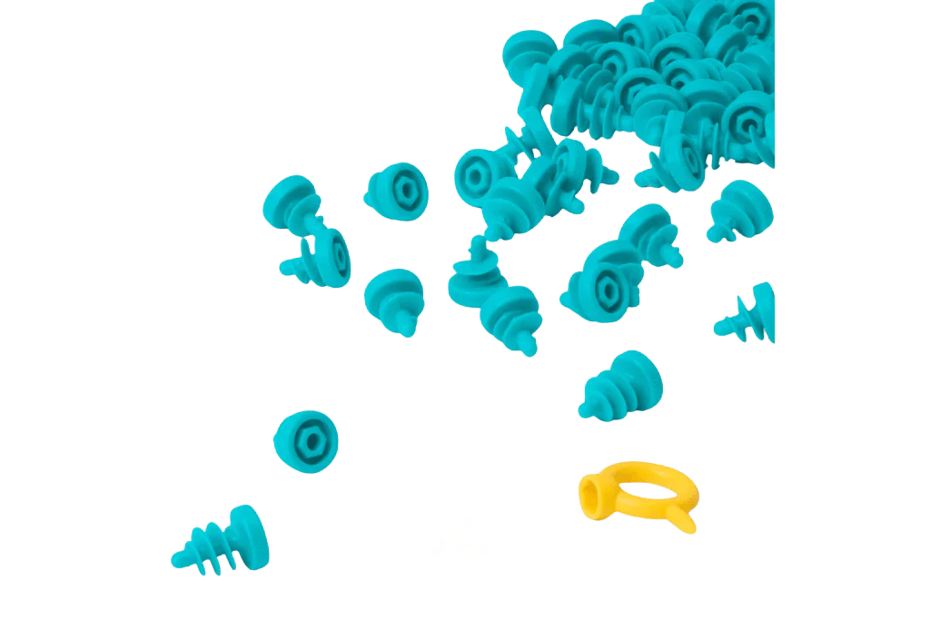

Materials:
  cardboard
  makedo kit
  Anything else you can find!
Click here - Using the Makedo Tools

Slide 3
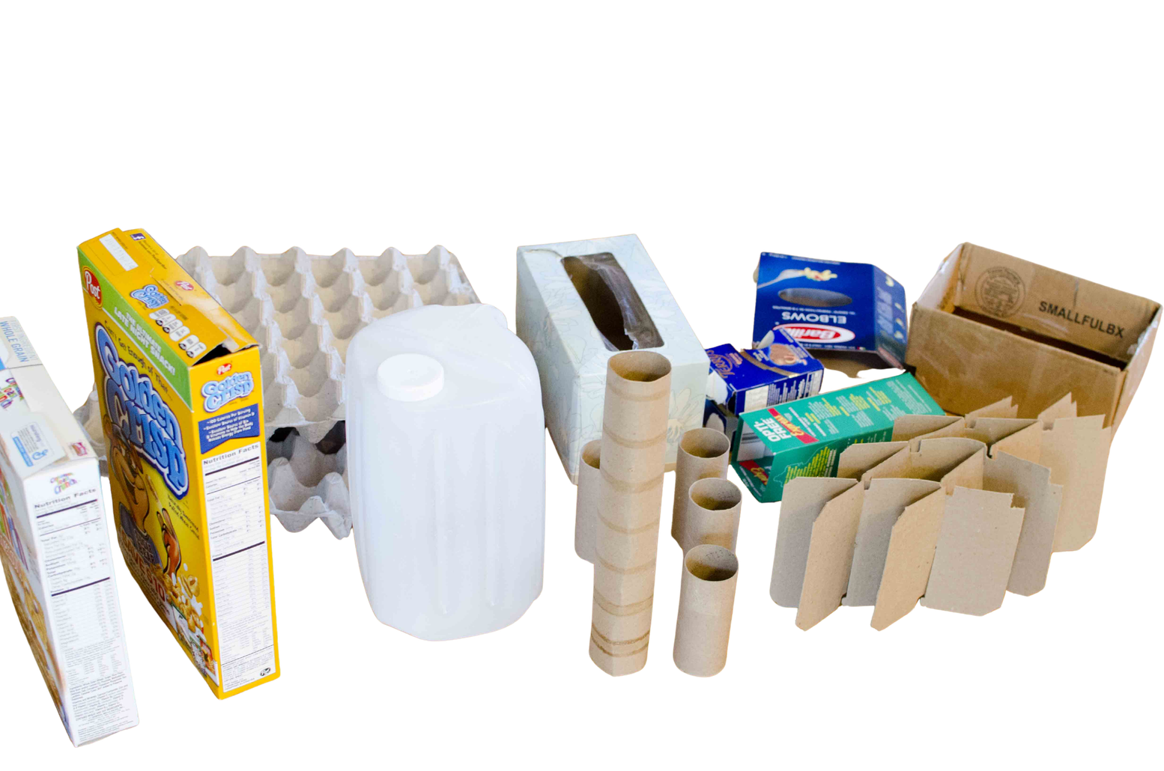
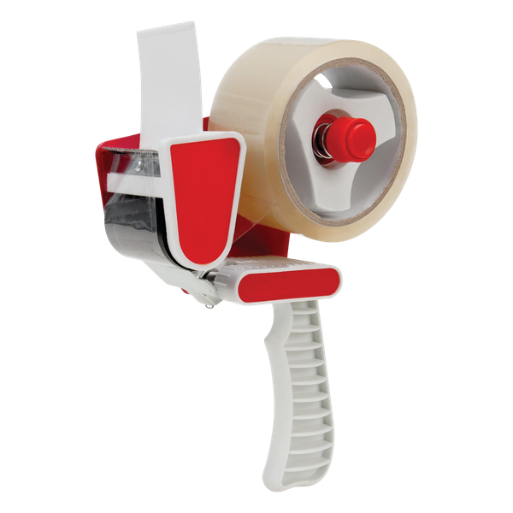
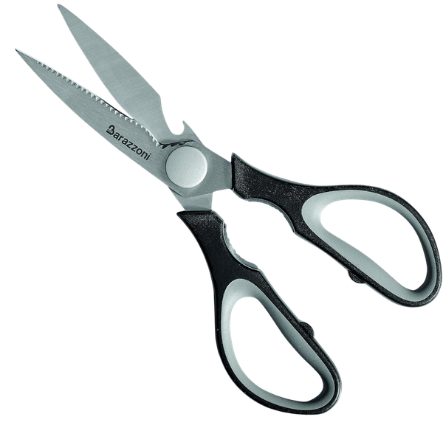
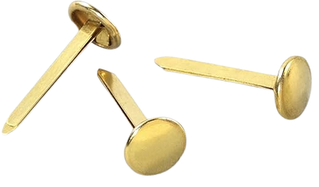
Materials:
  cardboard
  tape
  scissors
  brass fasteners
  Anything else you can find!

Slide 4


Challenge
Design and build a working...
arcade game!

Slide 5
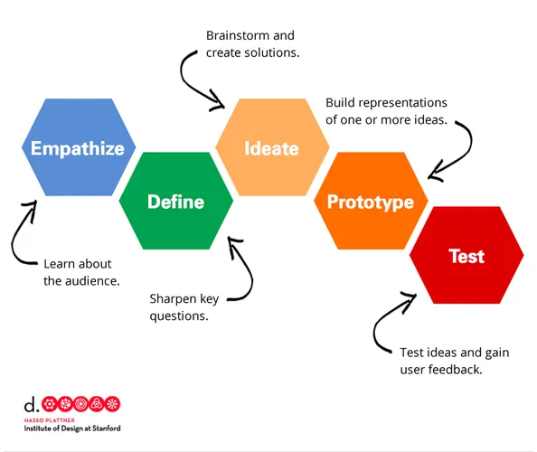
Design thinking

Slide 6

Design thinking
STEP 1: Empathize
Learn about the audience

Slide 7
Empathize
Understand who will play your arcade game and what they enjoy.
Questions:
  Who will play your arcade game? (Kids? Teens? Adults? Everyone?)
  What do these players like to do for fun?
  What problems might they face when playing arcade games? How can we make the game inclusive, so that all players can enjoy?

Slide 8




“player interviews”
1. pair up with a classmate.
2. Decide who will be the “arcade player” and the “game designer.”
3. Designers have 2 minutes to ask the Player questions about what features they like in games.
4. swap roles and repeat the activity.
5. find a new partner and try it again...

Slide 9
Design thinking
STEP 2: define
sharpen key questions

Slide 10
DEFINE
Clearly explain the challenge you are solving.
Questions:
  What is the main goal of your arcade game? what will make your game stand out from others?
  what skills will the players build while playing?

Slide 11

“Challenge Wall activity”
place sticky notes with ideas for challenges under at least 3 categories.
These may include existing games or descriptions of new ideas.
Moving soccer players to block ball from going in net.

Slide 12
Design thinking
STEP 3: ideate
brainstorm and create solutions

Slide 13
Ideate
Brainstorm as many ideas as possible.
Questions:
  Create a list of ideas without judgement - All ideas have value!
  Which idea(s) would be the most surprising or creative?
  Which idea(s) are possible considering the time and materials we have available? what barriers might you face and how can problem solving help?

Slide 14

“idea carousel”
groups start at different stations with paper and markers. They have 3 minutes to sketch a plan of the game concept they are thinking about. When time is up, they rotate to the next station and add to or improve the idea left by the previous group. Keep rotating until all groups have visited each station.

Slide 15
Design thinking
STEP 4: prototype
build one or more ideas

Slide 16
prototype
build your game using the materials provided
Questions:
  What materials can you use right now to build your game?
  How will you show the main parts of the game in your prototype?
  What will players need to do in your prototype? How can you make the instructions clear?

Slide 17

a prototype is...
a first or early model of an invention.
Designed for a purpose
Intended
to be improved
A 3D physical model

Slide 18
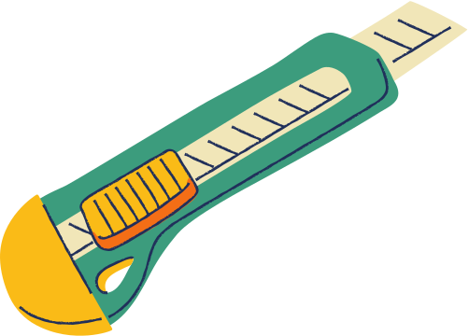
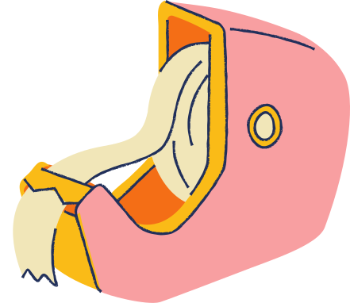
Be respectful of materials and others.
Be green by using materials wisely.
Be inclusive of everyone's ideas.
Makerspace Expectations

Slide 19
Design thinking
STEP 5: test
test ideas and gain user feedback

Slide 20
test
Try your game and learn from feedback.
Questions:
  What do players like most about your game?
  What confused or frustrated players?
  What would you change to make your game better?

Slide 21

“play and swap”
"Play and Swap" – Half the groups set up their prototype while the other half walks around to play and test. After 10-15 minutes, they swap roles. Everyone writes quick feedback notes on sticky notes and leaves them at each game station.

Slide 22
Design thinking
STEP 6: Revise

Slide 23
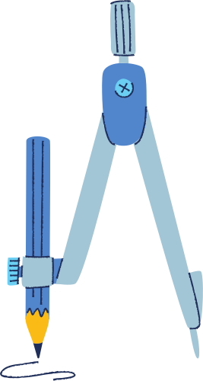
Want to keep learning?
here are some more challenges to try...

Slide 24
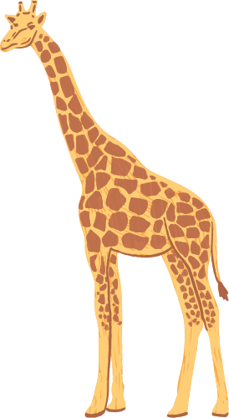
Challenge
Design a prototype that...
Helps an animal

Slide 25

Challenge
Design a prototype that...
helps people
who are unhoused

Slide 26

Challenge
Design a prototype that...
Makes old
technology new

Slide 27

Challenge
Design a prototype that...
self waters a plant

Slide 28
vocabulary:
design
arcade
mechanism
force
motion
Empathise
define
ideate
prototype
test
Feedback

Slide 29

Congrats!
Please share pictures of your creations to COE@gnb.ca and complete this survey to be entered in a prize draw!

