Slide 1


I
DEA TO
I
MPACT

Slide 2

WHAT IS AN ENTREPRENEUR?
Turn to your
classmate and
discuss!

Slide 3
An entrepreneur is someone who starts something new to solve a problem.

Slide 4
WHAT IS A PROBLEM?
Turn to your
classmate and
discuss!

Slide 5
A problem is when something isn’t working the way we want, and we need to find a way to fix it or make it better.

Slide 6


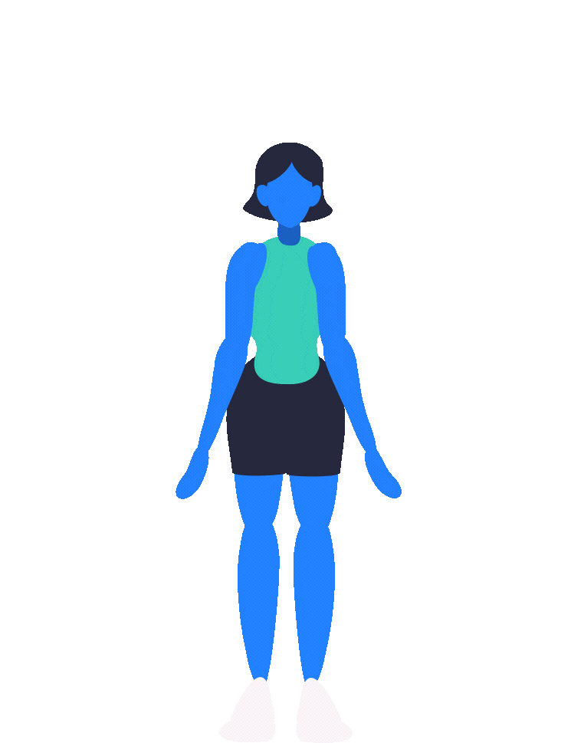
We have entrepreneurs in New Brunswick
TRUE
FALSE
JUMPING JACKS
SQUAT

Slide 7

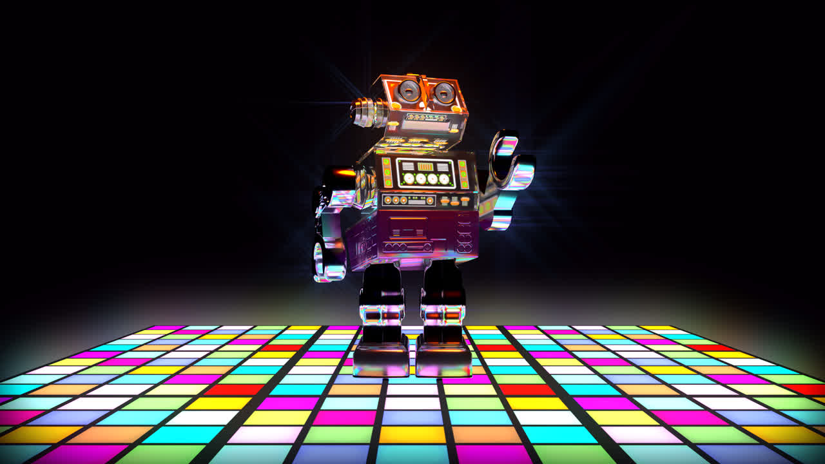
Only adults can be an entrepreneur
TRUE
FALSE
STATUE
ROBOT DANCE

Slide 8

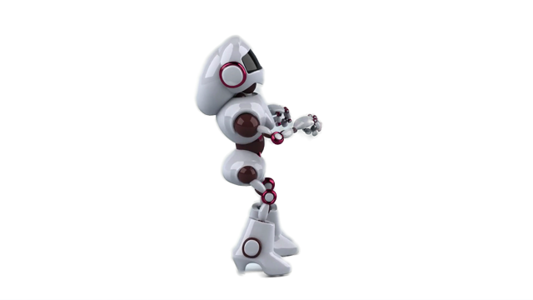
Entrepreneurs only work alone
TRUE
FALSE
DANCE
YOGA POSE

Slide 9

THINKING ABOUT PROBLEMS
NOTICE: WHAT IS SOMETHING AROUND YOU THAT DOESN’T WORK WELL OR COULD BE BETTER? WHAT TAKES TOO LONG? WHAT BREAKS EASILY?

Slide 10
THINKING ABOUT PROBLEMS
FEEL: WHAT IS SOMETHING THAT BOTHERS YOU OR IS FRUSTRATING?

Slide 11
IMAGINE: WHAT IS SOMETHING YOU WISH COULD BE EASIER, SAFER, OR MORE FUN? WHAT IS SOMETHING NEW THAT COULD HELP PEOPLE?
THINKING ABOUT PROBLEMS

Slide 12

Choose a problem....and think about a...

Slide 13
THE ACTIVITY
Use classroom materials to create
something that solves a problem!
A prototype is a simple model that helps test an idea.

Slide 14
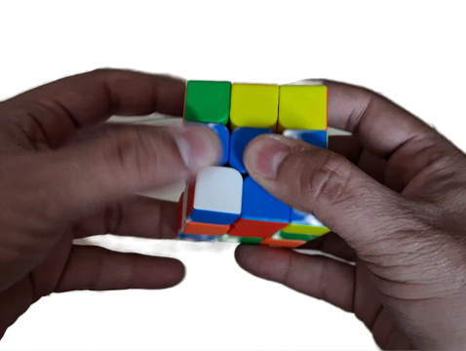
When Creating your Prototype
Start simple Test your idea
Adjust and improve Try again if needed

Slide 15

ASK YOURSELF
What problem are you solving?
How does it work?
What happened when you tested it?
What might you change?

Slide 16
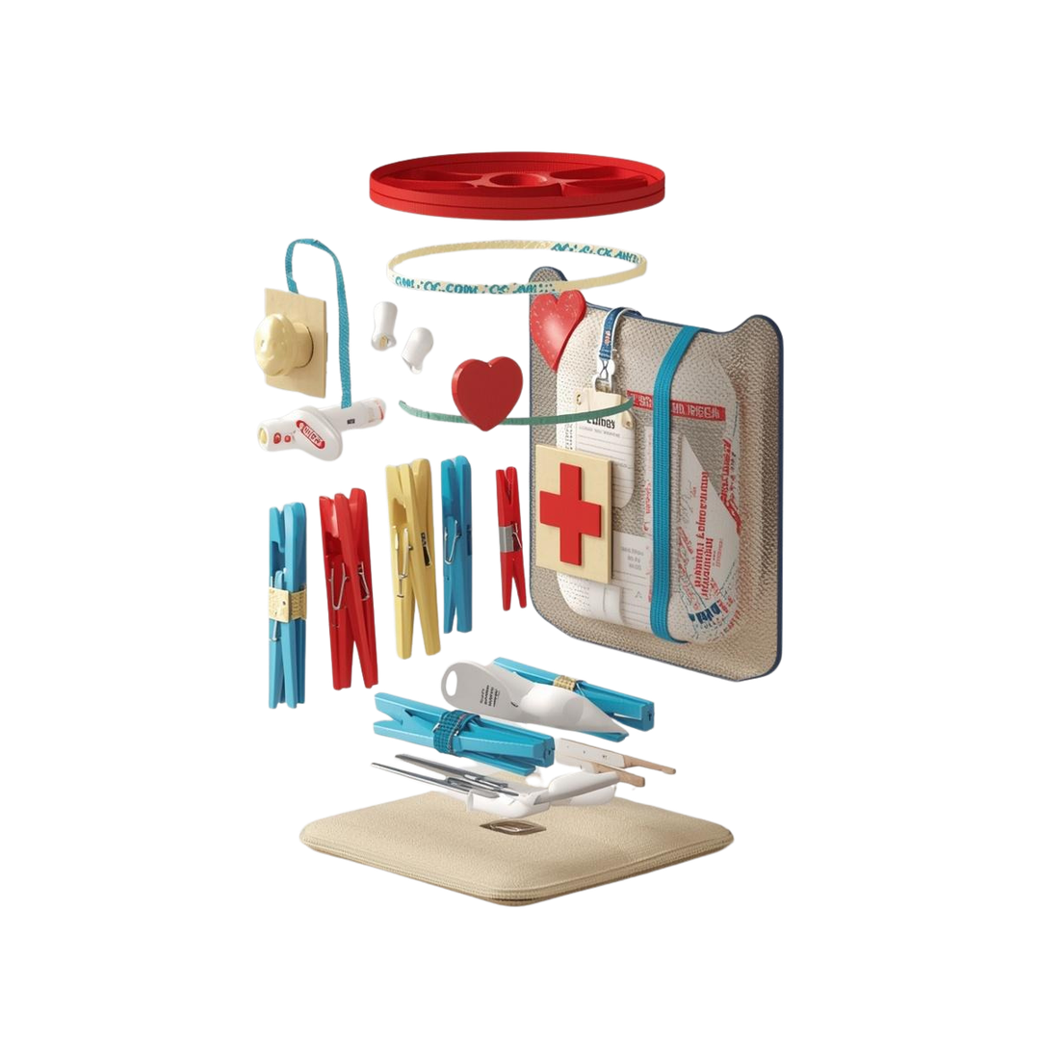
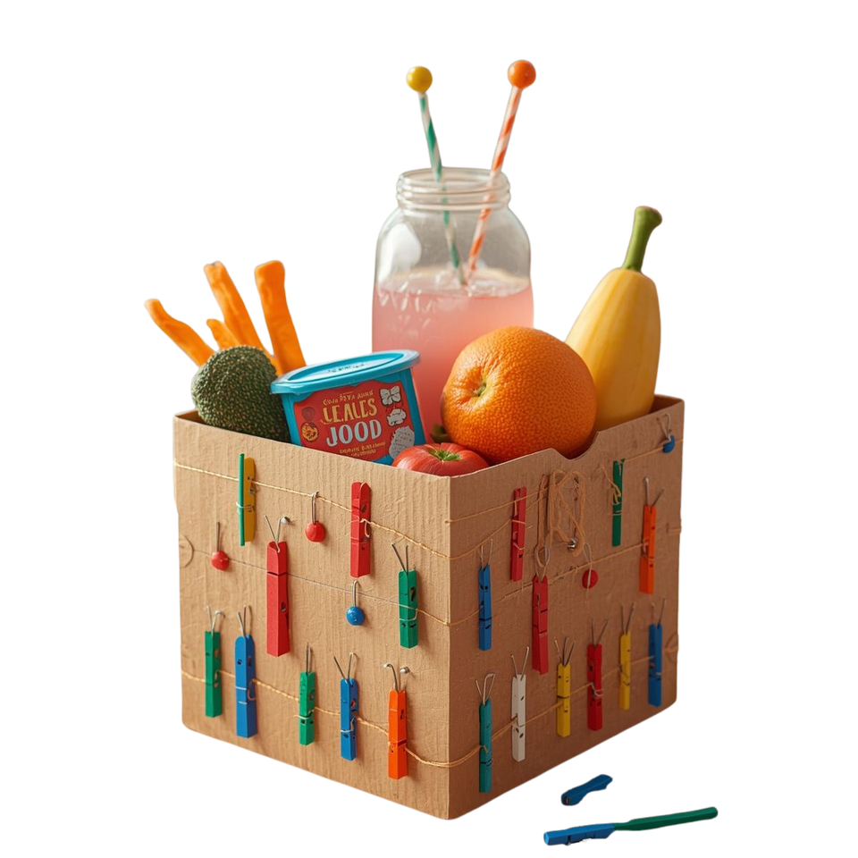
EXAMPLES
Stationary First Aid Kits
Community Food Box

Slide 17
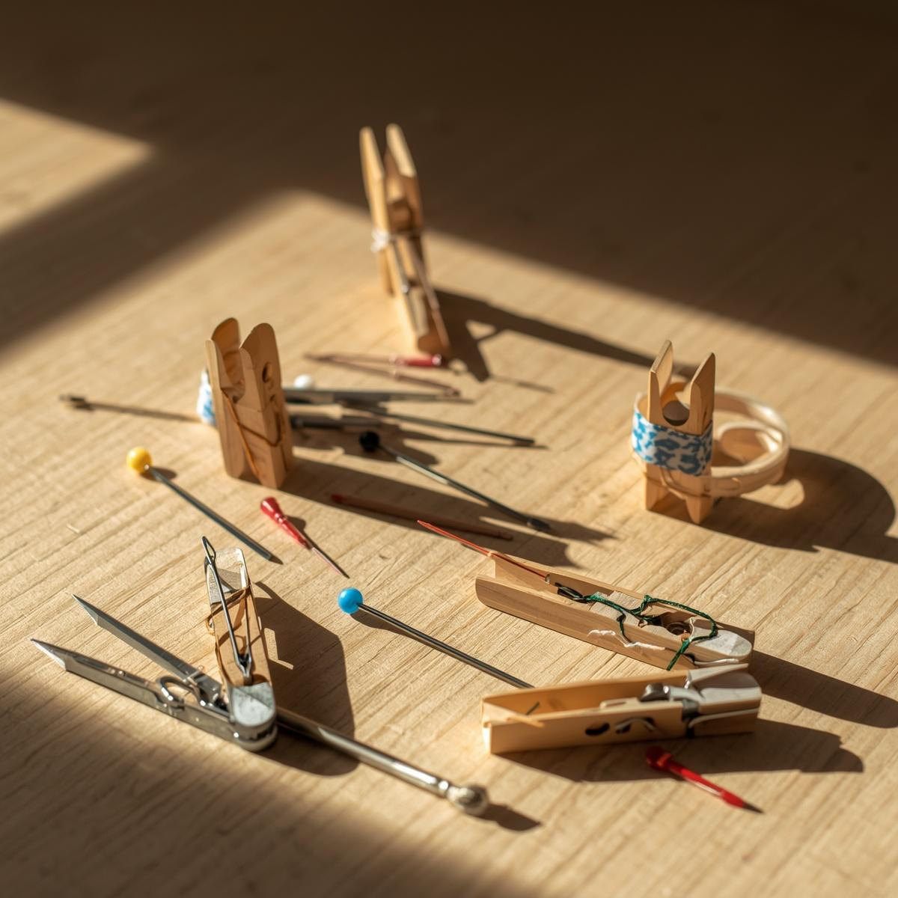
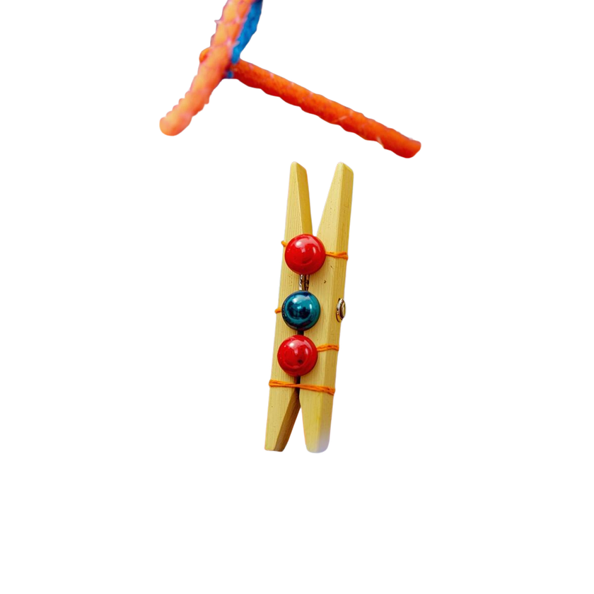
TIME to BUILD!

Slide 18

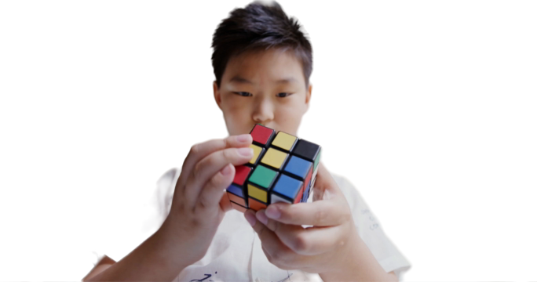

CARE TO SHARE?
One Success
One Challenge

