Slide 1
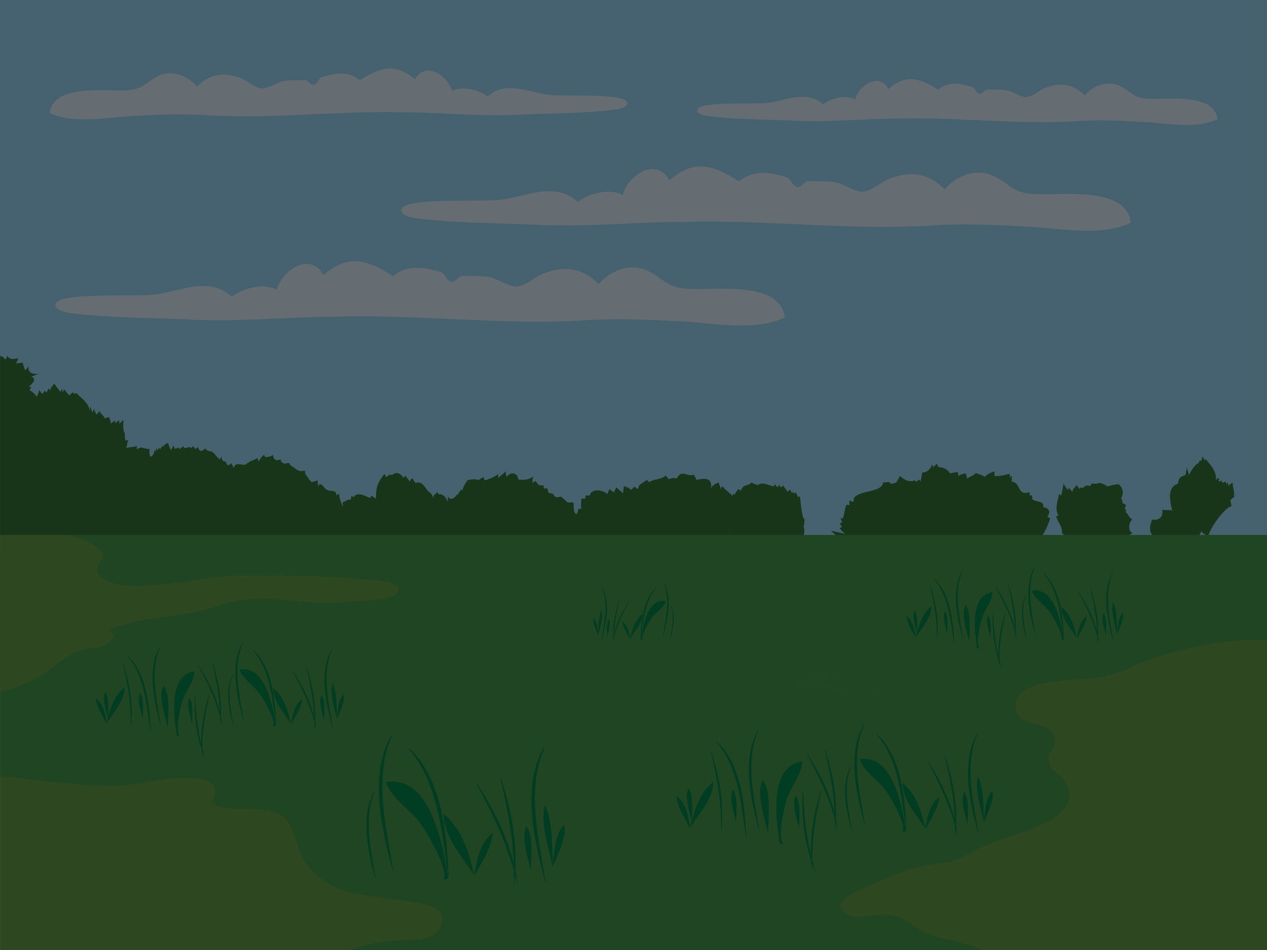
MONSTER MAKERS
COLOUR STUDIO

Slide 2
MEET THE
PRIMARY COLORS
RED
BLUE
YELLOW

Slide 3
WE CAN BE MIXED TOGETHER TO CREATE SECONDARY COLOURS!
RED
BLUE
YELLOW

Slide 4
DRAG AND DROP
Move the blue monster and place it on top of the red monster to unveil the new color.

Slide 5
VIOLET!

Slide 6
DRAG AND DROP
Move the red monster and place it on top of the yellow monster to unveil the new color.

Slide 7
ORANGE

Slide 8
DRAG AND DROP
Move the blue monster and place it on top of the yellow monster to unveil the new color.

Slide 9
GREEN

Slide 10
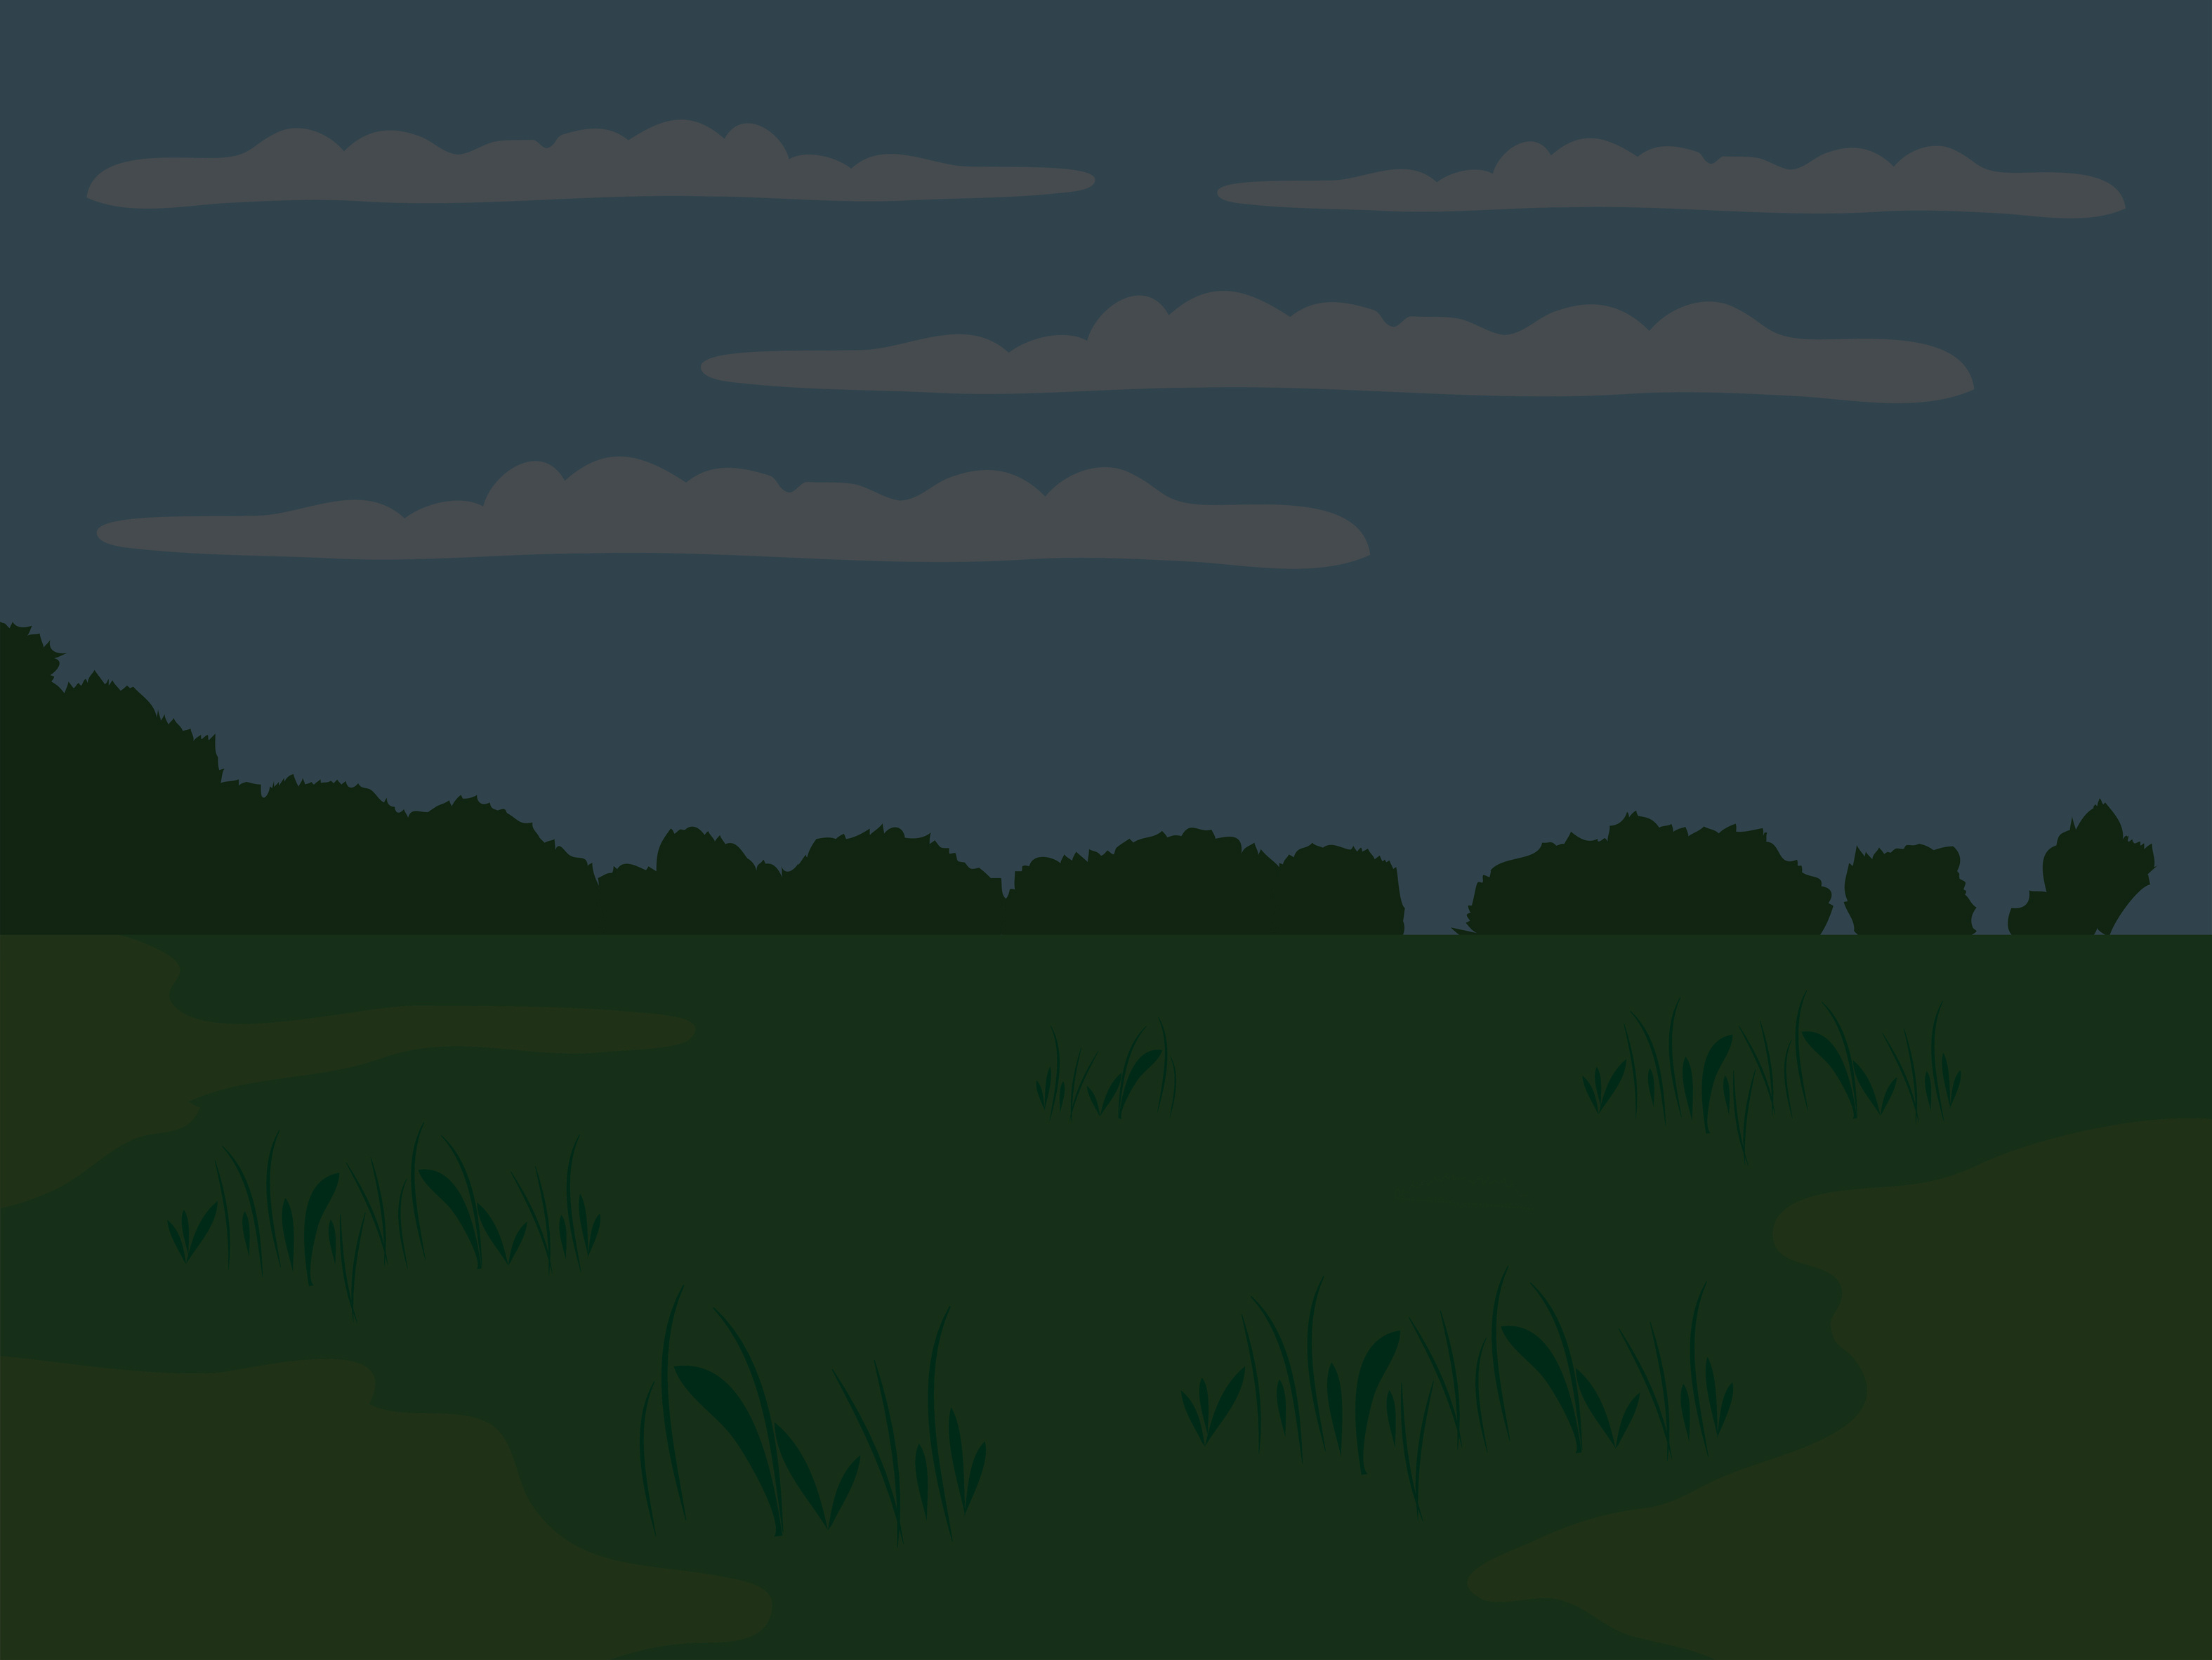

THE COLOUR WHEEL
The colour wheel helps artists know how to mix different colours.

Slide 11
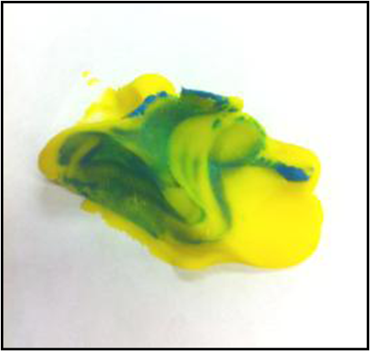
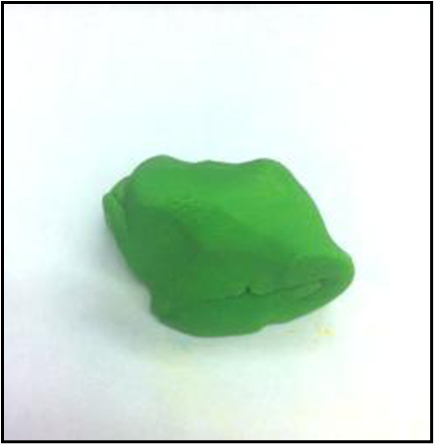
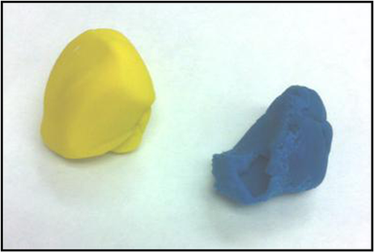
MIX A SECONDARY COLOUR
Choose two primary colours and create a secondary colour of your choice.

Slide 12
TIPS AND TRICKS
Try to make the most middle green you can make (or violet/orange)
Does the colour have too much yellow (yellow-green) or too much blue (blue-green)??
Which colour did you have to add more of to get the best middle green (or violet/orange)? Some colours are stronger than others because they are darker!

Slide 13
TERTIARY COLOURS ARE BETWEEN A PRIMARY AND SECONDARY COLOUR!

Slide 14
YELLOW GREEN
BLUE GREEN
YELLOW
ORANGE
BLUE
VIOLET
RED ORANGE
RED VIOLET

Slide 15
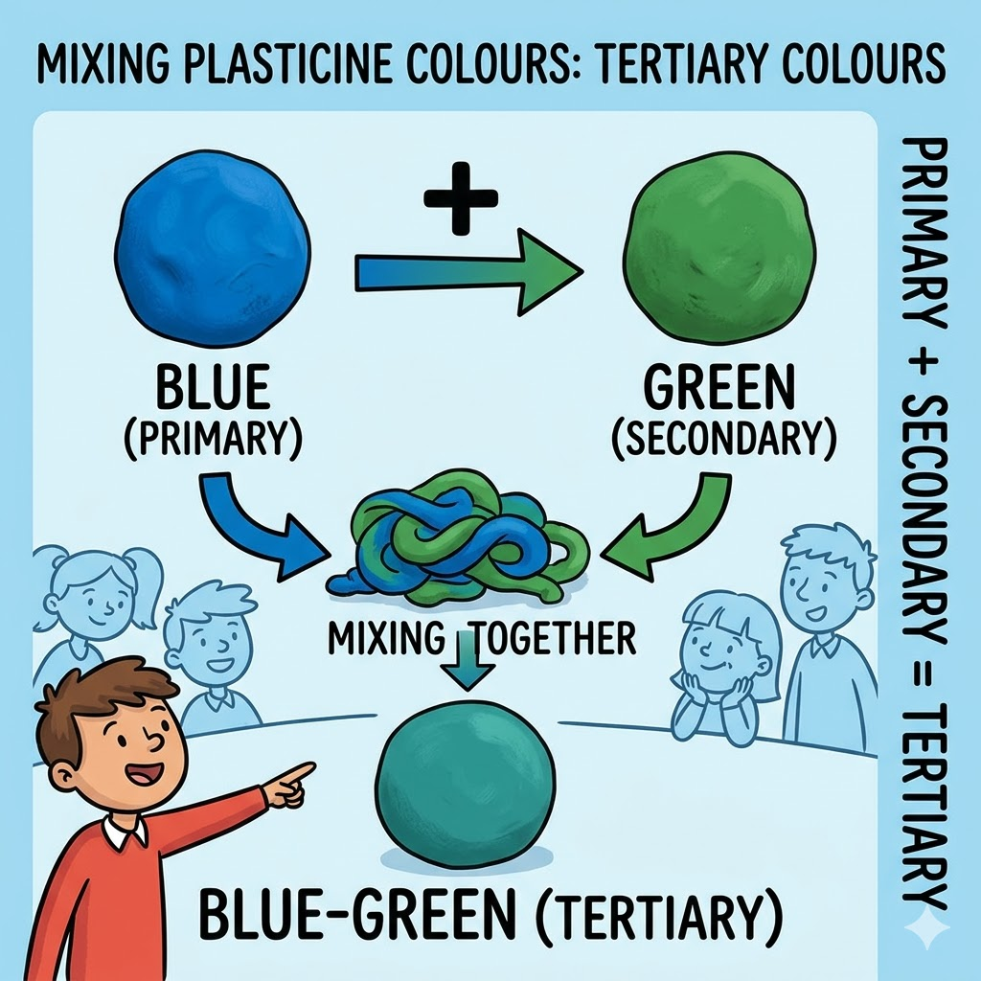
MIX A TERTIARY COLOUR

Slide 16
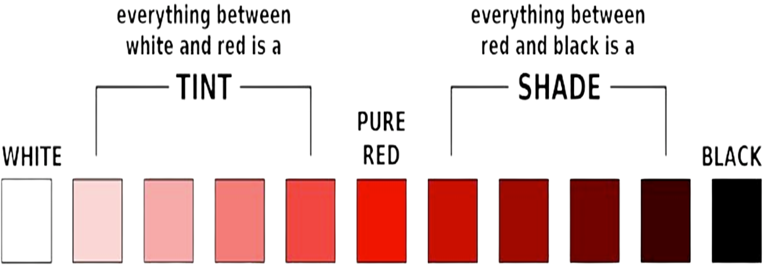
VALUE (TINTS AND SHADES)
WHEN WE MAKE A COLOUR LIGHTER WE CREATE A TINT
WHEN WE MAKE A COLOUR DARKER WE CREATE A SHADE.

Slide 17
DRAG AND DROP
Move the red monster and place it on top of the white monster to unveil the new color.

Slide 18
PINK

Slide 19
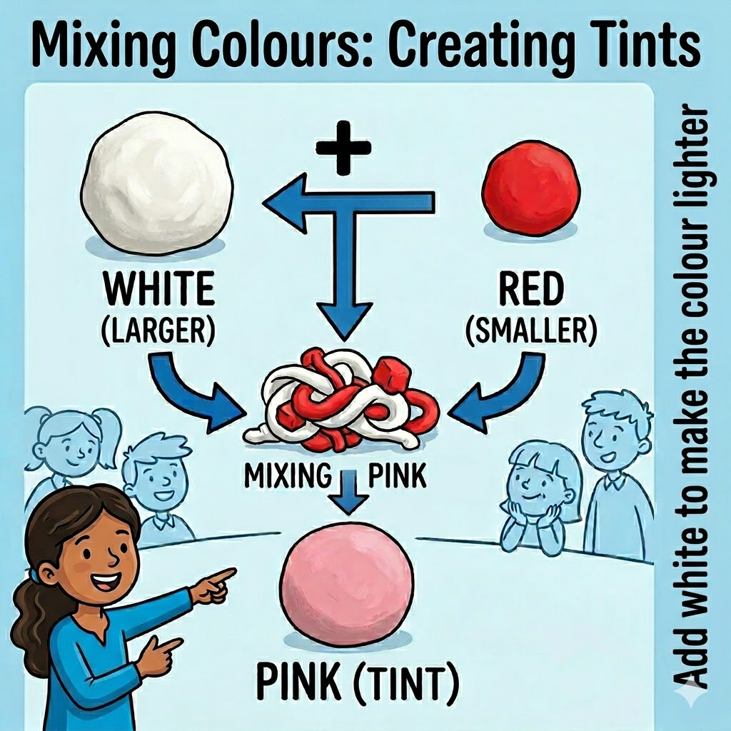
MIX A TINT (ADD WHITE TO MAKE A LIGHTER VALUE)

Slide 20
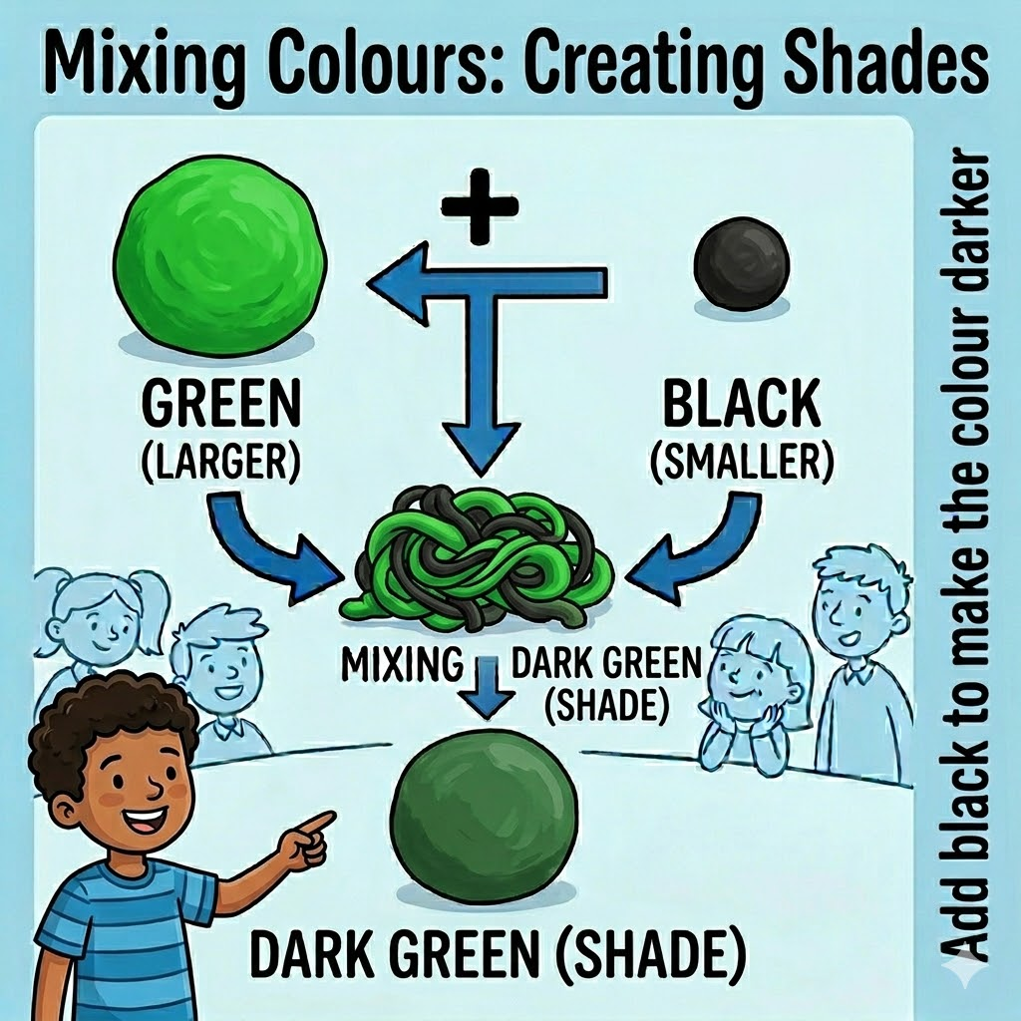
MIX A SHADE (ADD BLACK)
TIP - YOU ONLY NEED A TINY BIT OF BLACK TO MAKE A DIFFERENCE!

Slide 21
COMPLIMENTARY COLOURS SIT OPPOSITE EACH OTHER ON THE COLOUR WHEEL

Slide 22
YELLOW AND VIOLET
BLUE AND ORANGE
RED AND GREEN

Slide 23
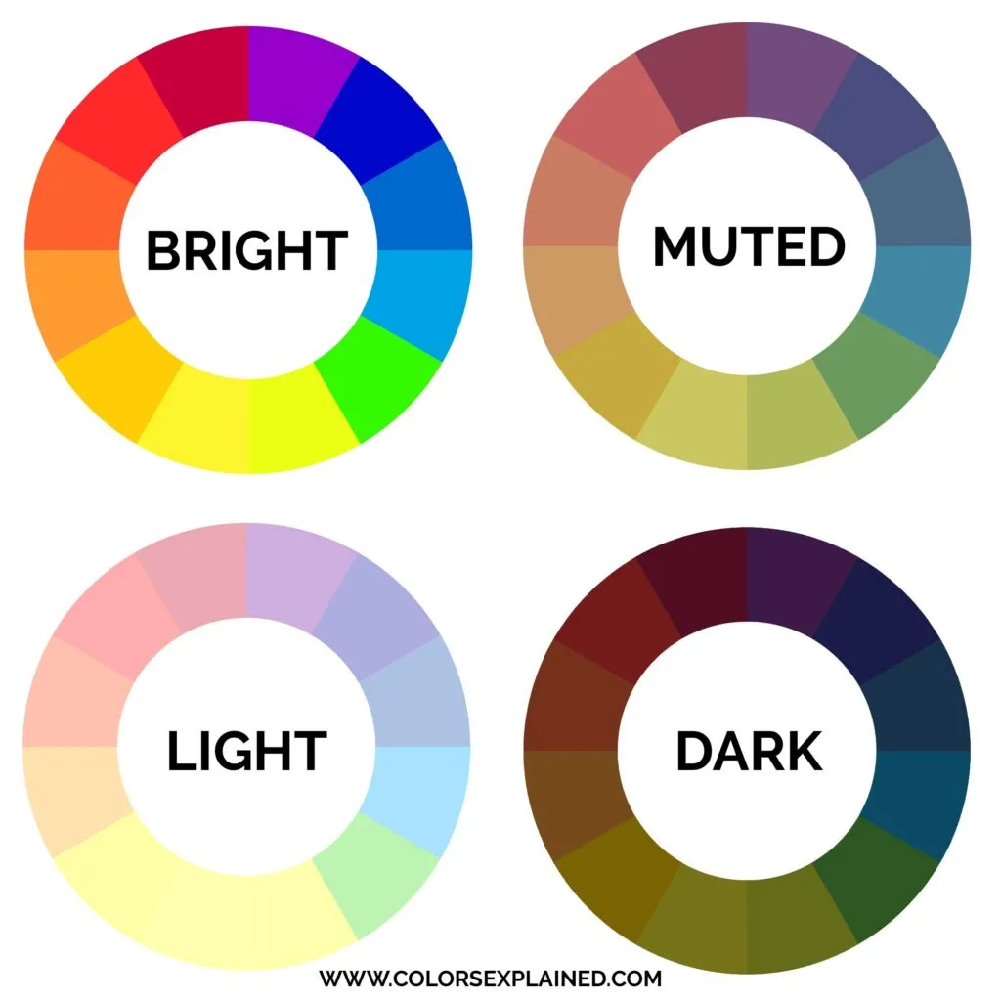
INTENSITY
INTENSITY REFERS TO HOW BRIGHT OR DULL (NEUTRAL) A COLOUR IS.

Slide 24
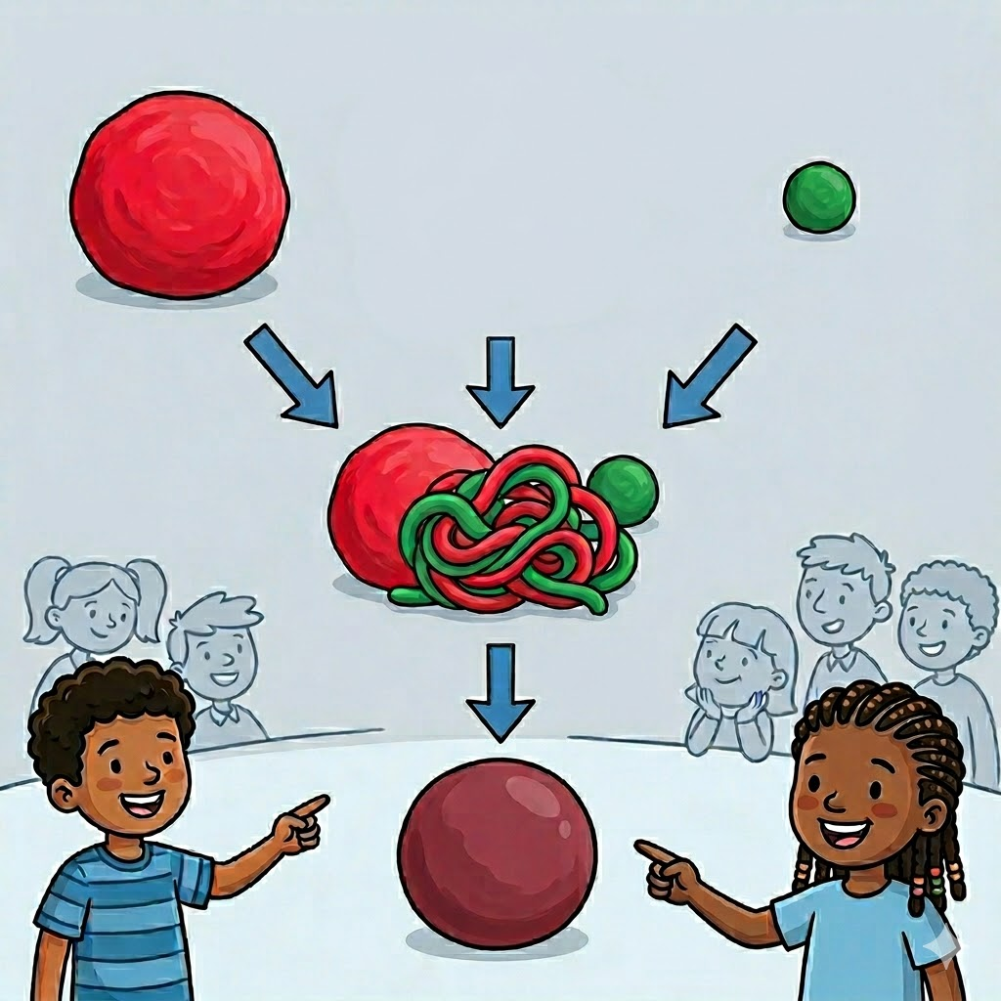
INTENSITY
THE ORIGINAL COLOUR (RED) IS BRIGHT!
ADDING THE COMPLIMENTARY COLOUR CREATES A MORE NEUTRAL COLOUR!

Slide 25
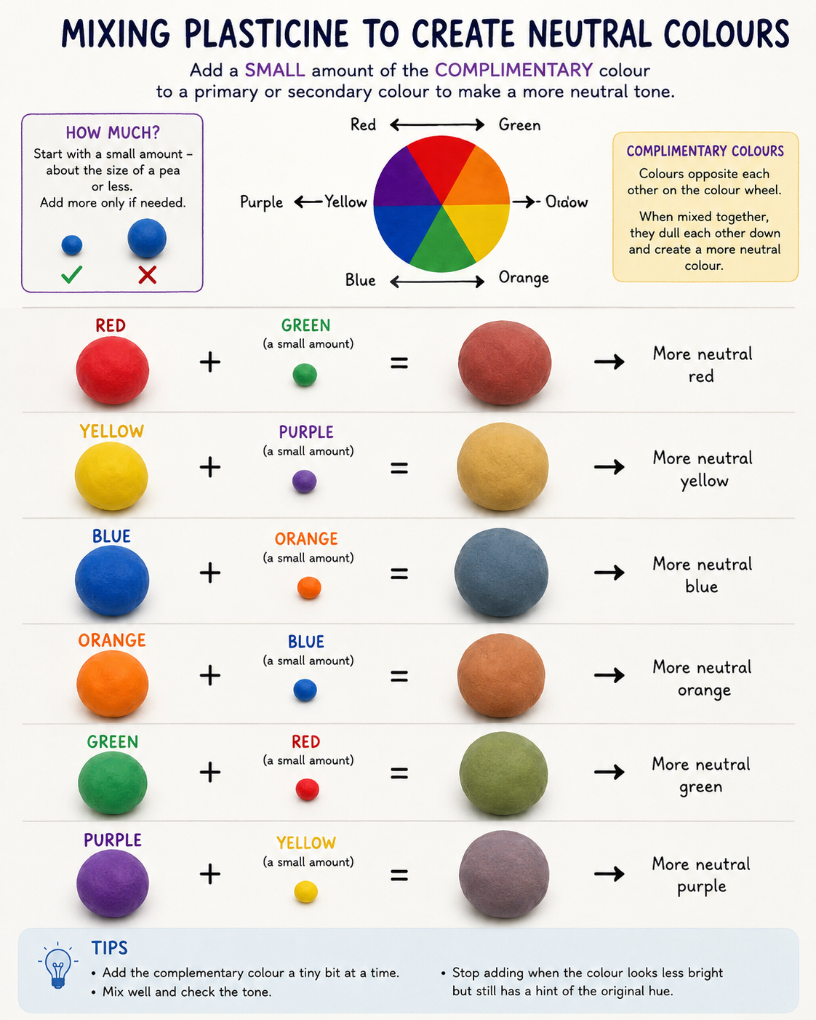
MIX A NEUTRAL COLOUR
CHOOSE A COLOUR AND MAKE IT NEUTRAL BY ADDING THE COMPLIMENTARY COLOUR!

Slide 26
TIME TO SCULPT!
LET’S USE WHAT WE HAVE LEARNED TODAY ABOUT COLOUR MIXING TO TURN OUR MONSTER CHARACTER DESIGNS INTO SCULPTURES!

Slide 27
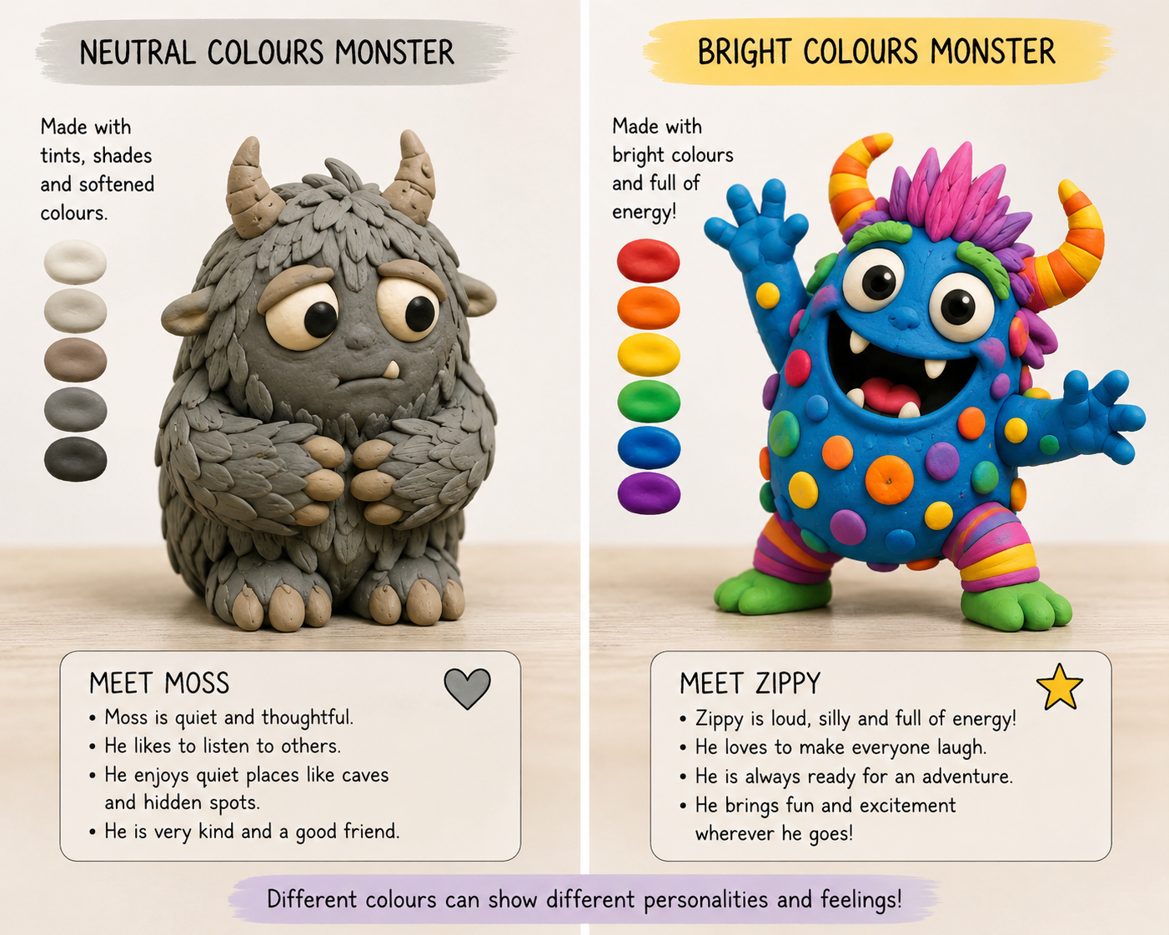
CHOOSING YOUR COLOURS
  WHICH COLOURS WILL MATCH THE MONSTER’S PERSONALITY?
  WILL COLOURS BE BRIGHT OR NEUTRAL?

Slide 28
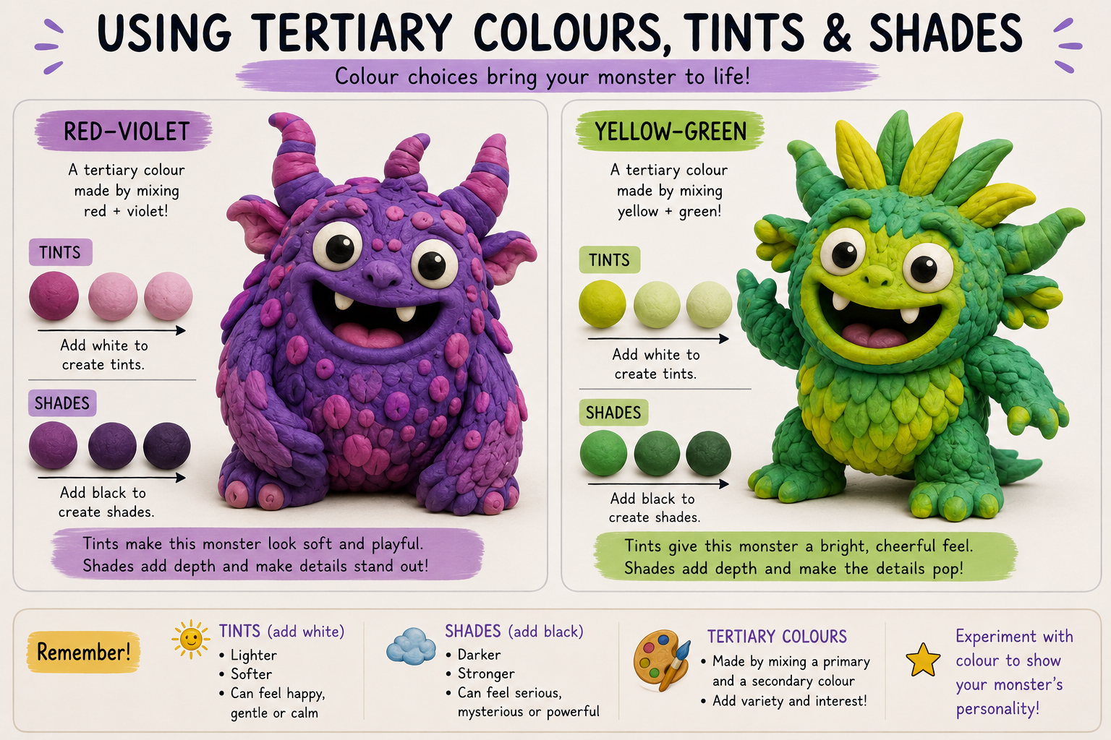
  CAN YOU MIX TERTIARY COLOURS TO USE IN YOUR DESIGN?
  WHERE COULD TINTS OR SHADES ADD DETAIL?

Slide 29
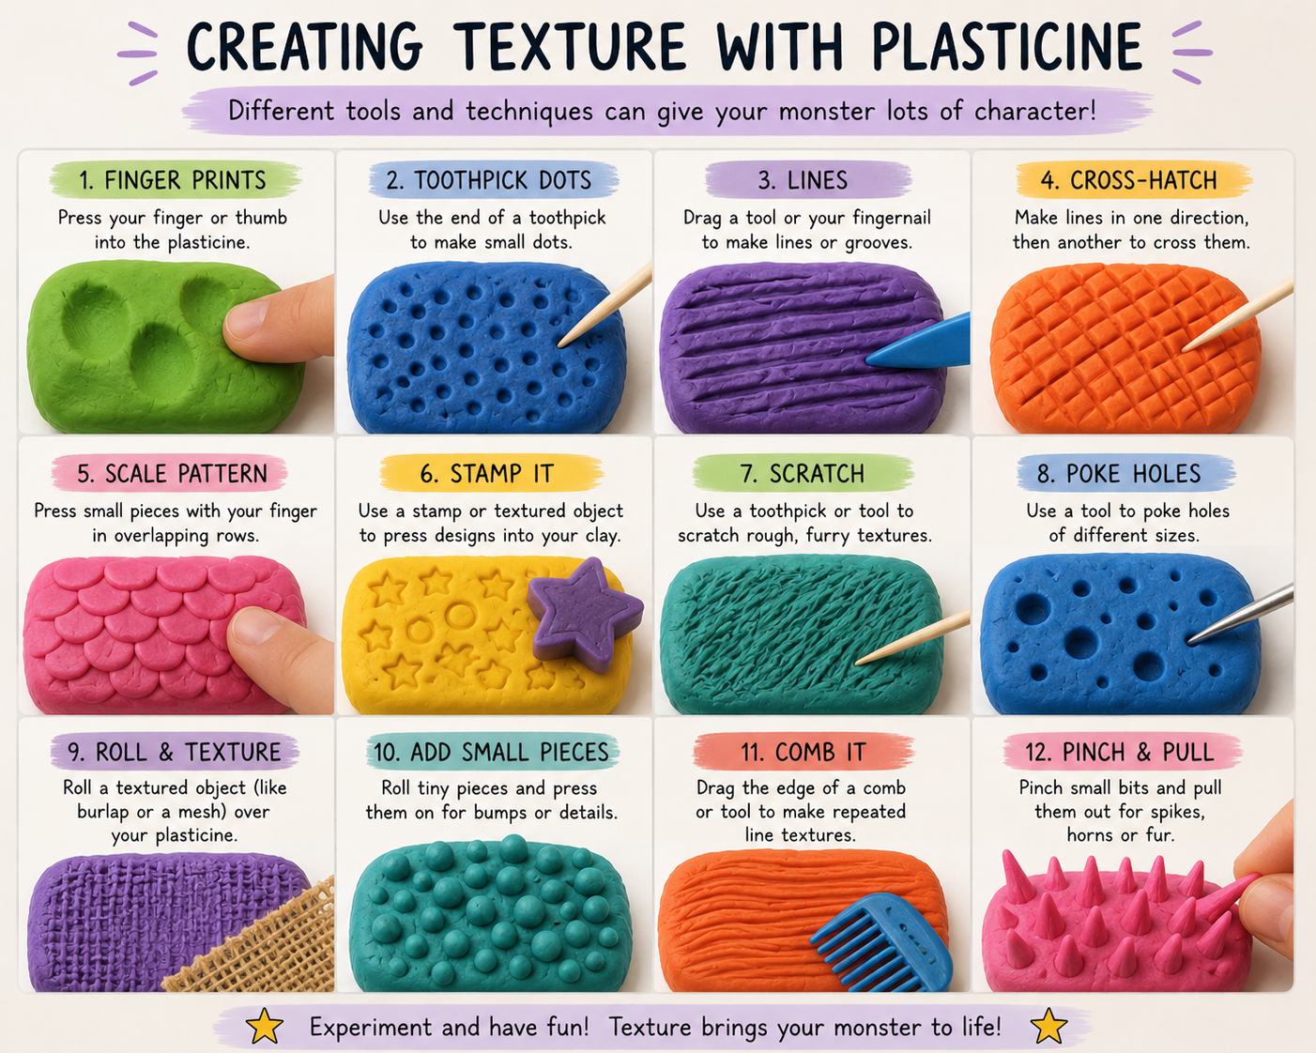
SCULPTING TIP:
ADD TEXTURE BY PUSHING INTO THE CLAY OR ADDING TO THE CLAY - REPEATING LINES OR SHAPES CREATE TEXTURE

Slide 30
SHARE PICTURES OF YOUR CREATIONS WITH US!
COE@GNB.CA

