Slide 1
Minute to Win it PSW edition
Here is where your presentation begins

Slide 2
Table of Contents
01
02
03
Prepare the Medication
Help Patients Commute
Prepare the Meals
04
05
06
Assist with Emotional Needs
Assist with Feeding
First Aid Care and CPR

Slide 3
00:60
You have only one minute to do each game, if you are a star and you find it easy, try taking seconds off to add difficulty.

Slide 4
01
Prepare the Medications
You could enter a subtitle here if you need it

Slide 5
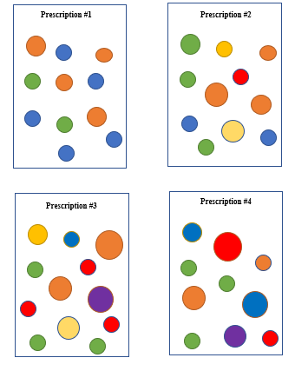
Prepare the Medications
You will be shown a pharmacist’s prescription and will have to prepare medication by placing the right amount of Smarties/color counters/color blocks into the paper plates as shown in the prescriptions for the patients.

Slide 6
02
Help Patients Commute

Slide 7
Help Patients Commute
Students will have 1 minute to transport 3 balloons to the other side of the room. The balloon will be held together between two students, and they have to work together to bring the balloon to the other side without using their hands

Slide 8
03
Prepare the Meals

Slide 9
Prepare the Meals
Second
First
Third
Students will have 1 minute to prepare 3 different plates of food based on the patients’ request
Put these pictures/toys figure on the table and have the student place them on a paper plate according to the patients’ request
Then the students will have to point out the ‘unhealthy food/drink’ in that plate and propose a healthy replacement

Slide 10
Patient’s Orders
Plate 1
Plate 2
Plate 3
Apple
Carrots
Fried chicken
White rice
A cup of milk
Banana
Broccoli
Steak
Mashed potatoes
A can of pop
Strawberries
Green beans
Slices of pork belly
Salad
A glass of water

Slide 11
04
Assist with Emotional Needs

Slide 12
Assist with Emotional Needs
Feeling #1
Feeling #2
Students will be given 3 different emotions/feeling and have 1 minute to explain what they will do when a senior is feeling that way.
Feeling #3
Click to add feeling
Click to add feeling
Click to add feeling

Slide 13
05
Assist with Feeding

Slide 14
Suck It Up
01
02
In 1 minute, students have to transfer all the beads or liquid from one cup to another using a spoon.

Slide 15
06
First Aid Care/CPR

Slide 16
First Aid Care or CPR
Students will have 1 minute to blow 10 balloons to the other side of the line using a straw

Slide 17
Mentions and medals
The fastest
The funniest
The partner
The most agile
The sweetest
The winner
For being the fastest in all or almost all tests. Well done!
This medal is yours because you are surely the funniest!
For being the best partner, you have encouraged everyone.
You are as agile as an orangutan, you deserve this medal, no doubt.
This medal is yours if you haven’t left a single candy alive in your path
You have scored more than anyone else, you are the super winner.

Slide 18
Printed medals
You can print this page and give a medal to each player.

Slide 19
Thank you!
Do you have any questions?
addyouremail@freepik.com
+91 620 421 838
yourcompany.com
Please keep this slide for attribution

Slide 20
Resources
Photos
Vector
Portrait of a girl looking through her painted hands standing against white brick wall
Front view teacher and kids posing together
Hand drawn design funny sticker collection
Positive energy in stickers collection
Kawaii food collection

