Slide 1
All Around Us An Exploratory Kit

Slide 2
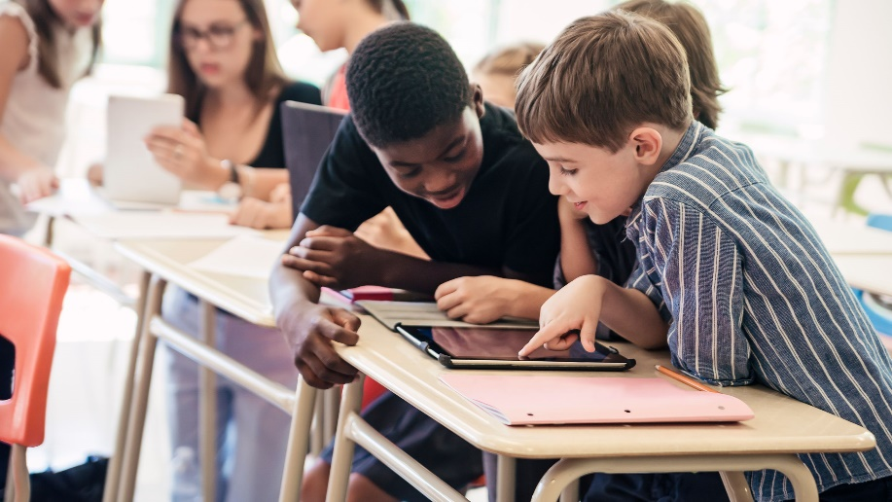
Our Learning Goals:
To understand and practice the skill of being mindful
To see how being mindful is a life-long skill needed for success in future careers
To consider our responsibilities to the Earth and the importance of plants through a First Nations perspective
To create purposeful art
To work together and problem-solve in our learning using a variety of resources and digital tools

Slide 3
What is all around us?

Slide 4
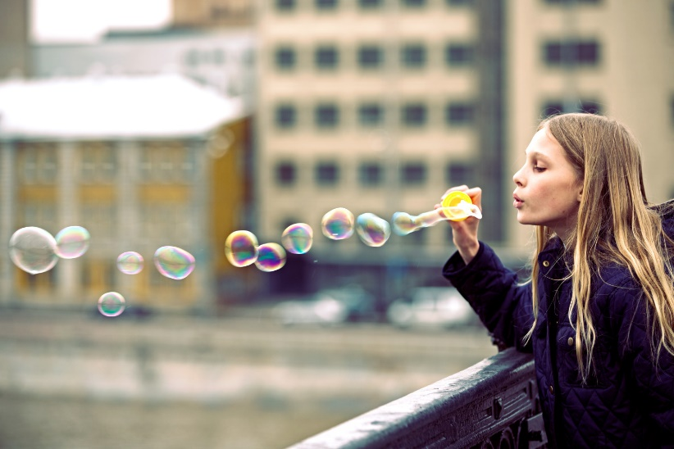
Mindful or Unmindful?
Mindful:
The skill of noticing (your emotions, others around you, your surroundings) in the present moment
Unmindful:
Not noticing what is around you; distracted; thinking of other things; inattentive; uncaring

Slide 5
Fog
With a pencil and square of paper, draw or write down as many details from the poem AFTER 30 seconds of SILENCE
Compare your writing or drawing with a partner near you
Hear the poem one more time – What details did you miss?

Slide 6
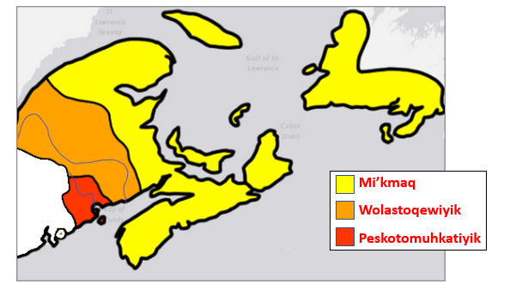
First Nations Territories
Notes:
This map shows the approximate outline of modern-day territories of each First Nation (but note that the act of strictly delineating boundaries is colonial in nature!). Mi’kma’ki is the largest and is made up of seven unique districts. Wolastokuk surrounds the Wolastoq river watershed, which flows in present-day N.B., Quebec, and north-eastern Maine. And Peskotomuhkatik surrounds the Skutik river watershed along the colonial-made border of Canada and the US.
Image credit:
- modified from original file available under Creative Commons https://commons.wikimedia.org/wiki/File:Map_of_the_Wabanaki_Confederacy_Range.png

Slide 7
The Importance
of Plants
What can each of us learn from plants?
What are our responsibilities to the earth?
Knowledge from Tuma Young, Mi’kmaq Elder

Slide 8
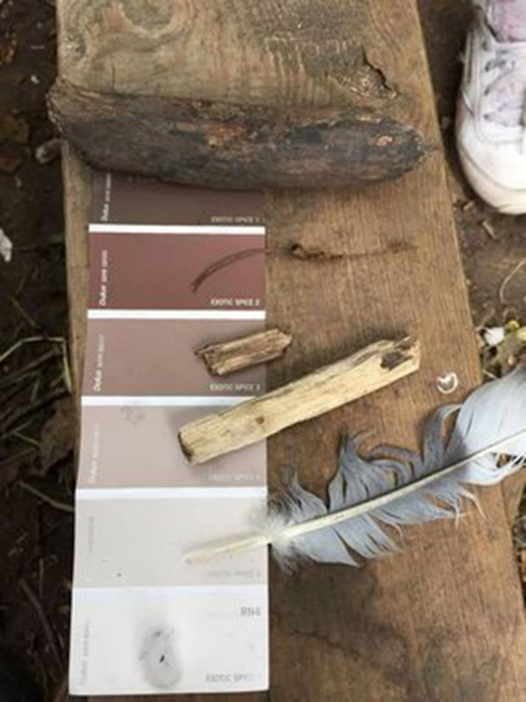
Paint Chip Card Scavenger Hunt
Being Mindful of what is in our school’s backyard

Slide 9
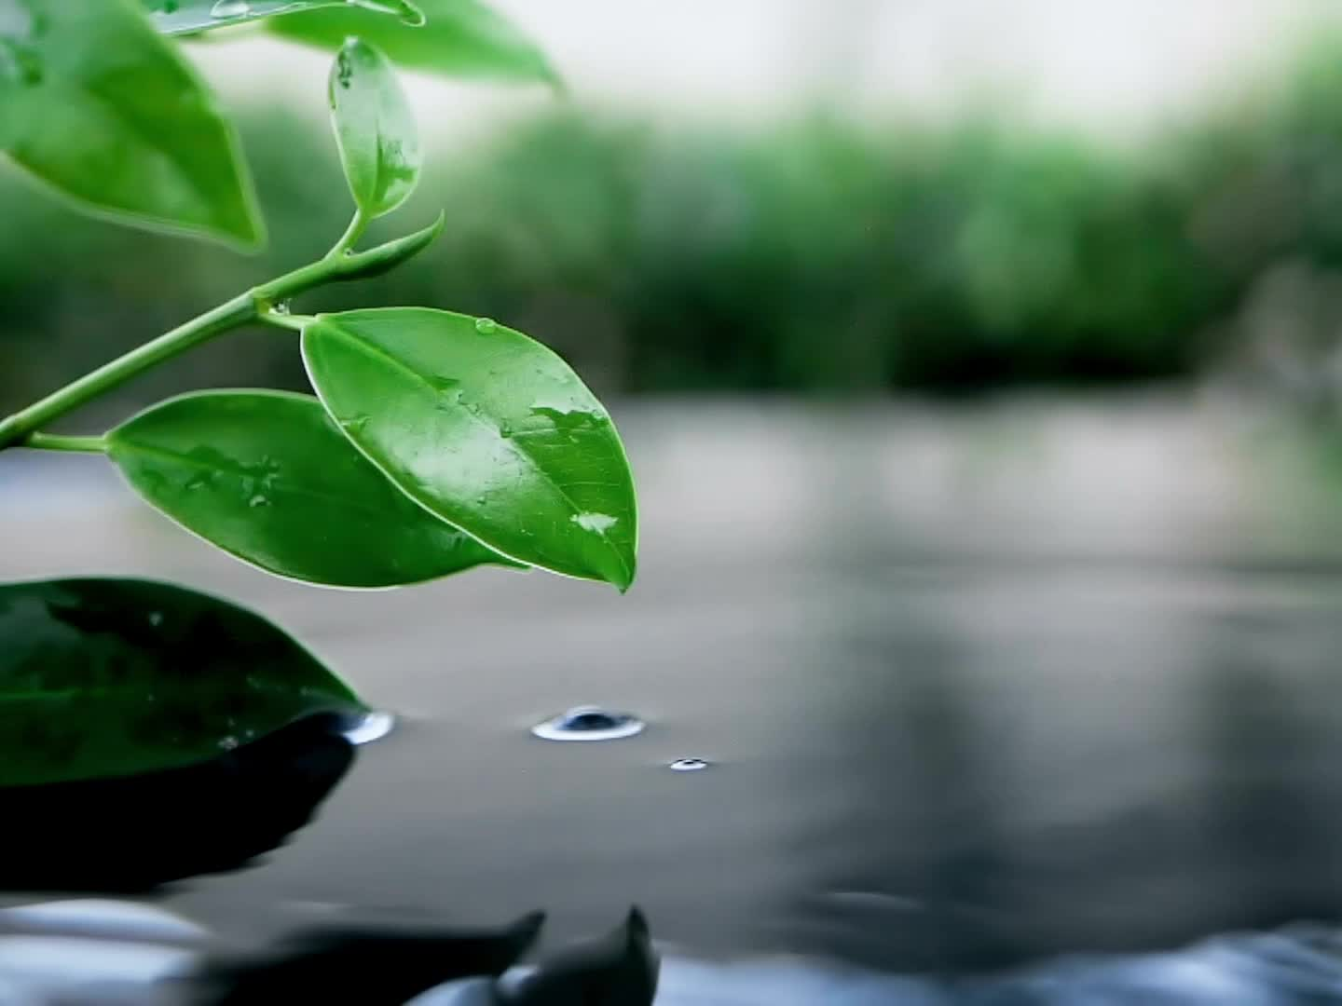
Walk & Talk
Are all our items natural or did we find evidence of human activity?
What is the impact of humans in our outdoor space?
If our playground or school was not here, how do we think the outdoor space would be different? What different items might we have found?

Slide 10
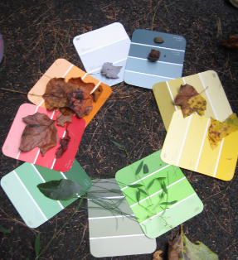
Textured Rainbow
Using each of our paint chip cards, create a textured rainbow. Place your items loosely on your card beside their label in black Sharpie. Gently set them down on chart paper. Create a rainbow (ROY G BIV) your own unique way!

Slide 11
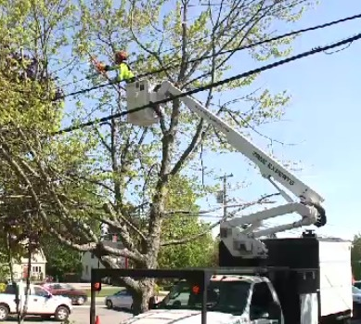
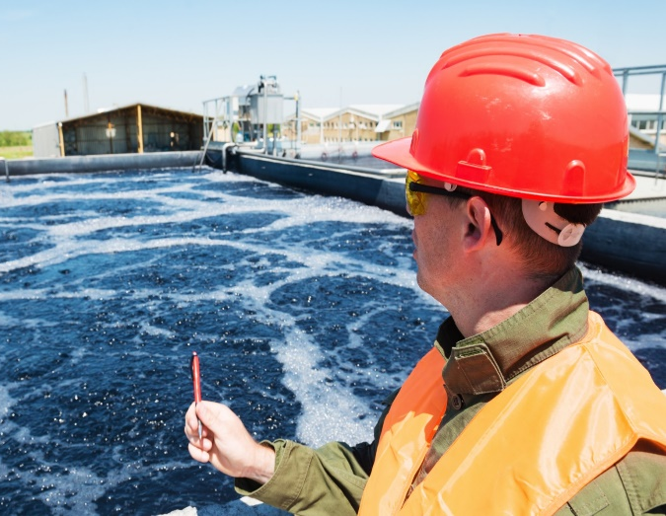
How is the skill of being mindful KEY to these careers?
Electrician
Tree Trimmer
Water Treatment Engineer

Slide 12
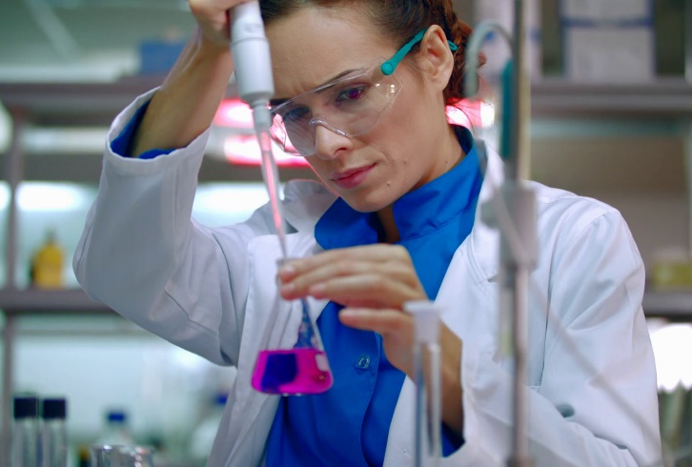
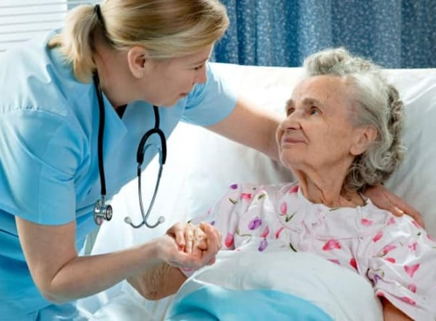
How is the skill of being mindful KEY to these careers?
Physical Therapist
NB Health Researcher
Registered Nurse (RN)

Slide 13
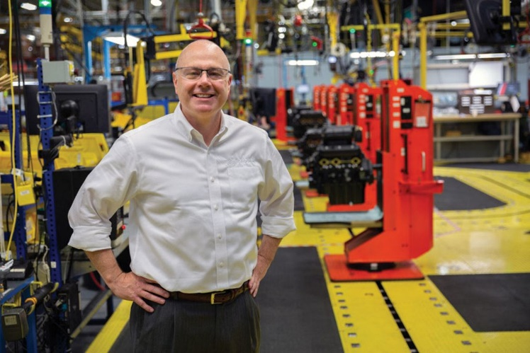
How is the skill of being mindful KEY to these careers?
Financial Planner
CEO
Marketing Consultant

Slide 14
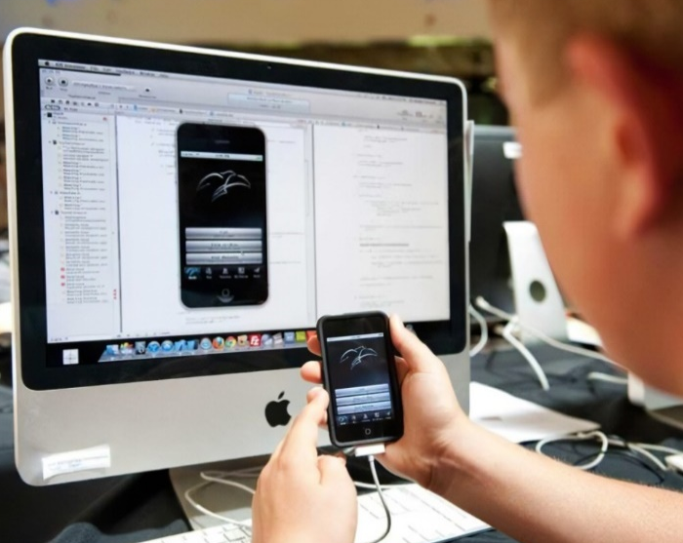
How is the skill of being mindful KEY to these careers?
Cybersecurity specialist
App Developer
Computer Programmer

Slide 15
Reflection: Now that we know more of what’s all around us, what are our responsibilities to our outdoor space? Are there any steps of action that we need to take?

