Slide 1







3-5 Long Term Care Bilingual BINGO

Slide 2




Interactive
How many Long Term Care Homes are in New Brunswick?
75-80
100-105
Stand On Your Tiptoes
Touch Your Toes

Slide 3

Interactive
How many Long Term Care Homes are in New Brunswick?
75-80

Slide 4


Interactive
How many residents are currently in Long Term Care Homes
in New Brunswick?
About 9000
About 5000
Small Arm Circles
Lunges

Slide 5
Interactive
How many residents are currently in Long Term Care Homes
in New Brunswick?
About 5000

Slide 6


Interactive
How many Long Term Care Professionals are currently working in Long Term Care Homes in New Brunswick?
About 2000
About 7500
Jumping Jacks
Jog on the spot

Slide 7
Interactive
How many Long Term Care Professionals are currently working in Long Term Care Homes in New Brunswick?
About 7500

Slide 8
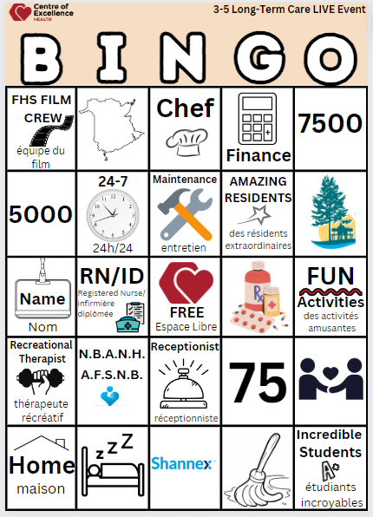
BINGO TIME
  Find a Partner or Play Solo
  Card in front of you
  Squares will be called in English & French
  Counters at your Fingertips
  Cover Up FREE SPACE

Slide 9

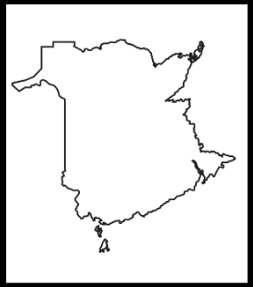
Long Term Care BINGO
1

Slide 10

2
Long Term Care BINGO

Slide 11

3
Long Term Care BINGO

Slide 12

4
Long Term Care BINGO

Slide 13

5
Long Term Care BINGO

Slide 14

6
Long Term Care BINGO

Slide 15

7
Long Term Care BINGO

Slide 16

8
Long Term Care BINGO

Slide 17

9
Long Term Care BINGO

Slide 18
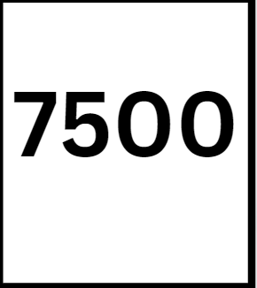
10
Long Term Care BINGO

Slide 19

11
Long Term Care BINGO

Slide 20
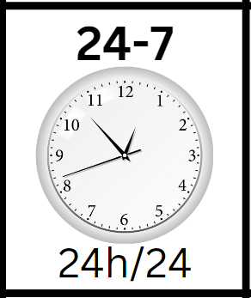
12
Long Term Care BINGO

Slide 21

13
Long Term Care BINGO

Slide 22

14
Long Term Care BINGO

Slide 23

15
Long Term Care BINGO

Slide 24

16
Long Term Care BINGO

Slide 25

17
Long Term Care BINGO

Slide 26

18
Long Term Care BINGO

Slide 27

19
Long Term Care BINGO

Slide 28

20
Long Term Care BINGO

Slide 29

21
Long Term Care BINGO

Slide 30

22
Long Term Care BINGO

Slide 31
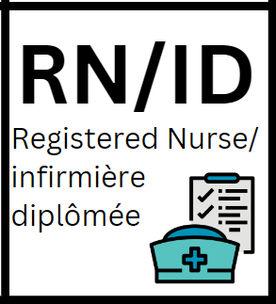
23
Long Term Care BINGO

Slide 32

24
Long Term Care BINGO

Slide 33
24
Long Term Care BINGO

Slide 34



Thank You!
N.B.A.N.H.
A.F.S.N.B.

