Slide 1
DAZZING DENTISTS

Slide 2
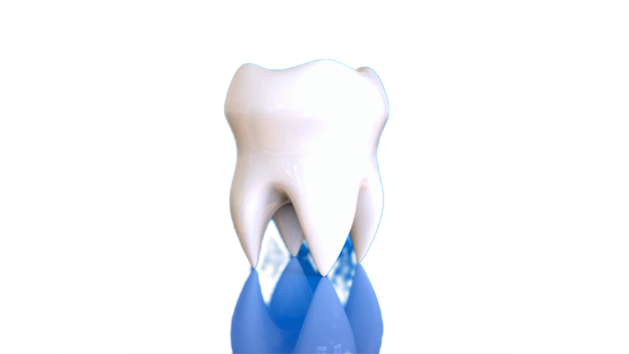
CLASS DISCUSSION
What do you think a dentist does?
Who has been to the dentist before?
What happened? Share your experience with a partner!

Slide 3
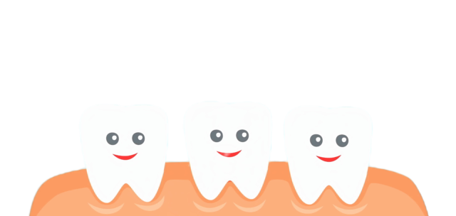
READ THE BOOK “DENTISTS”

Slide 4
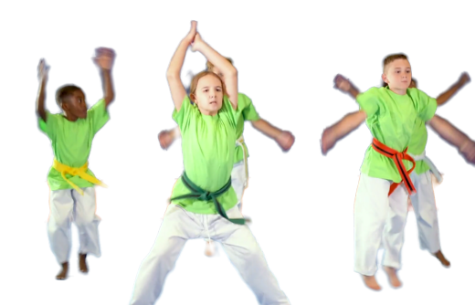
True or False?
A cavity is a small hole in a tooth.
True
False
Jumping Jacks
Squats

Slide 5
True
Cavities are small holes in teeth.

Slide 6
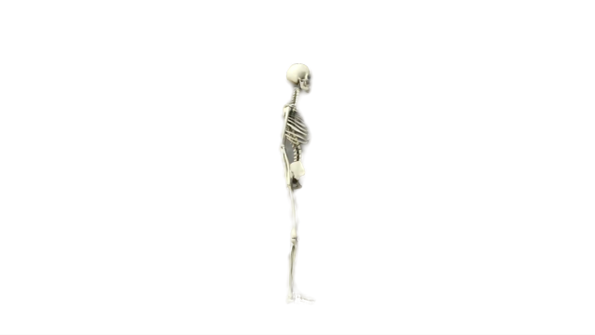
True or False?
An x-ray is a tool that brushes your teeth.
True
False
Reach for the Stars
Touch Your Toes

Slide 7
FALSE
An x-ray takes a picture of the inside of a body

Slide 8
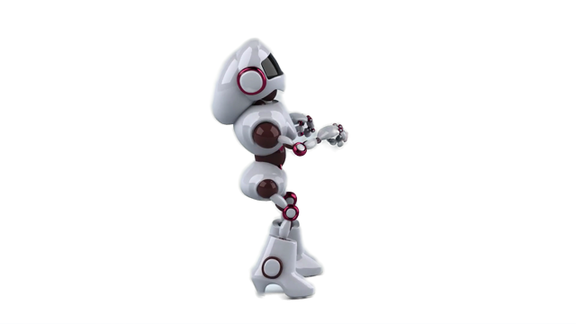
True or False?
Floss is like a special piece of string that cleans between your teeth.
True
False
Yoga Tree Pose
Dance

Slide 9
True
Floss is a special string that cleans between teeth.

Slide 10
You are going to pretend you are a dentist today!
But first, we need TEETH!

Slide 11
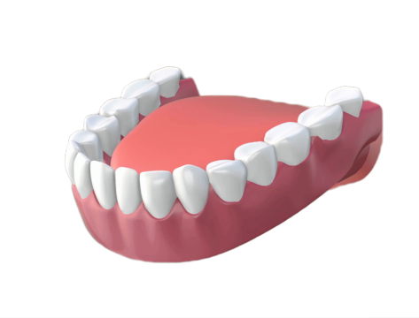
ACTIVITY: CLAY TEETH
Students will create CLAY TEETH! *Playdough also works!

Slide 12
ACTIVITY: CLAY TEETH
STEP 1
Pass out clay (or Playdough) to each student. Students will create a semi-circle base with clay.

Slide 13
STEP 2
Students will create different color teeth and lodge them into the semi-circle clay base.
*Colors can vary depending on supply.
PINK - SECOND MOLAR
PURPLE - FIRST MOLAR
GREEN - CANINE
YELLOW - LATERAL INCISOR
RED - CENTRAL INCISOR
FUN FACT: Children have twenty teeth

Slide 14
PLAQUE SCAVENGER HUNT
Take your teeth on a scavenger hunt. The goal is to get your teeth dirty! Use teacher approved materials/items to get some “PLAQUE” on your teeth!
*This could include glitter, pencil shavings, crumbs, paint, tiny piece of paper, tape, glue, stamp, chalk, markers, etc.,. Be creative!

Slide 15
DENTIST TOOLS
Dentists use all kinds of tools to help ORAL HYGIENE! How do you think each of these tools work? THINK / PAIR / SHARE!
SCALER
EXPLORER
MIRROR

Slide 16
DENTIST TOOLS
POLISHER
WATER FLOSSER
FLOSS

Slide 17
DENTIST CENTERS
Students will rotate centers, using different materials to clean their teeth.
Polisher (sponge)
Floss (string)
Explorer (toothpick)
Mirror (mirror)
Scaler (pencil)
Water Flosser (water)

Slide 18
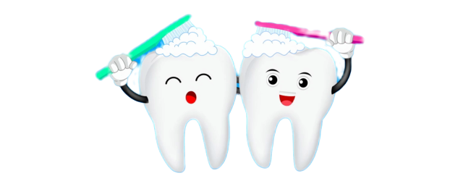
REFLECTION
Which tools worked best? Why?
Did anyone get a loose tooth?
Why is it important to take care of your teeth?

Slide 19
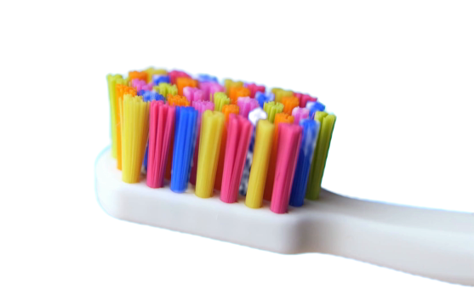
THANK YOU
DAZZLING DENTISTS!

