Slide 1
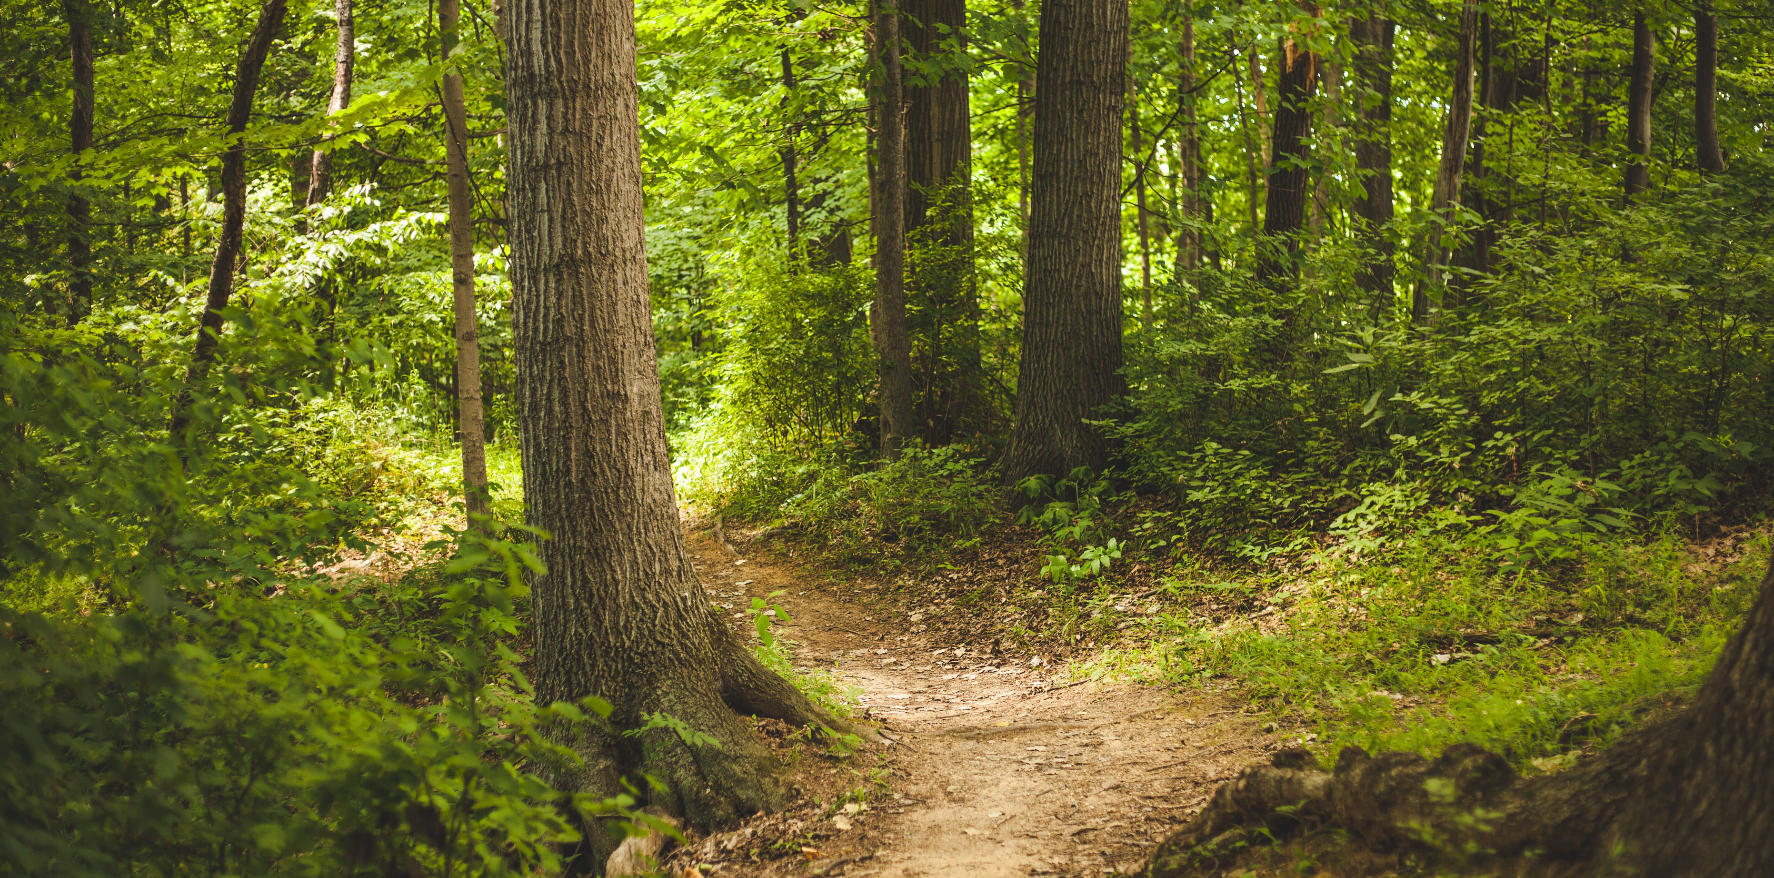
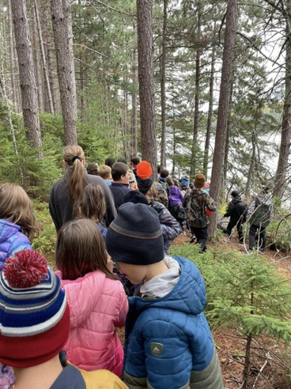
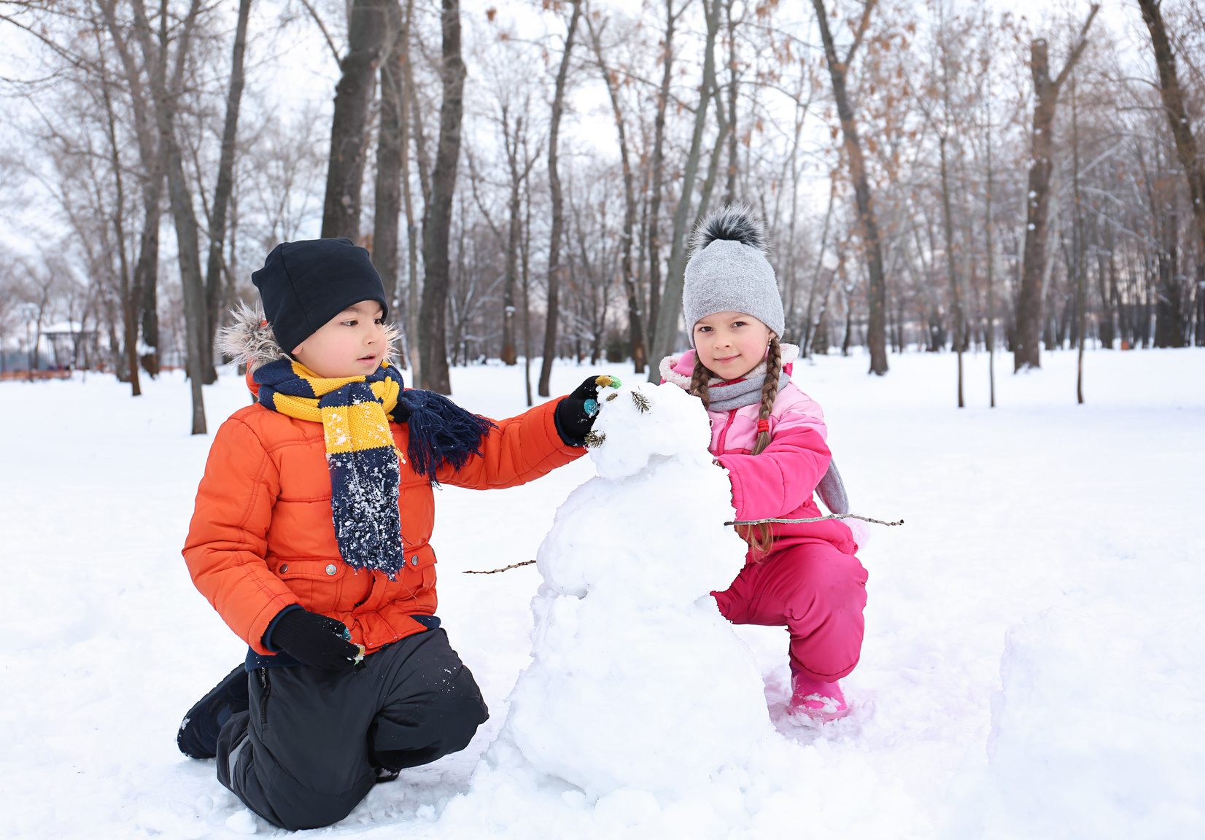






Parks NB: On Our
Playground
An Outdoor Learning Activity for Grades 3-5

Slide 2

TABLE OF CONTENTS
Learn about 10 FUN Parks in New Brunswick ☺☺
1 FUNDY
6 KOUCHIBOUGUAC
2 MOUNT CARLETON
7 SUGARLOAF
3 MURRAY BEACH
8 RÉPUBLIQUE
4 NEW RIVER BEACH
9 MACTAQUAC
5 NORTH LAKE
10 HERRING COVE
Presentation By Juliana Silva

Slide 3
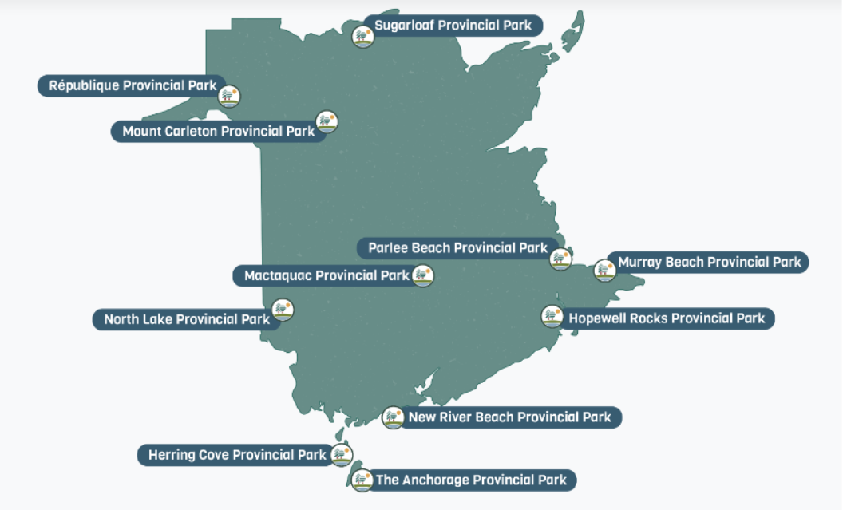
New Brunswick PARKS MAP

Slide 4
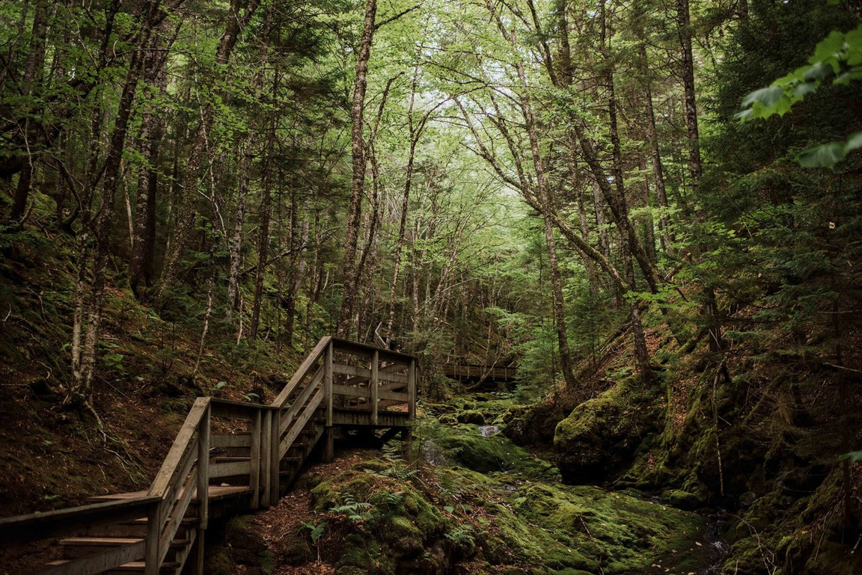

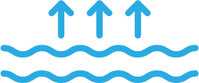
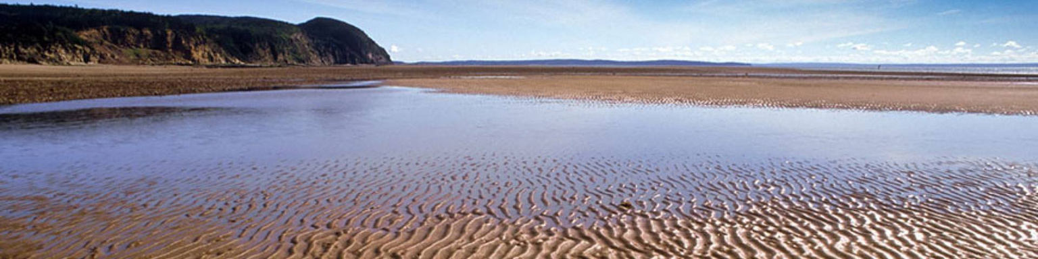

1 - FUNDY NATIONAL PARK
Alma, NB
Highest Tides in the World!!
25 waterfalls
Hundreds of plant species
Walk on the ocean’s floor

Slide 5
ACTIVITY #1 –FUNDY NATIONAL PARK
Parks NB Experience: | Fall & Spring Activity | Winter Activity
1. Fundy National Park: Bay of Fundy | Discussion Rope Measuring Challenge Red Light/Yellow Light/Green Light Game | Discussion Rope Measuring Challenge (with Snow Angels) Red Light/Yellow Light/Green Light Game
1 FUNDY
6 KOUCHIBOUGUAC
2 MOUNT CARLETON
7 SUGARLOAF
3 MURRAY BEACH
8 RÉPUBLIQUE
4 NEW RIVER BEACH
9 MACTAQUAC
Materials Needed:
Rope- 12.8 m in length (can also be meter sticks, hockey sticks, or skipping ropes tied together)
2 pylons
Meter stick or measuring tape
Soccer Field
5 NORTH LAKE
10 HERRING COVE
Presentation By Juliana Silva

Slide 6
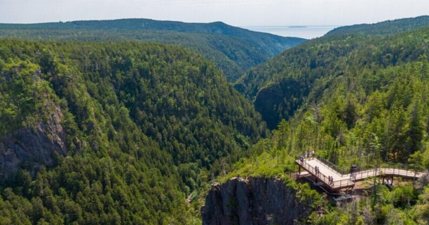
HIGH TIDES DISCUSSION
“Fundy National Park is home to the world’s highest tides! The Bay of Fundy, twice a day, sees an incredible amount of water come in to shore and then back out to sea. “
“How high do you think the water rises during high tide (in m)?”
Allow learners to discuss possibilities, as well as personal experiences with the Bay of Fundy waters.
1 FUNDY
6 KOUCHIBOUGUAC
7 SUGARLOAF
8 RÉPUBLIQUE
4 NEW RIVER BEACH
9 MACTAQUAC
5 NORTH LAKE
10 HERRING COVE
Presentation By Juliana Silva

Slide 7
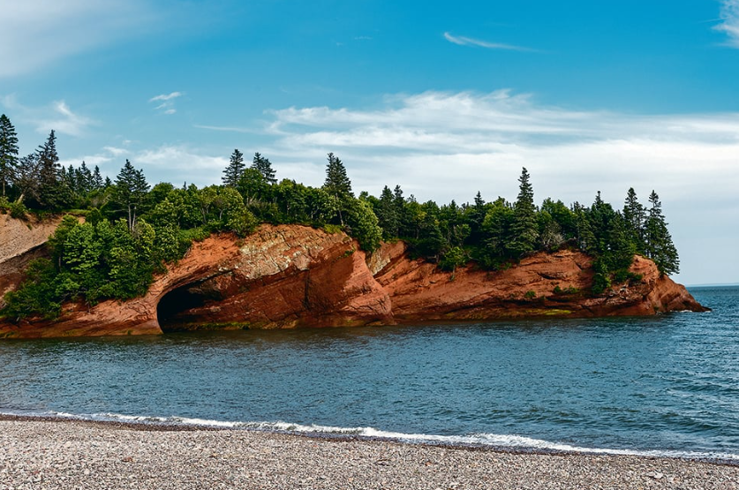
HIGH TIDE MEASURING
Using rope (or other materials available), measure 12.8m in length with students on a soccer field.
Place 1 pylon at the beginning and 1 pylon at 12.8m, so that it is clearly visible for students.
Have students see if they can be as high as the tides by lying on the ground beside the rope- head to toes.
Discuss how many students it takes to measure the tide heights.
Make another (in a second line beside the first line), until all learners are measured to fill in the blank: Our class is __________ times Bay of Fundy High Tides tall!

Slide 8

GAME – RED, YELLOW & GREEN LIGHT
All learners will create a single-file line, and all start at the first pylon.
They should be able to clearly see the 12.8m rope.
A caller will be responsible for yelling out Red Light, Yellow Light, or Green Light. For learners to get a sense of how tides move, it is necessary that the caller does not yell Red Light until the very last call.
Learners will walk or run as far as 12.8 and then walk or run back to the starting line and continue this pattern until Red Light has been called. After the first game, ask learners: Why was Red Light only called once? (Tides never stop moving.) Repeat, as desired.
Winter Option: For High Tide Measuring, allow learners to create Snow Angels for class measurements!

Slide 9
THANK YOU☺
Please tell us your thoughts on the activity. COE Health values NB Educator’s valuable feedback and appreciate you taking the time to complete the survey below.
Enter new COE Health survey here
Thank you and please feel free to reach out to COE Health Lead Daneen Dymond, Daneen.dymond@gnb.ca if you have any questions or would like to be part of a team who creates supporting Outdoor Learning resources and activities for Educator's in NB.

