Slide 1
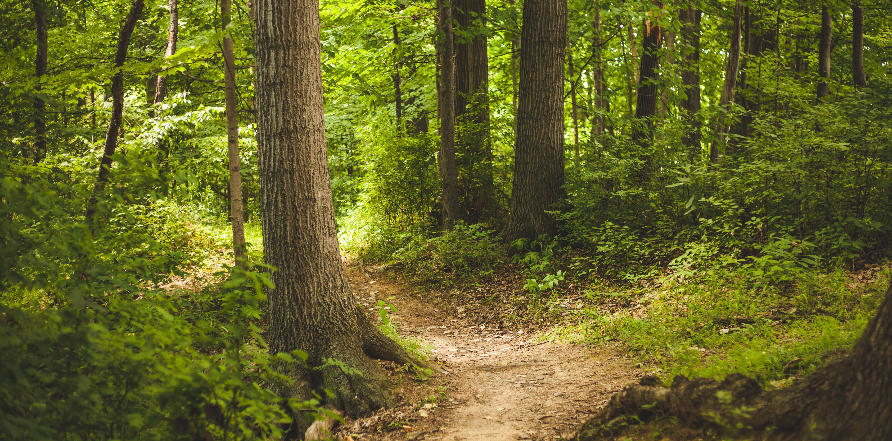
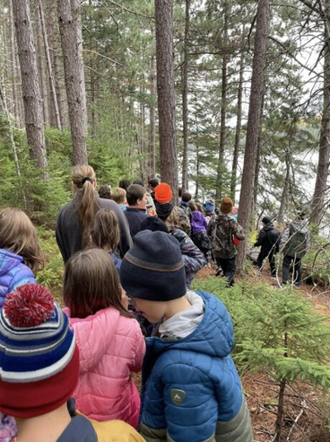
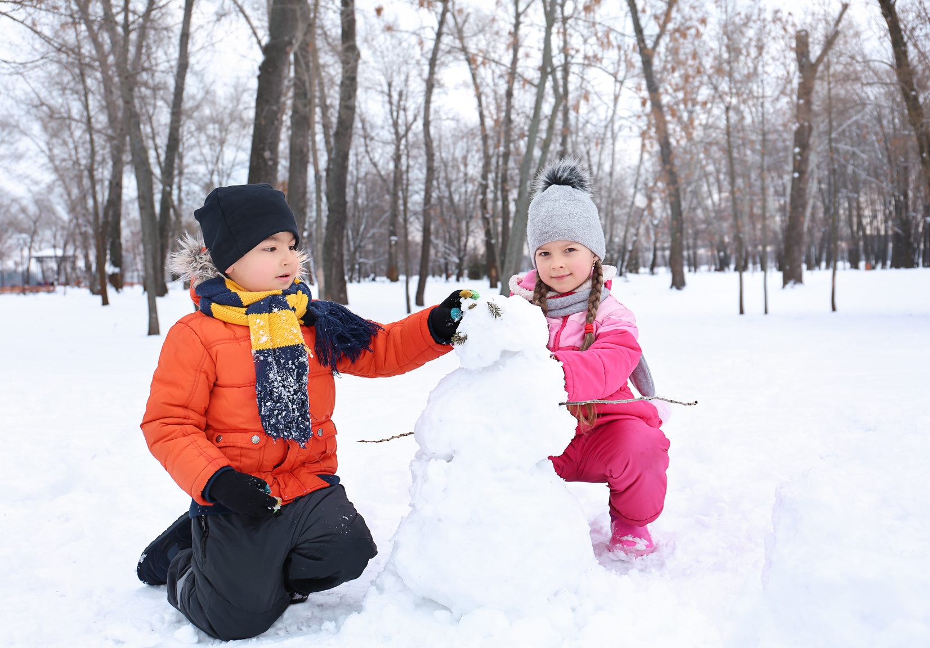






Parks NB: On Our
Playground
An Outdoor Learning Activity for Grades 3-5

Slide 2

TABLE OF CONTENTS
Learn about 10 FUN Parks in New Brunswick ☺☺
1 FUNDY
6 KOUCHIBOUGUAC
2 MOUNT CARLETON
7 SUGARLOAF
3 MURRAY BEACH
8 RÉPUBLIQUE
4 NEW RIVER BEACH
9 MACTAQUAC
5 NORTH LAKE
10 HERRING COVE
Presentation By Juliana Silva

Slide 3
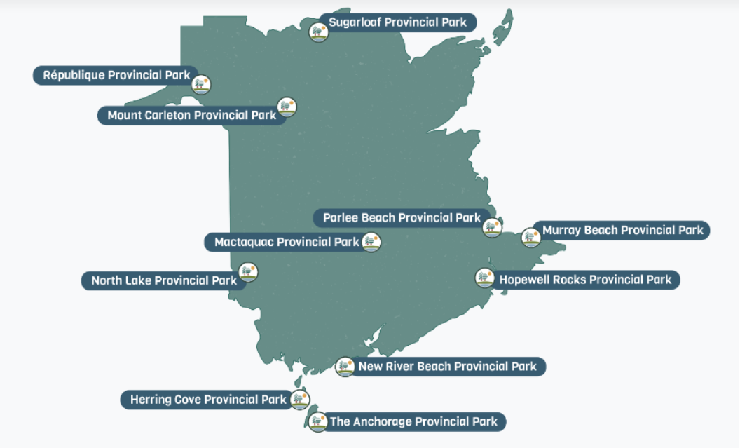
New Brunswick PARKS MAP

Slide 4
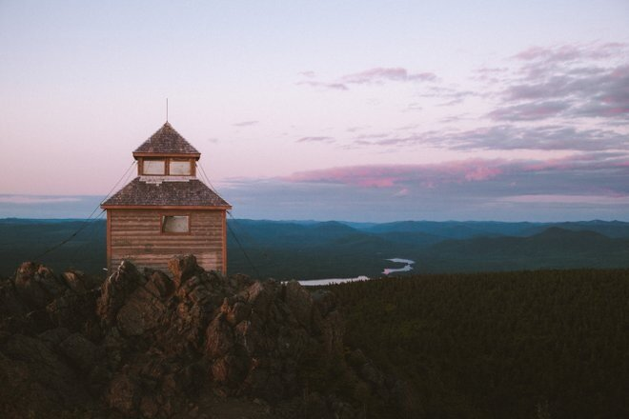
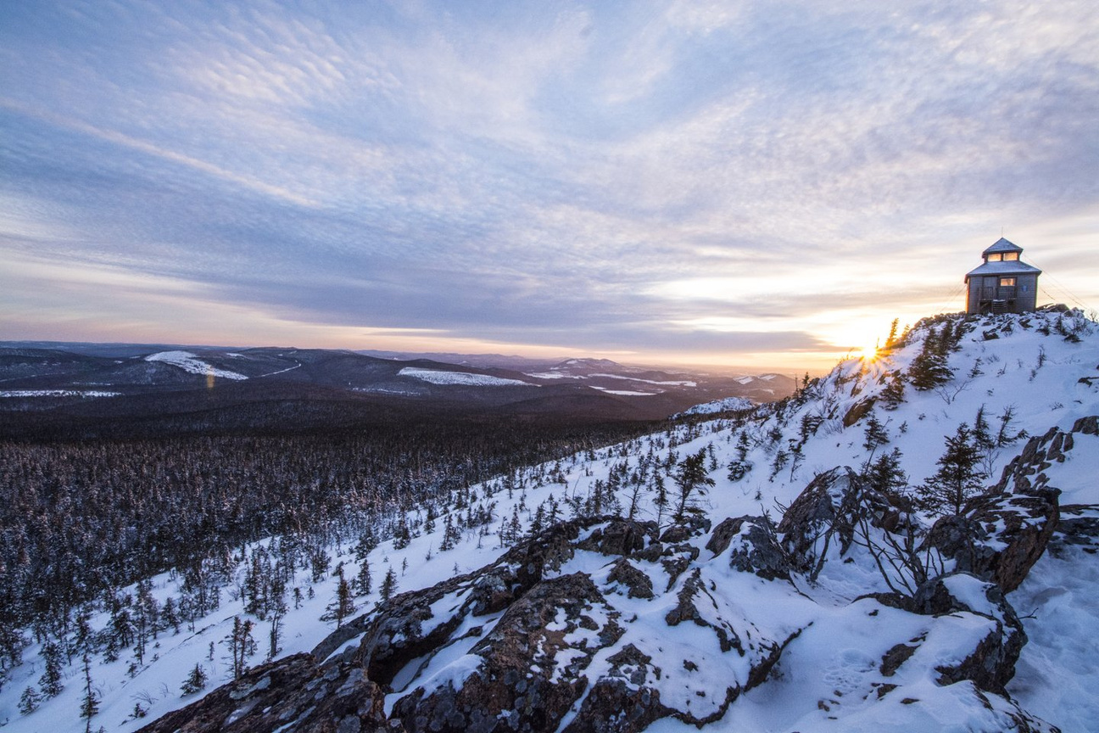

2 - MOUNT CARLETON PROVINCIAL PARK
Saint-Quentin, NB
Highest peak in the Maritimes
A designated dark sky preserve
Home to more wild animal species than any other part of the province

Slide 5
ACTIVITY #2 – MOUNT CARLETON PROVINCIAL PARK
Parks NB Experience: | Fall & Spring Activity | Winter Activity
2. Mount Carleton Provincial Park: Mount Carleton | Discussion Mountain Measuring Mount Carleton Obstacle Course | Discussion Mountain Measuring Mount Carleton Winter Obstacle Course
1 FUNDY
6 KOUCHIBOUGUAC
2 MOUNT CARLETON
7 SUGARLOAF
3 MURRAY BEACH
8 RÉPUBLIQUE
Materials needed:
1 Metre Stick
Soccer Field (or large, inclined hill if possible)
Chart Paper
Marker
RIVER BEACH
Various gym equipment (see below)
Smaller Items (various sizes of balls, pylons, frisbees, etc.) for packing into bookbags
Hike Packing Cards – 1 per learner, see printable in Appendix
Bookbag-1 per learner
Presentation By Juliana Silva

Slide 6
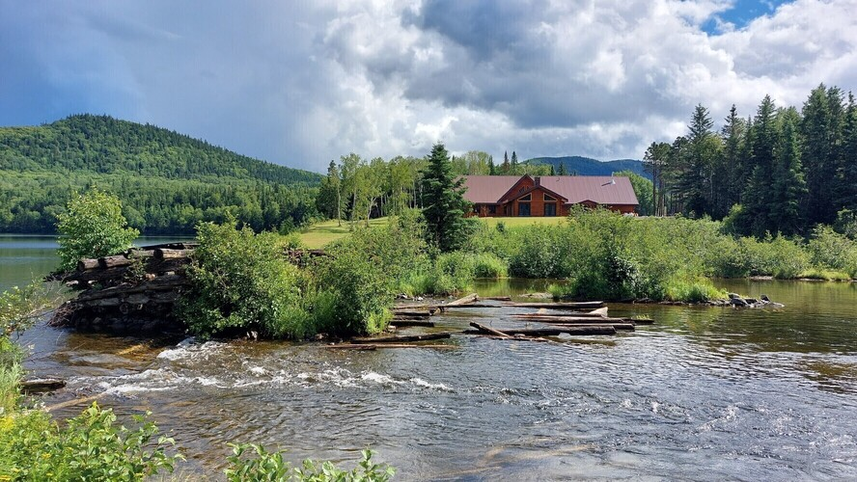
MOUNT CARLETON DISCUSSION
“Mount Carleton is the highest peak in the Atlantic Provinces! Has anyone ever climbed it, or another mountain? Can you tell us about your experience.”
“What is the difference between hiking on a trail in the woods and hiking a mountain?”
Allow learners to discuss possibilities, as well as personal experiences with mountain climbing.

Slide 7
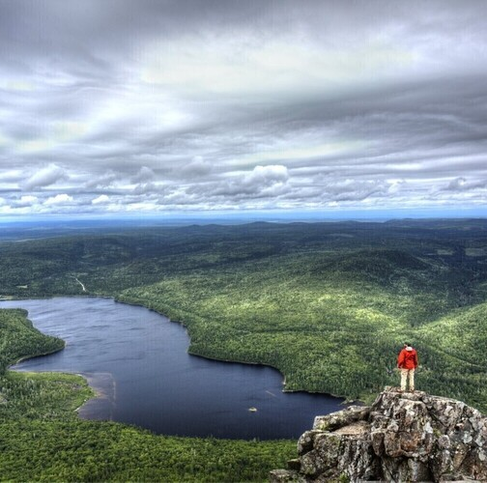
MOUNTAIN MEASURING
Using a metre stick, demonstrate 1 m with it touching the ground and explain: “Mount Carleton is 824m in height, or 824 times this metre stick high. The mountain may be that tall, but would the trail up to it be straight up (vertical)? What other natural things might we have to navigate up to the top of Mount Carleton?”
Allow learners to suggest: Tree roots, muddy conditions, Rocks/Boulders, Twists/Turns, Puddles, Lake/Rivers barriers to wade through, Natural Obstacles (fallen trees, windy conditions, bugs, beehives), etc.

Slide 8
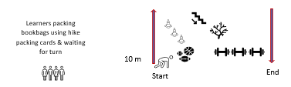
MOUNT CARLETON OBSTACLE COURSE
Using the chart paper, design your own Mount Carleton Obstacle Course experience. Measure a spot on either a soccer field or inclined hill – 10m to have one route up and one route returning to the start. Then, using a variety of gym equipment, have learners design obstacles and barriers. With each learner going through the obstacle course (up and back to start), each learner is traveling 20m. About 41 trips will need to be made to truly climb Mount Carleton. (Feel free to adjust the length of your course to meet your class’ needs). Gather learners and form a line at the start.
Create a Packing Pile (a variety of small and medium items – balls, frisbees, random gym equipment) for students to pack in their bookbags, according to the card that they receive. Have the first 2 climbers, demonstrate packing their bookbags with the cards that you give them. Pass out a card for each learner. As soon as a learner finishes, they can return their packing items to the pile for someone else to use. Record your class time and REPEAT – to see if you can beat it OR challenge another class!

Slide 9
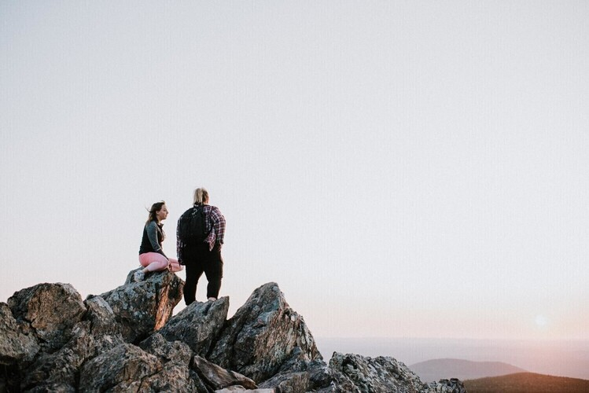
WINTER OPTION
To build your Mount Carleton Obstacle Course, feel free to sculpt and build with the snow for natural obstacles, as well as natural materials or waterproof materials. Bookbags are optional, as outdoor clothing would create additional weight and challenge.

Slide 10
THANK YOU ☺
Please tell us your thoughts on the activity. COE Health values NB Educator’s valuable feedback and appreciate you taking the time to complete the survey below.
Centre of Excellence Learning Support Feedbcak Form
Thank you and please feel free to reach out to COE Health Lead Daneen Dymond, Daneen.dymond@gnb.ca if you have any questions or would like to be part of a team who creates supporting Outdoor Learning resources and activities for Educator's in NB.

