Slide 1



Home > Resources >
Together in Change:
Digital Well-Being in Emergencies
COPYRIGHT 2026 @JACK.ORG

Slide 2


Land Acknowledgement.
Slide Deck
Together in Change
COPYRIGHT 2026 @JACK.ORG
Notes:
Below is Jack.org’s land acknowledgement. We encourage you to write your own acknowledging the Nations, communities, territories and treaties upon which you live and work, and your calls to action for reconciliation / Self Pledge.
Land Acknowledgment
Before we begin, I’d like to take a moment to acknowledge the land on which we gather.
We do this as an act of gratitude and respect for the Indigenous Peoples who have cared for, lived on, and worked with this land since time immemorial.
Jack.org is committed to advancing Truth and Reconciliation and continues to strive to be a place that welcomes and honours Indigenous community members.
We acknowledge that Jack.org operates on the traditional territories of the Huron-Wendat, the Seneca, and the Mississaugas of the Credit. For thousands of years, this land has been a gathering place for many Nations, and it remains home to Indigenous Peoples from across Turtle Island today. We are deeply grateful for the opportunity to live, learn, and work here.
It’s important that we recognize the long and ongoing history that has brought us to this moment and reflect on our place within that story.
A land acknowledgment is not only about the past — colonialism continues today — and each of us has a role to play in understanding our connection to this land and in contributing to reconciliation in meaningful ways.

Slide 3


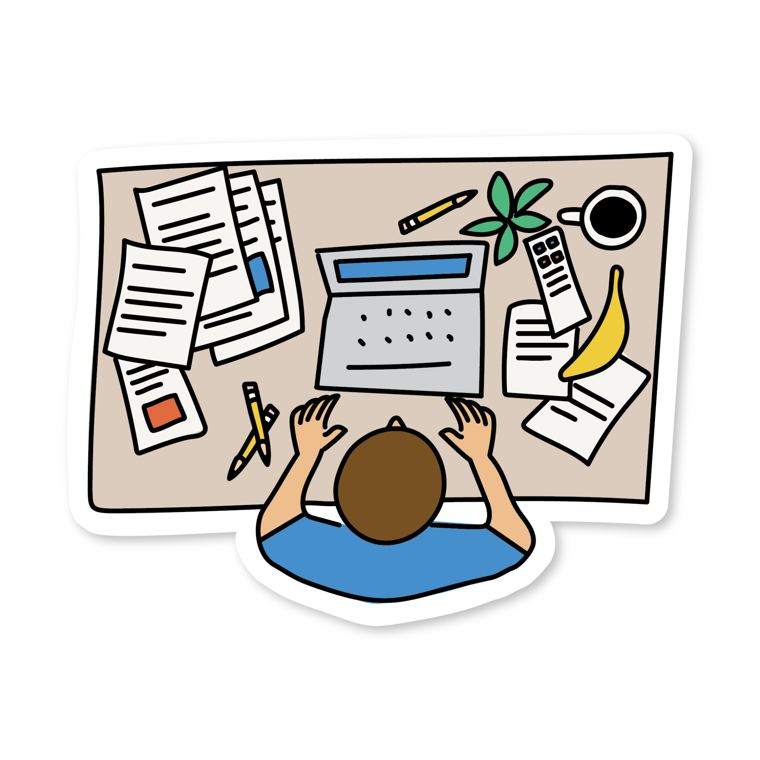
Objectives
The intention for today’s class is to…
Understand how digital platforms can both help people connect and increase stress during uncertain times.
Notice how and why people’s digital media use often changes during emergencies.
Identify ways online spaces can offer community, information, and support.
Learn simple strategies to manage digital overload and protect mental wellbeing.
Slide Deck
Together in Change
COPYRIGHT 2026 @JACK.ORG

Slide 4



Ensuring a Positive Experience
Should you feel your mental health is being negatively impacted at any point, we advise that you do the following:
Take a break
Practice some self-care
Reach out to someone for support
Supports available might include:
Guidance counsellor, Student Success teacher, administrator
Kids Help Phone by text (text CONNECT to 686868)
Slide Deck
Together in Change
COPYRIGHT 2025 @JACK.ORG
Notes:
Teachers: You may need to update this slide with additional or alternative mental health support information relevant to your school.

Slide 5

Minds On
Choose one of the following questions to reflect on:
During emergencies or stressful situations, what role does your phone or digital platforms usually play for you?
Agree or disagree? During emergencies, social media is more helpful than harmful.
Slide Deck
Together in Change
COPYRIGHT 2026 @JACK.ORG

Slide 6

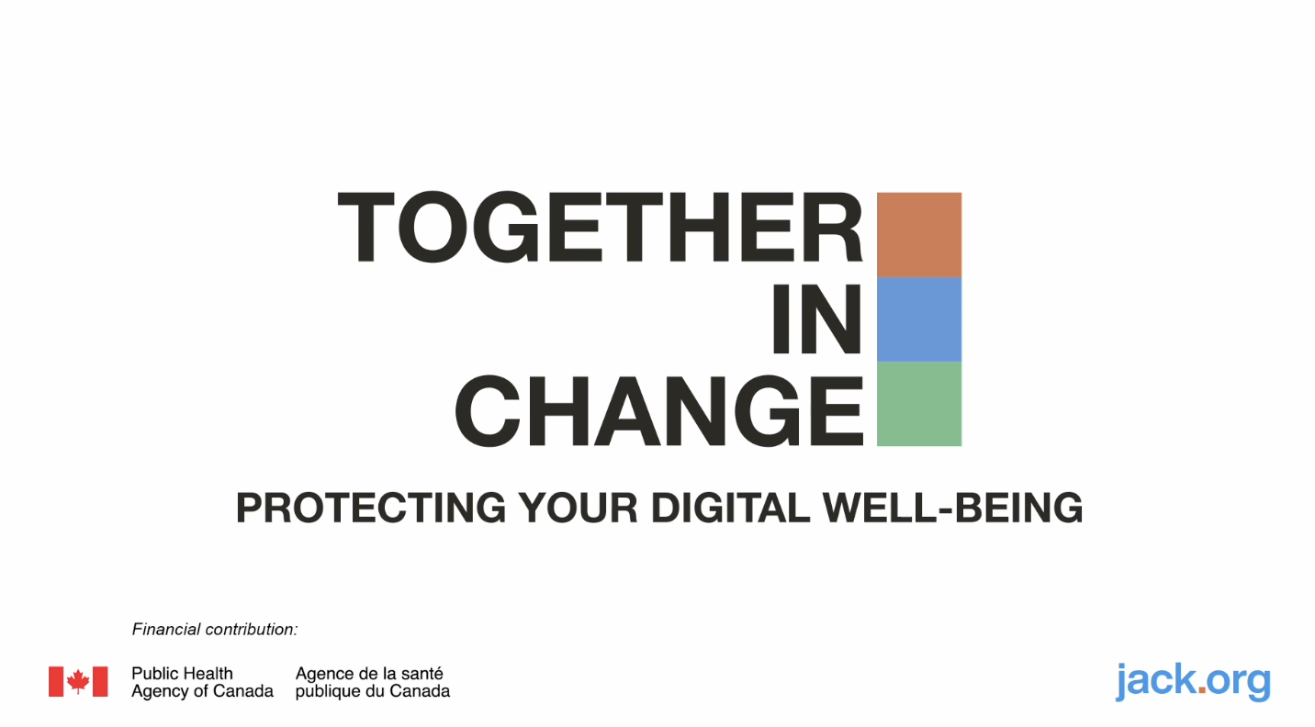
Video - Digital Well-Being in Emergencies
Slide Deck
Together in Change
COPYRIGHT 2026 @JACK.ORG
Notes:
“This video discusses how people use digital platforms during emergencies. While watching, you might notice emotions coming up. That’s okay. If at any point you need a break or just want to step back, that’s fine too.
You will not be asked to share personal experiences. You can choose how you participate: listening, writing, drawing, or taking a quiet break if needed.
We’ll watch the video, then do some discussion and activities to practice what we’ve learned. Sharing is always optional.”
“If you notice your body or mind getting tense while watching, you can try a few slow breaths, stretch, or gently refocus your attention. This is about learning strategies and seeing examples, not about reliving personal experiences.”

Slide 7
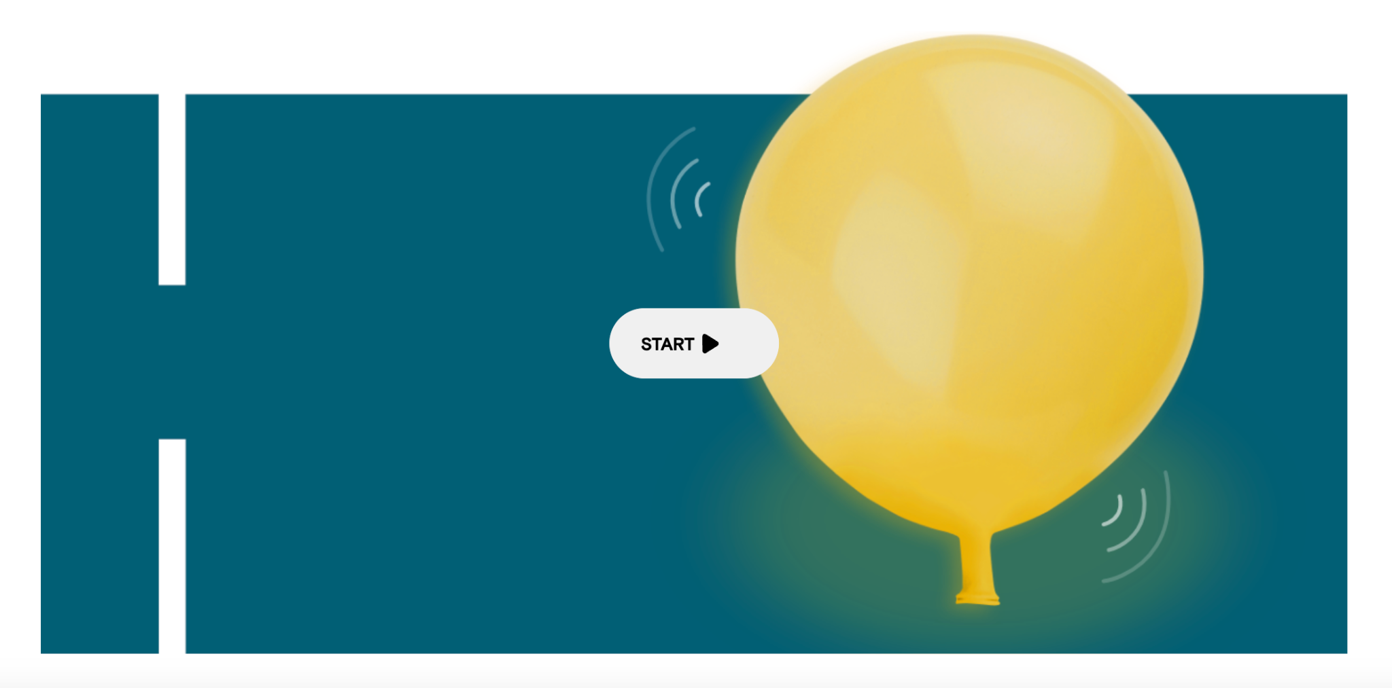
Regulation Pause 1
Kids Help Phone Breathing Balloon
Slide Deck
Together in Change
COPYRIGHT 2026 @JACK.ORG
Notes:
“Taking a few deep breaths can help to relax your body and mind. Breathing Balloon is a simple breathing exercise that you can do anywhere.” (KHP)
https://kidshelpphone.ca/get-info/breathing-balloon/

Slide 8
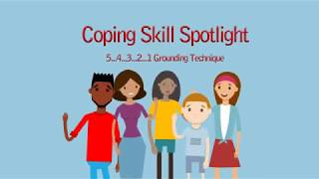
Regulation Pause 2
Five Senses Grounding Technique
Slide Deck
Together in Change
COPYRIGHT 2026 @JACK.ORG
Notes:
(1:51) Coping Skill: 5, 4, 3, 2, 1 Grounding Technique
Reminder: Turn on the Closed Captions

Slide 9

Post Viewing Discussion
How did the video show digital platforms helping during emergencies?
How can digital spaces increase stress or worry?
What does the video suggest about balancing staying informed with protecting your mental health?
What strategies did the speaker suggest to stay informed but not overwhelmed?
Slide Deck
Together in Change
COPYRIGHT 2026 @JACK.ORG
Notes:
How did the video show digital platforms helping during emergencies?
Possible student responses: getting updates about what’s happening locally, checking in with friends or family, people sharing helpful information or resources, classmates supporting each other online, organizing help or donations, seeing messages that remind people they’re not alone
How can digital spaces increase stress or worry?
Possible student responses: rumours or misinformation spreading quickly, seeing lots of scary posts or images, constantly checking for updates, people posting in a panicked way, conflicting information, feeling pressure to respond or stay online, not knowing what information to trust
What does the video suggest about balancing staying informed with protecting your mental health?
Possible student responses: you don’t need to follow every update, it’s okay to take breaks from news or social media, choosing a few trusted sources for information, noticing when online content is starting to feel overwhelming
What strategies did the speaker suggest to stay informed but not overwhelmed?
Possible student responses: setting limits on how often you check news or social media, turning off some notifications, checking updates at certain times instead of constantly, focusing on reliable information, stepping away from upsetting content when needed

Slide 10

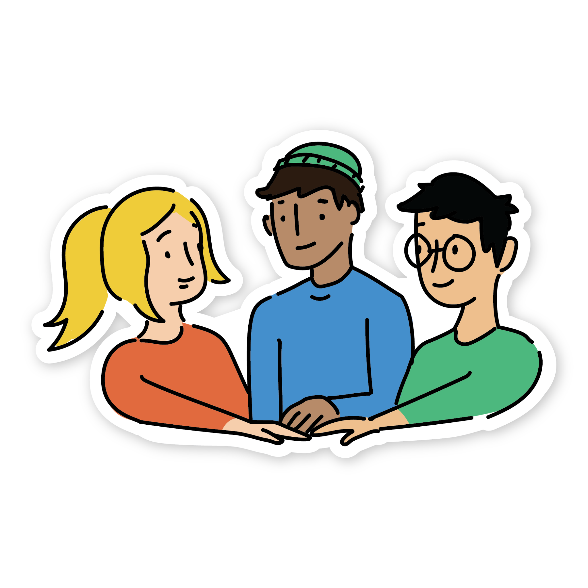
Activity: Scenario Practice
In small groups, discuss your scenario and the guiding questions.
Think about strategies for staying informed while protecting well-being.
There are no wrong answers. Different approaches can work. Discuss multiple ideas and strategies.
Slide Deck
Together in Change
COPYRIGHT 2026 @JACK.ORG

Slide 11


Activity: Quick Check-In
Complete the following statement with one idea you learned today:
“One thing that helps people protect their mental health while staying informed during an emergency is…”
Slide Deck
Together in Change
COPYRIGHT 2026 @JACK.ORG
Notes:
Teacher Prompt: “Now that we’ve talked about digital well-being during emergencies and practiced some strategies, let’s take a moment to reflect individually.”

Slide 12

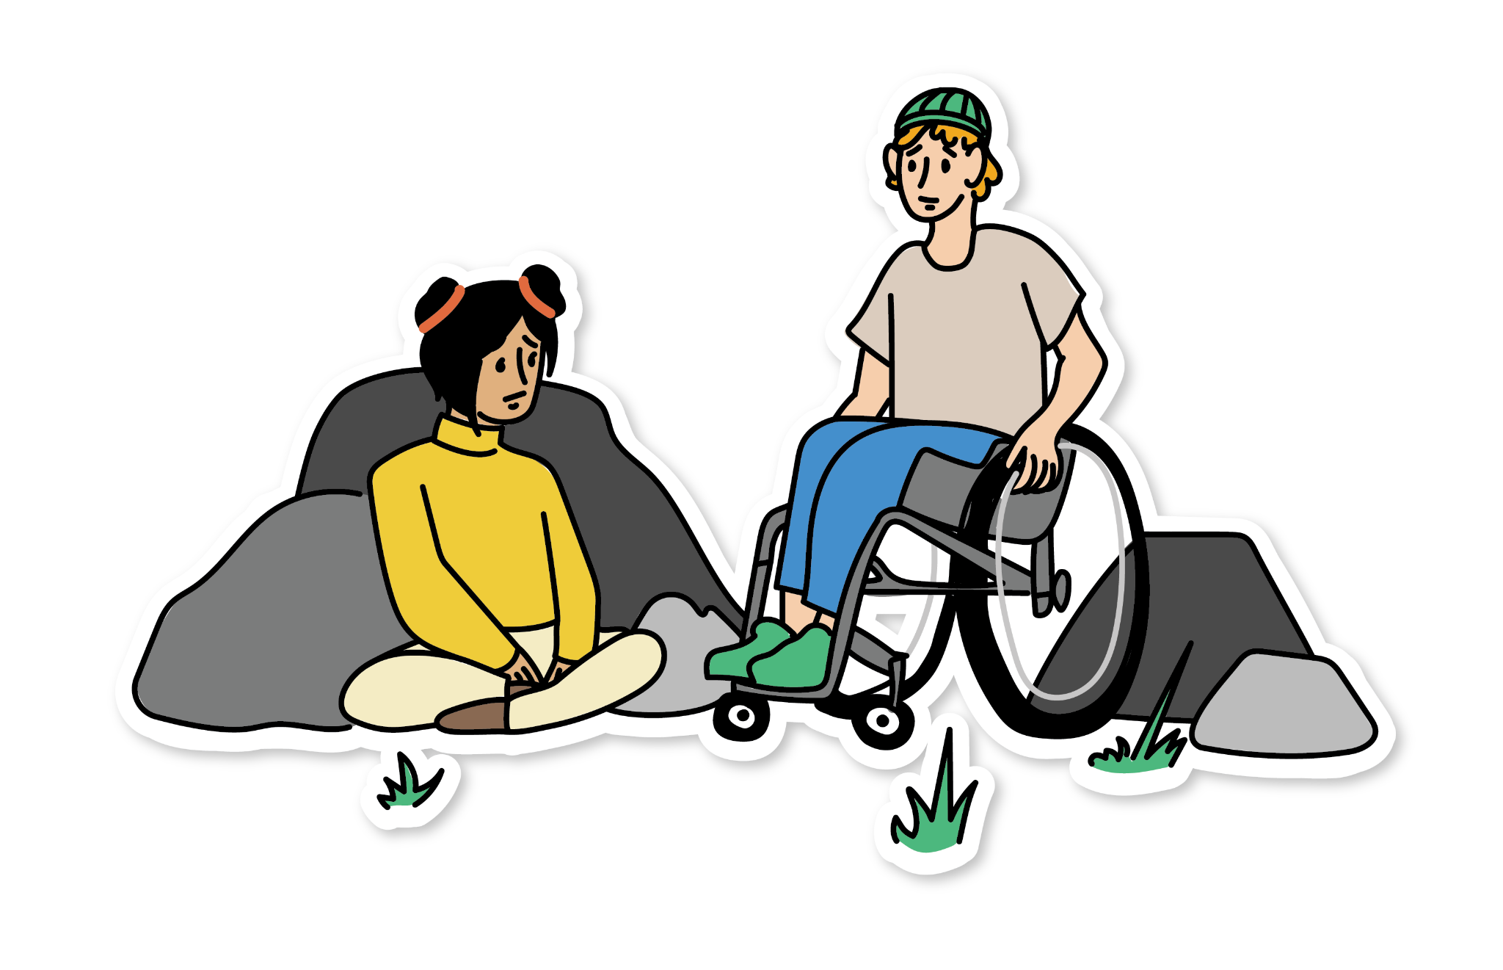
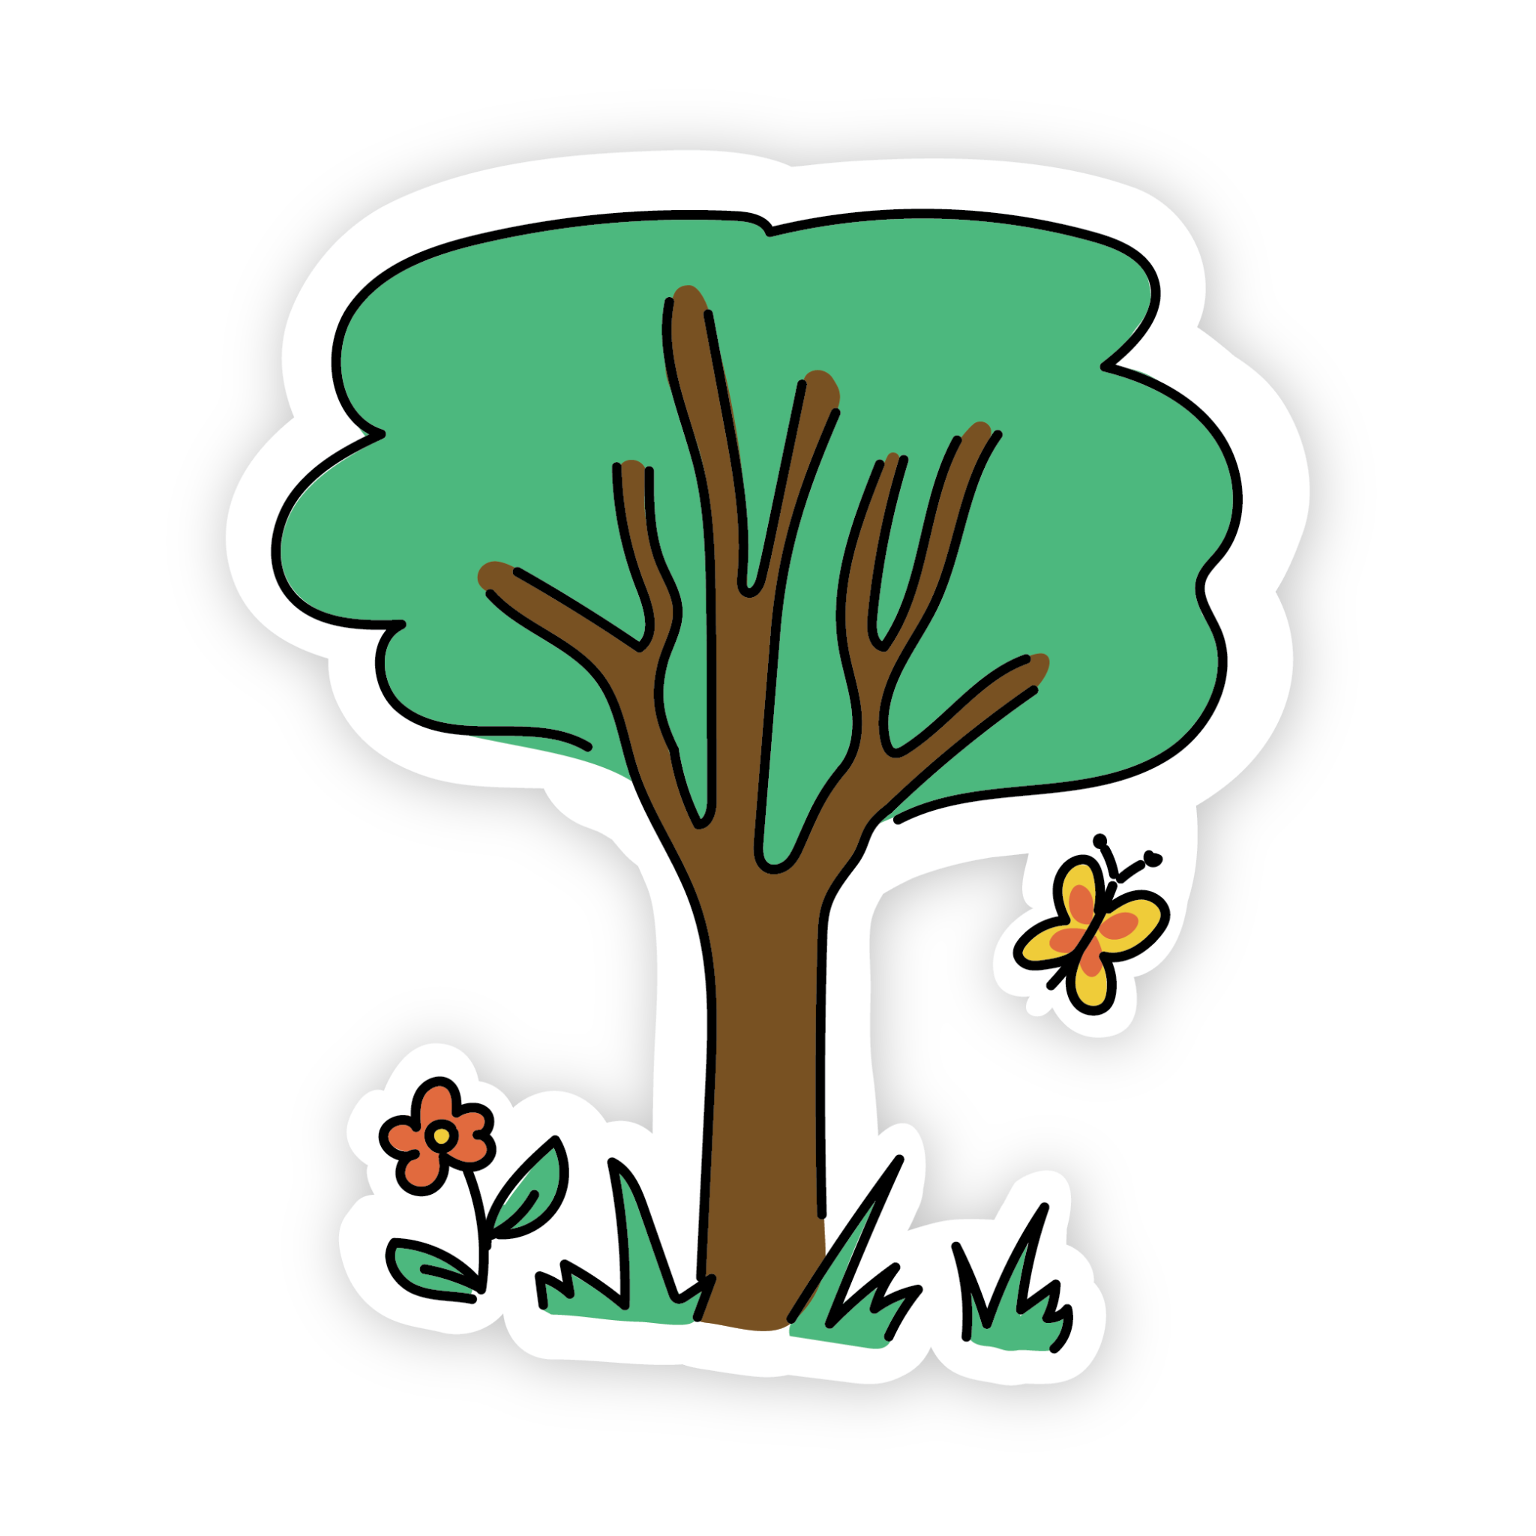
Remember…
Notice: Recognize how and when your digital habits affect your well-being, both negatively and positively.
Care: Take intentional breaks, set limits for checking notifications, curate your feed with good quality, useful sources of information
Connect: Check in with others, and use digital tools to build or rebuild community
Slide Deck
Together in Change
COPYRIGHT 2026 @JACK.ORG
Notes:
Remind students of supports specific to your location, for example:
School supports (counselor, trusted adults).
Crisis or community supports as appropriate.

Slide 13
Get Involved!
Form a community of mental health advocates by starting a Jack Chapter
Take our Community Challenge and run your own fundraising event by following our DIY toolkit
Keep in touch with Jack.org by following us on socials @jackdotorg
Slide Deck
Together in Change
COPYRIGHT 2026 @JACK.ORG

