Slide 1
Welcome
to
Roofing Sandwiches:
A Tasty Exploration

Slide 2
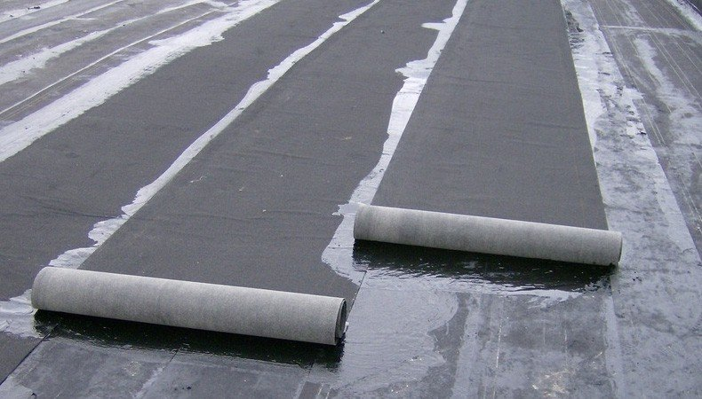
What is Commercial Roofing?
What are potentials careers in Commercial Roofing?

Slide 3
Commercial Roofing is…
Commercial roofing/roofers install, repair or replace flat roofs as well as sloped roofs They use a variety of materials such as corrugated metal, wood, membranes, insulation and shingles They must consider many factors such as regional weather, weight expectancy, flat versus sloped roof and available roofing materials to use, as well as their sequence.

Slide 4
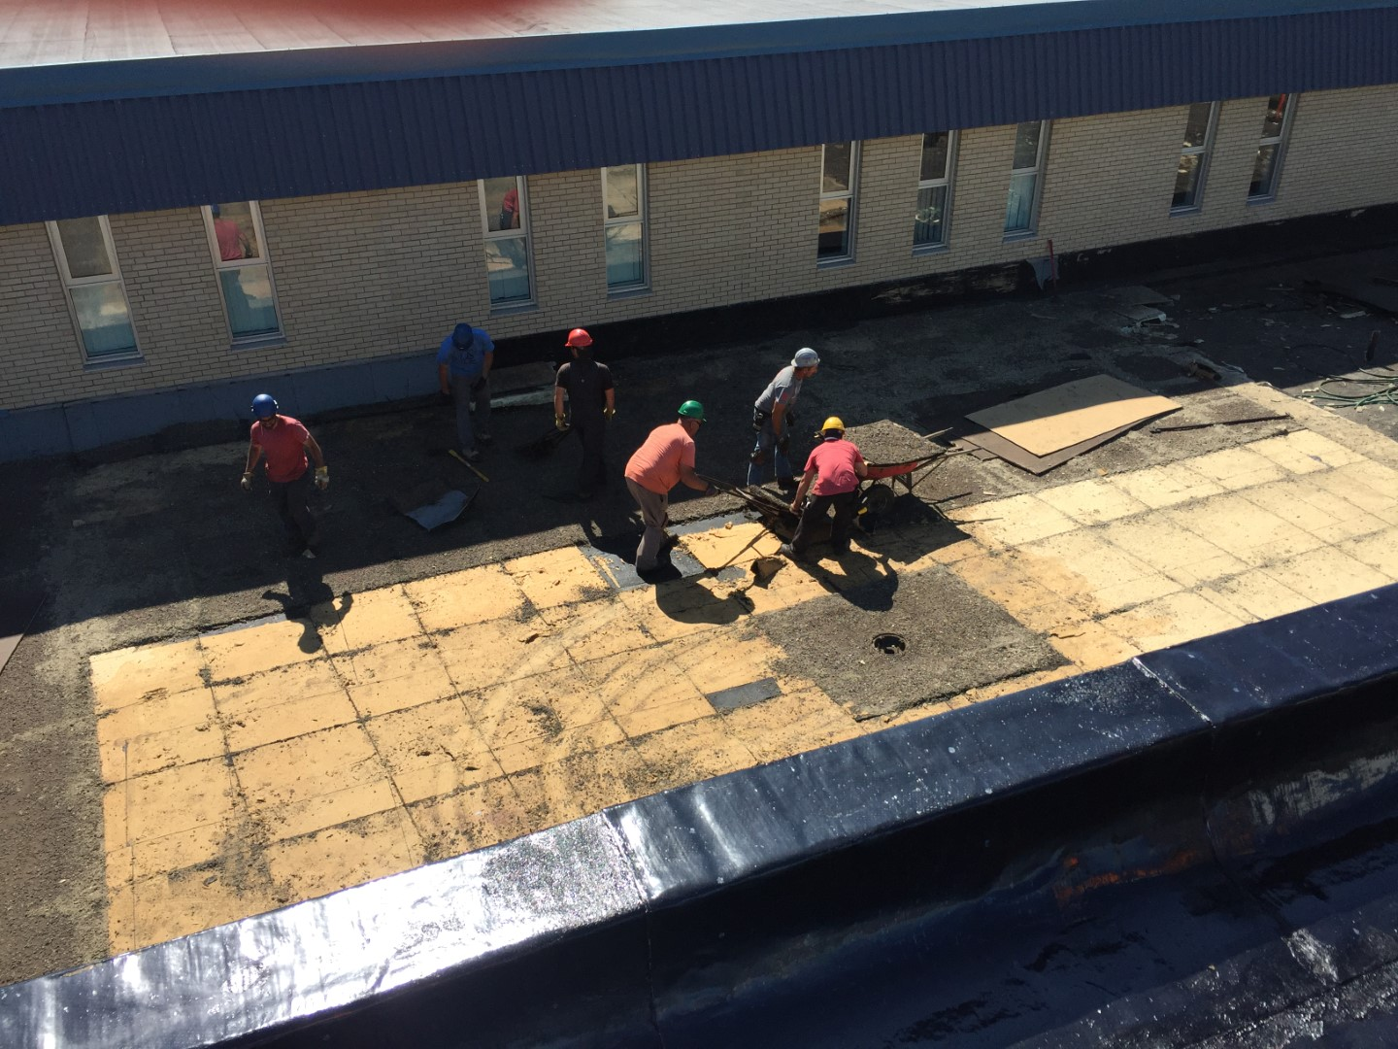
Careers in Commercial Roofing
Superintendent
Consultant
Observer
Roofer
Estimator

Slide 5
Meet Edgar!
NBRCA Roofing
Training Instructor

Slide 6
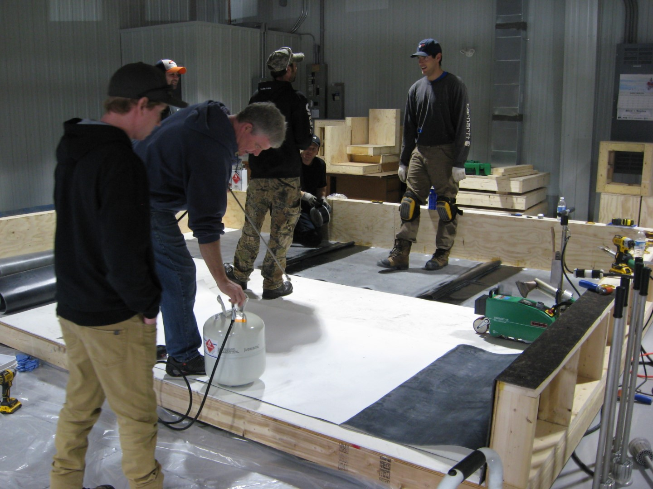
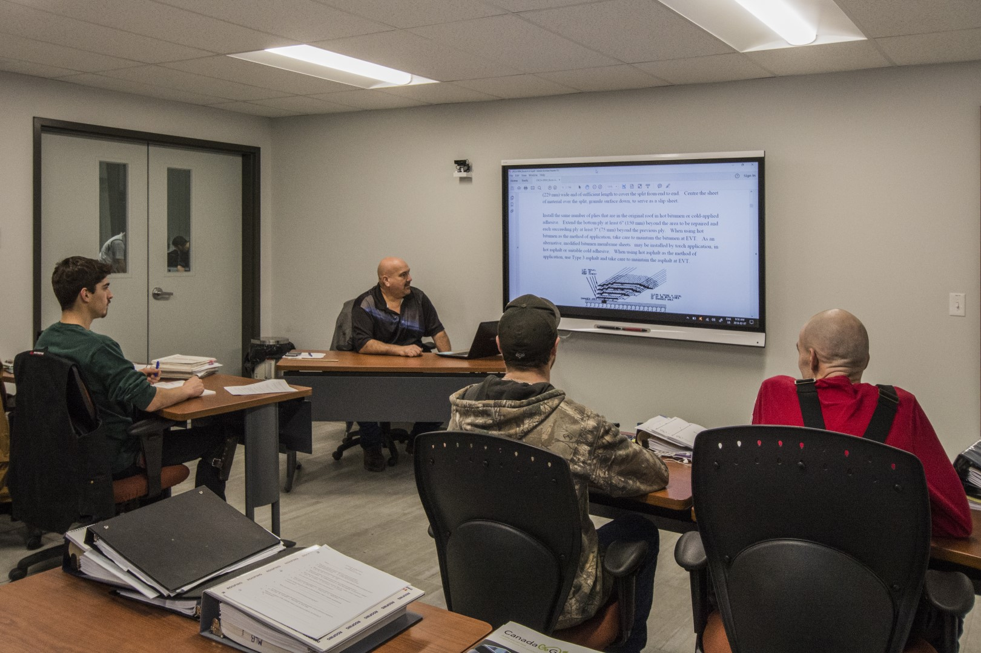
Life at the NBRCA Roofing Training Centre
NBJobs.ca Careers - Roofers

Slide 7
Roofing Materials and Layers
Cover Board
Roof Deck
Vapour Retarder
Membrane
Deck Cover
Insulation
Flashing

Slide 8
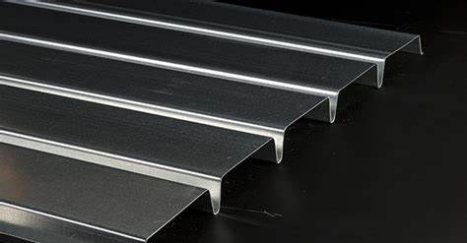
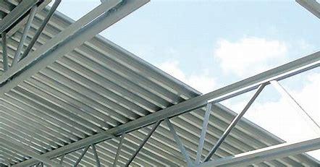
Roof Deck
A roof deck is installed as part of the building structure to keep the building together and support the roof system and the outside elements (rain, snow, ice, vegetated roof (plants), etc.) and are typically either wood, steel or concrete. When a roofer gets to the job site, a roof deck should already be in place. This is where a roofer's job begins.

Slide 9
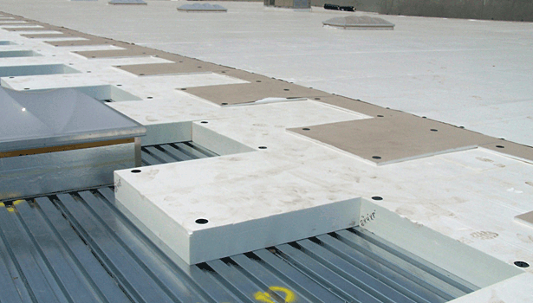
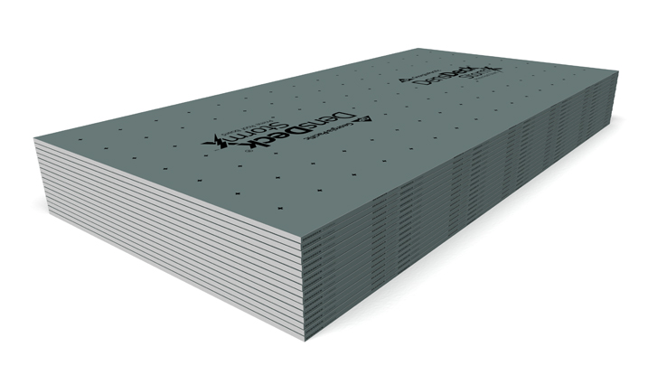
Deck Cover
The deck cover is the first step in building a roof. Typically used over a steel deck and only as required on wood or concrete decks if they are uneven. This is used to prepare the rest of the roof installation so it is solid and flat (gypsum board and plywood are common elements)

Slide 10
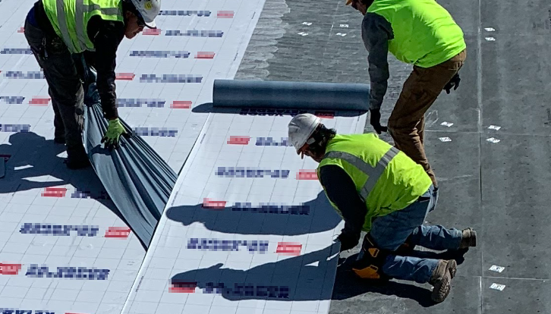
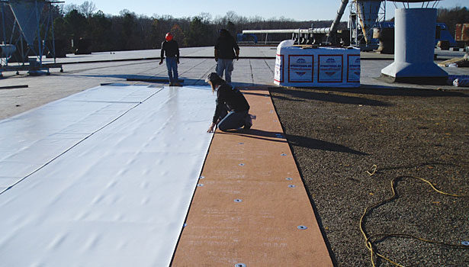
Vapour Retarder
The vapour retarder (barrier), which slows the movement of interior air/water (vapour) into the roof system and the exterior air/water (vapour) from the roof system into the building.

Slide 11
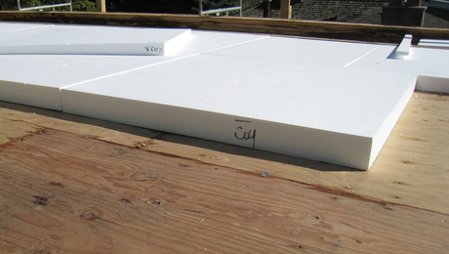
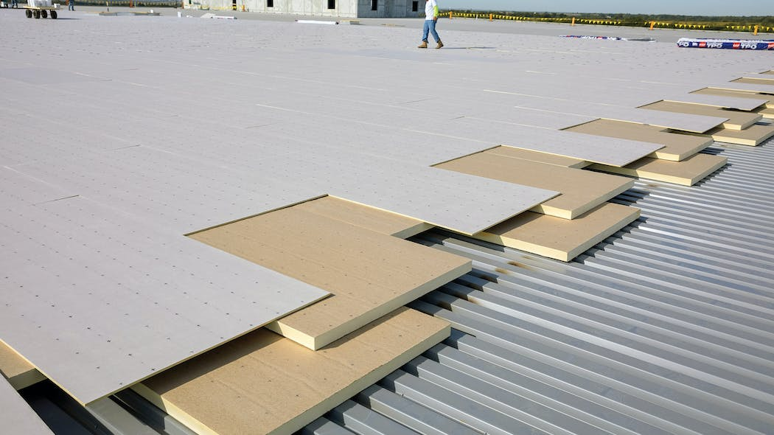
Insulation
Insulation insulates the roof of the building. It comes in various shapes, sizes and material types with various R- Values. It prevents loss of heat from the building and keeps the occupants of the building comfortable.

Slide 12
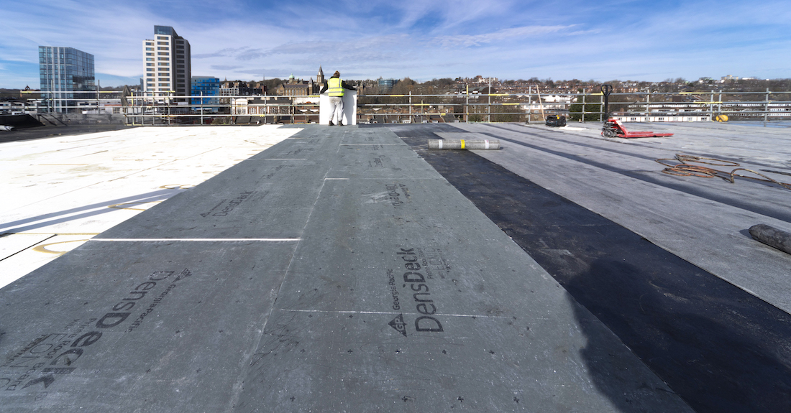
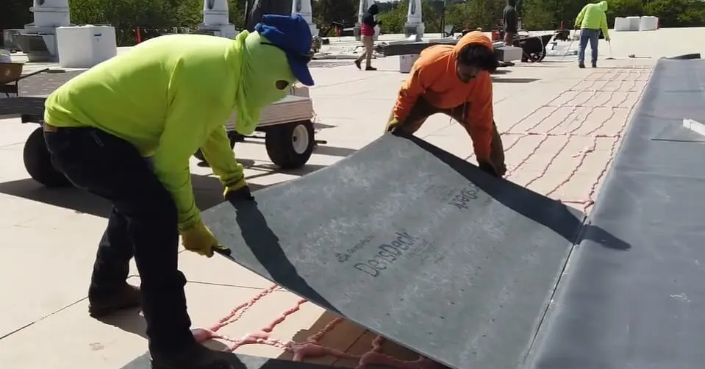
Cover Board
Coverboards are used to separate the insulation from the membrane. This is to allow movement from the two types of roof components caused by changes in temperature. The coverboard saves the membrane from potential ripping.

Slide 13
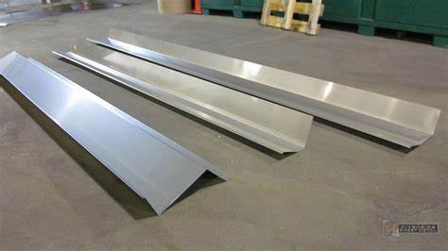
Flashing
Flashing is a thin sheet of material used to cover any remaining gaps or openings left around seams and edges. This will prevent water from entering where it's not supposed to go.

Slide 14
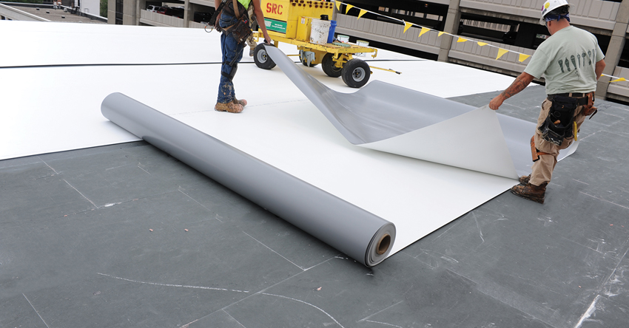
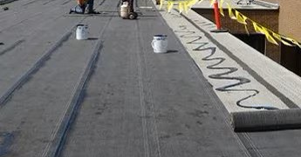
Membrane
A membrane is the waterproofing layer, keeping rain, snow, ice, wind, etc. outside.
Two common types are modified bitumen and single-ply (EPDM, PVC, TPO).

Slide 15
Exploration of Materials
What from your kit materials best represents each layer?

Slide 16
Exploration of Materials
Cover Board
Roof Deck
Deck Cover
Vapour Retarder
Membrane
Insulation
Flashing

Slide 17
ROOFING 101

Slide 18
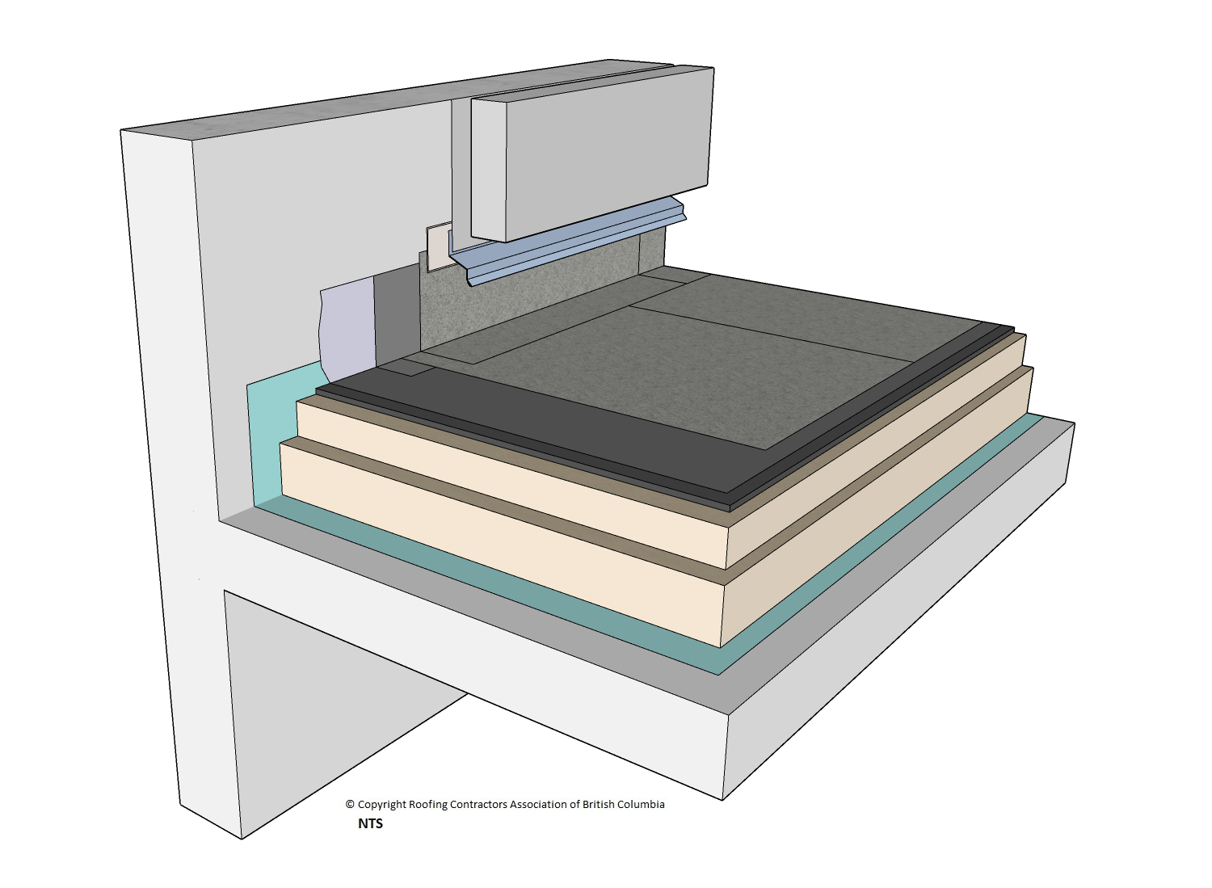
Roofing Building Challenge
Each sandwich MUST:
Include all 7 layers of a flat roof
Sandwich built in the correct order
At least one seam in top membrane
Demonstrate clean roofing skills (no glue leaking, flat roof, no holes in edge flashing)
Time to BUILD!!
Used with permission from RCABC

Slide 19
Roofing Building Challenge
Membrane (shelf liner) with a seam
Peel and stick to
Flashing (tinfoil)
Strips to close gaps and lap over sides
Cover Board (cardboard paper)
Tack or glue to
Insulation (foam sheets) - 1 or 2 sheets
Tack or glue to
Vapour Retarder (wax paper)
Tack or glue to
Deck Cover (meranti plywood)
Place inside of
Roof Deck (BBQ tray)
Used with permission from RCABC

Slide 20
PAIR & SHARE
1 CHALLENGE
1 VICTORY
Share one thing that you/your team had to overcome.
Share one thing that you/your team did well!

