Slide 1
Health and Safety at work: Your rights

Slide 2
Disclaimer
Please note that this presentation was created to provide an awareness of workplace health and safety to youth who are beginning a work placement or part-time employment. This presentation does not replace the new employee orientation and training that must be provided by employers under the Occupational Health and Safety Act.

Slide 3
Outline
01
Objectives for this presentation
05
Q2: Do I have a say in my workplace safety?
02
What does WorkSafeNB do?
06
Q3: When do I say “NO”?
03
The Occupational Health and Safety Act
07
Resources
04
Q1: How can I get hurt at work?

Slide 4

Objectives
Learn about WorkSafeNB and what they do.
Understand the fundamental rights of workers.
Learn how to protect yourself at work.
Find out how to access available resources.

Slide 5
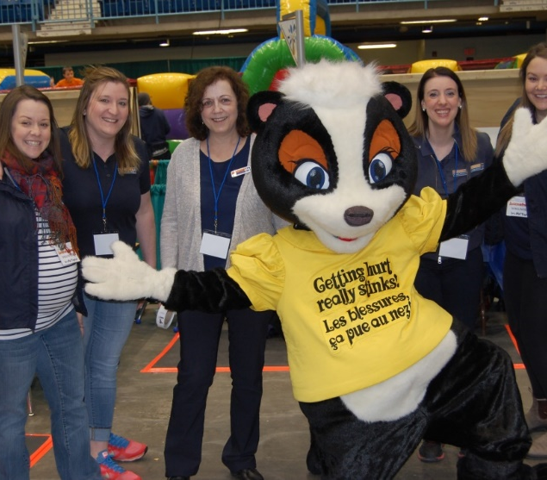
What does WorkSafeNB do?
WorkSafeNB is committed to promoting healthy and safe workplaces for New Brunswick's workers and employers. WorkSafeNB works tirelessly with New Brunswick employers and workers to create a positive safety culture in all workplaces. While their priority is preventing workplace injuries, they also offer a compensation program for workers who do get hurt at work.

Slide 6
The Occupational Health and Safety Act
The Act is a piece of legislation (i.e., a set of written laws) in New Brunswick that states that every worker has a right to a safe and healthy workplace.
Everyone at the workplace is responsible for their own health and safety as well as for the health and safety of others.

Slide 7
Some statistics
52,200 – New Brunswick workers aged 15-24 in 2023.
569 – New Brunswick workers aged 15-24 who suffered a workplace injury in 2023.
6 – New Brunswick workers aged 15-24 who died as a result of a workplace injury between 2013 and 2023.

Slide 8

The three fundamental rights
Like every other worker in New Brunswick, young workers have rights, too.

Slide 9

Are you safe at work?
Ask yourself three questions:
How can I get hurt at work?
Do I have a say in my workplace safety?
When do I say “NO”?

Slide 10
Are you safe at work?
First question:
How can I get hurt at work?

Slide 11

How can I get hurt at work?
All workers have the…
Right to Know!

Slide 12
Right to know
Your employer is responsible for ensuring your safety by :
Providing you with an orientation and training specific to your job;
Informing you about the hazards associated with your work;
Explaining your workplace’s safety policies and procedures;
Ensuring that you are trained to use and wear the personal protective equipment (PPE) required to do your job.
Ensuring that you are sufficiently supervised.

Slide 13
Right to know
Your supervisor is responsible for ensuring your safety by:
Ensuring that you comply with the Occupational Health and Safety Act and its regulations;
Taking every reasonable precaution to ensure your safety;
Informing you about the hazards associated with your work;
Providing you with the information and instruction that is necessary to ensure you stay safe at work.

Slide 14
Right to know
You have a role to play in staying safe by:
Following all health and safety rules and regulations;
Acting in a safe manner;
Learning about the hazards associated with your work;
Reporting any injury, hazard or unsafe work condition to your supervisor;
Wearing the PPE required for your job.

Slide 15
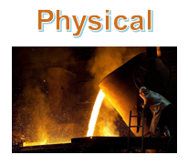





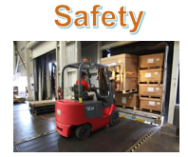
Right to know

Slide 16
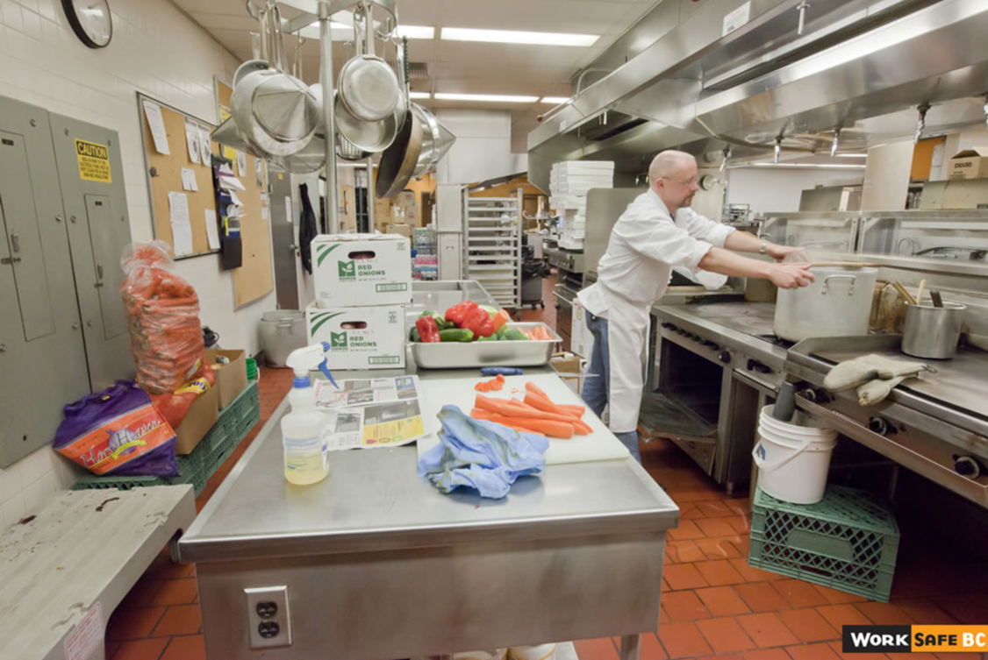
Activity 1: Hazard Identification

Slide 17
Activity 1: Hazard Identification

Slide 18
Activity 1: Hazard Identification
Your turn…
Complete the hazard assessment table for the photograph shown on the next slide.
Hazard | What could happen? | How could it be corrected?

Slide 19
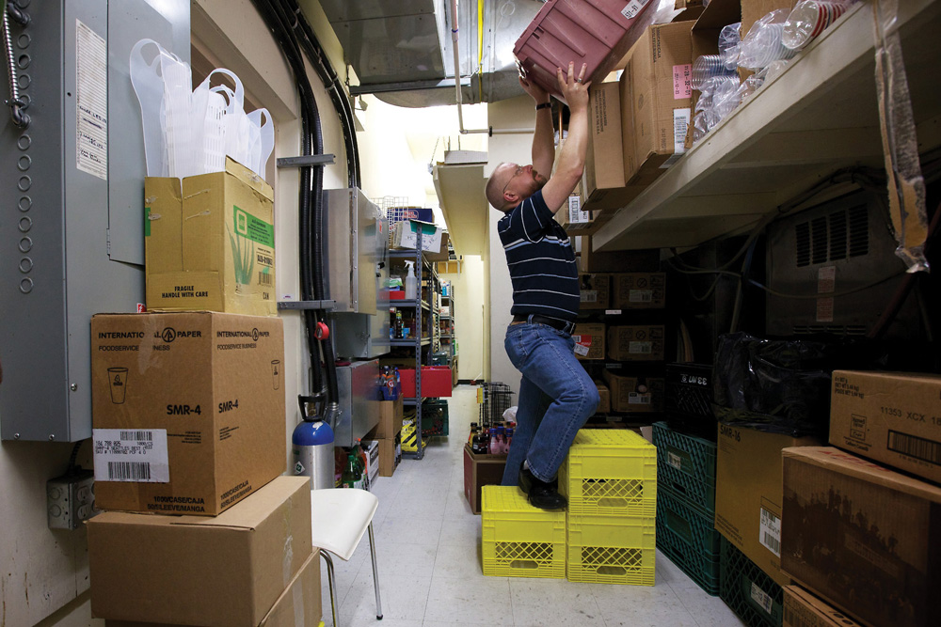

Activity 1: Hazard Identification
© WorkSafeBC (Workers’ Compensation Board), used with permission

Slide 20
Activity 1: Hazard Identification
© WorkSafeBC (Workers’ Compensation Board), used with permission

Slide 21
Remember… You have the right to know!
Knowing all the ways you can get hurt at work can help you stay safe.

Slide 22
Are you safe at work?
Second question:
  Do I have a say in my workplace safety?

Slide 23
Do I have a say in my workplace safety?
All workers have the…
Right to Participate!

Slide 24

Right to participate
Participating can include:
  Talking about safety;
  Expressing your concerns or asking questions about safety;
  Making suggestions about safety.

Slide 25

Right to participate
A formal way to participate is to serve:
On the joint health and safety committee, or;
As the health and safety representative.

Slide 26
Right to participate
Choose the ending that correctly completes the phrase.
You have a right to participate in your workplace safety:
  Only if you are a full-time worker.
  By bringing your suggestions to your supervisor and/or the joint health and safety committee.
  Only after you have turned 18 years old.
  Only if you are a supervisor.

Slide 27
Right to participate
Choose the ending that correctly completes the phrase.
You have a right to participate in your workplace safety:
  Only if you are a full-time worker.
  By bringing your suggestions to your supervisor and/or the joint health and safety committee.
  Only after you have turned 18 years old.
  Only if you are a supervisor.

Slide 28
Right to participate
Choose the ending that correctly completes the phrase.
One good way to participate in your workplace safety is to:
  Volunteer to be on the joint health and safety committee.
  Have lots of imaginary conversations with your supervisor.
  Not bother! Participating doesn’t work anyway.
  Tell all your safety concerns to your dog.

Slide 29
Right to participate
Choose the ending that correctly completes the phrase.
One good way to participate in your workplace safety is to:
  Volunteer to be on the joint health and safety committee.
  Have lots of imaginary conversations with your supervisor.
  Not bother! Participating doesn’t work anyway.
  Tell all your safety concerns to your dog.

Slide 30
Right to participate
Choose the ending that correctly completes the phrase.
In workplaces, a joint health and safety committee must :
  Be established if there are 20 or more workers.
  Be made up of an equal number of workers and management.
  Meet regularly.
  All of the above.

Slide 31
Right to participate
Choose the ending that correctly completes the phrase.
In workplaces, a joint health and safety committee must :
  Be established if there are 20 or more workers.
  Be made up of an equal number of workers and management.
  Meet regularly.
  All of the above.

Slide 32
Right to participate
Choose the ending that correctly completes the phrase.
In workplaces where there are between five and 19 workers:
  A student council member must be chosen.
  A worker must be selected to serve as the health and safety representative.
  There are never any safety issues.
  A team mascot must be chosen.

Slide 33
Right to participate
Choose the ending that correctly completes the phrase.
In workplaces where there are between five and 19 workers:
  A student council member must be chosen.
  A worker must be selected to serve as the health and safety representative.
  There are never any safety issues.
  A team mascot must be chosen.

Slide 34
Right to participate
Choose the ending that correctly completes the phrase.
The health and safety representative shall:
  Help to look into and solve workplace safety issues.
  Purchase whatever is needed to solve all safety concerns.
  Be expected to stay after work hours to deal with safety issues.
  Not be given any special training to be the health and safety representative.

Slide 35
Right to participate
Choose the ending that correctly completes the phrase.
The health and safety representative shall:
  Help to look into and solve workplace safety issues.
  Purchase whatever is needed to solve all safety concerns.
  Be expected to stay after work hours to deal with safety issues.
  Not be given any special training to be the health and safety representative.

Slide 36
Right to participate
Choose the ending that correctly completes the phrase.
If your workplace doesn’t have a joint health and safety committee or a health and safety representative, you should:
  Organize one yourself.
  Go online to report your workplace.
  Discuss this with your supervisor and ask about getting one set-up.
  Not worry, because it’s not your concern anyway.

Slide 37
Right to participate
Choose the ending that correctly completes the phrase.
If your workplace doesn’t have a joint health and safety committee or a health and safety representative, you should:
  Organize one yourself.
  Go online to report your workplace.
  Discuss this with your supervisor and ask about getting one set-up.
  Not worry, because it’s not your concern anyway.

Slide 38

Activity 2: Participation Practice
Role play a conversation between a worker and a supervisor, where the worker participates in their workplace safety. (You decide if the supervisor you create is an “Approachable Annabelle” or a “Bully Bertha”).
See next slide for an example.

Slide 39
Activity 2: Participation Practice
  WORKER: Hi, Josh. Do you have a few minutes?
  SUPERVISOR: Sure, what’s up?
  WORKER: I have concern about those boxes.
  SUPERVISOR: What is it?
  WORKER: They’re really heavy. How do I move them?
  SUPERVISOR: Let’s go take a look. I’m glad you asked.
Hi, Josh.
Do you have a minute?
Sure, what’s up?

Slide 40
Remember… You have the right to participate!
Participating in health and safety decisions can help you stay safe.

Slide 41
Are you safe at work?
Third question:
  When do I say “NO”?

Slide 42
When do I say “NO”?
All workers have the…
Right to Refuse!

Slide 43
Right to refuse
But… “refusing” isn’t easy.
What if I get in trouble?
Stand up to my boss?! That’s hard to do!
I’m not good at saying “no”.

Slide 44


Right to refuse
  How can I refuse without saying « NO »?
  “Can I ask you something?”
  “I have a concern…”
  “I don’t feel comfortable doing this…”
  “Is there a safer way to do this?”
  “This just doesn’t feel safe.”

Slide 45
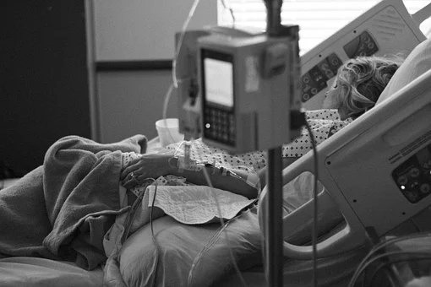
Right to refuse
  If refusing to do unsafe work is such a hassle, is it even worth the trouble?
  What do you think?

Slide 46
Right to refuse
Here are some work situations where you may need to exercise your right to refuse:
Being asked to work alone without good security measures.
Being told to use new equipment, without being trained.
Being expected to use equipment that is broken.

Slide 47
Right to refuse
Continued…
Not being told about or being provided with proper PPE.
Noticing changes in tasks, materials, or procedures, with no additional safety training.

Slide 48

Right to refuse
To refuse unsafe work:
First step: Talk with your supervisor.
Second step: Talk with a member of your joint health and safety committee, or if your workplace doesn’t have a committee then you can talk with your health and safety representative.
Third step: Call WorkSafeNB at 1-800-999-9775 and explain your situation.

Slide 49
Activity 3: Saying “No"
Develop a guideline that would help a worker know when they need to say, “No”
Examples:
  When your boss asks you to run a machine, but doesn’t show you how to do it, just say, “No”
  When you always wear gloves and goggles for a cleaning task, but the glove box is empty, just say, “No”
  When the guard on the table saw is broken and won’t be replaced until Tuesday, just say, “No”
Design a poster to illustrate your guideline.

Slide 50
Remember… You have the right to refuse unsafe work!
Knowing when to refuse work that can hurt you can help you stay safe.

Slide 51

Are you safe at work?
To sum things up:
How can I get hurt at work?
  Right to know
Do I have a say in my workplace safety?
  Right to participate
When do I say “NO”?
  Right to refuse

Slide 52

Resources
For more information:
    Website: www.worksafenb.ca
    Guide to OHS Legislation

Slide 53

If you have any questions or concerns, WorkSafeNB is here to help
Give us a call at 1-800-999-9775.

