Slide 1
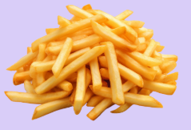
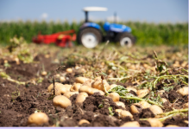


From Farm to Fry:

Slide 2
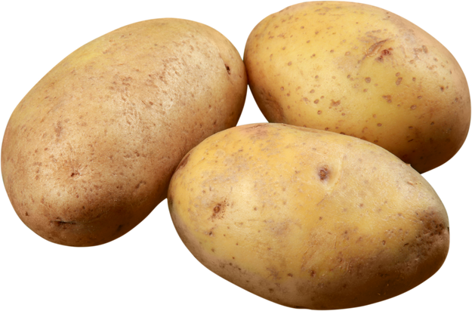

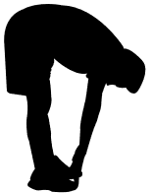
From Farm to Fry Trivia
Potatoes are the world’s third most important food crop.
True
False
Toe Touches
Side Stretches

Slide 3
From Farm to Fry Trivia
Potatoes are the world’s third most important food crop.
True
Potatoes are third, after
rice and wheat.
Toe Touches

Slide 4


From Farm to Fry Trivia
Potatoes are graded - just like us on a report card!
True
False
Jumping Jacks
Lunges

Slide 5
From Farm to Fry Trivia
Potatoes are graded - just like us on a report card!
True
Potatoes are graded on size, shape, firmness, and without having blemishes or rotten spots. Grade 1 are the best!
Jumping Jacks

Slide 6


From Farm to Fry Trivia
Potatoes have eyebrows.
True
False
Jog on the Spot
Push Ups

Slide 7
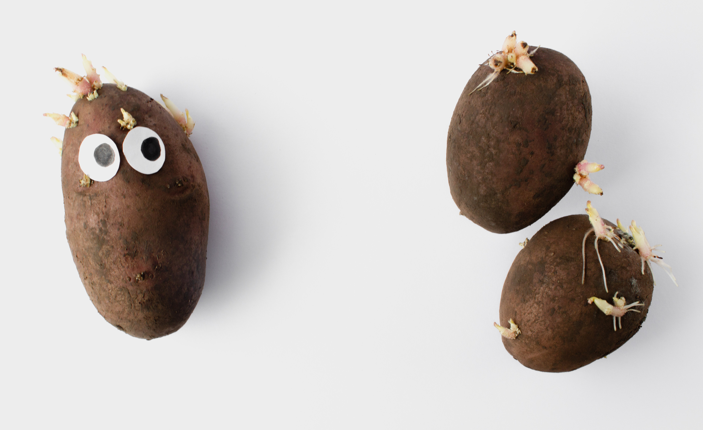
From Farm to Fry Trivia
Potatoes have eyebrows.
True
Potatoes have eyes - these are the beginnings of a new potato. Each of these eyes has an eyebrow. These tell us which way the potato is upside down or right-side up.
Jog on the Spot

Slide 8
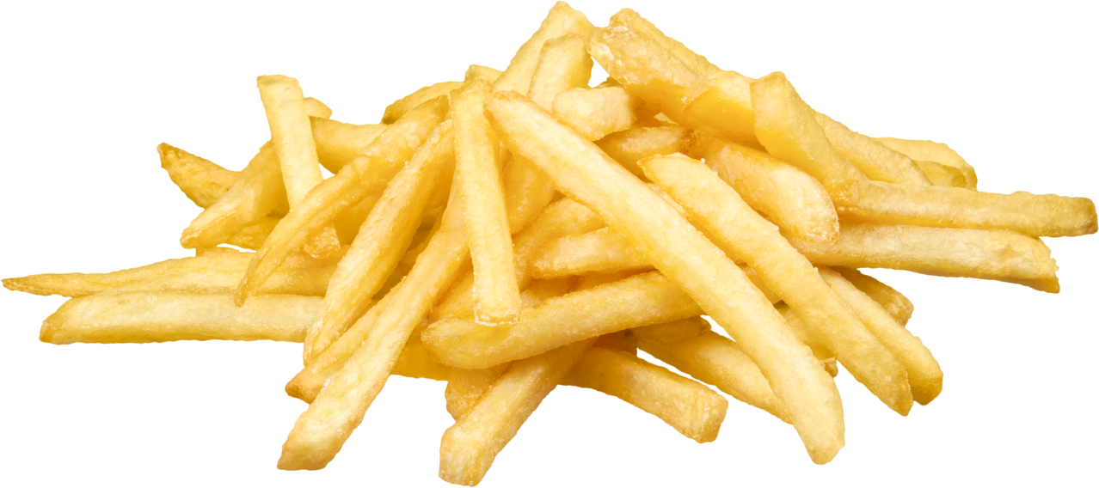
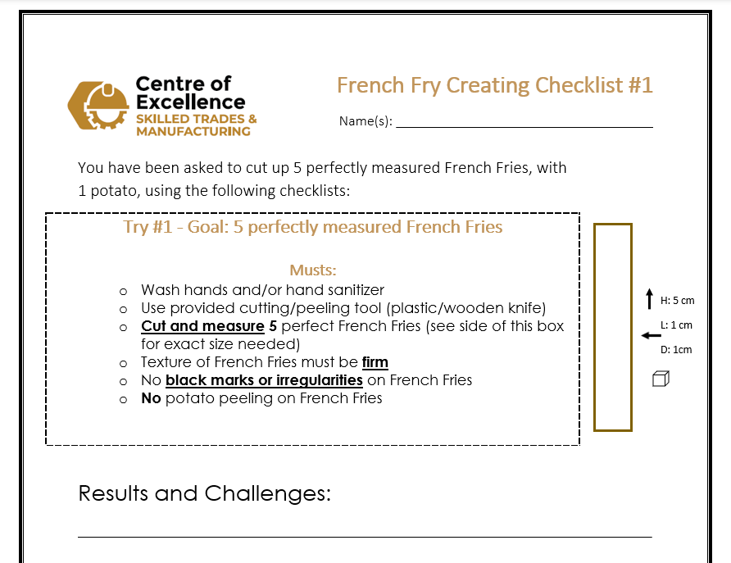

From Farm to Fry
Challenge #1

Slide 9
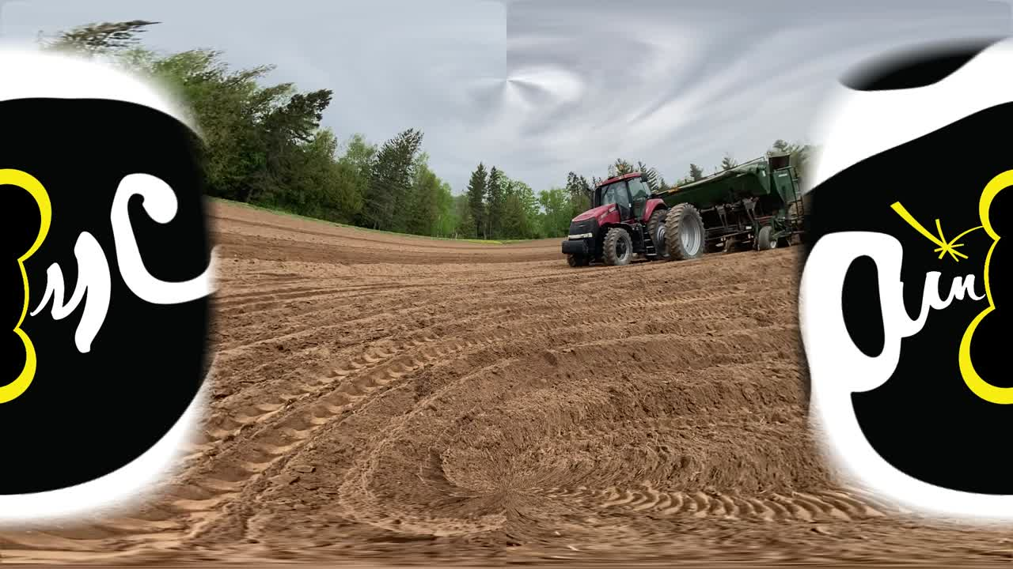
From Farm to Fry

Slide 10
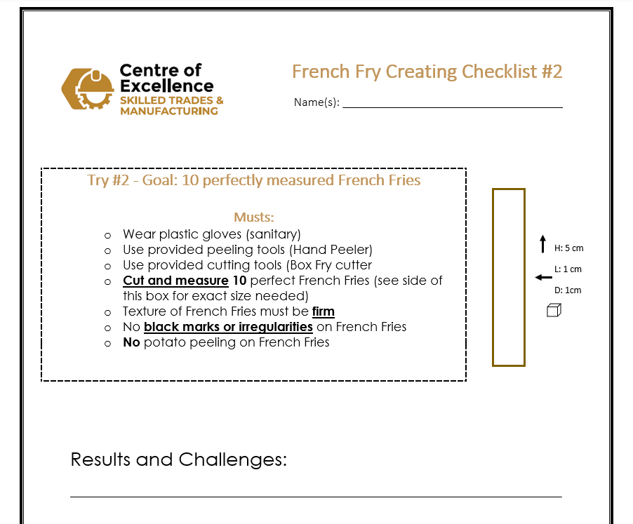
From Farm to Fry
Challenge #2

Slide 11
From Farm to Fry
Why does Quality Control matter?

Slide 12
From Farm to Fry
Thank You!

