Slide 1



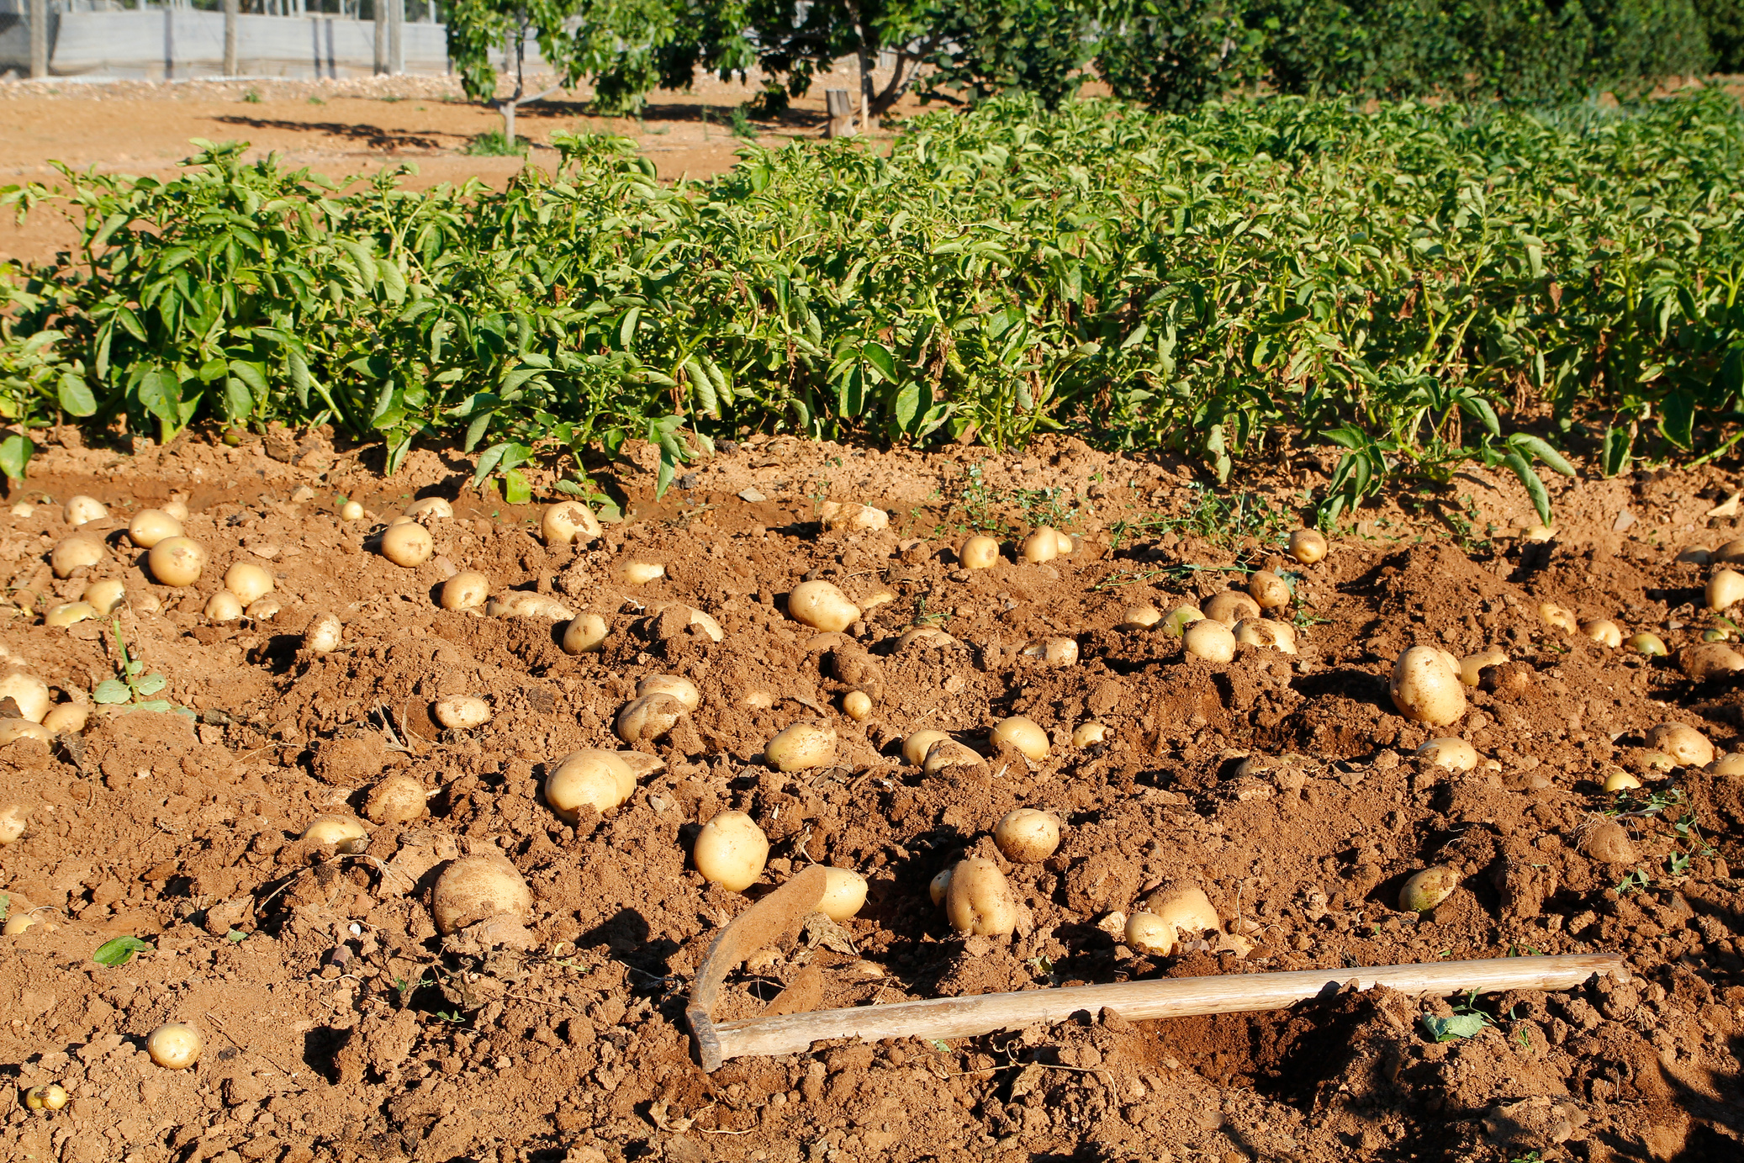
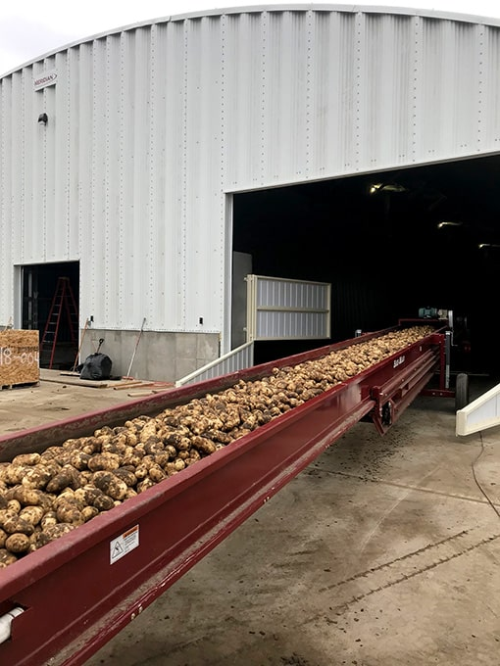
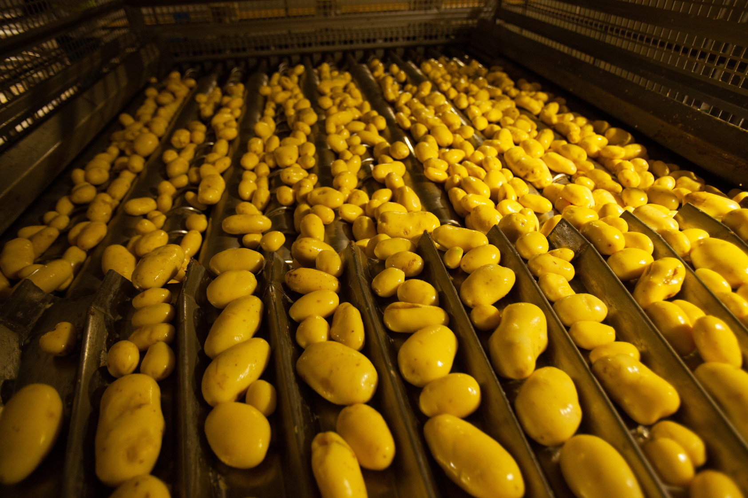
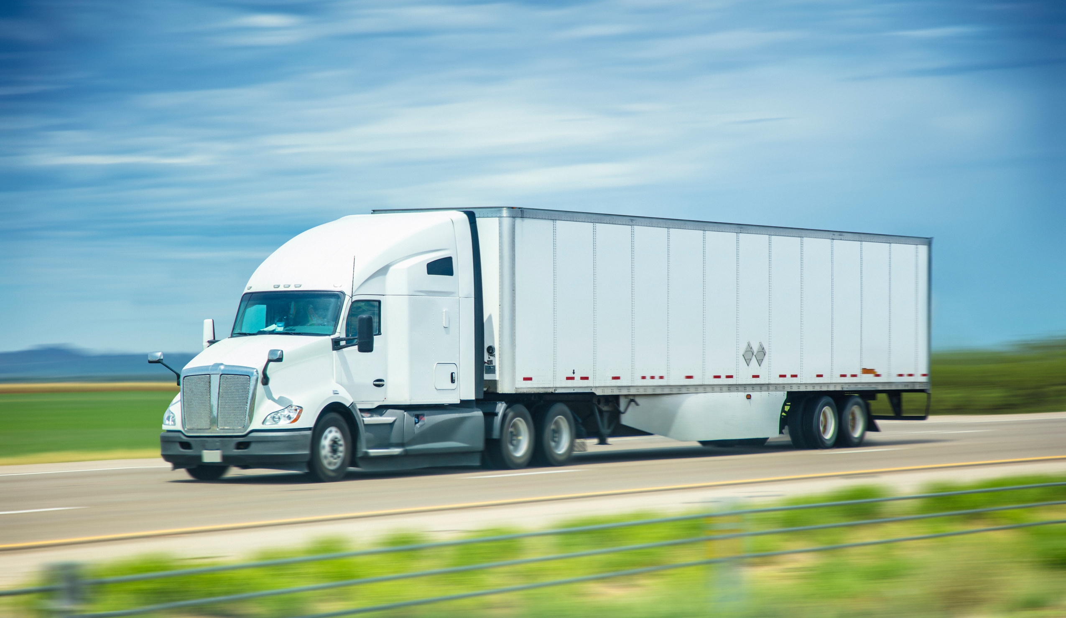



The Great Potato Adventure
A Potato Supply Chain Learning Experience for K-2 Learners

Slide 2
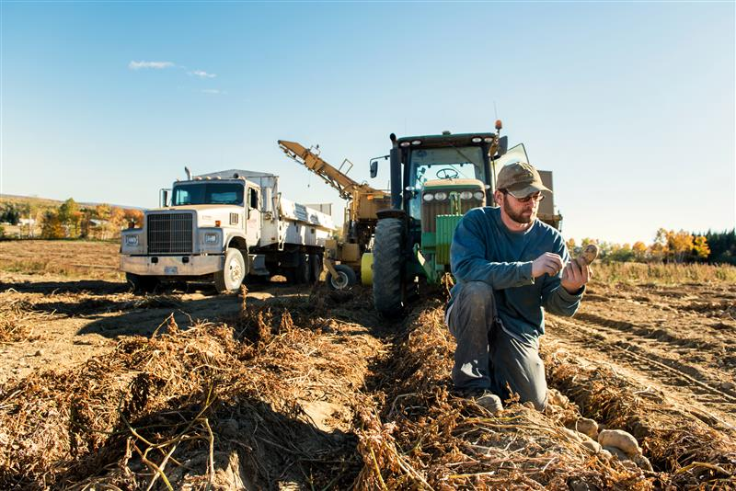
The Great Potato Adventure
Farm

Slide 3
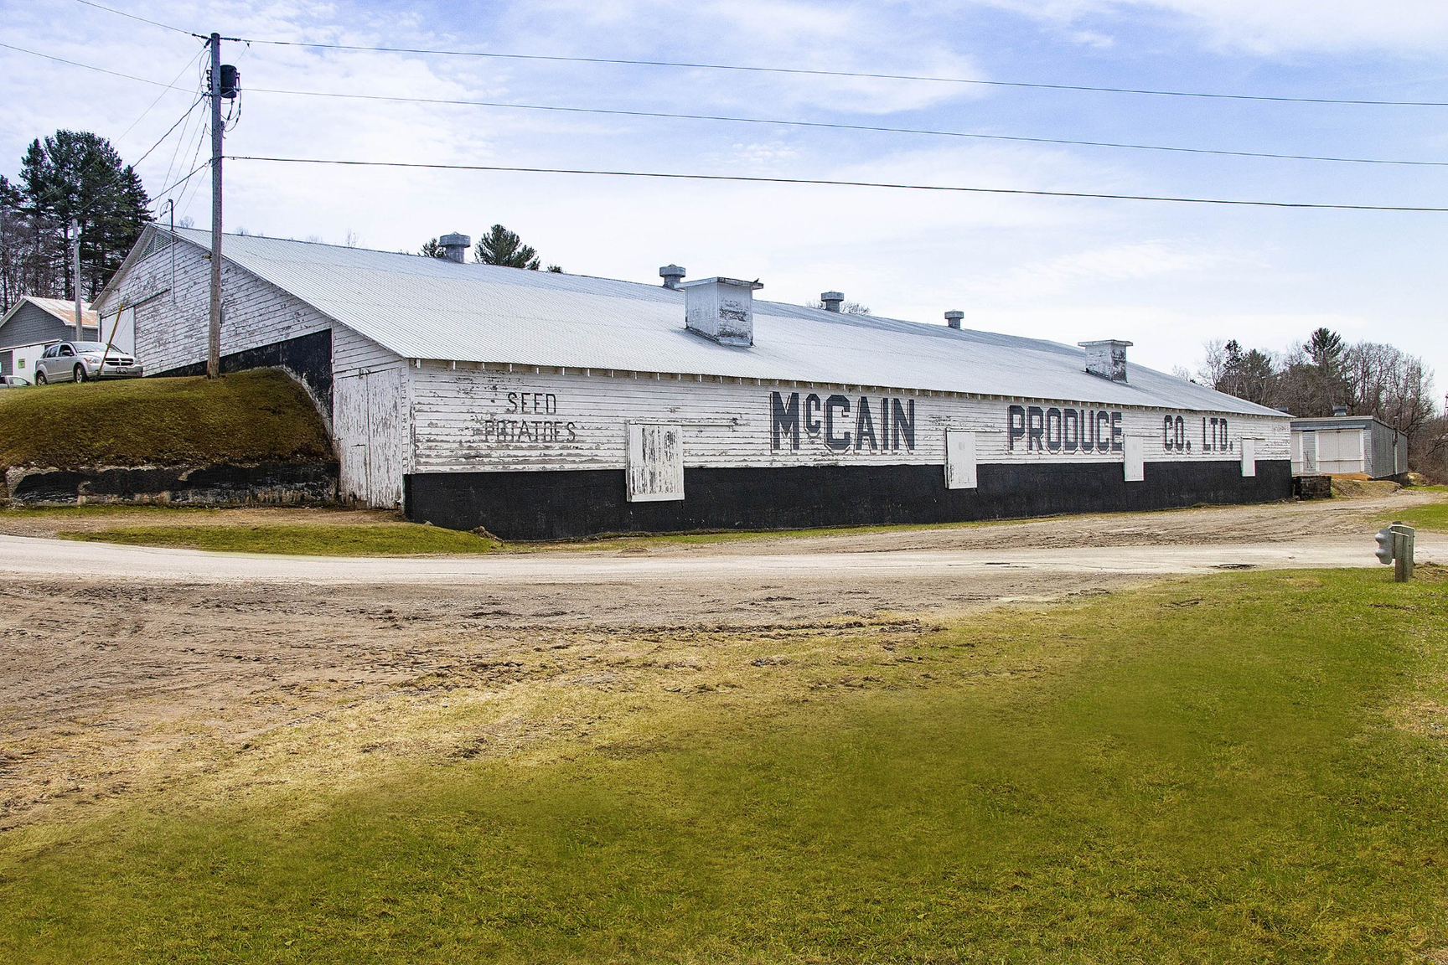
The Great Potato Adventure
Storage Shed

Slide 4
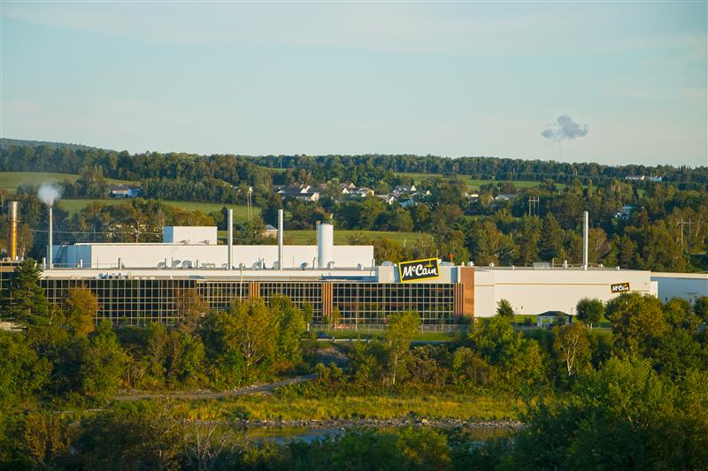
The Great Potato Adventure
Factory

Slide 5
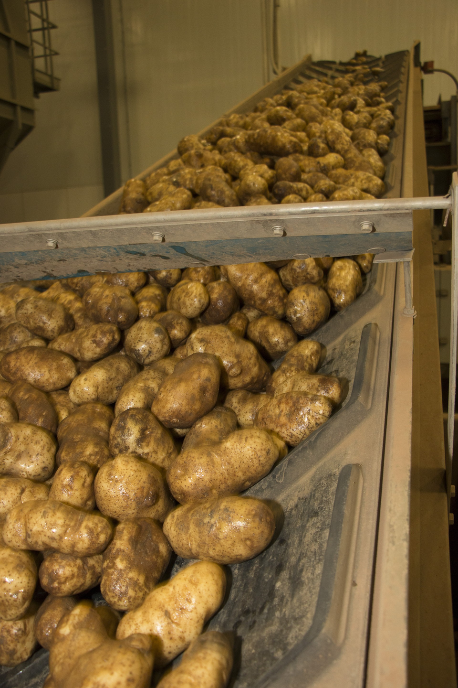
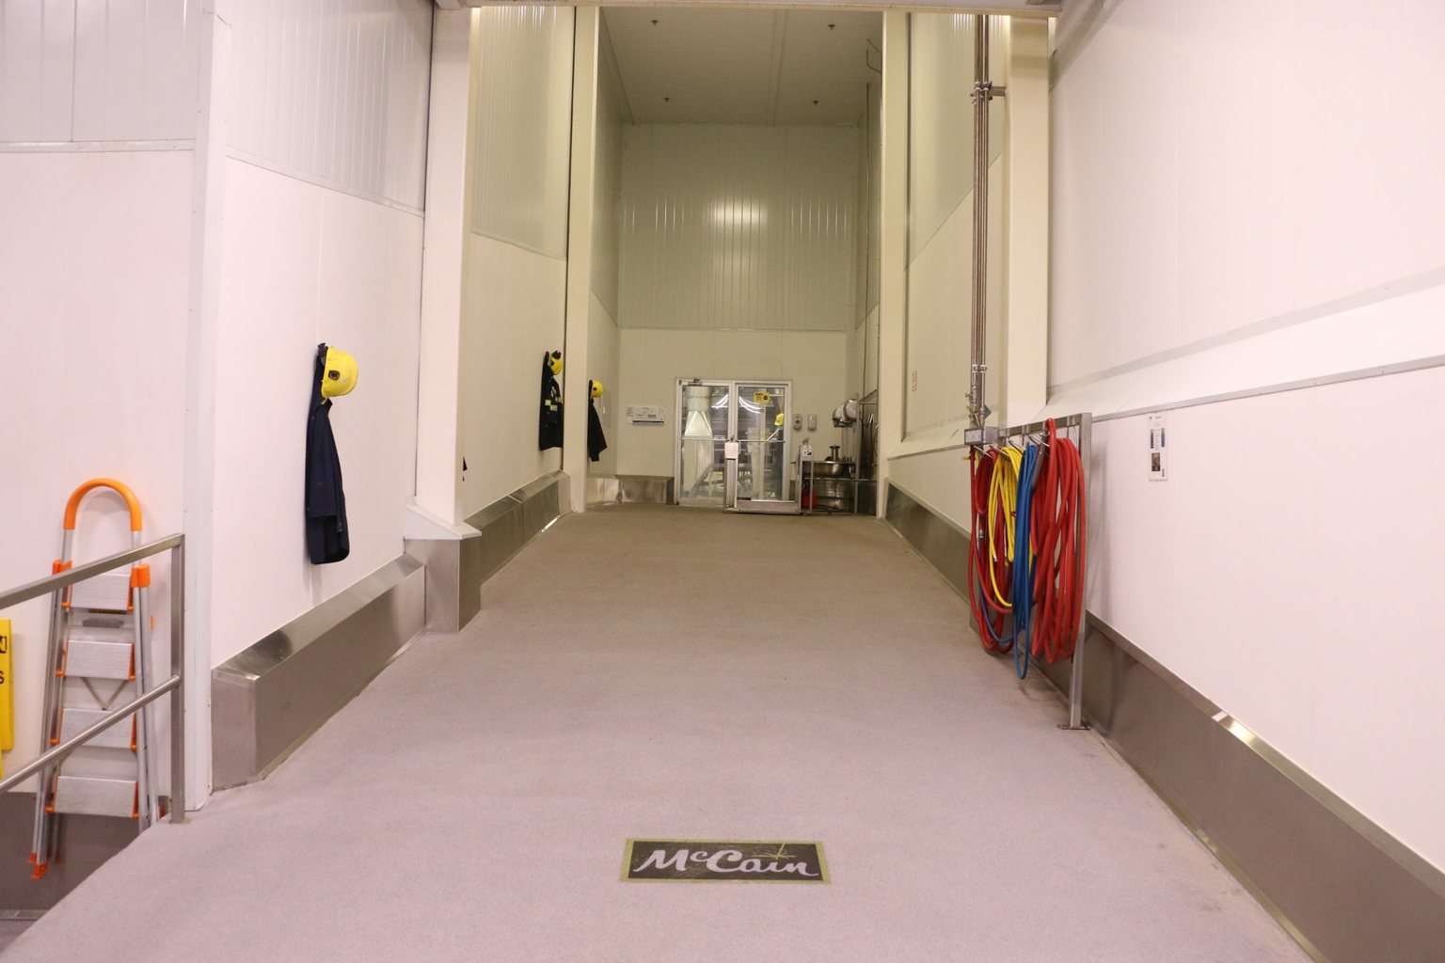
The Great Potato Adventure
Factory

Slide 6
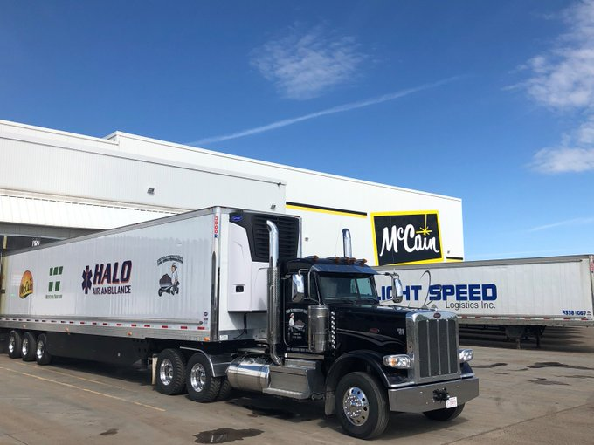
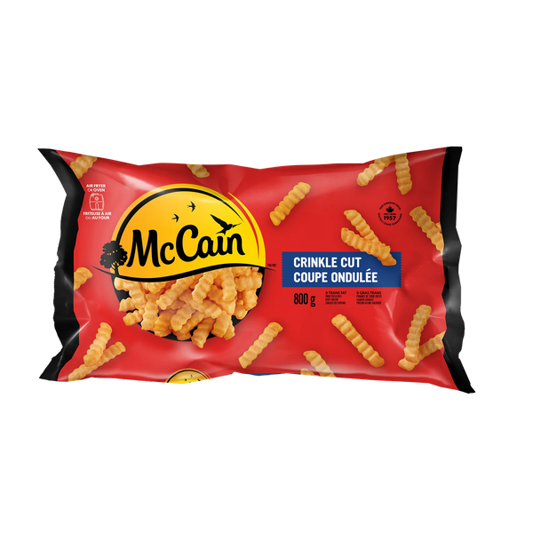
The Great Potato Adventure
Delivery Trucks

Slide 7
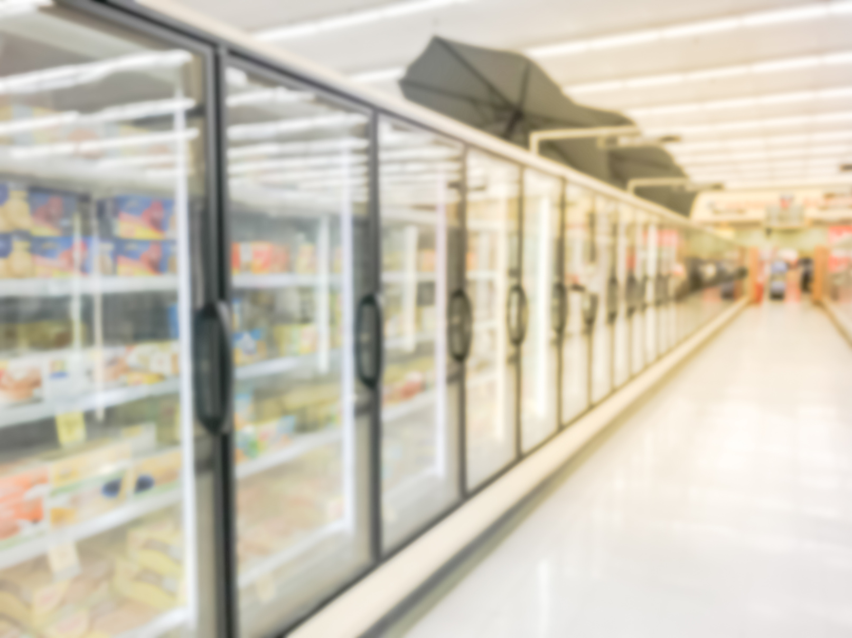
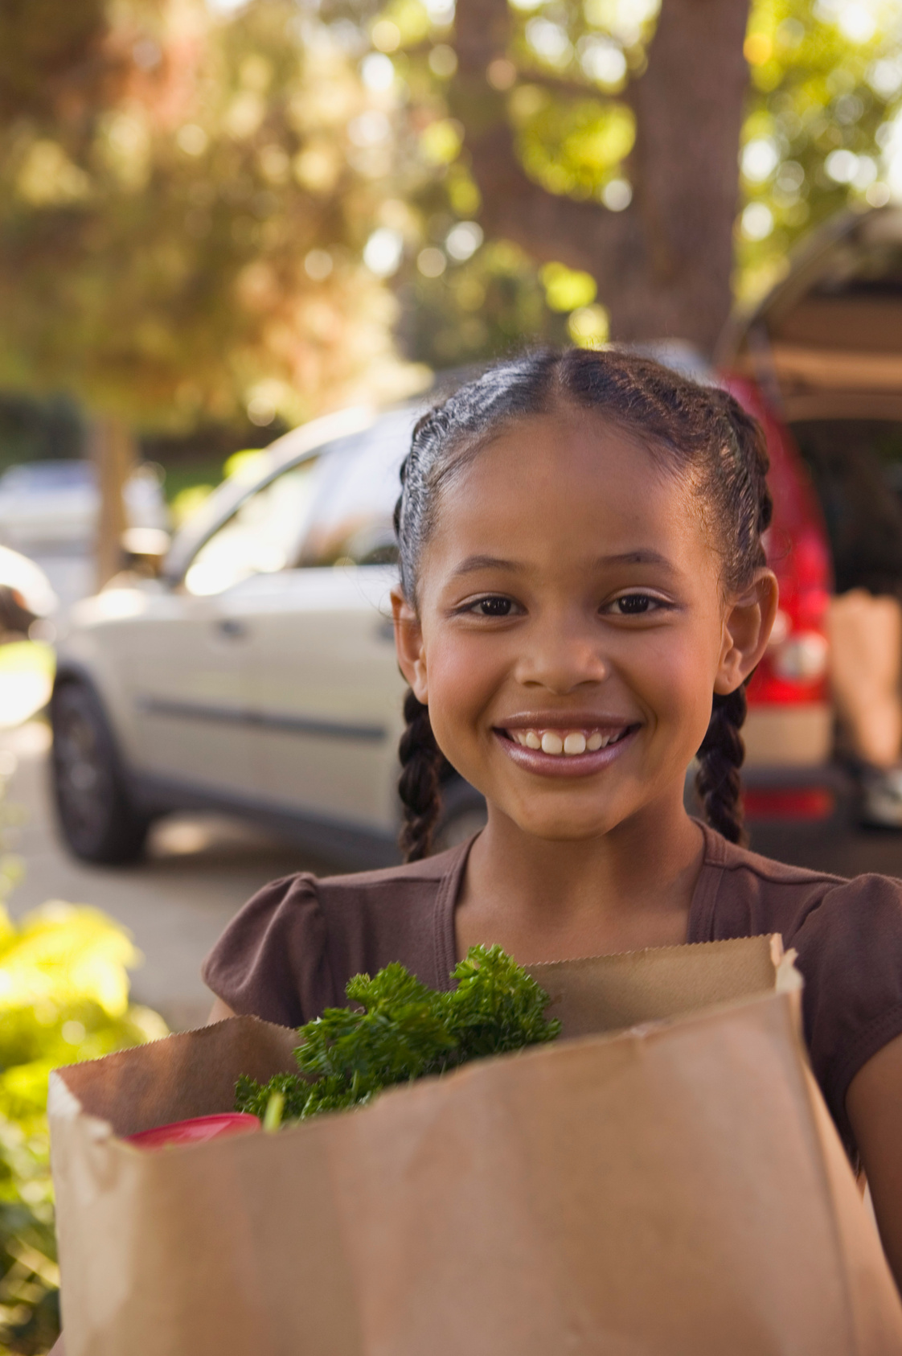
The Great Potato Adventure
Grocery Store

Slide 8
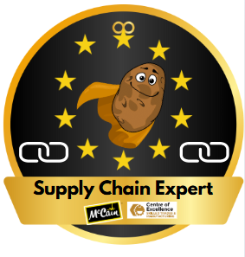
The Great Potato Adventure
Why are supply chains important?

Slide 9
The Great Potato Adventure
Thank You!

