Slide 1


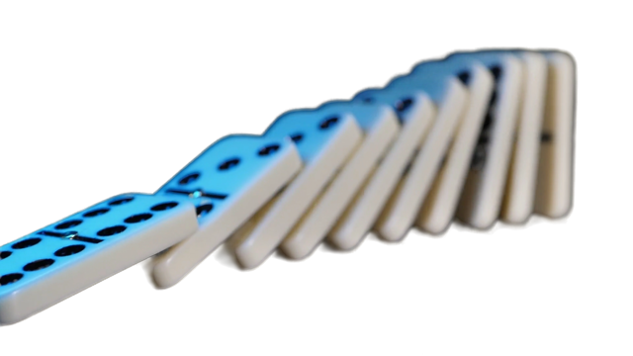
TOPPLE AND TINKER:
DOMINO TRADE CHALLENGE
CAREER CONNECTION:
ARCHITECTS, BUILDERS, AND ENGINEERS DESIGN TALL STRUCTURES THAT MUST BE STABLE AND SAFE. THIS CHALLENGE PRACTICES STABILITY, BALANCE, AND PROBLEM-SOLVING.
EXTENSION CHALLENGE – STABILITY TOWER CHALLENGE:
COMBINE TWO GROUPS TO BUILD THE TALLEST FREE-STANDING DOMINO TOWER YOU CAN WITHOUT IT FALLING.
YOUR TOWER MUST INCLUDE A PLATFORM TO HOLD A TESTING TOY.
TRY REBUILDING OR ADJUSTING YOUR TOWER TO MAKE IT MORE STABLE WHILE KEEPING IT TALL.

Slide 2
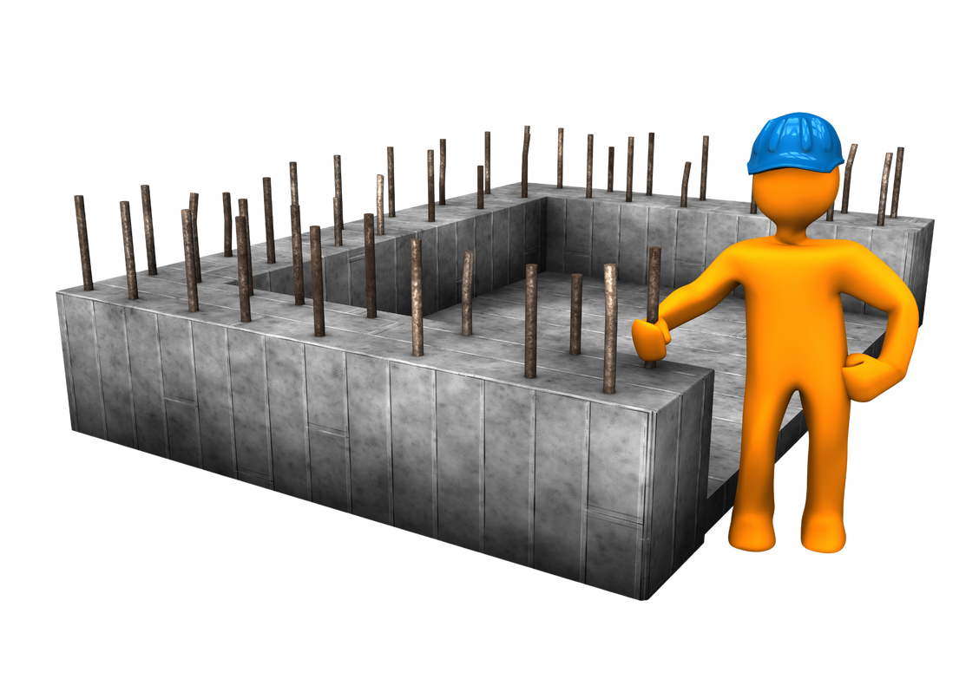
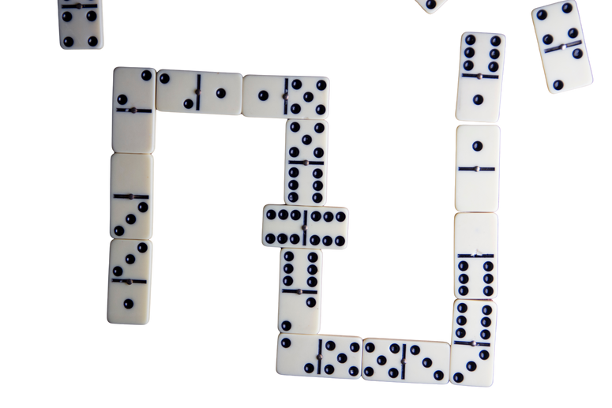
CARPENTER’S FOUNDATION
YOUR MISSION
BUILD A CLOSED FRAME USING A MINIMUM OF 10 DOMINOES. THIS WILL REPRESENT THE FOUNDATION OF A HOUSE.
MEASURE THE PERIMETER WITH A RULER. HINT: THINK ABOUT THE LENGTH OF ONE DOMINO TO HELP FIND YOUR PERIMETER.
BUILD A SECOND FRAME WITH THE SAME PERIMETER TO CREATE A DIFFERENT SHAPE.
.

Slide 3
CARPENTER’S FOUNDATION
EXTENSION
BUILD A THIRD DIFFERENT FRAME WITH DOMINOES STACKED TO REPRESENT A TRUE BASEMENT FOUNDATION.
WHAT IS THE HEIGHT OF YOUR BASEMENT FOUNDATION? WHAT IS YOUR NEW PERIMETER?
CAREER CONNECTIONS
CARPENTERS MEASURE AND CUT LUMBER PRECISELY WHEN BUILDING HOUSES, FURNITURE, AND STRUCTURES. FOUNDATIONS ARE THE START OF BUILDING A HOUSE AND MUST BE ACCURATELY BUILT AND MEASURED.

Slide 4
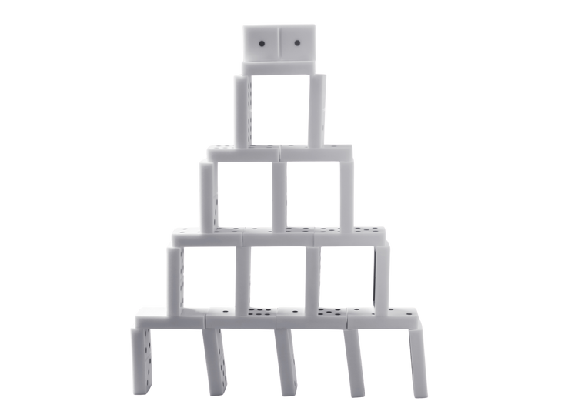
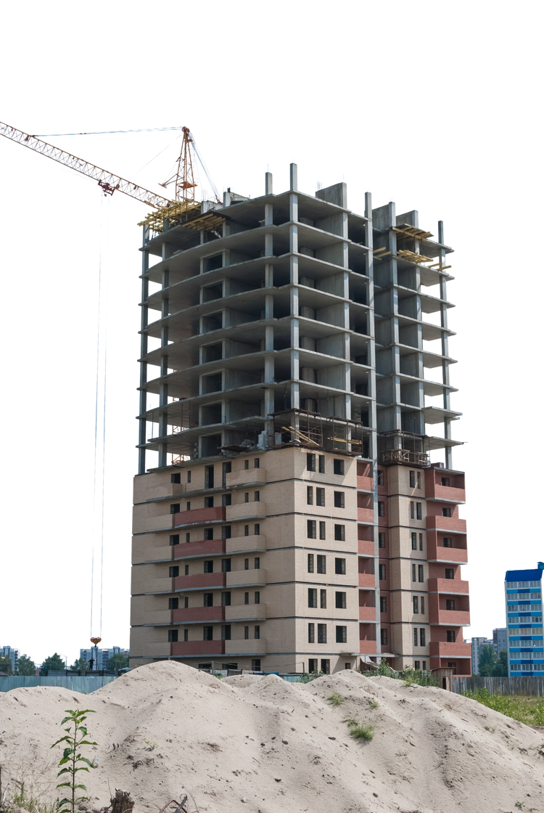
TOWER OF TRADES
YOUR MISSION
· BUILD THE TALLEST FREE-STANDING DOMINO TOWER YOU CAN USING ALL OF YOUR GROUPS DOMINOES.
· BEFORE BUILDING, ESTIMATE THE HEIGHT OF YOUR TOWER.
· AFTER YOUR TOWER IS BUILT, MEASURE ITS HEIGHT.

Slide 5
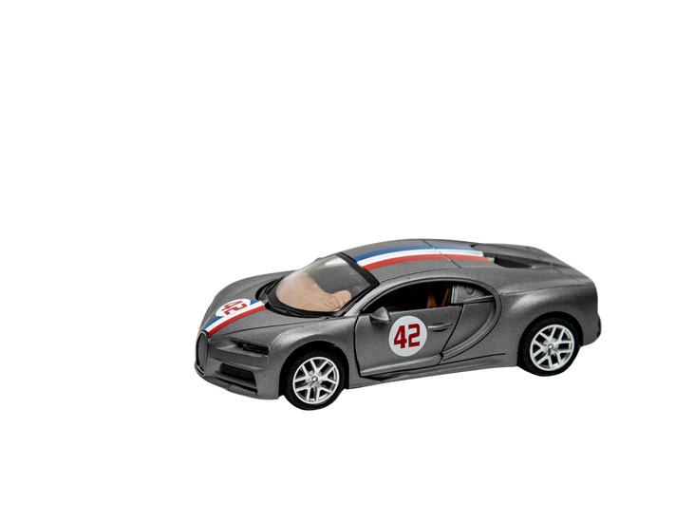
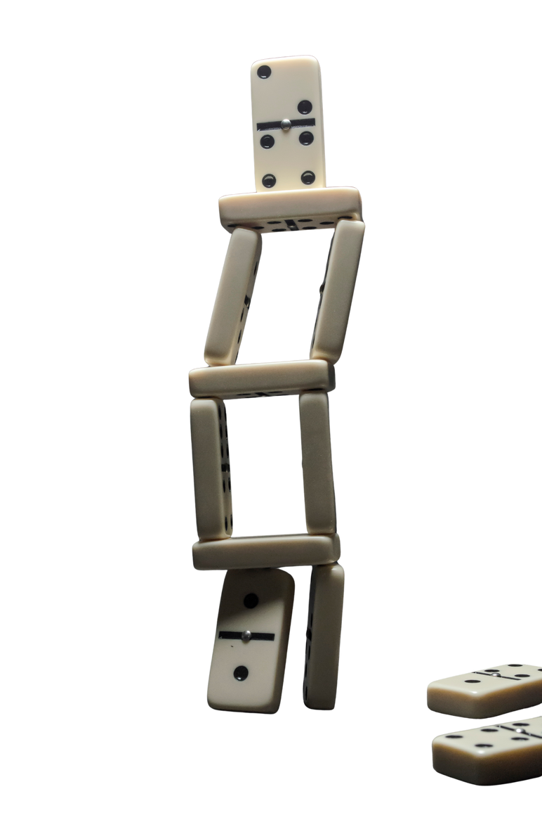
TOWER OF TRADES
EXTENSION
COMBINE TWO GROUPS TO BUILD THE TALLEST FREE-STANDING DOMINO TOWER YOU CAN WITHOUT IT FALLING.
YOUR TOWER MUST INCLUDE A PLATFORM TO HOLD A TESTING TOY.
CAREER CONNECTIONS
ARCHITECTS, BUILDERS, AND ENGINEERS DESIGN TALL STRUCTURES THAT MUST BE STABLE AND SAFE.

Slide 6

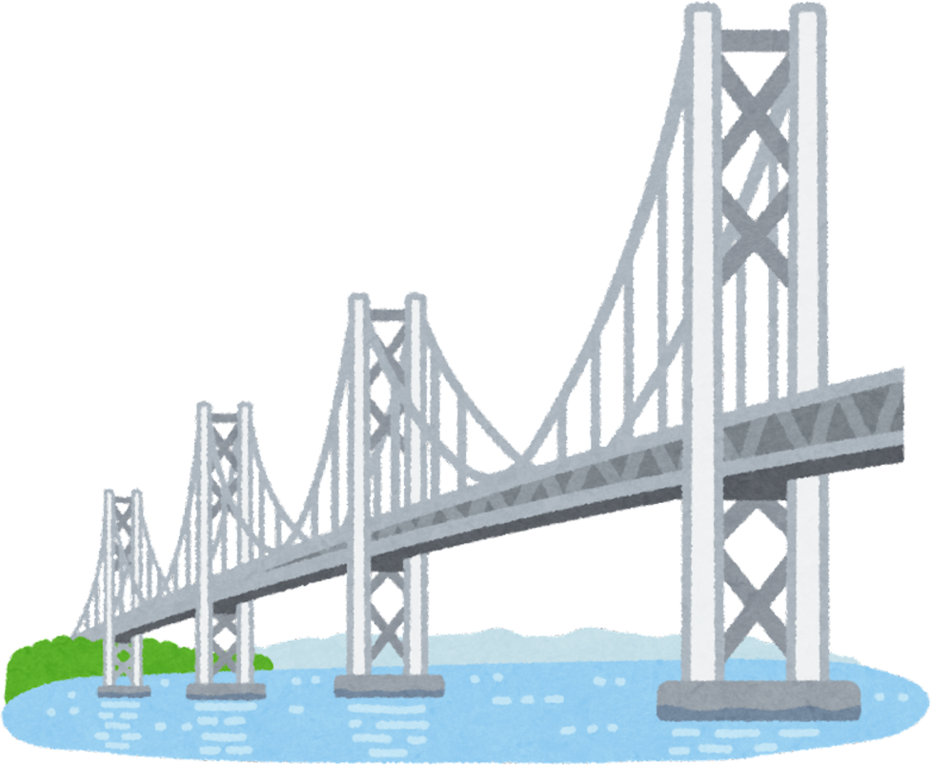
ROAD AND BRIDGE BUILDER DELIVERY ROUTE
YOUR MISSION
· BUILD A SINGLE LANE DOMINO ROAD/ROUTE/PATH (LAY DOMINOES FLAT) THAT TRAVELS FROM POINT A TO POINT B USING 10 DOMINOS.
· ESTIMATE THE LENGTH OF YOUR ROAD/ROUTE/PATH. HINT: REMEMBER THE LENGTH OF ONE DOMINO. NOW MEASURE YOUR ROAD/ROUTE/PATH.
· NOW BUILD A TWO-LANE ROAD/ROUTE/PATH USING 20 DOMINOS.
HAS YOUR ROAD/ROUTE/PATH CHANGED?

Slide 7
ROAD AND BRIDGE BUILDER DELIVERY ROUTE
EXTENSION
· ADD A BRIDGE OR TUNNEL. YOU MAY USE THE REMAINING DOMINOS OR REDUCE THE LENGTH OF YOUR ROAD/ROUTE/PATH.
· HAS YOUR ROAD/ROUTE/PATH CHANGED?
· BUILD A SINGLE LANE DOMINO ROAD/ROUTE/PATH FROM POINT A TO POINT B WITH AT LEAST 2 OBSTACLES TO BUILD AROUND.
· HAS YOUR ROAD/ROUTE/PATH CHANGED?
CAREER CONNECTIONS
ENGINEERS AND CONSTRUCTION WORKERS BUILD ROADS AND BRIDGES THAT ARE SAFE AND STRONG. TRUCK AND DELIVERY DRIVERS NAVIGATE THESE ROADS AND RIDGES.

Slide 8
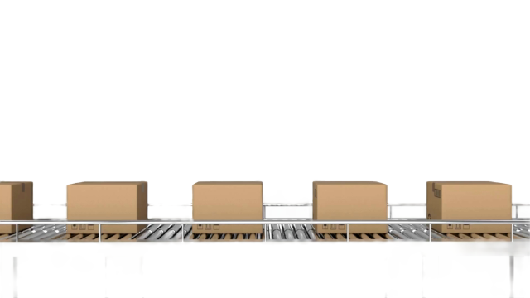

FACTORY LINE PATTERN BUILDER
YOUR MISSION
· IN YOUR GROUP, DESIGN A DOMINO “FACTORY LINE” USING AN INCREASING OR DECREASING PATTERN.
· WHAT IS YOUR PATTERN RULE?
· INVITE ANOTHER GROUP (OR TEACHER) TO ACT AS THE INSPECTORS OR SUPERVISORS TO CHECK AND EXPLAIN YOUR PATTERN RULE.

Slide 9
FACTORY LINE PATTERN BUILDER
EXTENSION
· COMPETE WITH ANOTHER GROUP. CREATE A NEW FACTORY LINE WITH A NEW PATTERN RULE.
· YOUR COMPETING GROUP IS TO GUESS THE PATTERN RULE AND PREDICT THE NEXT 3 STEPS IN YOUR PATTERN SEQUENCE.
CAREER CONNECTIONS
ON A PRODUCTION LINE, WORKERS AND ENGINEERS DEPEND ON PATTERNS AND SEQUENCES TO KEEP MACHINES RUNNING AND PRODUCTS BUILT CORRECTLY. QUALITY CONTROL INSPECTORS LOOK FOR MISTAKES OR BREAKS IN THE SEQUENCE.

Slide 10


THINK / PAIR / SHARE
WHICH CHALLENGE DID YOU ENJOY THE MOST – WHY?
NAME...
One Success
One Challenge

Slide 11
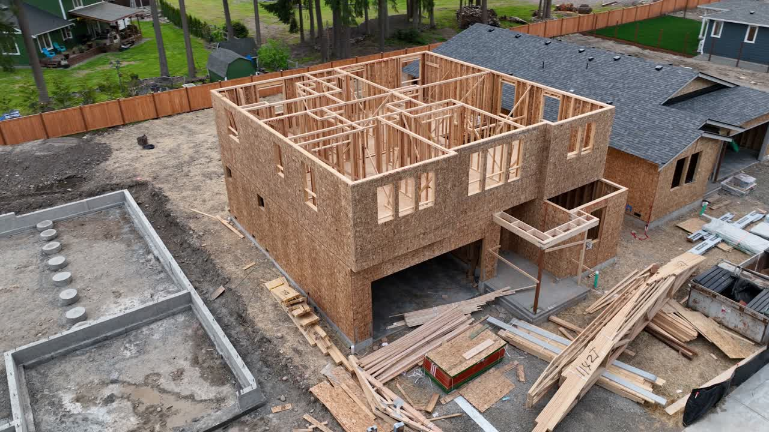
THANK YOU

